Slide 1
Right-sizing your facility:
A TALE OF TWO SOFTWARE PACKAGES
March 13, 2018

Slide 2
Agenda
Introduction
Simulation Definitions
Software Tools
Case Study:
  Overview and Assumptions
  SchedulePro®
  BioSolve Process
  Lessons Learned & Conclusions
Q&A

Slide 3


Introductions
Emily Thompson
Process Engineer
Morgan Malick
Process Engineer

Slide 4
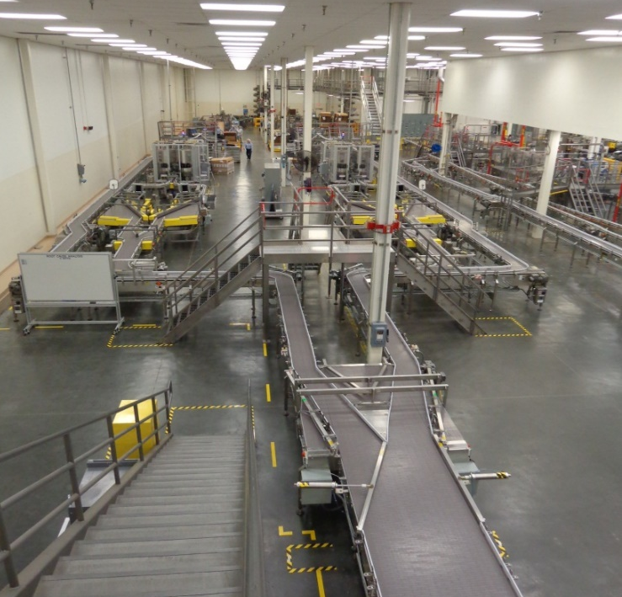
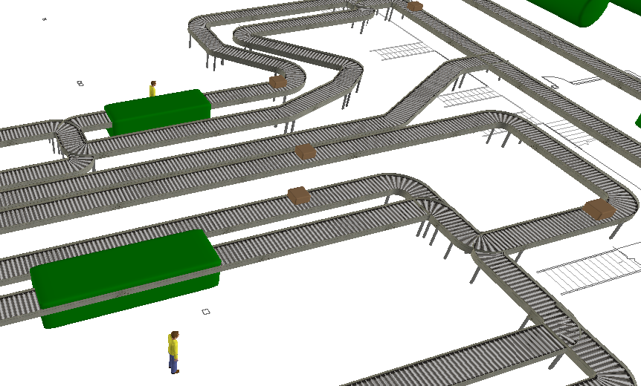
Simulation Definitions
What is Process Modeling?
A computerized representation of a real world process
What is Simulation?
Using a model to reproduce the past (Model Validation)
Using a model to predict the future

Slide 5
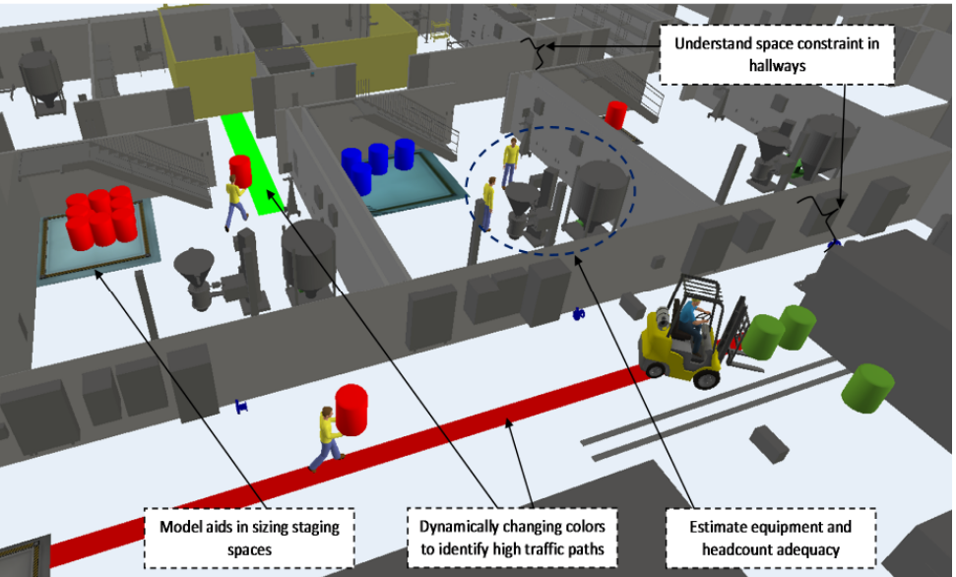
Why Use Process Simulation?
Layout Evaluation
Cost of Goods Analysis
Utility Sizing
Throughput Analysis
Notes:
Throughput Analysis:
Confirm Throughput
Determine Bottlenecks
Resolve Bottlenecks
Cost of Goods Analysis:
Process Alternative Selection
Preliminary Product Pricing
Utility Sizing:
Storage, generation and distribution
Layout Evaluation:
Determine staging space required
Evaluate traffic and material movement efficiency
Size warehouse

Slide 6

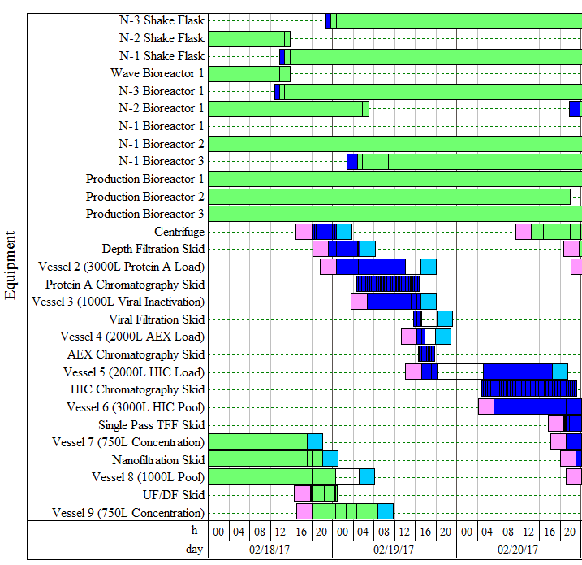
Software Types: SchedulePro®
Finite Capacity Scheduling Tool
Batch Processes
Semi-Continuous Processes
Best for:
Production Planning & Scheduling
Resource Management
Multi-Product Facilities
Compatible with SuperPro® Designer (Material & Energy Balance Software)
Notes:
Commercially available software developed by Intelligen, Inc.
Founded in 1991 out of the Biotechnology Process Engineering Center at MIT
Finite Capacity Scheduling Tool
Batch Processes
Semi-Continuous Processes
Best for:
Production Planning & Scheduling
Resource Management
Multi-Product Facilities
Compatible with SuperPro Designer
(Material & Energy Balance Software

Slide 7
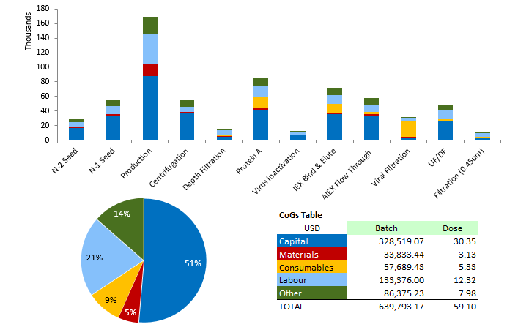
Software Types: BioSolve Process
Cost of Goods Analysis Tool
Best for:
Capital Estimates
Detailed Cost Breakdowns
Facility Equipment Lists
Consumables Lists
Sensitivity Analysis
Notes:
Commercially available software developed by Biopharm Services in the UK
Cost-of-goods analysis software, Microsoft Excel Add-in

Slide 8
Software Types: Comparison
 | SchedulePro | BioSolve
Single-Product Facilities | X | X
Multi-Product Facilities | X
Cost-of-Goods Analysis |  | X
Utility Analysis | X
Throughput Scheduling | X
Built-In Equipment and Consumable Costs |  | X
Ability to Scale Up within Model |  | X

Slide 9
Case Study
Overview

Slide 10
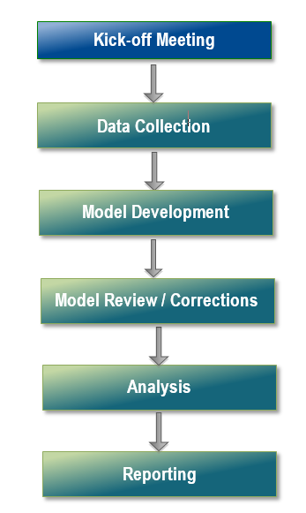
Typical Simulation Project Approach

Slide 11

Kick-Off: Simulation Goals
  Scale Up
  Clinical Scale
  Commercial Scale (3X Factor, 10X Factor)
  Cost-of-Goods Analysis
  Evaluate Single-Use, Stainless Steel, Hybrid
  Evaluate Buffer Prep Concentrates vs. Neat
  Evaluate alternative unit operations
  Throughput Analysis
  Clinical Scale – increase from 10/4 to 24/7
  Commercial Scale – 24/7
  Utility Sizing
  Clean Utility Sizing
  Buffer Capacity
  Commercial Scale – determine number of vessels required to support two trains
Notes:
Scale Up
Clinical Scale
Commercial Scale (3X Factor, 10X Factor)
Cost-of-Goods Analysis
Evaluate Single-Use, Stainless Steel, Hybrid
Evaluate Buffer Prep Concentrates vs. Neat
Evaluate alternative unit operations
Throughput Analysis
Clinical Scale – increase from 10/4 to 24/7
Commercial Scale – 24/7
Utility Sizing
Clean Utility Sizing
Buffer Capacity
Commercial Scale – determine number of vessels required to support two trains

Slide 12
Kick-Off: Why use two software packages?
  Results desired included:
  Cost-of-Goods Analysis
  Utility Sizing
  Labor
  Throughput and Bottleneck Analysis
  Too much for one software package to efficiently deliver!
Schedule Pro
Material Balance
BioSolve
Results!

Slide 13
Kick-Off: Case Study- Scenarios
 | Case 1 | Case 2 | Case 3
Primarily Single-Use Equipment | X
Primarily Stainless Steel Equipment |  | X | X
Single-Use Buffer Prep (10X Concentrates) | X | X
Stainless Steel Buffer Prep (“At-Use” Buffers) |  |  | X
Notes:
What If and Assumptions

Slide 14
Data Collection
Site Visits
Interview SMEs
Shadowing
Targeted Assumptions
Time Studies
Batch Records

Slide 15
Case Study
Schedulepro MODEL

Slide 16
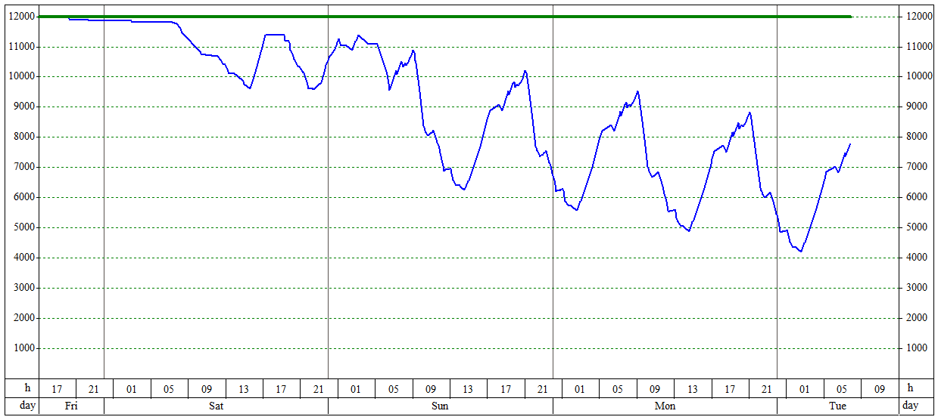
Model Development: Schedule Pro - Goals
Case Study Objectives
Size Clean Utilities
Estimate Labor Requirements
Quantify Throughput
Compare Single Use vs. Stainless Steel
Compare “At-Use” Buffers vs. 10X Concentrates
Tank Volume (Gallons)
Notes:
Size Clean Utilities including WFI and Process Waste
Estimate Labor Requirements
Compare Single Use, Stainless Steel, and Hybrid approaches
Compare Buffer Strategy, “At-Use” or 10X
Quantify Throughput

Slide 17
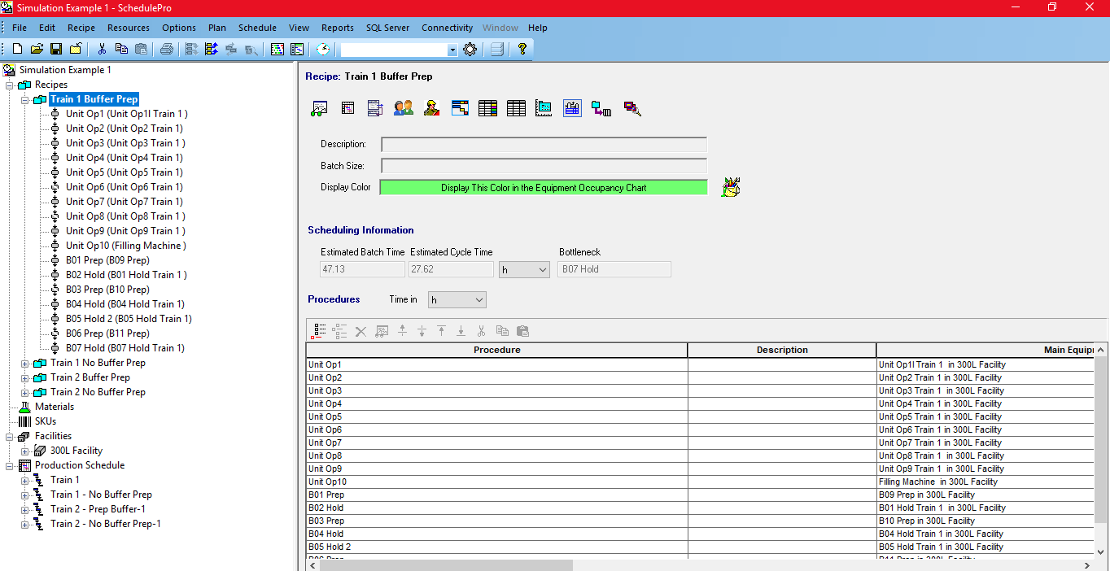
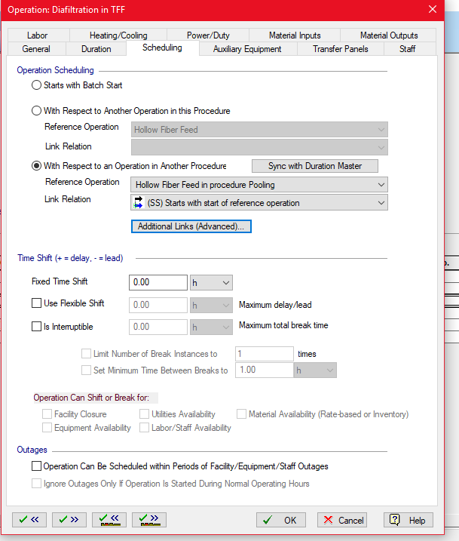
Model Development: SchedulePro Model
Mass Balance for each process scale
Main Process Recipe in SchedulePro
Separate recipes made for each buffer
Estimated CIP durations, WFI consumption, and waste generation
Entered labor required for each operation

Slide 18
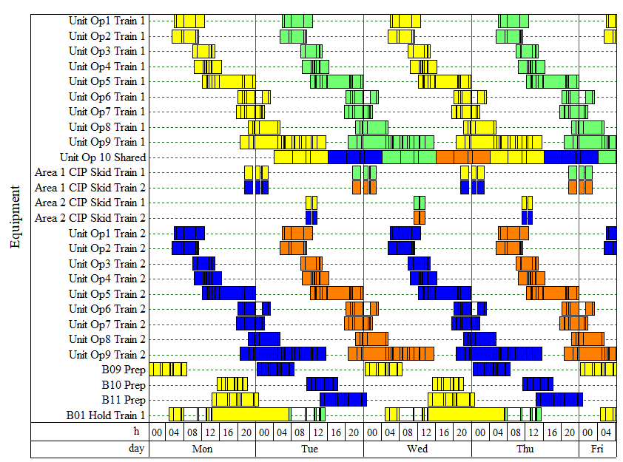
Model Review: SchedulePro – Equipment Occupancy Output
Initial Bottleneck
CIP Skids
Optimized Buffer Prep
Notes:
Shows equipment usage vs. time
Equipment conflicts are revealed and resolved
Optimize CIP Skids
Easily adjust multi-train scheduling and view implications

Slide 19
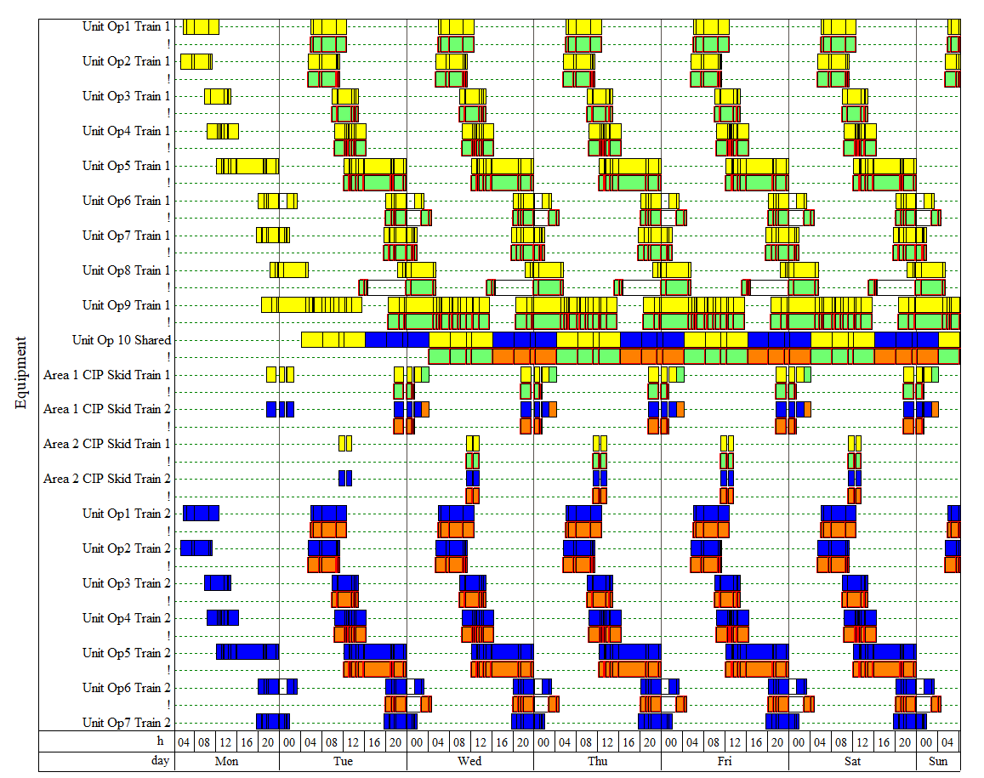
Corrections: SchedulePro – Conflict Resolution
Equipment Bottlenecks may require additional equipment
CIP Bottlenecks can be resolved
Notes:
Conflict Resolution is a methodical process
Repeating conflicts are identified first and resolved
CIPs can be shifted later, however it is important to keep track of “dirty hold times” and maintain within a reasonable window
Sometimes conflicts are unresolvable indicating that the desired results are unfeasible

Slide 20
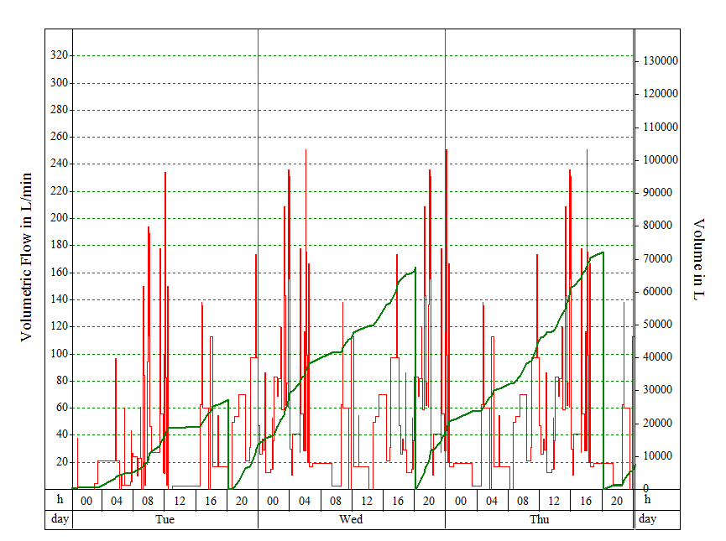
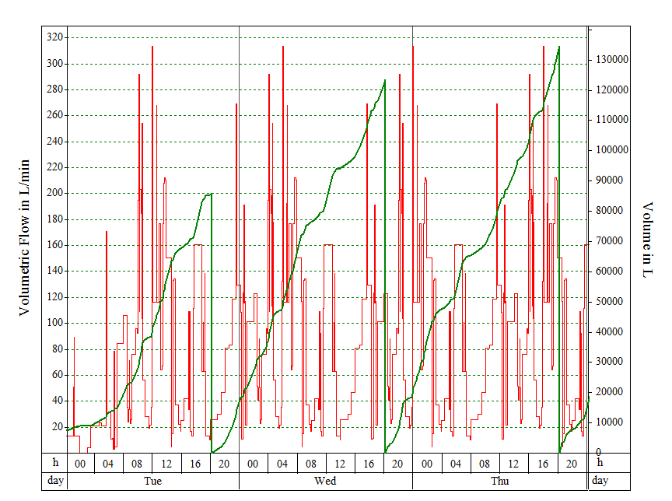
Analysis: SchedulePro Output - Utilities (WFI)
WFI Consumption vs. Time (Single-Use)
WFI Consumption vs. Time (Stainless Steel)

Slide 21
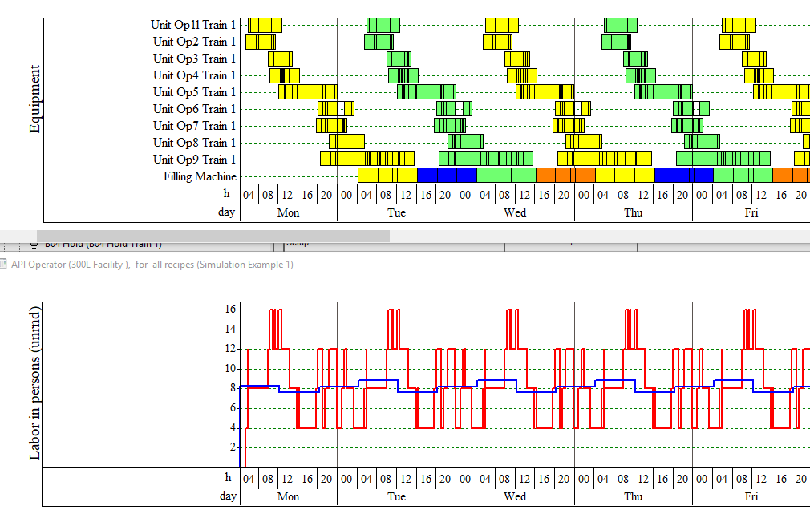
Analysis: SchedulePro Output - Labor
Equipment shifted to reduce peaks
Equipment
Peak Labor
Labor
Time
Average Labor
Notes:
Case Study Example
Two operators per step
Estimate eight to ten operators required per shift for two trains
Number of Operators
Labor dedicated per area
Load leveling
Chart shows instantaneous and average labor pools

Slide 22


SchedulePro Model Development - Results
Throughput identified for different scales
Buffer optimized to include shared prep vessels
Utilities sized for maximum cost savings and efficiency
SchedulePro
Notes:
Tell the story of how we changed their mindset of their current facility and how it was not optimized and continued to prove to them the bottlenecks scaling up
The value of the model prevented wrong decisions moving forward
Batch Cadence
Hybrid - Primarily Stainless Steel
24hr Cadence
Independent Trains
CIP Skids
Two skids per area
Buffer
“Neat” buffers (1X)
Shared Prep Tanks
Dedicated Hold Vessels

Slide 23
Case Study
BIOSOLVE MODEL

Slide 24
Model Development: BioSolve
Inputs
Ops
Testing
Process
Four Key Steps:
Cost Data
Define Facility
Modify Process Sequence
Detail
Resources
Verify Model
Run Scenarios
Notes:
Inputs – check and input cost data, parameters, and define facility
Process – using a BioSolve template, modify process sequence
Ops – add details on process sequence and resources
Testing – verify model results and run scenarios

Slide 25
Model Development: BioSolve - Inputs
Capital Costs
Materials
Consumables
Labor
Other
Utilities
Insurance
Costs
Equipment
Cost of Works Factors
Operators
Quality
Indirect Labor
Media & Buffer
CIP
QC Tests
Tubing Sets
Bags
Notes:
Capital Costs:
Equipment
Cost of Works Factors
Materials:
Media, Buffer
CIP
QC Tests
Consumables:
Tubing Sets
Bags
Labor:
Operators
Quality
Indirect Labor
Other:
Utilities

Slide 26
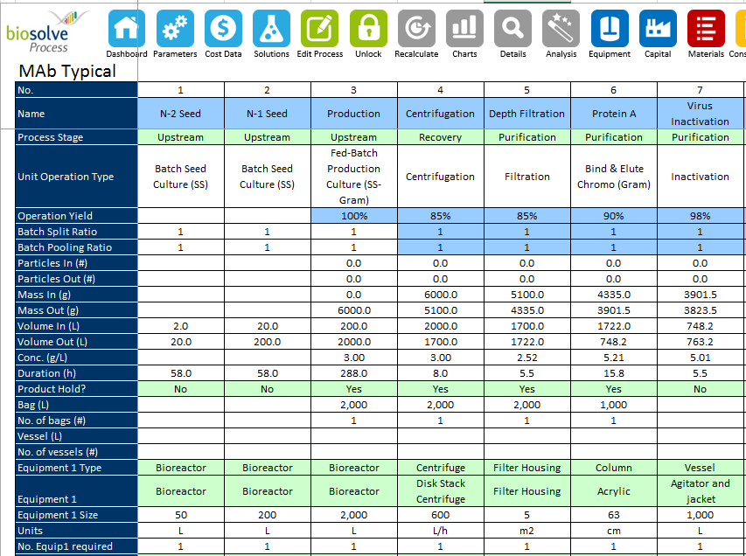
Model Development: BioSolve - Process
Select Template
Match Process
Sequence
Add Equipment, Consumables,& Parameters
Notes:
Start from BioSolve Templates:
mAb Stainless Steel
Microbial
Vaccine
mAb Perfusion
mAb Single Use
Modify to match desired process sequence
Assign Equipment and Consumables
Select type, size and quantity
Add Parameters:
Process Flowrate
Filter Loading Capacity
UF Cassette Re-use

Slide 27
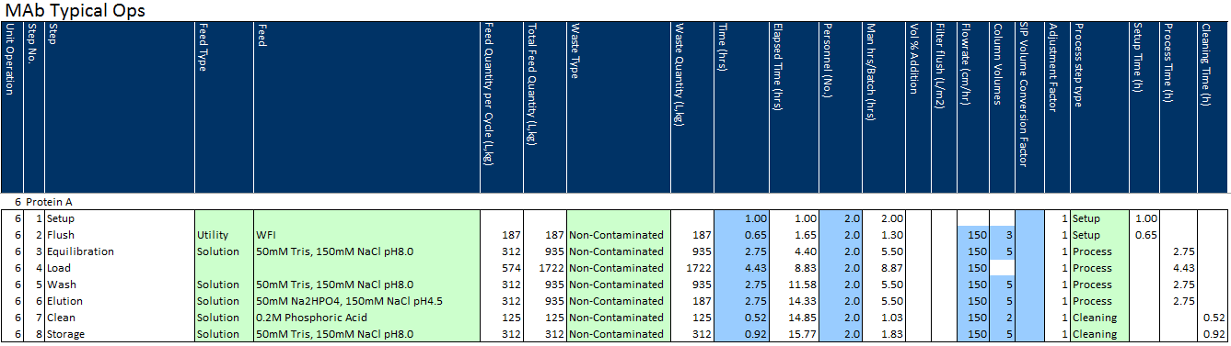
Model Development: BioSolve - Ops
Labor
Step Duration
Waste Volume and Type
Buffers and Volumes
Notes:
Each Unit Operation is detailed using the Ops tab
Add in Buffer and Media volumes
Add step durations and step types
Add Labor
Add Waste and designate type

Slide 28
Model Development: BioSolve - Testing
Cost per run drops by 1/3 as number of batches increases
Unit Operation Cost – 10 Batches / Year
Unit Operation Cost – 200 Batches / Year
Notes:
BioSolve breaks down cost on multiple levels:
Cost by Dose, Gram, Batch, Campaign, or Year
Cost by Unit Operation is also an option
Five Cost Buckets are broken down here by unit operation
Red = Materials
Yellow = Consumables
Dark Blue = Capital Costs
Light Blue = Labor
Green = Other
Note that as the number of batches increases, the capital costs drop drastically as they are absorbed by the higher batch rate

Slide 29

Case Study - Results
Single Use vs. Stainless Steel
Higher Production Rate Stainless Steel
Lower Production Rate Single-Use
Assumptions are Critical
Objective Cost Data drove Path Forward
BioSolve
Notes:
Single Use vs. Stainless Steel
At a high throughput rate, single-use consumable costs become prohibitive
At lower production frequencies, single-use outshines stainless steel
Non-cost related factors such as warehousing space, manual labor, and supply chain management were considered
Multi-product facilties may push towards single-use dependent on changeover requirements and downtime

Slide 30

Case Study - Lessons Learned
How to use BioSolve and SchedulePro together
Simulation results are only a piece of the puzzle
Stay as unbiased as possible
Cost Database should be confirmed and checked
Maintaining Scope can be difficult
Notes:
How to use BioSolve and SchedulePro together
Organization and documentation of data inputs is key
Simulation results are only a piece of the puzzle
Ease of Use
Supply Chain Availability
Staying as unbiased as possible
Single-Use vs. Stainless Steel debate has fans on either side
BioSolve can be manipulated to skew costs favorably in either direction
Cost Database should be confirmed and checked
This can have a huge result on pricing
Maintaining Scope can be difficult
Seeing results generally leads to ideas about new cases to examine

Slide 31
SchedulePro
BioSolve
Right
Size
Questions?

