Slide 1
Validating and Protecting
Pharmaceutical Manufacturing Processes
Greg Bunting
Executive Director
Indegy
greg@Indegy.com
404-312-8422

Slide 2
Greg Bunting
Executive Director Indegy
Indegy provides situational awareness and real-time security for industrial control networks to ensure operational continuity and reliability.

Slide 3
AGENDA
Pharmaceutical Industry Complexity
Manufacturing Environment Challenges
Pharmaceutical Manufacturing Challenges
The Answer: Visibility to Control Systems
Summary
Q&A

Slide 4

PharmaCeutical
Organizations
Operational Challenges
Global and Distributed
  Inconsistent Policies/Standards/Regulations
Consolidation and M&A over the years
Diverse Products
  Many Production Environments
Large Network of Vendors, Contractors, System Integrators, etc.
  Many Production Touch Points

Slide 5
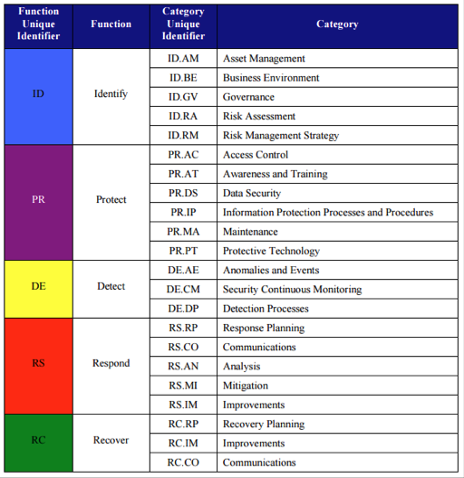
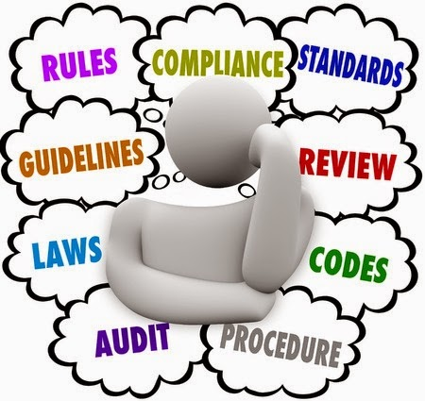
Regulations and Standards COMPLIANCE

Slide 6
Production (and ReGulATORY) Complexity
REQUIRES
VISIBILITY And MoNITORING
Of
INDUSTRIAL NETWORKS
IN ORDER TO
Prevent Operational Disruptions and
Meet reporting requirements
PharmaCeutical OT/ICS
REALITY

Slide 7
ICS Network challenges
Internet
Perimeter Controls
Extensive Control and Visibility
Corporate
IT Controls
Corporate Network: user workstations, servers, business applications
DMZ
Segmentation
Access Management
ICS servers, OPC Servers
Limited Control and
Visibility
Industrial Networks
HMI stations, Engineering stations
Controllers (PLCs, RTUs)
Field Devices (turbines, pumps, etc.)
Lack of management and security tools
Lack of visibility and control

Slide 8



Why is it critical to protect the controllers?
The role of industrial controllers in ICS networks
PLC/DCS Controller
HMI
new_rpm(20)
blender_rpm(20)
Cone Blender
Operator Workstation
Control Logic:
If new_rpm < MAX_RPM
set blender_rpm = new_rpm
else
ignore
Send Error Message
Industrial controllers are not simple proxies between HMI and I/Os

Slide 9
Why is it critical to protect the controllers?
PLC/DCS Controller
HMI
new_rpm(200)
Cone Blender
Operator Workstation
Control Logic:
If new_rpm < MAX_RPM
set blender_rpm = new_rpm
else
ignore
Send Error Message
Error
The controller determines if and how operational changes should be processed and prevents execution of unsafe instructions

Slide 10
The Anatomy of an
Industrial Cyber Attack
Engineering Workstation
Or
Rogue
Device
?
Alter controller logic
PLC/DCS Controller
HMI
blender_rpm( 200*MAX_RPM)
Cone Blender
Operator Workstation
Control Logic:
If new_rpm < MAX_RPM
set blender_rpm = requested_rpm
else
ignore
Send Error Message
blender_rpm = 200*MAX_RPM
Unauthorized controller changes can cause significant damage!

Slide 11
ICS THREATS - CYBER ATTACKS (External)
Stuxnet (2010)
Destroyed 20% of Iran's nuclear centrifuges
German Steel Plant Cyber Attack (2014)
Second physical damage cyber attack reported in history
Dragonfly / BlackEnergy (2014)
Over 250 ICS networks (Energy, Pharma, etc.) compromised
New York Water Dam (2015)
Iranian hackers managing to get control of the flood gates
Crashoveride /Industroyer (2016)
Ukraine Power Grid blackout as an act of Russian aggression
Dragonfly 2.0 / APT targeting Energy and more (2017)
Wide range campaign targeting government entities and organizations in the energy, nuclear, water, aviation, and critical manufacturing sectors
Triton (12/2017)
Triconex Safety Instrumented System (SIS) controllers. Added program to the execution table of the controller. Suspected Nation State aiming for physical damage.

Slide 12
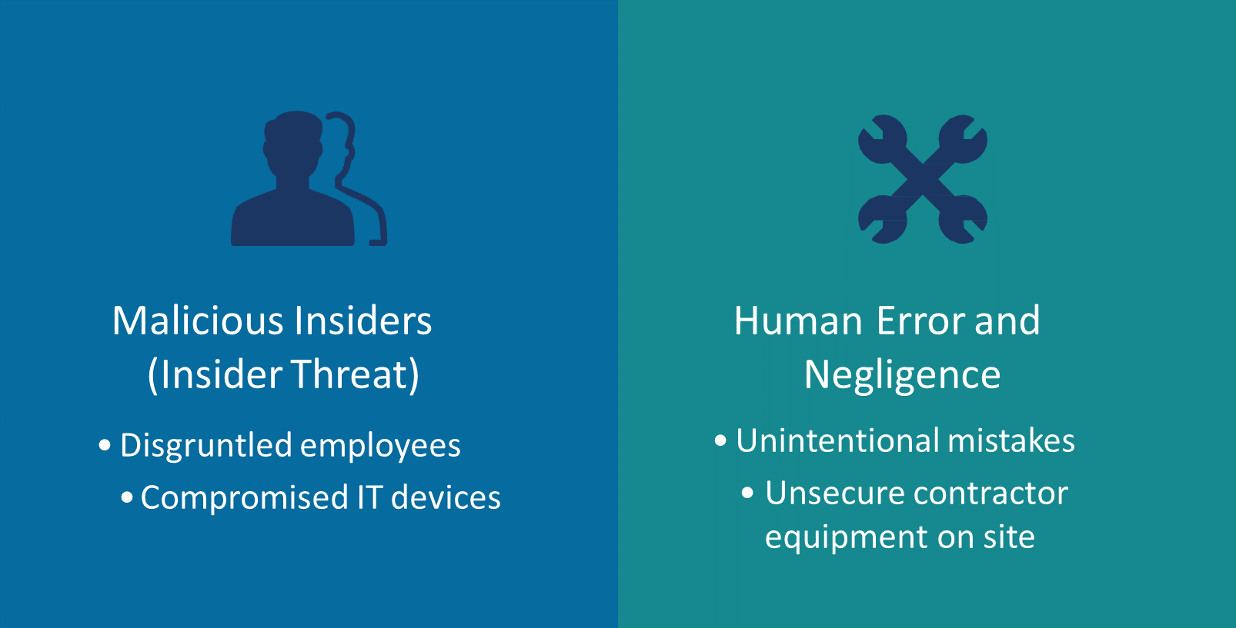
Other threats to
industrial control systems

Slide 13
External threats, Internal threats and human error
REQUIRE
VISIBILITY And MoNITORING
Of
INDUSTRIAL NETWORKS
IN ORDER TO
Prevent Operational Disruptions
Manufacturing OT/ICS
REALITY

Slide 14

Confirm (no) changes were made to controllers
FDA Regulatory Compliance
The Food and Drug Administration guidance:
Drug products should be produced with a high degree of assurance that they meet all the attributes they are intended to possess.
Pharma manufacturers should maintain processes in a state of control over their entire lifecycle, even as materials, equipment, production environment, personnel and manufacturing procedures change.
Regulation mandates REAL TIME documentation

Slide 15

TRACKING Maintenance
Work on ICS
The details needed to ensure proper maintenance and operational safety:
  IP / MAC / Serial address
  OS / Firmware versions
  When were they last updated? By who?
  Associated risk of the device
  List of potential vulnerabilities
The details are constantly changing over time
  Usually through a manual process
  3rd Party contractors and integrators may be involved
  Error prone
  No Documentation
This Environment Promotes Stagnation

Slide 16
ICS CHALLENGES FOR PHARMA
ORGANIZATIONS
Tracking maintenance work on ICS
  Unable to confirm no changes were made to controllers as per regulation
  Unable to confirm changes were made to controllers i.e. firmware upgrades to prevent CVEs
Human factor that cause disruption to your operation
  Integrator Errors, Integrator compromised devices
Lack of visibility and forensic data
  What’s connected to my Network?
Threats targeting the company's intellectual property and manufacturing process
Inconsistent standards
WHO owns it? IT/OT

Slide 17


THE CHALLENGE: TRACKING
ENGINEERING ACTIVITIES
Control-Plane vs. Data-Plane
Data-Plane
Standard HMI and SCADA application Protocols like:
MODBUS, PROFINET, DNP3
PLC/DCS Controllers
HMI
Operator Workstation
Cone Blender
Control-Plane
Proprietary, vendor specific engineering protocols
(Unnamed, Undocumented)
Logic
Configuration
Firmware
Engineering Workstation
ICS data-plane and control-plane communications use different protocols!

Slide 18


SOLVING THE VISIBILITY
CHAllenge
1
Understand
What Needs to be Protected
2
Continuously Monitor
Access and Changes
Without visibility you can’t have security
4
Enforce
Policies,
Get Real-time
Alerts
3
Assess Risk to Devices and Networks
Insure Reliability, Security and Intergrity of the Control Layer

Slide 19

SOLVING THE VISIBILITY
CHAllenge
STEP 1: Understand What Needs To Be Protected = Asset Discovery
Automate asset discovery, classification and management for better device control.
STEP 2: Continuously Monitor Access and Changes
Track network changes in real time
  Policy-Based and Anomaly-Based Detection
Track changes made directly to the controllers
  Requires active component that mimics engineering workstation protocols

Slide 20
SOLVING THE VISIBILITY
CHAllenge
STEP 3: Assess Risk to Assets and Network
Compare Firmware Versions to CVEs
View Communications, Protocols, Quantity and Number of Sessions
STEP 4: Enforce Policies and Get Real Time Alerts
Clearly define policies
  New Devices, New Protocols
  Abnormal Activites – i.e. HMI Downloading Code to a PLC
Send alerts that support existing workflow
Eliminate issues before they cause downtime and/or recover faster from incidents

Slide 21

Suggested Steps to
IMPLEMENT a SOLUTION
Make sure that the person protecting your ICS environment is the
same person who will suffer if/when there is failure
Enlist stakeholders from IT and OT
Align Technology, People and Processes
  Operational analysis to determine the impact of converged technologies
  Develop a road map to converged technology environment
  Gap analysis
  Establish a top-down approach for implementation
  Establish Governance
Develop a comprehensive inventory of all IT and OT assets
Manage Changes Systematically – Policies, Anomalies, Device with Alerts
The best cyber solution provides visibility (both network and device) and drives efficiency in the manufacturing process

Slide 22

Session Recap
Manufacturing Complexity Requires Visibility provided by Purpose Built Technology
Automated control-asset discovery and a continuously updated inventory ensures full visibility into critical assets
Comprehensive audit trail allows the manufacturer to track the ‘who’, ‘what’, ‘when’, ‘where’ and ‘how’ of all access and changes to critical ICS assets
Solution must enable manufacturers to meet FDA requirements ensuring zero changes to the controllers
Real-time alerts provide detailed information about unauthorized changes to critical assets enabling quick and effective incident response

Slide 23
Thank you!
Want to know more?
Visit: www.Indegy.com
Contact us: info@Indegy.com
Greg Bunting
Executive Director
Indegy
greg@Indegy.com
404-312-8422
Indegy provides situational awareness and real-time security for industrial control networks to ensure operational continuity and reliability.

