Slide 1
THE ZERO SHUTDOWN GOAL
Rich Tree
Vice President, North America
CAI

Slide 2
Rethinking the frequency and execution of planned shutdowns

Slide 3
Agenda
Welcome & Introductory Remarks
Shutdown Drivers – The Problem with Shutdowns
Condition Based Maintenance – Maintenance Optimization
Shutdown Optimization – Driving to Zero
Question & Answer

Slide 4
Introduction
Shutdowns represent the greatest negative contribution to overall equipment effectiveness (OEE) across all process industries and introduces new and significant risk that must be managed by the operations managers.
There are few activities on the maintenance calendar that pose a bigger risk to your production than shutdowns. They consume resources, create downtime, and are often plagued by over-runs and restart issues.

Slide 5
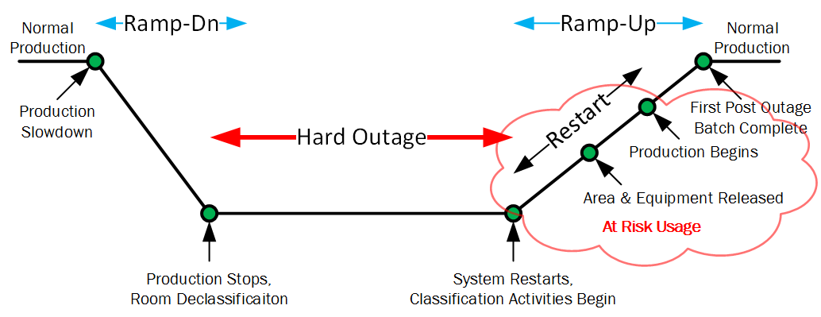
Shutdown Illustrated
How much does an hour of downtime cost your company in lost revenue?

Slide 6
The Real cost of Shutdowns
Traditionally calculated as a direct cost
Occasionally idled labor force can be absorbed
True cost is lost Opportunity
Especially true for Constrained products
With Flexible manufacturing-lost opportunities
Calculate this number- Dwarfs direct cost
$1B Facility- $5M/day lost revenue
Talk to production managers!

Slide 7
Shutdown Drivers
Preventive Maintenance
Beneficial
Unnecessary
Preventive maintenance driven by pure water system cleanliness
Overly conservative
Planned Corrective Maintenance
Capital Projects
Fear?
Notes:
Lou

Slide 8
The Problems with Shutdowns
Lost Production/Lost Revenue
Durations not Restrained
S/D go for Weeks/Months
Relied Upon
Disruptive to Operations Flow
Infant Mortality Failures
HR Challenge
Encourages Poor Planning & Scheduling
Notes:
Lou

Slide 9
Common Industry Maintenance Practices
Routine elastomer replacements
Mechanical seal replacements
Heat exchanger pressure tests
Routine Derouging/Passivation
AHU pre-filters/belts
Cleanroom/HEPA Testing
Is it possible these are all driven by overly conservative thinking? Can we use risk-based decision making
Cleanliness Driven
Notes:
Rich

Slide 10
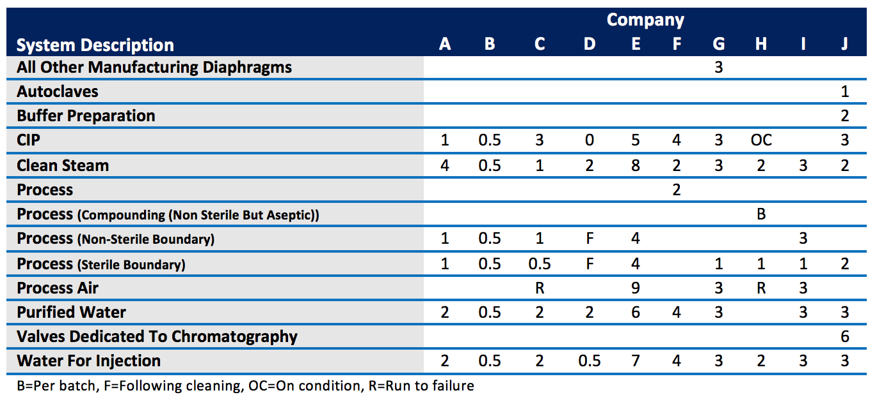
Elastomer Change out Periods based on Company
2011 BioForum Operation Group non-scientific survey of their membership
Notes:
Rich

Slide 11
What Drives the Decision Making Process? Heuristics/Biases.
Biases
Anchoring
Availability
Substitution
Framing
1978 Nolan and Heap published a report for United Airlines. The report contained information on the conditional probability of failure against operating age for a variety of electrical and mechanical items in the aviation industry.
The most interesting Nolan and Heap finding was that 68% of items conformed to the failure pattern classified as the Infant Mortality Failure Pattern.
Notes:
Rich

Slide 12
Failure Profiles
UAL 1968 | BROBERG 1973 | MSDP 1982 | SSMD 1993 | SUBMEP 2001
4% | 3% | 3% | 6% | 2%
2% | 1% | 17% |  | 10%
5% | 4% | 3% |  | 17%
7% | 11% | 6% |  | 9%
14% | 15% | 42% | 60% | 56%
68% | 66% | 29% | 33% | 6%
89% | 92% | 77% | 93%
Notes:
Rich

Slide 13
Early Failures (F) – Why So High?
Scheduled intrusive maintenance can actually increase overall failure rates by introducing infant mortality into otherwise stable systems.
The increased conditional probability of failure after maintenance is a result of such factors as human error, the use of defective material, errors in technical documentation, etc.
Anyone ever experience a diaphragm replacement that leaks after the maintenance where otherwise would never have leaked before?
If the maintenance were not mandated, there would not be the exposure to infant mortality and no penalty in decreased operational availability would result.
Notes:
Rich

Slide 14
Maintenance Strategies
Rethinking the approach
Notes:
Rich

Slide 15
Challenge the Assumptions
Up to 40% of all preventive maintenance tasks originate from diaphragm valve maintenance
Improving reliance on condition based maintenance
Reconsidering the risk of elastomer replacements
Testing HEPA filters and clean rooms – evaluate practices using the December 2015 update to ISO 14644-2
Reconsider the risk based on the newest revision to the specifications for testing and monitoring to prove continued compliance
Notes:
Rich

Slide 16
Planning & Scheduling Strategies
Rethinking the approach

Slide 17
Normal Planning & Scheduling
Downtime (Planned Or Unplanned)
Planned Maintenance Outages
Notes:
Rich

Slide 18
Optimized Planning & Scheduling
Available downtime is used to complete shutdown driving maintenance
Downtime (Planned Or Unplanned)
Planned Maintenance Outages once every three years instead
Planned Maintenance Outages
Notes:
Rich

Slide 19
Shutdown Optimization Strategies
Notes:
Lou

Slide 20
Shutdown Optimization
Ensure your entire organization understands your definition for a shutdown period.
Establish clear roles and responsibilities for shutdowns.
Manage a shutdown like a project.
Plan, plan and plan; then work the plan. Establish a planning process. Plan for restart and recovery.
Keep leadership involved.
Conduct & implement Lessons Learned
Notes:
When you state “Shutdown” does everyone understand it includes the ramp down and ramp up periods or are they thinking about the actual work period? This impacts everyone from the facility to inventory and sales.
Clear roles and responsibilities ensure every task or need is assigned to someone and that someone understands they own it.
A shutdown has to be managed like a project. There has to be a defined period and a defined budget with well managed work scope. Work scope needs to be frozen at a specific point prior to the shutdown and any addition after that point needs to be managed to understand additional cost, manpower and schedule impact.
There has to be an overall shutdown coordinator that has responsibility for planning of the shutdown and does not just start when the shutdown starts. For some facilities this may be a full time, year-round position. Smaller facilities may only require someone part-time. Every bit of work to be executed during the shutdown needs to go into the overall shutdown plan. Plan all retests and validation efforts into the plan.
A planning process involves representatives from every department (Maintenance, Planning, Engineering, Quality, Validation, Lab, EH&S and Leadership). This way, there are no surprises that are likely to arise because someone did not understand a requirement. An example may be Environmental may need to complete a new permit due to a change in emission controls. Utilize personnel from Production to assist with work, if available. Work around the clock instead of just during day shift. Paying additional OT is often a drop in the bucket when it comes to increasing days of a shutdown.
Plant leadership must remain involved in the shutdown. Ensure frequent walkdowns by leadership to ensure all work is being conducted to standard. Have daily EH&S walkdowns.
Ensure the restart and recovery of critical utilities is integrated into the shutdown as well as time for cleaning and restoration of environmental conditions. Utilities (pure water, steam, WFI, waste treatment) & HVAC need to be coordinated for restart and environmental monitoring to restore systems and spaces.
Always conduct a lessons learned from every shutdown and implement those into your next shutdown planning and execution process.

Slide 21
Shutdown Optimization
Analyze current drivers
Can you do it in smaller parts?
Can you modify system to allow partial SD?
N+1
Add valves, temporary system tie ins
Validate alternative sanitizations
Calibrations
Increase periodicity
Add dry wells and isolation valves

Slide 22
Example
WFI system
Inline TOC and Conductivity - release on these
Validate pump sanitization
Revise calibration PM for level, pressure
Remove calibration of non-critical instruments
Go to trace metal for derouge
Use the available downtime for elastomers. Should have several systems

Slide 23
Helpful hints
24x7 usually cheaper then lost production
Write contracts with schedule clauses
Detailed restart plan
Risk based sampling
Risk based use of systems
Start utilities while construction finishes.

Slide 24
Question & Answer

