Slide 1
Oligonucleotide Synthesis Manufacturing Facility Project Enabling Technology for the Present and the Future
ISPE-CASA 2018 Technology Conference
March 13, 2018
Sheron Branham Associate Director ASO Process Engineering
Paul Richards Principal Engineer Global Process Engineering

Slide 2
Topics of discussion
Antisense oligonucleotides (aso)
Project Overview
Process Overview
Challenges and Solutions
Results

Slide 3
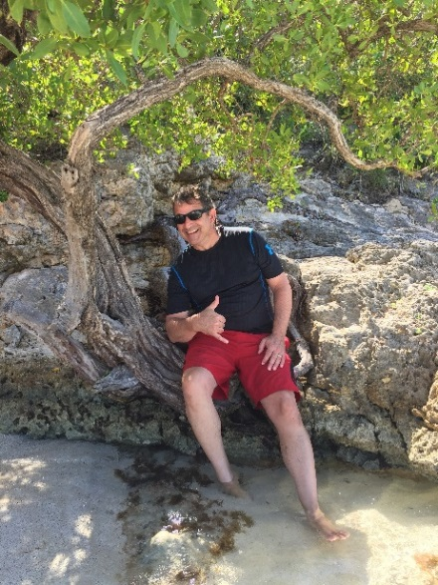
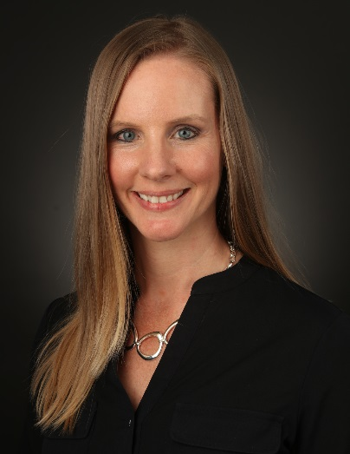
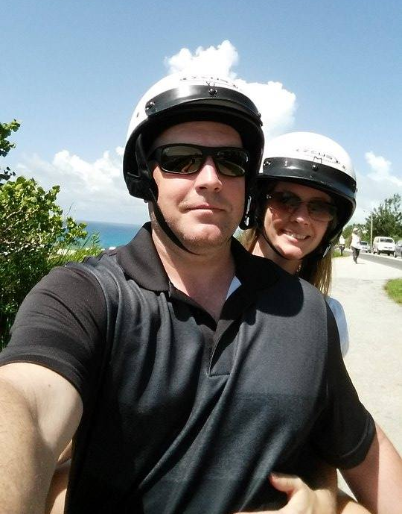
Speakers
Paul Richards
Principal, Global Process Engineering
BS Chemical Engineering – UConn
MS Management – Rensselaer
30 years experience – API, OSD, Fine Chemical
5 years at Biogen
Sheron Branham
Associate Director, ASO Process Eng & Mfg
BS Chemical Engineering from Clemson University
Expected MBA from NC State in May!
19 years in Pharmaceutical Mfg – API and OSD
5 years at Biogen

Slide 4
Clinical Manufacturing (as needed)
Milestone and Royalty Payments
Knowledge Transfer
Regulatory
Manufacturing
Commercialization
Development through Registration
Drug Discovery

Slide 5
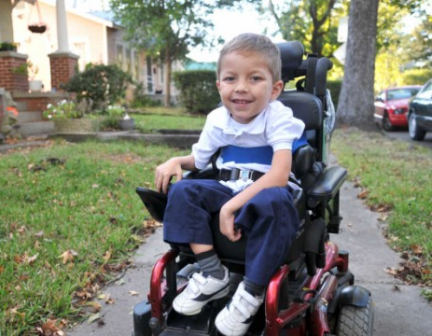
Biogen’s Therapeutic Focus for ASOs
ALS
Alzheimer’s
Parkinson’s
SMA

Slide 6
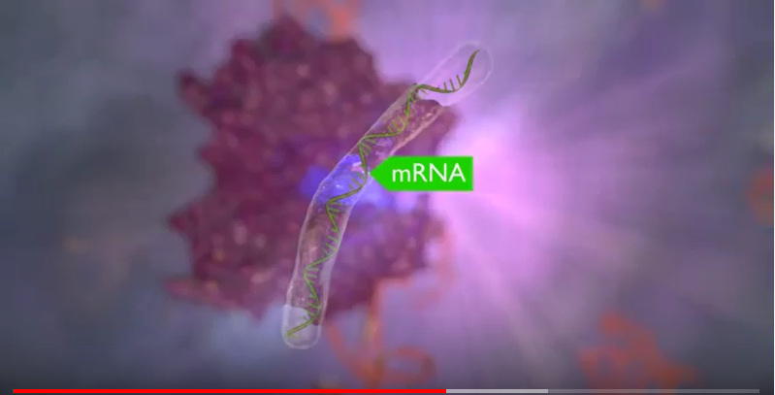
What is an Antisense Oligonucleotide?

Slide 7
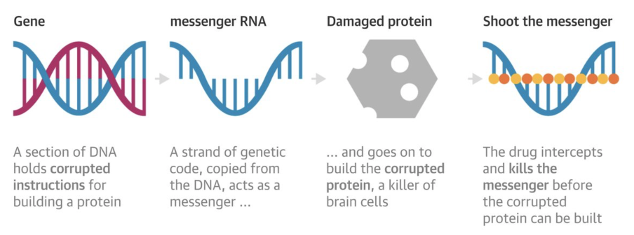
What is an Antisense Oligonucleotide?

Slide 8
A True “Platform” Process
Spinraza Sequence
5’
^{Me}U
^{Me}C
A
^{Me}C
^{Me}U
^{Me}U
^{Me}U
^{Me}C
A
^{Me}U
A
A
^{Me}U
G
^{Me}C
^{Me}U
G
G
3’
2’ MOE
2’ MOE
2’ MOE
2’ MOE
2’ MOE
2’ MOE
2’ MOE
2’ MOE
2’ MOE
2’ MOE
2’ MOE
2’ MOE
2’ MOE
2’ MOE
2’ MOE
2’ MOE
2’ MOE
2’ MOE
Benefits:
Same equipment and raw materials used for all molecules
Reduced development time
Rapid tech transfer and startup
Minimizes cost of implementation
Speed to patient
Notes:
Building blocks . Unlike small molecule – unique chemistry and process for each – expensive

Slide 9
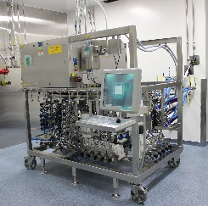
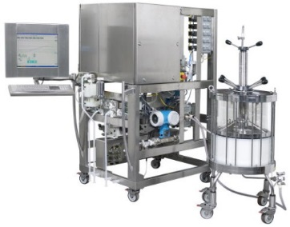
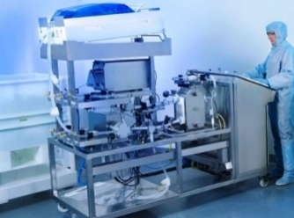
ASO Manufacturing Process
3 Rxn/ Cycle Synthesis
Raw Materials
(nucleotide building blocks)
Automated Solid-Phase Synthesis
Ammonolysis / Cleavage
^{Me}U
G
G
^{Me}U
…
^{Me}U
grow chemically on a resin bead
…one unit at a time…
HIC Purification
Detritylation
& Neutralization
AEX Purification
UF/DF
Ready-to-fill
Product
Novel Biologics-like Aqueous Purification

Slide 10
Biogen’s Projected Demand for ASOs

Slide 11
Oligonucleotide Industry
First Blockbuster!
1970:
ASO chemistry first described
1996:
Major advancement in ASO chemistry
1998:
First ASO Approved by FDA
2012:
40 ASOs in Clinical Trials
2013-2017:
Four more ASOs approved by FDA
2018:
147 ASOs in Clinical Trials
347% increase in # molecules!
Notes:
Development began in 1970s
1996 – major advancements in ASO chemistry
First FDA Approval of an ASO (Vitravene) in 1998
40 molecules in clinical trials in 2012
Second FDA Approval of an ASO (Kynamro) in 2013
Two approved (Spinraza and Exondys 51) in 2016
Macugen(aptamer) Eteplirsen, vitravene
147 molecules in clinical trials right now

Slide 12
Three CMOs asked to bid…
Ask again in 18 months
Supplier 1
Supplier 2
Ok, but we need 18 months notice and a large non-refundable reservation fee.
Supplier 3

Slide 13
Decision to Build
Growing ASO pipeline
High Cost to Outsource
Build $19 M
ASO Facility
Supply Risk Mitigation
Limited CMO Capacity
Limited Flexibility and Significant Lead Time with CMO
But… With Zero Headcount Change

Slide 14
Phased Approach to Investment
Extend- Stage 3
Manufacture -Stage 2
Build technical capability and capacity
Provide pivotal clinical supply
Deliver commercial materials
Plant operations
Global reach
Manufacturing and Support staff
Lab space
Scientists
Build cGMP Facility
Develop - Stage 1
Trigger: Second commercial
product in phase 3 trials and commercial platform defined
Trigger: Commercial product and multiple clinical programs

Slide 15
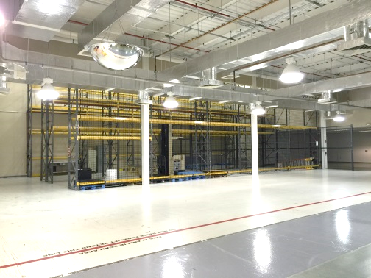
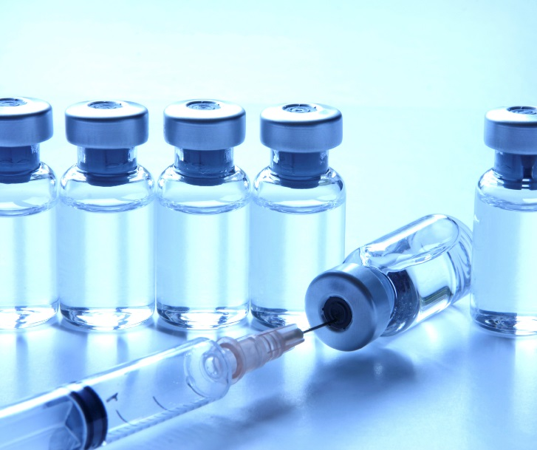
A Mission to Reach the Clinic
Warehouse space to GMP manufacturing in 16 months
Project Goals
Renovate a warehouse and build a new cGMP ASO facility
Deliver product to the clinic on time
Create flexible, efficient, and scalable systems and equipment to support the future pipeline

Slide 16
Facility Design Overview
>2000 Liters Solvent / kg product
Notes:
Safety first?

Slide 17
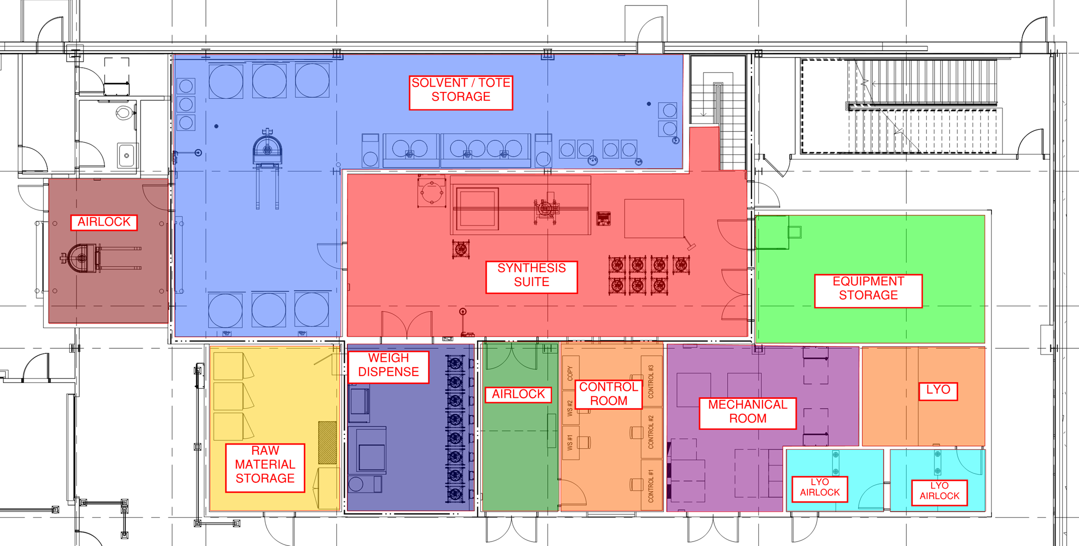
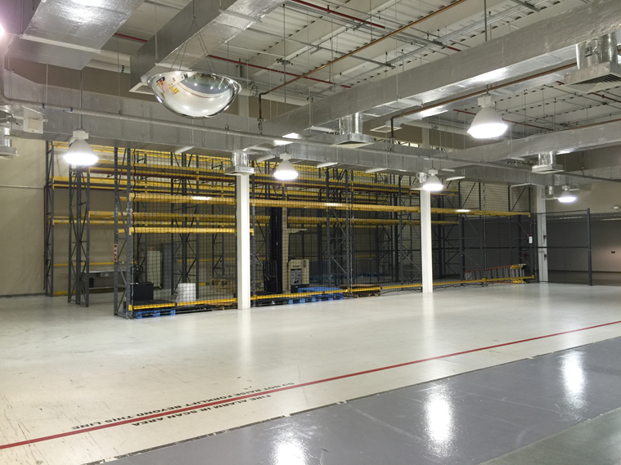
Facility Capabilities
Facility Overview
Scope cGMP oligonucleotide synthesis manufacturing facility to support clinical and commercial production Renovation of high bay warehouse and packaging area ~ 5,000 ft² first floor ~ 1,000 ft² mezzanine
Synthesis Scale - 0.5 – 3.3 kg/batch (final product)
 | Synthesis Scale | Implementation | Final Product | Synthesis Column
 | 163 mmol | Year 1 | ~ 0.5 kg | 30 cm
 | 367 mmol | Year 1 | ~ 1.0 kg | 45 cm
 | 1000 mmol | TBD | ~ 3.3 kg | 75 cm
Expansion Capability – facility and equipment designed to facilitate adding a second synthesizer train
Notes:
Update table – remove solvent purification
Consider bookending scale options
More pics in general

Slide 18
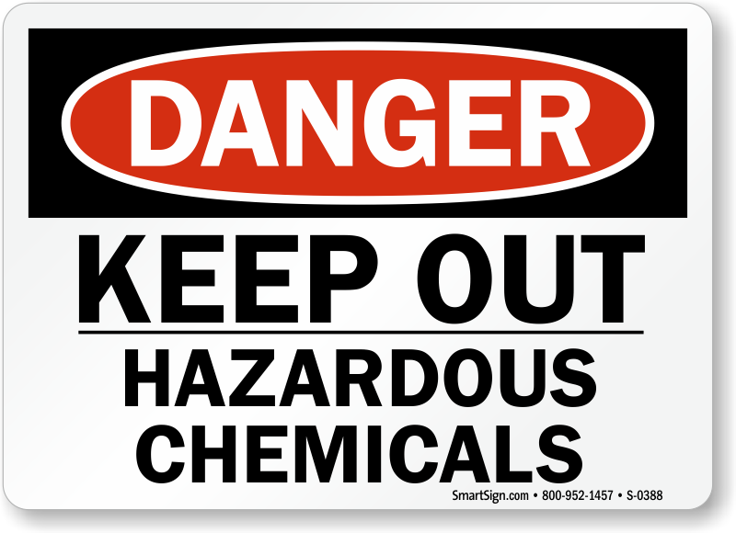
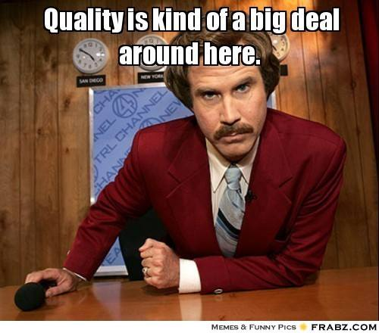
Unique Challenges
Notes:
ASOs are chemically synthesized. Current products are biologics (grown from cells in an aqueous process) and small molecule drug product (formulation and powder handling). Chemistry expertise only in technical development who supports external API manufacturing for small molecules. Started organization from this group –
Challenges: high solvent usage, flammable/toxic materials; evolving demand/facility needs for next 10 years; no experience in ASOs; flexible thinking – particularly with QA requirements

Slide 19
Challenge 1: Skilled Resources Closing the Gaps in Expertise
EHS
Consultants
Facility Design
ASO Experienced engineering firm
Operations
Chemical mfg experience
Process Engineering
Organic Chemistry
Learning Agility
Questioning attitude
Ionis Site Visits
Safety-conscious
Ionis team
Systems approach
Hands-on
Generalists
Involve Tech Dev in design
External
Internal
Notes:
What else to add to facility design?

Slide 20
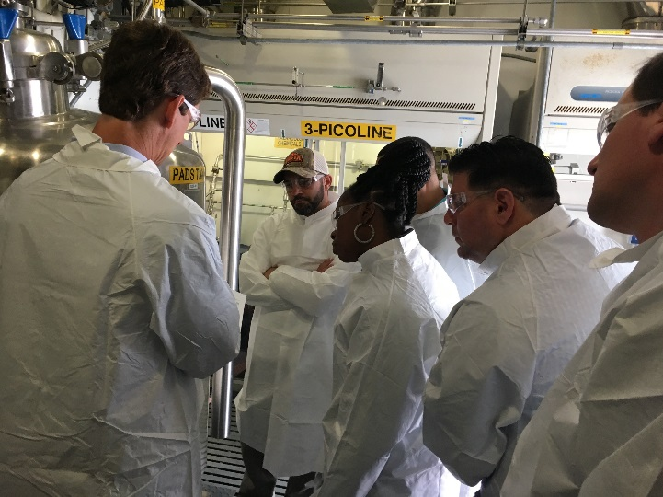
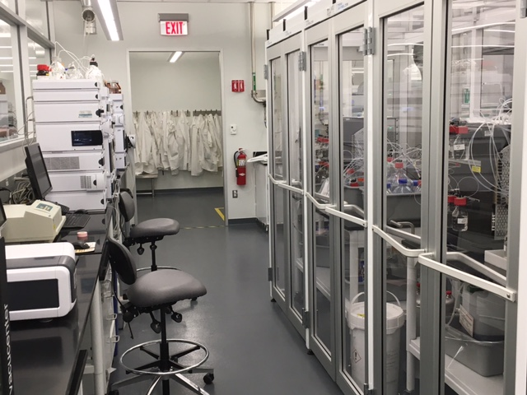
Challenge 1: Skilled Resources Manufacturing Staff Readiness
Expert mentors: Ionis & technical development scientists
Attended live batch run at Ionis
Seamless knowledge transfer from Ionis
Practice Time: water runs, solvent runs, engineering batch
Hands-on training at Cambridge Pilot Plant

Slide 21
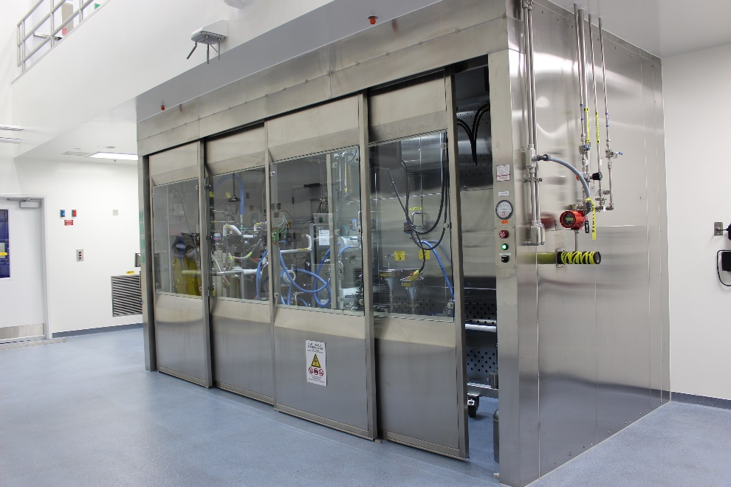
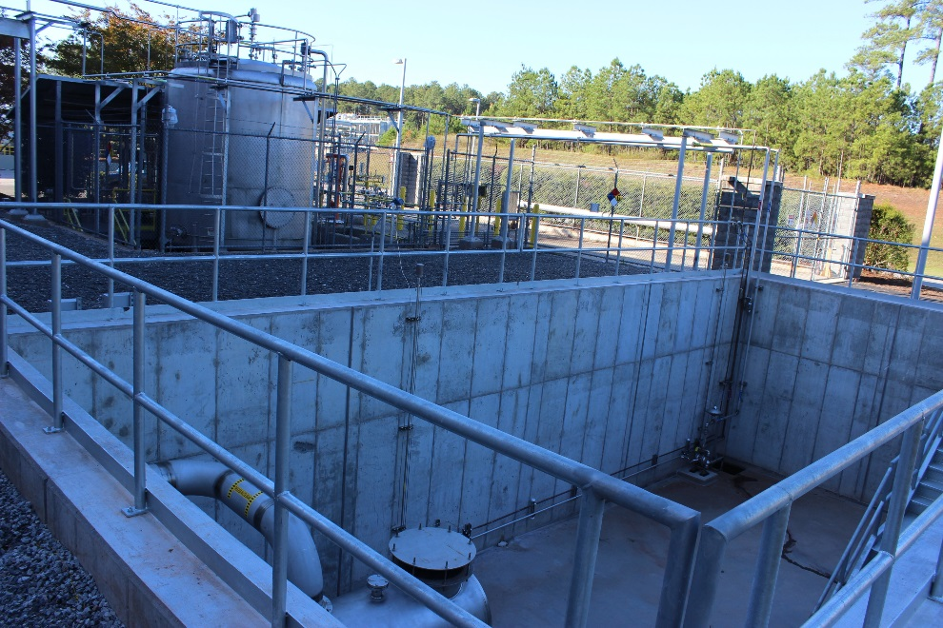
Challenge 2: Elevated Safety Risk Engineering Controls
General Protection
Walk-in Fume Hoods
High Air Change rates
Control Room to minimize time staff is on the floor
Flammables
Hazardous Area Electrical Classification
Electrostatic dissipative flooring
Active monitoring of grounding and bonding
Corrosives
Higher Alloys
Spill containment below grade
Toxic /Odorous
Ventilated Weigh/Dispense enclosure
Closed charging
Minimize raw material sampling / Tailgate samples
Fire Water Containment Pit
30 minutes fire water containment per code
Process spill containment tank within pit
Notes:
Replace pics with new pit pic, make pics really big

Slide 22
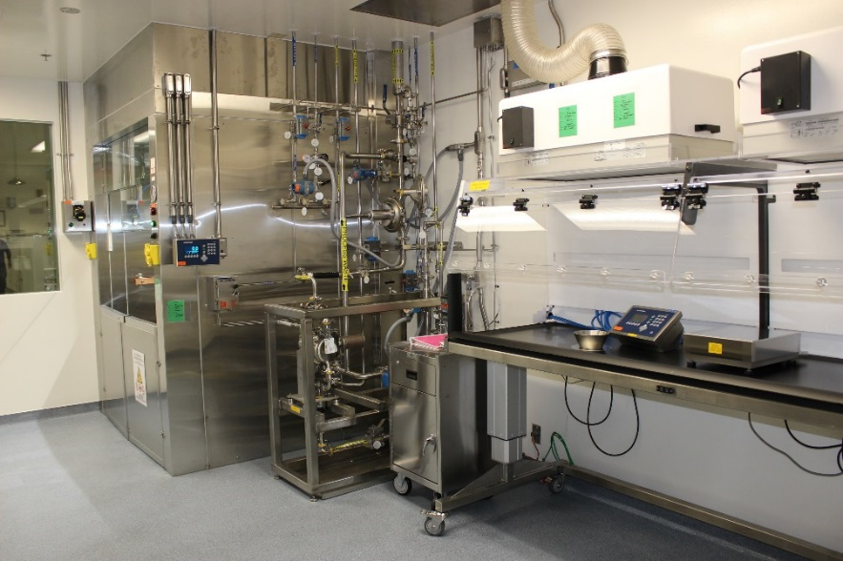
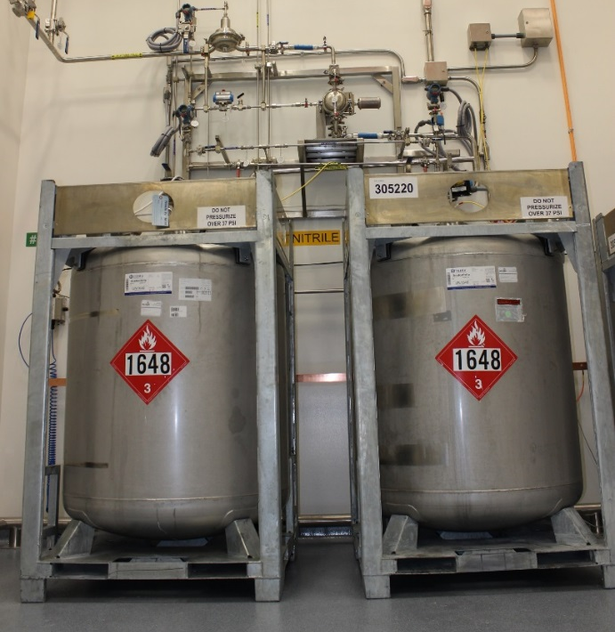
Challenge 2: Elevated Safety Risk Engineering Controls
Equipment / Process Design
Nitrogen Inertion – automatic purge cycles and nitrogen blanketing
Powder Prep hood for solid weighing (amidites / PADS)
Closed process transfers
Closed sampling for Deblock
Active monitoring of grounding and bonding of equipment
Emergency vent knock out tank
Recycletainers for solvents / reagents (return & refill)
Keyed connections for raw materials
High purity, closed system supplied with N2 blanket
Bulk organic waste tank and collection system
Carbon absorption system for process vents

Slide 23
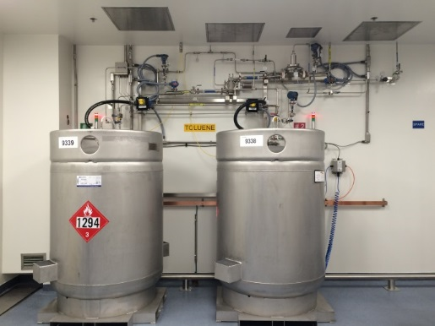
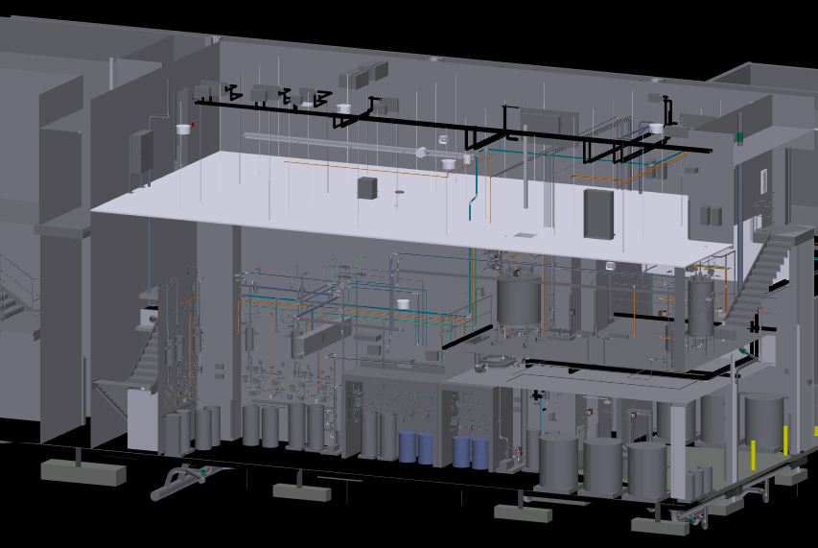
Challenge 2: Elevated Safety Risk Engineering Controls: Process Closure
CHALLENGE
SOLUTION
Closed processing where practical
Reduce risk of operator exposure to hazardous materials
Reduce risk of fire
Downgrade hazardous area electrical classification (Div 1 -> Div 2)
Recycletainers
Safety and quality
Closed transfers
Bubble traps/ day tanks
Separate Weigh/Dispense for powder handling
2 areas of open processing
Small volume flammable weigh/dispense in hood in Weigh Room
Large volume open processing for synthesis column packing and cleaning within fume hood

Slide 24
Challenge 2: Elevated Safety Risk Cultural Considerations
Transition from Fear to Confidence
Go/No Go Meetings
New Safety Tools / Systems
Expert Confirmation
Practice Opportunities / Small Wins
Constant Reinforcement
Notes:
Communications to management – opportunities to verbalize/vet out concerns. Constant reminders on importance. Clarity in expectations for behavior. New tools to enable open assessment/conversations.
From Fear to Confidence
No blame environment

Slide 25
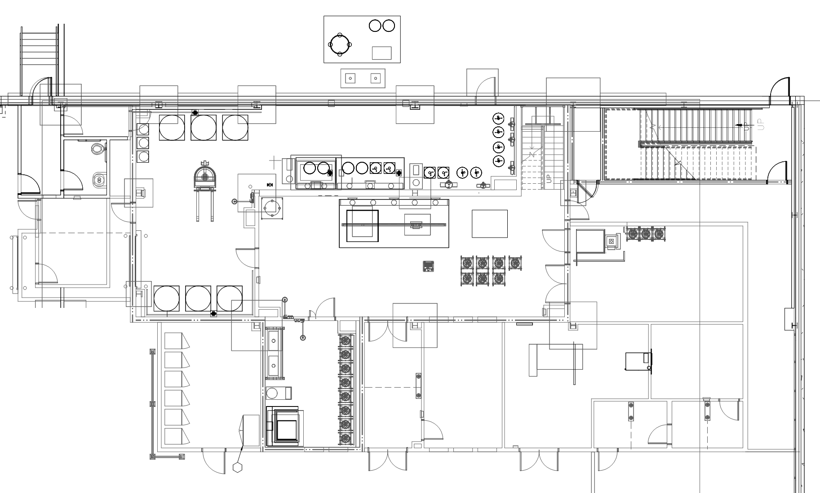
Challenge 3: Evolving ASO Pipeline Flexibility for Expansion
CHALLENGE
Capacity
Support clinical and commercial pipeline based on drug portfolio forecast
Current Facility Design
SOLUTION
Space planning
Solvent delivery Tote manifolds for pre-made solutions
Expandable Synthesis suite for 2nd Synthesizer and Ammonolysis Hood
Ample mezzanine space for Solution vessels to feed synthesizer skids
Pipe Bridge, Area for 2 future bulk tanks outside
Future Build-out

Slide 26
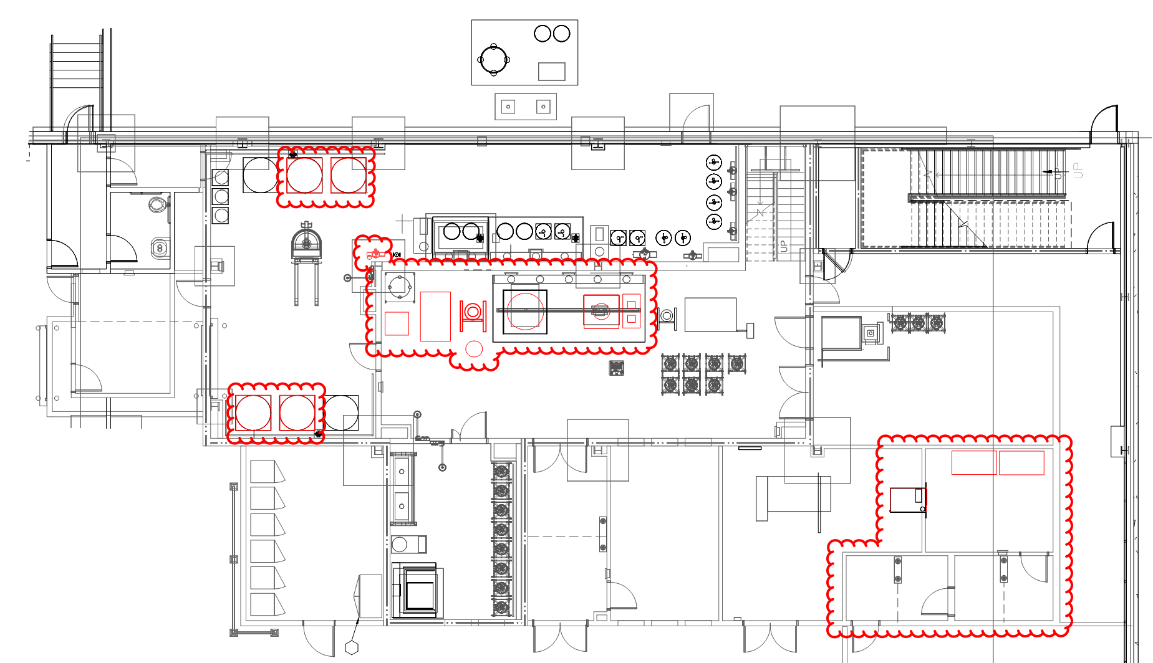
Challenge 3: Evolving ASO Pipeline Flexibility for Purification
CHALLENGE
SOLUTION
Design to allow for future infrequent downstream processing
Vacuum Stripping in Ammonolysis Operation
HPLC with Methanol/water/acetate
Ethanol Precipitations
Acid Detritylation
Lyophilization
HVAC
Capacity designed in to process as ISO 8 in Synthesis suite
ISO 7 Processing in Lyophilizer Room
Space allocated, and process utility drops provided, for Downstream Processing
Equipment procurement deferred
Install shell space for lyophilization room and associated airlocks.

Slide 27
Challenge 3: Evolving ASO Pipeline System Flexibility
Material Safety Stock
Scalable Staffing Model
Templated & Flexible Documents
Reduced Tech Transfer Time
Notes:
Templated Documents, Formula, material inventory safety stock, scalable staffing model

Slide 28
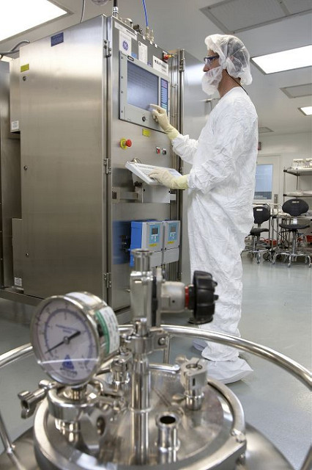
Challenge 4: Quality Systems Raw Material Sourcing
Raw materials only available from the “chemical industry”
Biogen’s quality systems designed for Biologics
Solution:
Supplier Audits
Technical Risk Assessments
Additional Quality Testing
Procedural updates
Notes:
Challenge with sourcing from the chemical industry – use in a pharmaceutical environment / systems. Had to get around requirements – justify not following procedures with technical assessments, quick procedural changes, or additional controls. Example of supplier – lack of quality systems had to add extra testing to ensure confidence, another similar issue, wrote up justification of why material was non-critical.

Slide 29
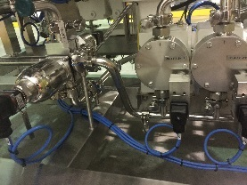
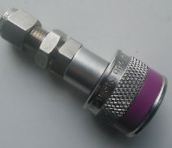
Challenge 4: Quality Systems Engineering Controls
CHALLENGE
SOLUTION
Prevent Mix-up
Raw Materials - How to confirm correct totes are hooked up to correct charging station?
Amidite Solutions - How to confirm correct amidites are charged to correct synthesizer inlet port?
Nitrogen versus Air
Engineering Controls
Different keyed Swagelok QTM fittings on recycletainers for each solvent / reagent
Synthesizer design to facilitate installation of PAT for on-line amidite ID confirmation
Prevent incorrect coupling sequence
Swagelok quick disconnects for N2
Staubli quick disconnects for compressed air

Slide 30
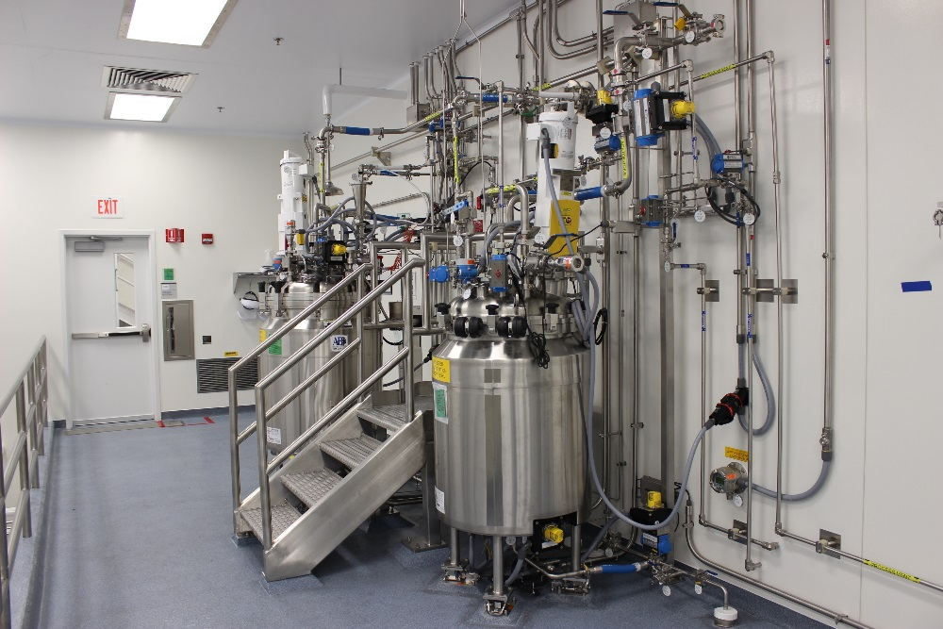
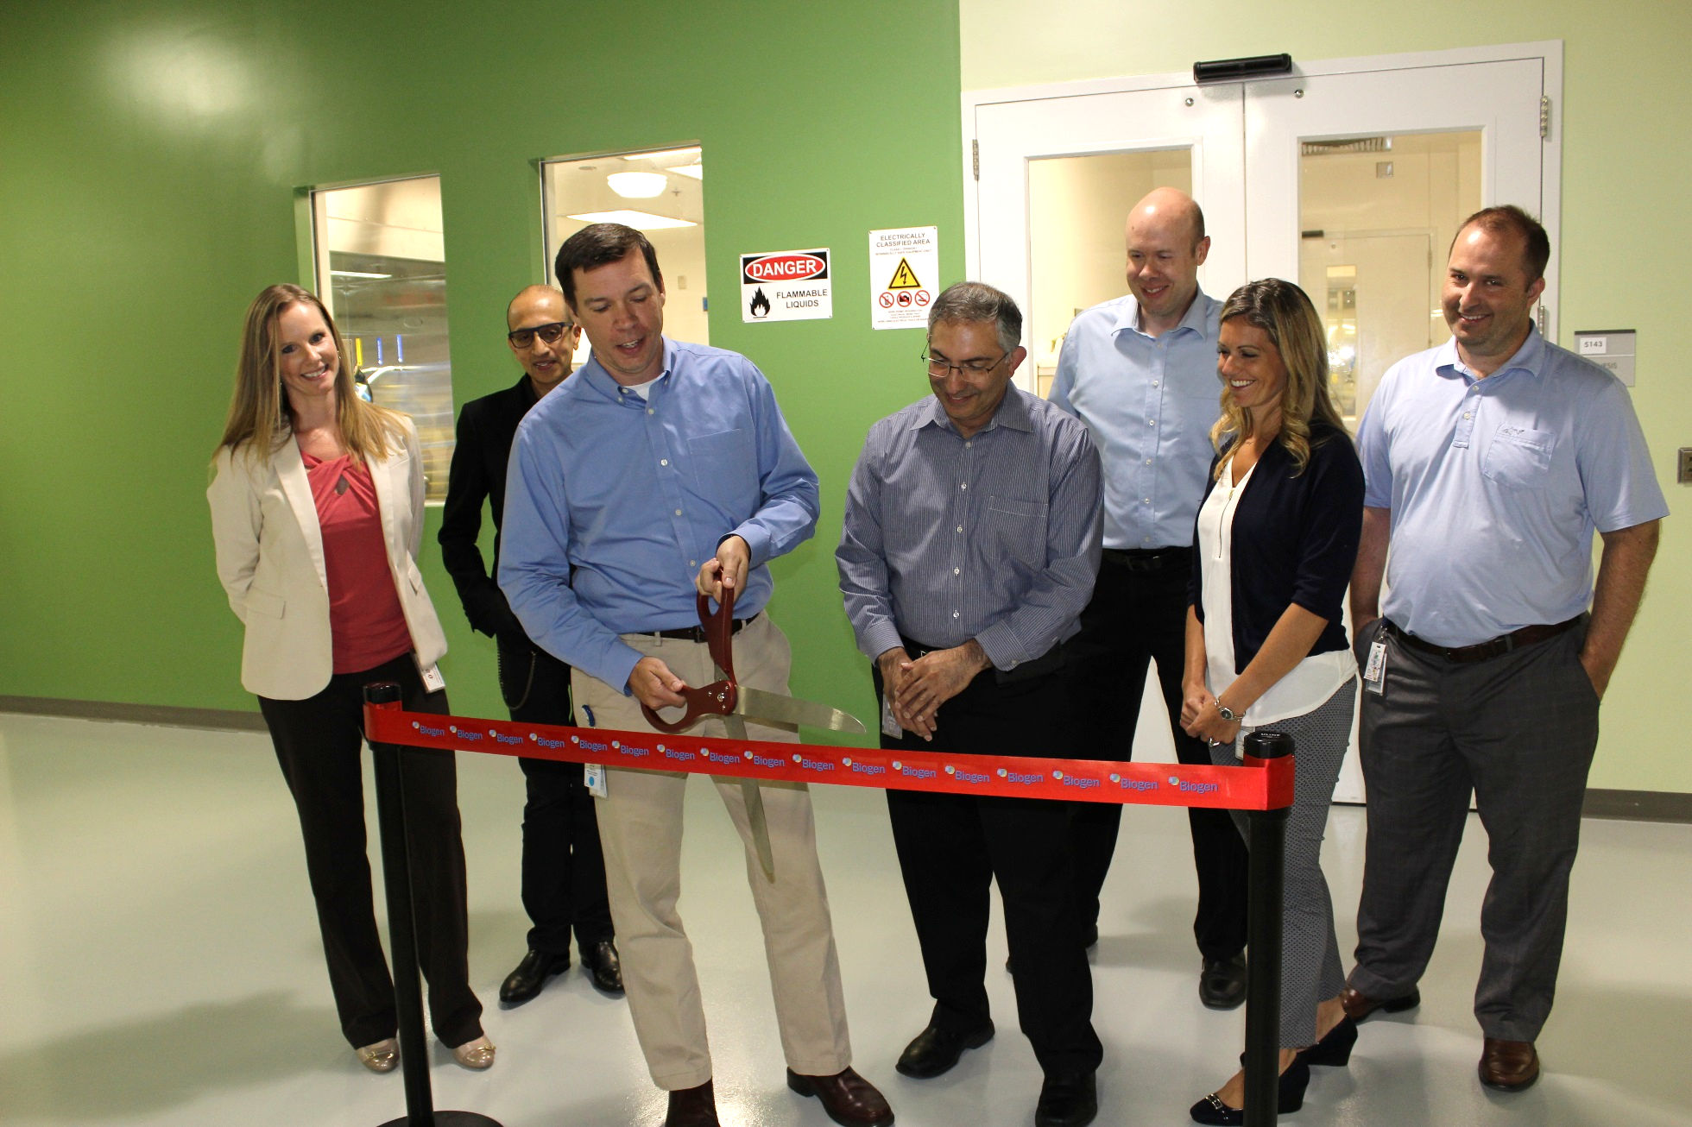
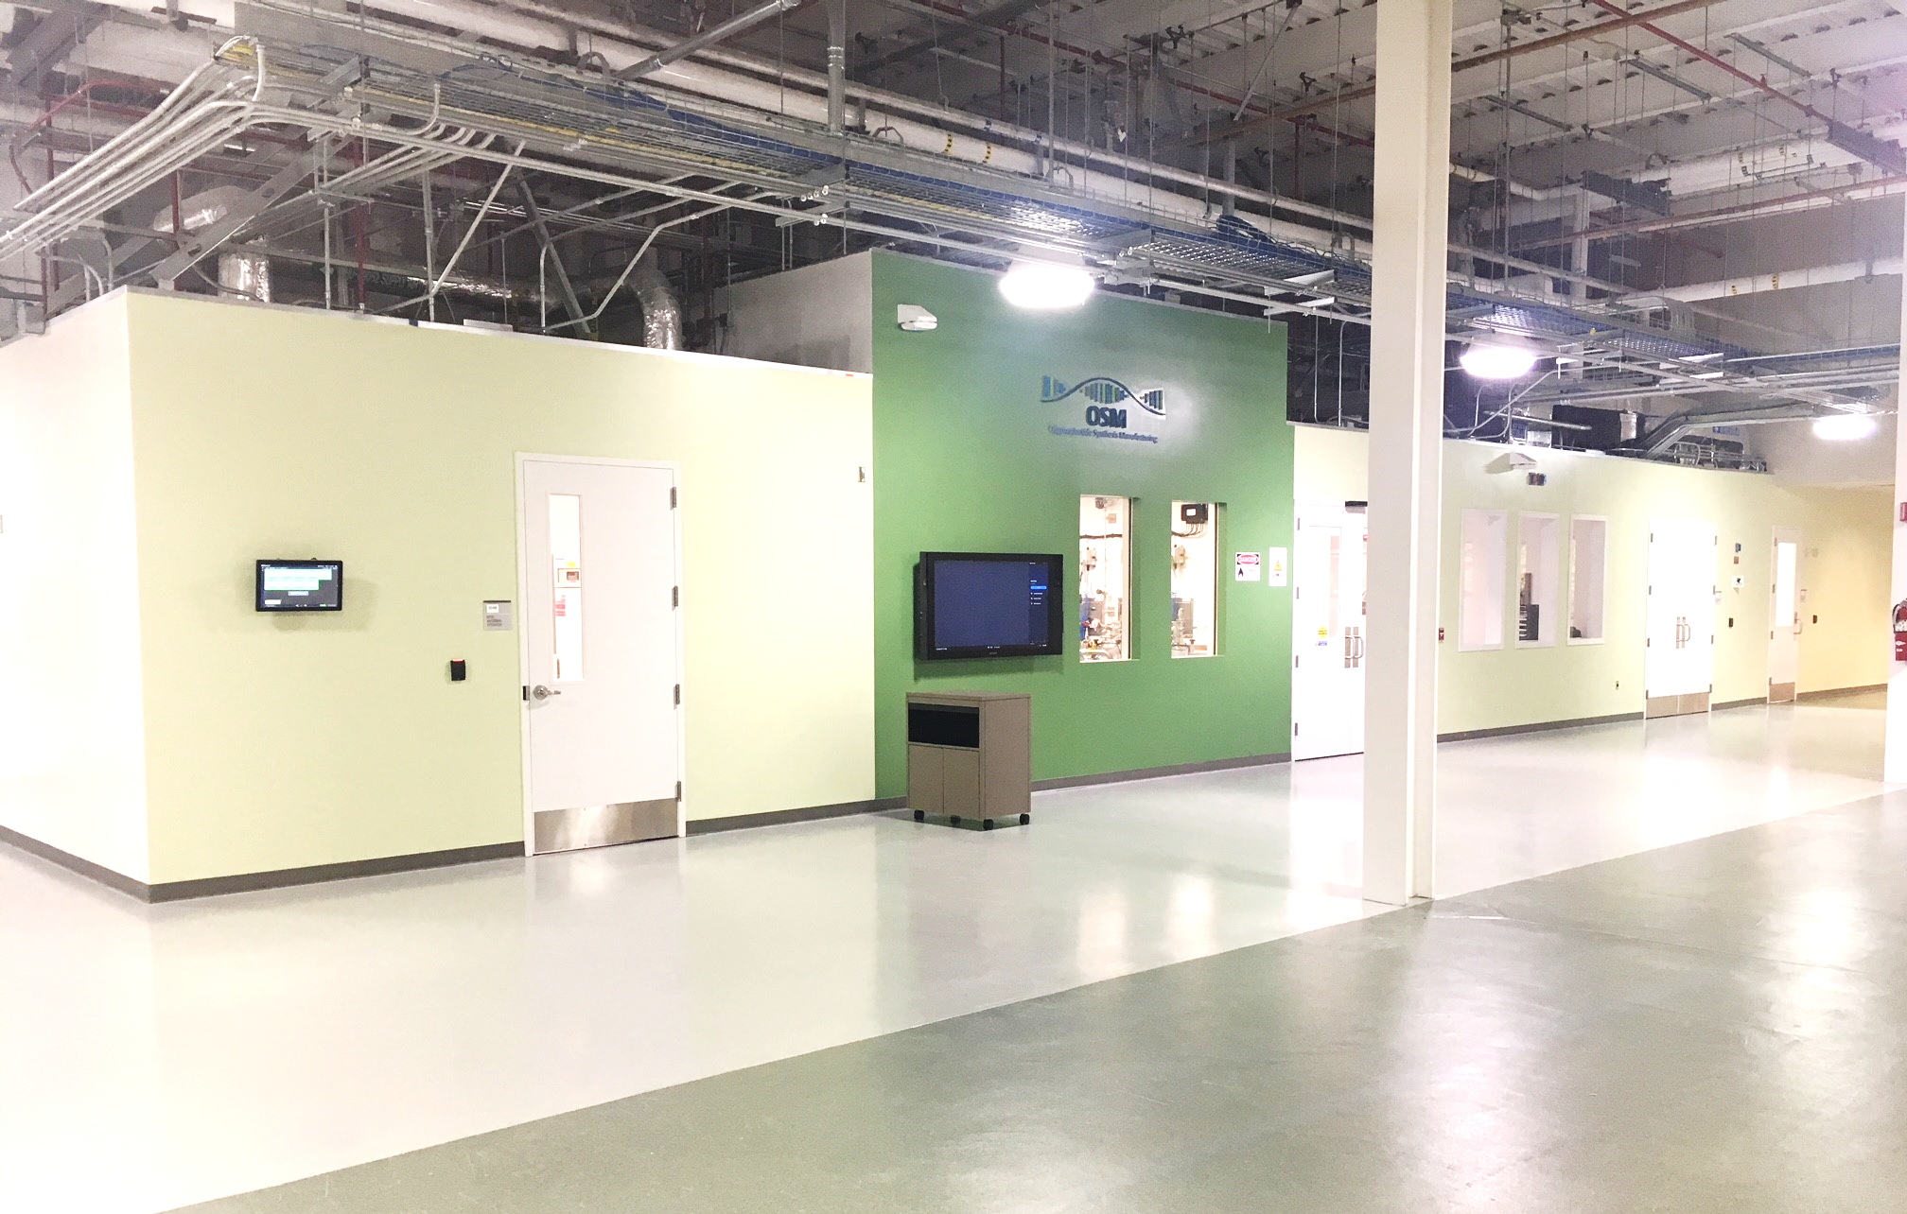
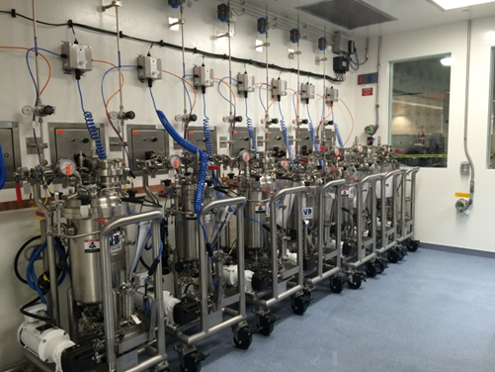
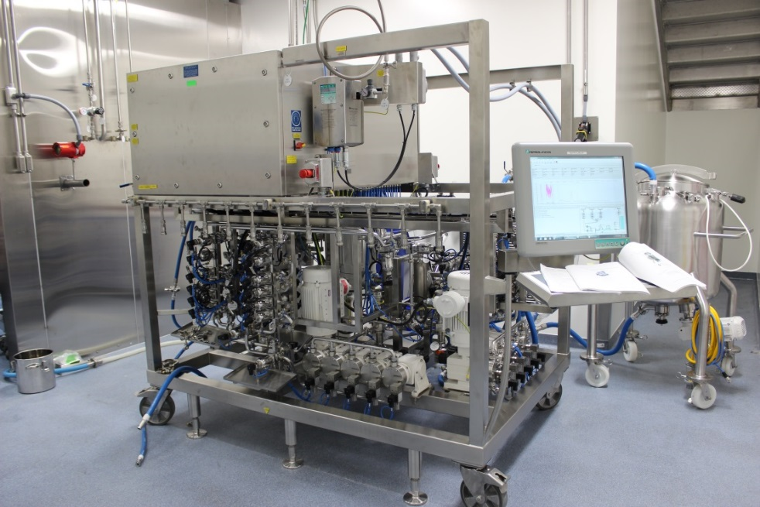
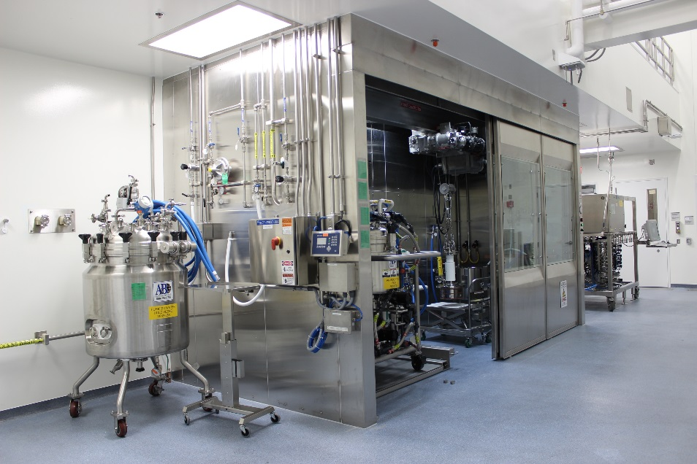
16 months later…

Slide 31
Results
Higher yield than comparison batches
Comparable impurity profiles
Biogen process scaled up smoothly
Notes:
Update from alex

Slide 32
What did we accomplish in 16 months?
Full Funding Approval 30Jun16 → First GMP Batch 01Nov17
Construction of $19 M ASO synthesis facility
Procurement and Qualification of 51 equipment systems and 251 instruments
Sourcing, procurement, and release of 24 new raw materials
Creation or modification of 93 procedures and batch records
Development and/or qualification of 39 analytical methods
Successful production of our first ASO molecule:
On schedule No safety incidents High purity High yield
Notes:
How many materials, procedures, and equipment adds in FVM?? Other topics?

Slide 33
Summary
Thoughtful incremental investments minimize financial risk
Unique challenges arise when implementing novel technologies to existing facilities
Challenge assumptions to find optimal solutions
Oligonucleotides are a growing field with lots of potential
Finding creative options to closing expertise gaps is essential

Slide 34
Questions?

