Slide 1
Advances in Raman spectroscopy for in-line, real-time bioprocess monitoring and control
Maryann Cuellar
Life Science Product Manager
Kaiser Optical Systems, Inc.
ISPE-CaSA Technology Conference
Raleigh Convention Center
March 13, 2018

Slide 2
Overview Process Analytical Technology and Raman Spectroscopy

Slide 3
Introduction
Raman spectroscopy has successfully been used for process analysis for many years, across many industries
There is a strong need for process analytics for biopharmaceutical development and production, specifically for monitoring and controlling bioreactors
This is reinforced by the FDA’s Process Analytical Technology and Quality by Design initiatives
Compared to similar PAT tools, Raman spectroscopy has many benefits specifically for bioprocesses
An introduction to Raman, it’s benefits for biopharma, a review of industry milestones and examples, and new innovations will be presented
Copyright Kaiser Optical Systems, Inc. 2018

Slide 4
Process Analytical Technology (PAT)
PAT is a system for designing, analyzing and controlling manufacturing through timely measurements
Aspect of Quality By Design (QbD)
Initiative being undertaken by the pharmaceutical industry to:
  Better understand, control, and optimize processes
  Reduce production time by implementing on-, in-, and/or at-line measurements and controls
  Preventing rejects, scrap, re-processing, and waste
  Minimize product defects
  Increasing the use of automation to improve operator safety and reduce operator error
  To facilitate the development of risk mitigation strategies
  To save money, ensure patient safety
PAT is not new, but is still being realized in biopharma
Copyright Kaiser Optical Systems, Inc. 2018

Slide 5
PAT Tools - Spectroscopy
“Spectroscopic measurements appear to be the most promising for process monitoring due to their ease of sampling and potential to measure multiple analytes simultaneously.”
Spectroscopy fundamentals - The study of the interaction between matter and light
Emission – Specific colors of light emitted in all directions. Example: Atomic Emission Spectroscopy
Absorbance – All colors of light go in, only part comes out. Light travels in one direction only. Examples: UV, mid-IR (MIR), near-IR (NIR) Spectroscopy
Fluorescence – Wide band of colors emitted in all directions
Raman – Light scattering technique (photons re-emitted in all directions)
Abu-Absi, N., Kenty, B., Cuellar, M., Borys, M., Sakhamuri, S., Strachan, D., Hausladen, M., Jian Li, Z. (May 2011) Real Time Monitoring of Multiple Parameters in Mammalian Cell Culture Bioreactors Using an In-line Raman Spectroscopy Probe. Biotechnology and Bioengineering. Bioengineering,108 (5):1215-1221.
Copyright Kaiser Optical Systems, Inc. 2018

Slide 6
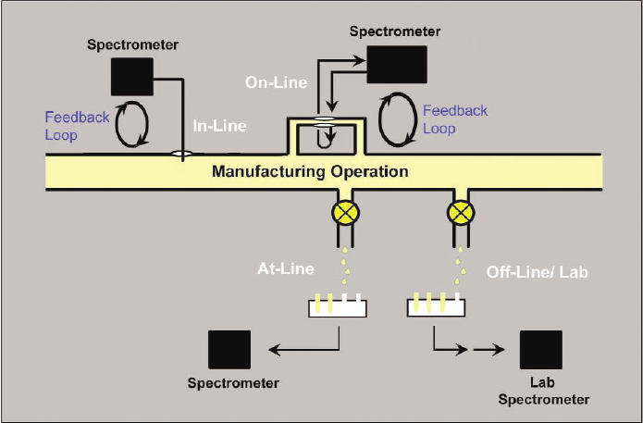
Implementation of spectroscopic methods
Copyright Kaiser Optical Systems, Inc. 2018
Notes:
Off-line – lab
At-line – in production area, analysis during production close to the manufacturing process
On-line – analysis on diverted stream connected to process
In-line – process stream disturbed
Non-invasive – sensor not in contact with material, process not disturbed (regulatory advantages)
Benefits:
Allows interference while process is evolving, corrective action
Allows real-time prediction of product quality = no wait for post production analysis before proceeding with next step
Reduced time = dollars saved
Remote sampling via fiber optics = sampling without disturbance and from hazardous areas

Slide 7
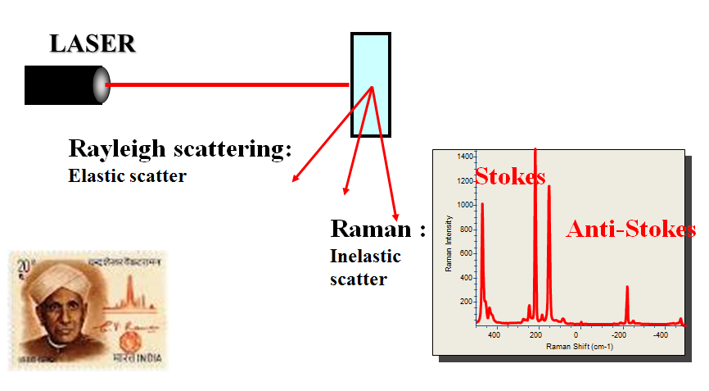
What is Raman spectroscopy?
Raman spectroscopy is a light scattering technique
Raman spectra provide a “molecular fingerprint”, enabling qualitative and quantitative analysis
Process Raman enables direct, in situ, real-time process measurements
Sampling flexibility: applicable to solids, liquids, gases, slurries
Raman combines the benefits of MIR and NIR
Ease of use and sampling similar to NIR with chemical specificity of MIR
Copyright Kaiser Optical Systems, Inc. 2018
Notes:
And so then, how do we incorporate these principles into a process environment? And what do we need to think about while doing it?

Slide 8
Raman technology illustrated
Laser light of specific wavelength (e.g. 785 nm) interacts with molecules (scattering)
1 out of 10⁸ photons is frequency shifted due to specific energy transfer (Raman shift)
Result: Specific photons allow identification & quantification (solvent, products, substrate)
Raman Probe
Laser light of specific wavelength (Rayleigh scattering)
Wavelength shifted light (Raman scattering)
Copyright Kaiser Optical Systems, Inc. 2018

Slide 9

Raman technology illustrated
Back-scattered photons are collected
Laser light is filtered out followed by separation of Raman light
Raman photons are simultaneously detected on CCD detector
Fingerprint of chemical components & quantification of each component
Laser light of specific wavelength (Rayleigh scattering)
Wavelength shifted light (Raman scattering)
CCD
Detector
HoloPlex®
Grating
Notch®
Filter
Raman Probe
Copyright Kaiser Optical Systems, Inc. 2018

Slide 10
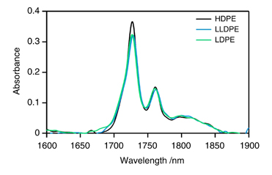
Advantages of Raman in process environments
Direct, real-time, and in-process
Method transferability
Compatible with classified environments
Compatible with process control software
Sampling flexibility: compatibility with aqueous systems, slurries, feeds, turbulent mixtures, moving streams, gas-liquid mixes, gases, and biological tissues
C-C stretch
CH₂ twist
CH₂ bend
Relative Intensity
Raman spectra of polyethylene
1000
1100
1200
1300
1400
1500
Raman Shift, cm⁻¹
Near-infrared spectra of polyethylene
Reference: Polymer Journal 44(2):162-166
Copyright Kaiser Optical Systems, Inc. 2018
Notes:
Method transferability: eases management of analytical method life cycle. Today I will discuss how to use sampling options to maximize amount of signal in life sciences and polymer applications. And an important consideration in sampling options is the amount of optical scattering in your sample.

Slide 11
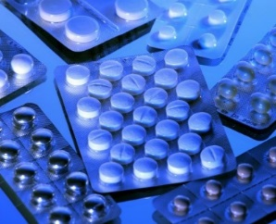
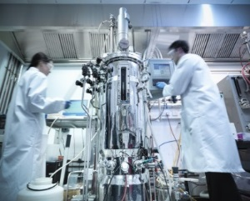
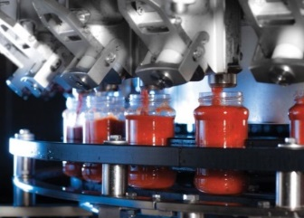
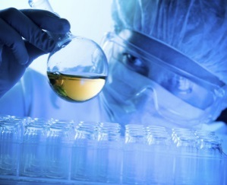
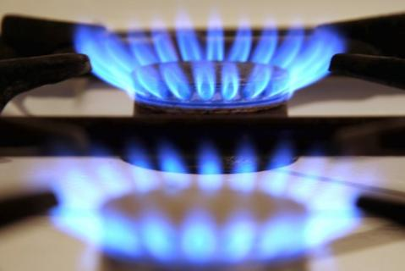
Who is getting value from process Raman?
      Pharmaceutical Industry
          solid forms: polymorphism, crystallization, HTS screening, quality control, in-line coating process, …
    Chemical, Polymer and Petro Industry
          in-line monitoring, reaction optimization, batch end point, gas composition, safety…
        BioTech Industry (BioPharma, BioFuels, BioBasedChemical)
          in-line monitoring (Glucose, Glutamate, Lactate, Ethanol, NH4⁺….), closed loop process control
    Food and Cosmetic Industry
          quality control, research, process monitoring
  University and Others
Copyright Kaiser Optical Systems, Inc. 2018

Slide 12
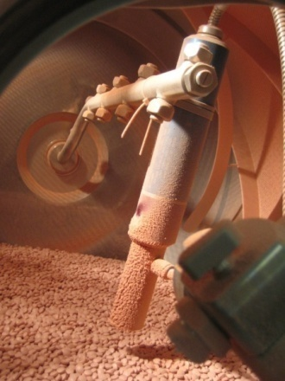
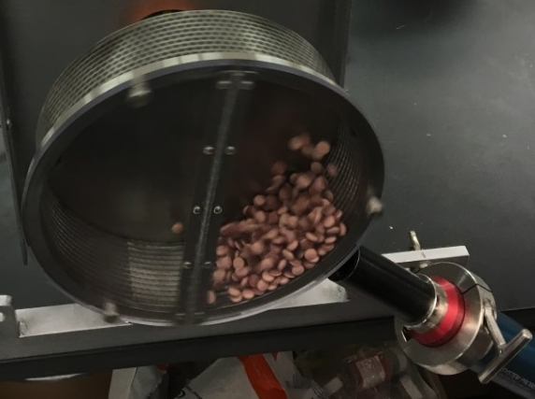
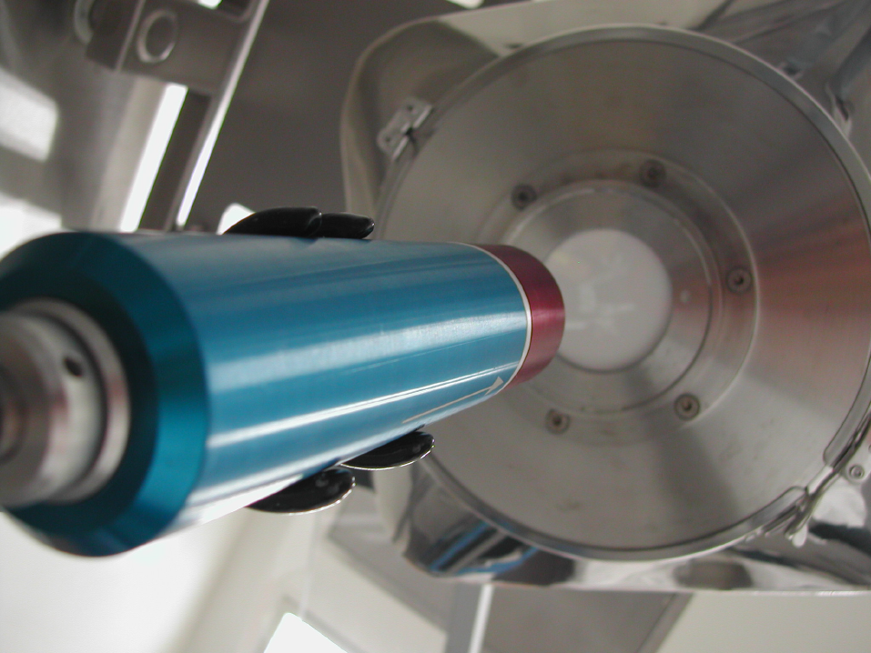
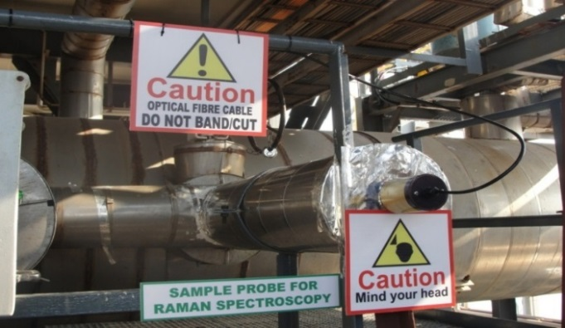
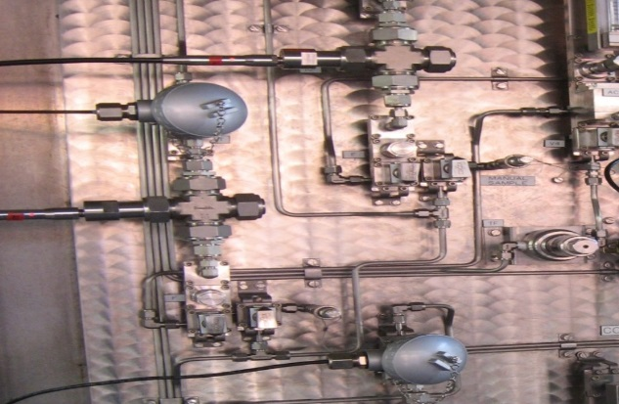
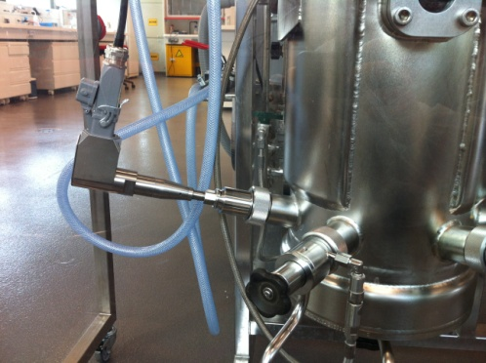
Kaiser Raman probe installation examples
Copyright Kaiser Optical Systems, Inc. 2018

Slide 13
Biopharmaceutical Applications of Raman

Slide 14
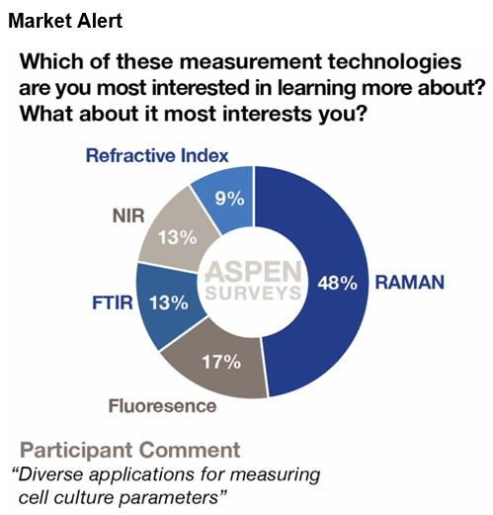
Advantages of Raman for bioprocessing
Insensitive to water
High chemical specificity to key process parameters
Ease of both qualitative and quantitative analysis
Versatile to many applications
Fiber-optic cabling and multiplexing enable flexible installations
Compatible with process automation platforms
Scalable from lab to pilot to production
Copyright Kaiser Optical Systems, Inc. 2018

Slide 15
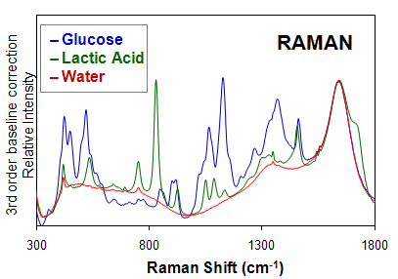
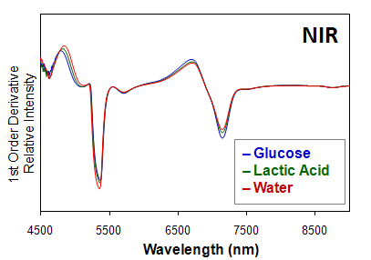
Advantages of Raman for bioprocessing
~60 g/L glucose
~ 20 g/L lactate
Insensitive to water
High chemical specificity to key process parameters
Ease of both qualitative and quantitative analysis
Versatile to many applications
Fiber-optic cabling and multiplexing enable flexible installations
Compatible with process automation platforms
Scalable from lab to pilot to production
Copyright Kaiser Optical Systems, Inc. 2018

Slide 16
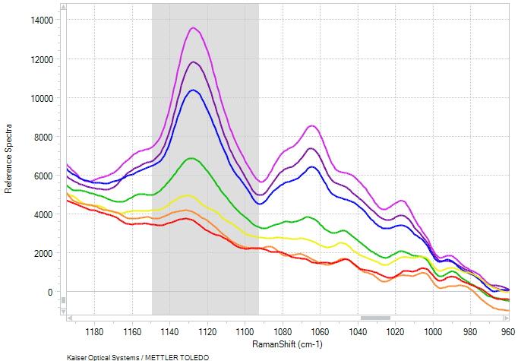
Advantages of Raman for bioprocessing
Insensitive to water
High chemical specificity to key process parameters
Ease of both qualitative and quantitative analysis
Versatile to many applications
Fiber-optic cabling and multiplexing enable flexible installations
Compatible with process automation platforms
Scalable from lab to pilot to production
15 g/L
13 g/L
10 g/L
5 g/L
2 g/L
1 g/L
0.5 g/L
Copyright Kaiser Optical Systems, Inc. 2018

Slide 17
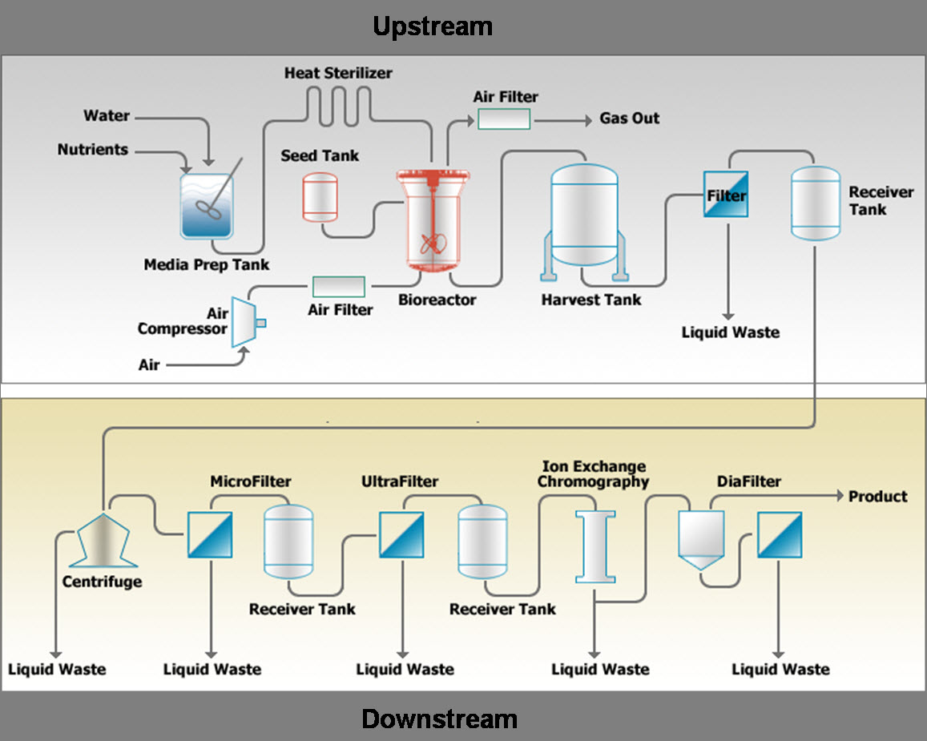
Biopharmaceutical manufacturing operations
Copyright Kaiser Optical Systems, Inc. 2018
Notes:
The Upstream process segment has the lowest barrier to entry accompanied by the larger unit volume opportunity.

Slide 18
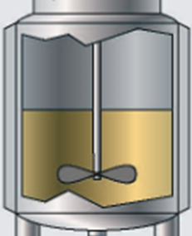
Traditional, undesirable bioreactor practice
Limited in-line bioprocess measurements
Nutrients, metabolites, growth, product – all analyzed off-line
      Off-line methods use consumables, have excessive down time, high instrument-to-instrument variability, and lack scalability
      Manual sample extractions are infrequent, while automated extractions increases sterility risk
QC determination after batch completion
    Problems are found too late, no correction or optimization possible
Nutrient concentration determines feed rate
dO2
pH
Temp
Extract samples
Off-line measurement of cell density, nutrients, metabolites, etc
Copyright Kaiser Optical Systems, Inc. 2018
Notes:
Add bioreactor schematic

Slide 19
Preferred bioreactor practice
  In situ, real-time bioprocess measurements
Key process and quality parameters measured directly in bioreactor, no sample extraction
More frequent sampling leads to better process understanding
Better process understanding leads to optimization and control
Control enables decreased variability, increased quality and yield
Problems detected and interpreted on the fly - corrections possible!
Nutrients
Metabolites
Cell density
Titer
Real-time analytics
Process Understanding
Process Control
dO2
pH
Temp
In-line Raman Probe
Copyright Kaiser Optical Systems, Inc. 2018
Notes:
Add bioreactor schematic

Slide 20
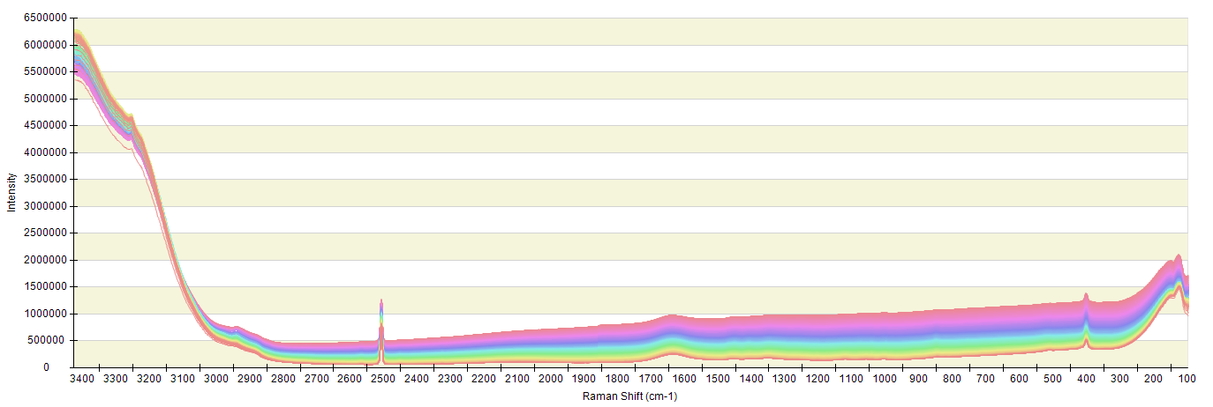
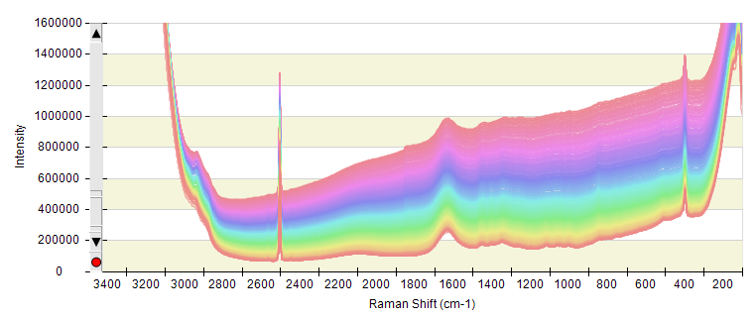
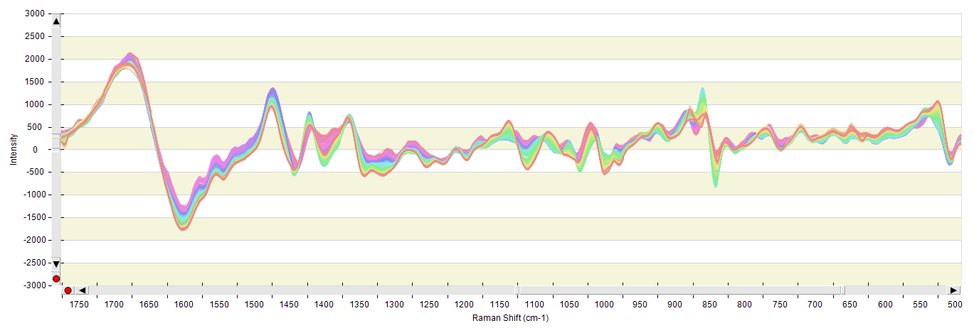
Raman spectra from a batch CHO cell culture process
Raw, full spectral range
Batch Progression
1st derivative, zoomed
Chemical changes during batch progression
protein
glutamate
protein
glucose
protein
glutamine
glutamate
lactate
Copyright Kaiser Optical Systems, Inc. 2018

Slide 21
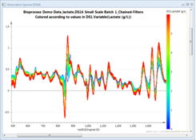
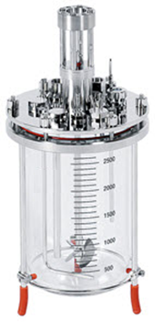
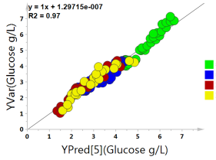
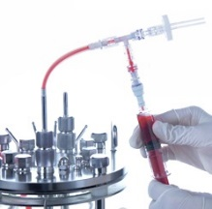
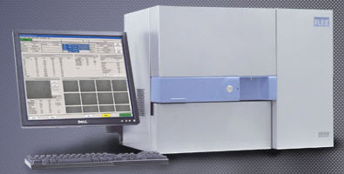
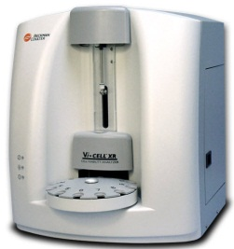
Experimental approach for generating Raman PAT methods
In situ Raman spectra
Spectral variation
+
+
Predictive models
Extract & Prep samples
Off-line analysis
Copyright Kaiser Optical Systems, Inc. 2018

Slide 22
Experimental approach for generating Raman PAT methods
In situ Raman spectra
Spectral variation
+
+
Predictive models
Extract & Prep samples
Off-line analysis
Copyright Kaiser Optical Systems, Inc. 2018

Slide 23
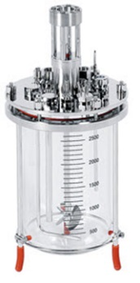
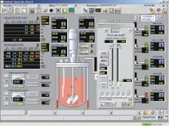
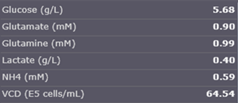
Implementation of Raman PAT methods
Copyright Kaiser Optical Systems, Inc. 2018
Notes:
Mention can be done at any scale, shown later

Slide 24
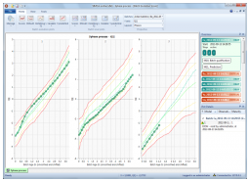
Implementation of Raman PAT methods
Copyright Kaiser Optical Systems, Inc. 2018
Notes:
Mention can be done at any scale, shown later

Slide 25
Industry Examples

Slide 26
Kaiser Raman for biopharma milestones
Generic models (transfer across different media, cells & processes), and Raman Robustness reported
Bioprocess specific Raman products lead to increased industry adoption
SUB and Perfusion compatibility, and
Control in GMP presented, general technology advances
Feasibility for in situ Raman for cell culture, start of R&D publications
2011
2014
2016
2018
2015
2017
2008
1st publications on industrial use of Raman for bioprocesses monitoring of CPPs
2012
Emergence of works on Raman transferability cross-scales (including large-scale production). Feedback control R&D.
Publications on Raman-based control resulting in CQA improvement (% glycation) and titer increase (85%!)
Extended applications -
Additional CQAs and downstream
Copyright Kaiser Optical Systems, Inc. 2018

Slide 27
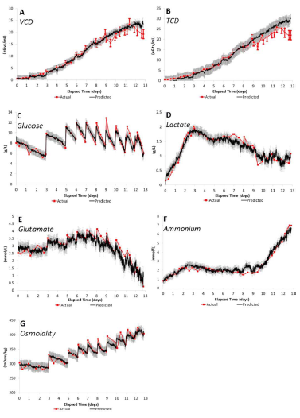

3L to 2000L Scale-Up
Multi-component, multi-scale Raman spectroscopy modeling of a CHO cell culture process producing a monoclonal antibody.
Lab Scale (3L)
Models
Demonstrated method transferability
between scales
Manufacturing Scale (2000L) Models
Pilot Scale (200L) Models
Real-time predictions during a 2000L manufacturing scale cell culture process
Berry, B. et al, “Cross-Scale Predictive Modeling of CHO Cell Culture Growth and Metabolites Using Raman Spectroscopy and Multivariate Analysis,” in Biotechnology Progress, 2015 Mar-Apr; 31(2) pp. 566-577.
Copyright Kaiser Optical Systems, Inc. 2018
Notes:
2015 Mar-Apr;31(2):566-77.

Slide 28
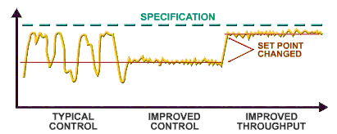
Process Raman spectroscopy enables process control and intensification
https://goo.gl/images/CdVUWs
Copyright Kaiser Optical Systems, Inc. 2018
Notes:
Biogen glucose control example

Slide 29
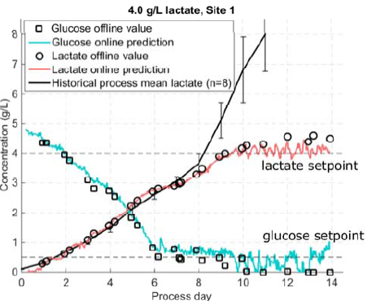
Raman based control strategies – titer increase
Automated control of lactate by restricted glucose feeding led to improvements in culture duration, viability, productivity, and robustness
Culture duration was extended from 11 to 13 days
Harvest titer increased 85% over the historical process
Automated Control Lactate via Restricted Glucose Feed
Increase in Culture Duration, Viability, Productivity and Robustness
Minimize
Waste
  Matthews, T. et al. (2016) “Closed loop control of lactate concentration in mammalian cell culture by Raman spectroscopy leads to improved cell density, viability and biopharmaceutical protein production”.
Copyright Kaiser Optical Systems, Inc. 2018
Notes:
Closed loop control scheme based on real-time Raman measurements of glucose and lactate concentrations to control glucose feed rate and lactate (regardless of stage).
Due to the minimization of waste accumulation via an optimized feeding strategy, culture duration was extended from 11 to 13 days leading to a demonstrated harvest titer increase of 85% over the historical process.
Product quality attributes were found to not be impacted by Raman controlled feeding scheme.
Online control of culture feed responded to an unexpected critical process deviation (oxygen depletion due to sparging line failure) in real time by limiting lactate accumulation by suspending glucose feeding.

Slide 30
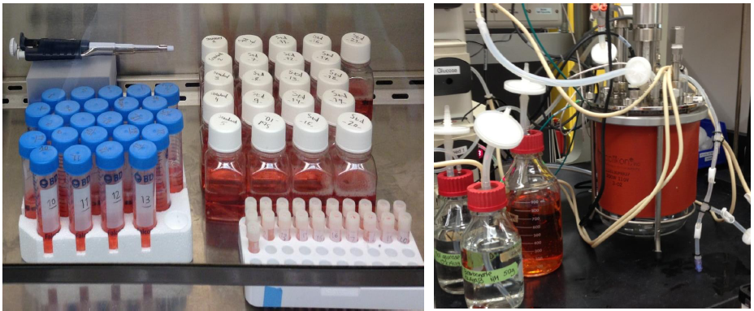

Raman flexibility in cell culture process development
  Generic Models demonstrated
  Models are generic, in the sense that they are applicable to various products, media, and cell lines based on CHO host cells, and are scalable to pilot and manufacturing scales.
Includes spectra of off-line spiked media samples and in-line bioreactor samples from various cell lines and media types
Mehdizadeh, H. et al. (2015) “Generic Raman-based calibration models enabling real-time monitoring of cell culture bioreactors”
Copyright Kaiser Optical Systems, Inc. 2018

Slide 31
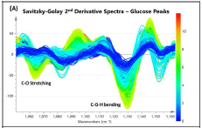
Raman flexibility in cell culture process development
  Generic Models demonstrated
  Models are generic, in the sense that they are applicable to various products, media, and cell lines based on CHO host cells, and are scalable to pilot and manufacturing scales.
Mehdizadeh, H. et al. (2015) “Generic Raman-based calibration models enabling real-time monitoring of cell culture bioreactors”
Copyright Kaiser Optical Systems, Inc. 2018

Slide 32
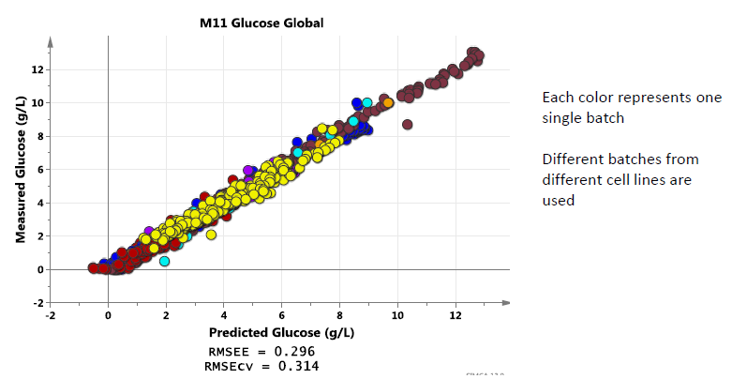
Raman flexibility in cell culture process development
  Generic Models demonstrated
  Models are generic, in the sense that they are applicable to various products, media, and cell lines based on CHO host cells, and are scalable to pilot and manufacturing scales.
Mehdizadeh, H. et al. (2015) “Generic Raman-based calibration models enabling real-time monitoring of cell culture bioreactors”
Copyright Kaiser Optical Systems, Inc. 2018

Slide 33
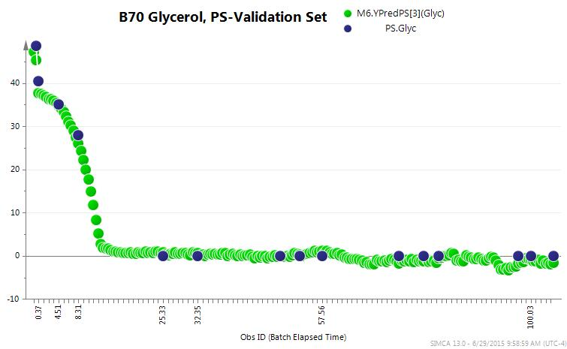
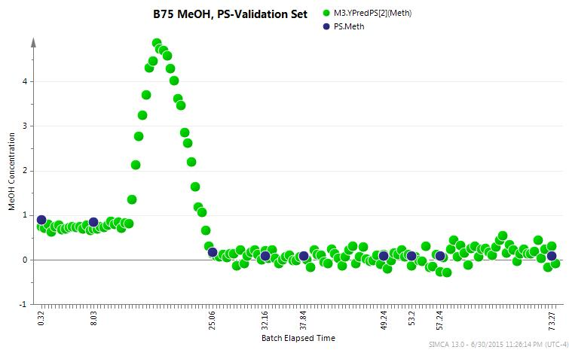

Raman flexibility in fermentation process development
  Monitored → optimized process parameters and environmental conditions in real-time within a series of fermentation batches for quality and productivity of protein expression
  Adopting developed models to generate Raman-defined design space for batch release
  Process changes were neither modified nor adapted for the Raman measurement
  Real-time CPPs measured: Glycerol, Methanol and Sorbitol
Process Variable Changes
Microbe strain (ex. productive, null)
Batch media composition (ex. additions/subtractions)
Feed mode and Total amount (amts. at certain times)
Feed components (both natural and synthetic)
Duration of Feed/Batch
Other parameters (pH, etc.)
Aon, JC et al. (2015) “In situ & Real-time Monitoring of Multiple Biochem. During Microbial PD Utilizing Raman Spectroscopy”
Copyright Kaiser Optical Systems, Inc. 2018

Slide 34
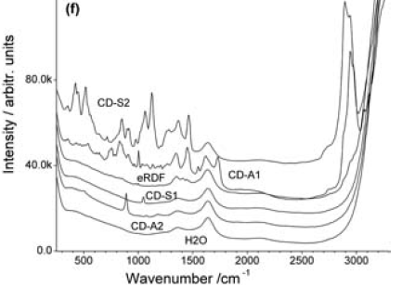
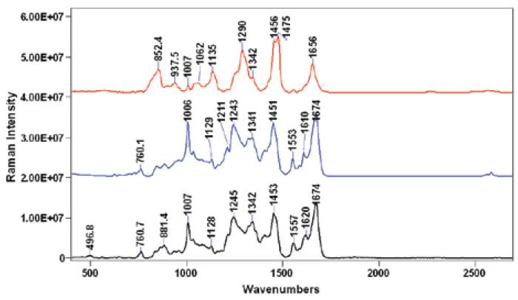
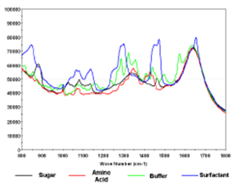
Additional bioprocess applications
Media
Proteins
Buffer Excipients
A typical Raman spectrum of protein/mAb provides valuable insight into:
Tertiary and secondary structure
Hydrogen bonding network
Side chain inter-actions of the protein molecule
Inter-molecular inter-actions
Copyright Kaiser Optical Systems, Inc. 2018

Slide 35
Additional bioprocess applications
Media
Proteins
Buffer Excipients
Boyan Li, et al. (2010) “Rapid Characterization and QC of Complex Cell Culture Media Solutions Using Raman Spectroscopy and Chemometrics”
Wen, Z., Cao, W., Phillips, J. 2010) “Application of Raman Spectroscopy in Biopharmaceutical Manufacturing”
Ram, N. et al. (2010) “Raman Spectroscopy for Purification Bioprocess Operations”
A typical Raman spectrum of protein/mAb provides valuable insight into:
Tertiary and secondary structure
Hydrogen bonding network
Side chain inter-actions of the protein molecule
Inter-molecular inter-actions
Copyright Kaiser Optical Systems, Inc. 2018

Slide 36
Additional bioprocess applications
Purification | Lyophilization
Aggregation | Forensic analysis
Determination of side chain conformations / protein conjugation reactions | Product identification and quantification
Post Transitional Modifications (PTMs) | Support real-time release
Critical process excipients | Quality control
A typical Raman spectrum of protein/mAb provides valuable insight into:
Tertiary and secondary structure
Hydrogen bonding network
Side chain inter-actions of the protein molecule
Inter-molecular inter-actions
Copyright Kaiser Optical Systems, Inc. 2018
Notes:
Purification
Testing/Release of Formulation Buffers
Quantitative Monitoring of Excipient and Protein concentrations in ultrafiltration/ diafiltration (UF/DF) operations
Determination and Quantification of Impurities
Raw Material ID of Stationary Phase Resins
Aggregation
Thermal Aggregation Investigations (effects of aggregation due to process conditions/variables)
Qualitative and quantitative analysis of aggregation pathways
Determination of side chain conformations / protein conjugation reactions
Post Transitional Modifications (PTMs)
Glycosylation Monitoring
Structural determination
Phosphorylation
Acetylation
Trimethylation
Ubiquitination
Critical Process Excipients
Qualitative and Quantitative Determination of Amino acids
Lyophilization
Including examination of polymorphism
Distribution and structure
Forensic Analysis
Contaminates and foreign particle identification
Unexpected residues
Drug counterfeits
Product identification
Quantification of Product Yield
Quality control

Slide 37
Recent Raman Technology Advances

Slide 38
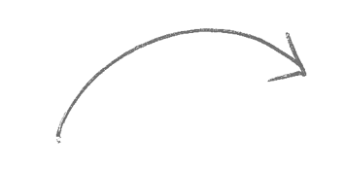
Components of successful Raman PAT
Identical Instrument Performance
Maximize Signal, Reduce Noise and Inefficiency
Hardware
Engineering
&
Production
Sampling
Interface
&
S/N
Representative Measurements &
Modeling
Calibration
&
Verification
Reproducible, Rugged, Robust Methods
Clone Instrument Response + Eliminate Error
Copyright Kaiser Optical Systems, Inc. 2018
Notes:
Add Animation

Slide 39
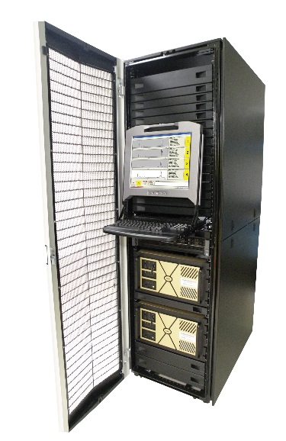
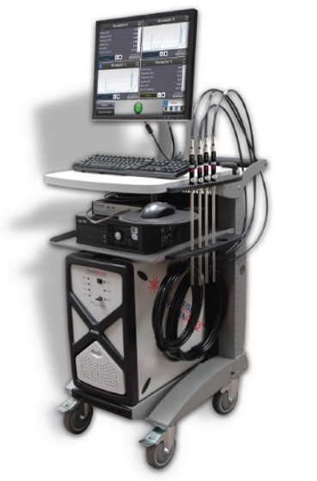
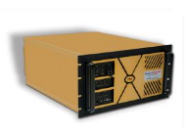
Location specific packaging
Same internal hardware, spectral response, and high performance
Benchtop
Cart Mounted
Rack mounted
Copyright Kaiser Optical Systems, Inc. 2018

Slide 40
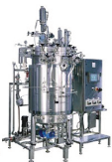
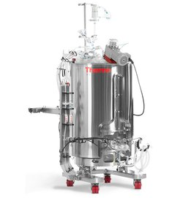

Bioprocess specific probes
same optical interface and quality spectra, optimized for each scale
Benchtop
Pilot & GMP
Single-use
Copyright Kaiser Optical Systems, Inc. 2018

Slide 41



Bioprocess specific probes
same optical interface and quality spectra, optimized for each scale
Benchtop
Pilot & GMP
Single-use
Copyright Kaiser Optical Systems, Inc. 2018

Slide 42

Data is transferable between single-use and multi-use Kaiser Raman Probes
Spectra from single-use probes are identical to spectra from reusable probes for benchtop and stainless steel bioreactors
This enables easy transfer of Raman methods across various platforms and scales
-- Disposable probe for SUB
-- Reusable probe for benchtop or stainless steel reactors
1st derivative
1%, 5%, 10%, 15% glucose in water standards
Copyright Kaiser Optical Systems, Inc. 2018

Slide 43










Software for development through production
same user interface, easy integration to existing controls
Basic bioreactor control
Advanced process control
PAT platforms
Multivariate analysis
Data historians
Benchtop
SUB - PD & GMP
SS - Pilot & GMP
Copyright Kaiser Optical Systems, Inc. 2018

Slide 44







Kaiser Raman Technology: From Discovery to Production
Discovery Research
Process
Development
Manufacturing
Product
Development
Process
50l. +
Lab-scale
0.5 – 5l.
Pilot-scale
10-50l.
Copyright Kaiser Optical Systems, Inc. 2018
Notes:
SIG slide

Slide 45
Bioprocess Raman PAT opportunities
One Probe, Multiple Real-Time Bioprocess Measurements
Cell Culture
Glucose
Glutamine
Glutamate
Lactate
Ammonium
Osmolality
VCD
Viability
Titer
Additional amino acids
Fermentation
Glucose
Optical Density/Biomass
Sugars/Sugar Alcohols (MeOH, EtOH, Glycerol, Maltose, Maltotriose, DP4+, etc.)
Starch sum
Purification
mAb
Aggregation
Structure and Functionality
Sugar
Buffer
Amino acids
and more…
Additional product and process related CQAs demonstrated in literature
Copyright Kaiser Optical Systems, Inc. 2018
Notes:
Add Picture

Slide 46

Summary
  Raman offers the ability to transfer with a new material from R&D to manufacturing
  Raman is a uniquely suited spectroscopy for bioprocess PAT, with many benefits being realized by biopharmaceutical manufacturers
  In situ, real-time Raman allows for improved bioprocesses to make a quality product consistently and efficiently
Copyright Kaiser Optical Systems, Inc. 2018
Notes:
Interchangeable sampling probes extend utility of an analyzer and enable plug and play changes in applications.

Slide 47
Summary
  Raman offers the ability to transfer with a new material from R&D to manufacturing
  Raman is a uniquely suited spectroscopy for bioprocess PAT, with many benefits being realized by biopharmaceutical manufacturers
  In situ, real-time Raman allows for improved bioprocesses to make a quality product consistently and efficiently
“Implementation of QbD and PAT could revolutionize the way biopharma industries operate”
Kizhedath, A. European Pharmaceutical Review (2018) Vol 22:6
Copyright Kaiser Optical Systems, Inc. 2018
Notes:
Interchangeable sampling probes extend utility of an analyzer and enable plug and play changes in applications.

Slide 48



The Kaiser Difference – not all Raman is created equal
History of Process Raman leadership, expertise, innovation, and reliability for 30+ years
20+ years proven solutions in GMP -- Proven compliance, calibration transfer, and up time
A future powered by investment and growth via recent acquisition from Endress + Hauser, the People for Process Automation
We are Global -- teams of Raman and Process Automation experts Worldwide
  Recently received the 2017 Advancement of Upstream Bioprocessing Award by a leading bioprocessing publication
    For Kaiser’s excellence in performance, innovation, and customer feedback
Visit booth #232 (Carotek, local Kaiser Raman reps) to learn more about the Kaiser difference
Copyright Kaiser Optical Systems, Inc. 2018

Slide 49
Acknowledgements
Kaiser Optical Systems:
Dr. Ian R. Lewis, Dr. Sean Gilliam, Dr. Karen A. Esmonde-White, Dr. Patrick Wiegand, Dr. David Strachan, Dr. Yong Yang, Jeremy Linoski, Lisa Ganster, Dr. Bruno Lenain, Alexander Pitters, Dr. Carsten Uerpmann, Dr. Hervé Lucas
Collaborators and customers:
Polymer, petrochemical, pharmaceutical and bioprocessing fields
Thank you! Any questions? Maryann.Cuellar@kosi.endress.com
Copyright Kaiser Optical Systems, Inc. 2018

