Slide 1
Cleanroom Best Practice: Disinfectant Rotation and Residue Removal
ISPE CaSA
2018
Case Study: Introduction of Detergents in Disinfectant Program

Slide 2
Introduction
Aaron Mertens
Technical Service Specialist
STERIS Corporation | Life Sciences
Mobile: 440-530-0060
E-Mail: Aaron_Mertens@steris.com
Web: www.sterislifesciences.com
STERIS Technical Services

Slide 3
Introduction
Angela Swain
QA Manager
Patheon Manufacturing Services, LLC
Phone: 252-707-2219
E-Mail: Angela.Swain@patheon.com

Slide 4
Cleanroom Best Practice:
Disinfectant Rotation and Residue Removal in the Cleanroom
To provide an overview of recommended practices for disinfectant use and residue removal in the cleanroom environment.

Slide 5
Case Study: Introduction of Detergents in Disinfection Program
To demonstrate the advantages of routinely
using detergents to enhance the cleaning and
disinfection program.

Slide 6
“Disinfectants” - Background

Slide 7
EPA Classification
Three antimicrobial groups:
Sanitizer
Disinfectant
Sterilant

Slide 8
Sanitizer
Reduces but does not necessarily eliminate all microorganisms on a surface.
Minimum 99.9% reduction of each test organism.
Used on pre-cleaned surfaces

Slide 9
Disinfectant
Kill or inactivate disease producing microorganisms on inanimate objects
Proper use results in 100% kill of vegetative bacteria, target viruses and target fungi
  4 Log reduction of bacteria
  3 Log reduction of viruses
  6 Log reduction of fungi
May or may not require pre-cleaning

Slide 10
Sterilant
Proper use results in 100% kill of all microorganisms, including bacterial spores (B. subtilis, C. sporogenes)
6-7 Log reduction
Always requires precleaning

Slide 11
Chemical Types
Alcohols
Phenolics
Quaternary Ammonium Chloride Compounds
Peracetic acid / Hydrogen peroxide blends
Sodium hypochlorite
Chlorine dioxide
Hydrogen peroxide
Peracetic acid
Ozone
Biguanides
Iodine Products
Glutaraldehyde / Formaldehyde
Sodium Hydroxide
Alcohols
Phenolics
Quaternary Ammonium Chloride Compounds
Peracetic Acid / Hydrogen Peroxide Blends

Slide 12
Disinfectant Rotation

Slide 13
Why do we rotate?
Rotation of a disinfectant and a sporicide helps ensure bacterial spores do not take hold in manufacturing and aseptic areas.
Regulatory expectations (FDA, MHRA, EU)
USP 38 <1072>, PDA Technical Report

Slide 14
PDA Technical Report No. 70
“All rotation systems should be evaluated via the use of area classification, environmental monitoring data, and/or risk assessment.”
Section 10, 11 Pages 36 and 38

Slide 15
Rotation Guidance
PDA TR 70
  “Given this knowledge, the pharmaceutical and biotechnology industries have moved away from the rotation of two disinfecting agents. This formerly common practice led to high residue levels and subordinate efficacy performance. Today most firms use a system whereby a disinfectant is rotated with a sporicide to more effectively reduce the bioburden levels. The rotation of a disinfectant with a sporicide is superior to the use of rotations of multiple disinfectants.”

Slide 16
What is rotation?
Alternation of antimicrobial actives
  Two disinfectants in sequence, regular rotation, with sterilant as needed
  One disinfectant daily, with sterilant weekly, monthly, or quarterly or as needed

Slide 17
Sterilant Application
Frequency Rationale
  Spore control vs. chemical exposure
  Corrosivity and Irritation
Sporicidal agent
  Rationale (environmental monitoring)
  Weekly, monthly, quarterly
  Should be specified in SOP’s

Slide 18
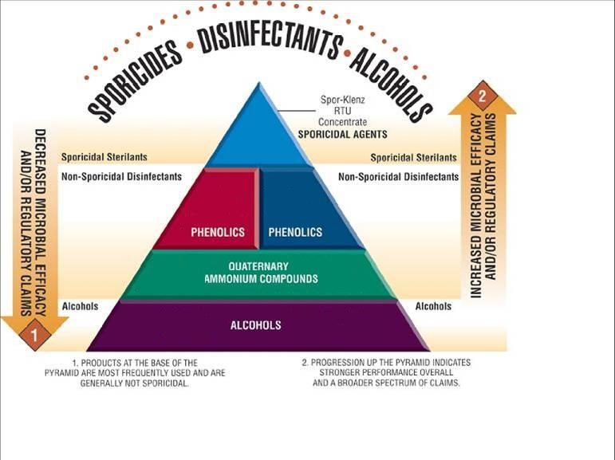

Slide 19
Residue Removal

Slide 20
Residue Removal
Maintain surfaces in the cleanroom by periodically removing residue from the surfaces.
The presence of residue may:
impact disinfectant effectiveness
hide microbial contamination
contaminate environment and/or product
be an aesthetic issue
create a particulate issue

Slide 21
Residue Removal Strategy
Where does the residue come from?
Product, process residue
Sanitizers, disinfectants, sporicides
Existing cleanrooms that may have never had a rinsing program
Implementing a rinsing program in a new cleanroom environment
Addition of a detergent to enhance the disinfection program

Slide 22
PDA TR No. 70
“Irregular or porous surfaces trap residues and other contaminants and make the surface more difficult to clean and disinfect. Development of appropriate cleaning systems is critical to successfully preparing a surface for disinfection. Cleaning operations should routinely occur and frequencies should be based on area classification, usage, risk and visible cleanliness. A good cleaning agent is formulated to contain an effective surfactant system that will support the water in its efforts to release particles, residues and other foreign materials. Procedurally, strict cleaning (without the use of a sanitizer, disinfectant or sporicide) should be conducted on a routine basis as defined by written procedures.”

Slide 23
Rinsing Frequency
Guidance USP 39 <1072>
70% IPA or Water for Injection
Detergents (Acidic, Neutral, Basic)
As needed to control residue
  Aesthetic
  Safety Risk (Sticky, Tacky, Slippery)
  Particulate Issues
  Functional
  Microbial Issue (Hiding Microbes & Food Sources)
  Product risk (Flaking of residues into filled products)

Slide 24
Recommendations
Routine Residue Removal
  Water For Injection
  70% Isopropanol, 70% Ethanol
  3% H₂O₂
  Detergents

Slide 25
Contamination Control Program Recommendation
  Rotation: Disinfectant and Sterilant Program
    Disinfectant - Phenol or Quat
    Sporicide
    Frequency established using risk based approach and adjusted based on environmental trending data
  Residue Removal Program:
    WFI or 70% Alcohol on a routine basis
    Detergent to enhance disinfectant program
    Frequency based on surface aesthetics

Slide 26
Best Practice Conclusion

Slide 27
Resources
Disinfectant Rotation:
Technical Tip 420-200-4002, “A Rational Approach to Alternating (Rotating) Disinfectants in Pharmaceutical, Biotech and Medical Device Cleanrooms”
Residue Removal:
Technical Tip 420-200-4038, “Residue Removal Recommendations for Hard-Surface Germicidal Agents used in Critical Environments”
Case History 420-500-4001, “Cleaning Floors in Cleanrooms with ProKlenz NpH Neutral Detergent”
General Disinfection:
Technical Tip 420-200-4001, “Product Property Charts for STERIS Sanitizers/Disinfectants and Sterilants”
Technical Tip 420-200-4014, “Disinfectant Application Guidelines for Cleanrooms and Controlled Environments”
Technical Tip 420-200-4021, “Survey of Disinfectant Usage in Parenteral Facilities”

Slide 28
References
USP 39 <1072> Disinfectants and Antiseptics
PDA Cleaning and Disinfection TR No. 70 (2015)
Annex 1 (2008) and MHRA Orange Guide (2016)
FDA Aseptic Processing Guide (2004)
FDA, MHRA, HPRA, CFDA, ANSM, ANVISA, & EMA Expectations
Industry Articles (Ex. Scott Sutton, Jose Martinez, Richard Prince, Rebecca Smith, Tim Sandle)
The CDC Handbook - A Guide to Cleaning & Disinfecting Cleanrooms (Tim Sandle 2016)
A Guide to Disinfectants and their use in the Pharmaceutical Industry (Pharmig 2006)
USP 39 <1116> Microbiological Control and Monitoring of Aseptic Processing Environments
PIC/S Guide to Good Practices for the Preparation of Medicinal Products in Healthcare Establishments (2014)
WHO Annex 6
PHSS Technical Monograph #20 “Bio-contamination characterization, control, monitoring and deviation management in controlled/GMP classified areas
USP 39 <797> Pharmaceutical Compounding-Sterile Preparations

Slide 29
Thank you!
Audience
ISPE CaSA Chapter
Angela Swain - Patheon

Slide 30

PATHEON
CASE STUDY Introduction of Detergents in Disinfectant Program
A HEALTHIER WORLD. DELIVERED
©2015 PATHEON®

Slide 31
Why Use Detergents in an Environmental Cleaning Program?
Clean surfaces to remove:
        - product
        - protein
        - residue
        - etc.
Increases efficacy of disinfectant solutions

Slide 32
How Detergents increase the efficacy of Disinfectants?
Contains a surfactant and may have oxidizing agents or other performance-enhancing ingredients
Surfactants (Surface Active Agents) are chemicals, when dissolved, orient themselves at the interface between the liquid and a solid (residue) and modify the properties of the interface; thereby reducing the surface tension to allow removal

Slide 33
Change Control initiated to introduce cleaning agents and cleaning materials to the Greenville Sterile facility
Assess new tools, methods, and cleaning agents for safety/ergonomics
Assess effectiveness tools, methods, and cleaning agents
Update procedures
Perform Disinfectant Efficacy Study
Obtain MSDS for new cleaning agents
Create new material numbers for receipt of new cleaning agents
Evaluate new tools related to steam sterilization

Slide 34
Greenville, NC - Site Environmental Cleaning Program (2011)

Slide 35
Environmental Cleaning Program Enhancements (CTM)
Techniques
Tools
Disinfecting Solutions
Cleaning Solutions

Slide 36
Implementation for Assessment (CTM)

Slide 37
Quality Assessment (CTM)
Technique
Tools
Visual Residue
EM Data

Slide 38
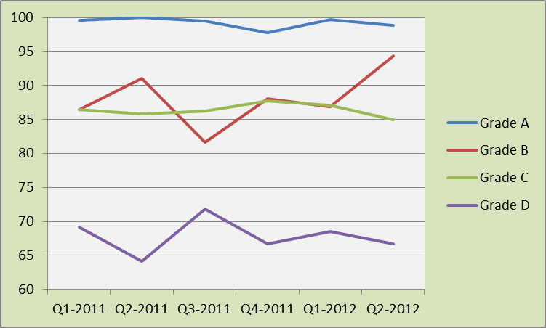
Trend Data from Assessment – CTM Area

Slide 39
July 2012 Enhanced Cleaning Program Implemented for Facility
Production areas assessed for additional cleaning/disinfection tools
Cleaning procedures updated
Operators trained

Slide 40
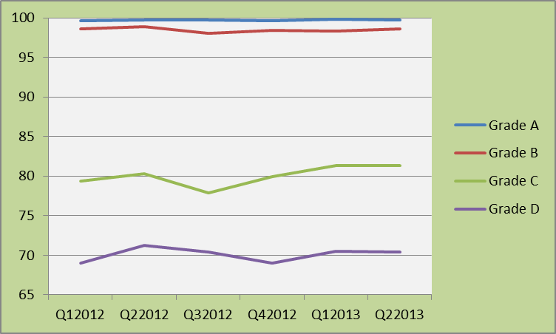
EM Data for Sterile Facility

Slide 41
Effectiveness of Implementation and Continued Improvement
Reduction of visual residue
Right Tools
Increase operator knowledge
Improved procedures
Development of On-The-Job Training Documents
Quality on the Floor

Slide 42
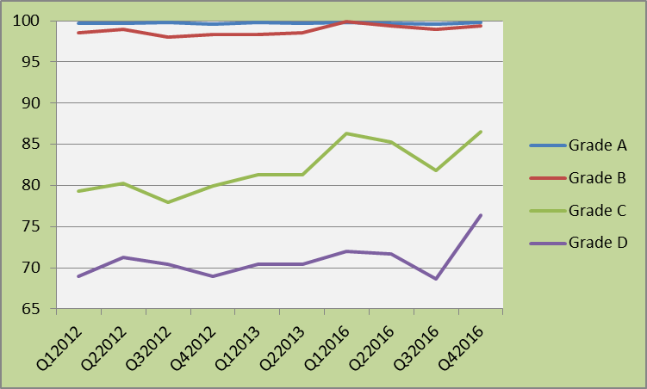
Environment - Then and Now

Slide 43
Thank You

