Slide 1
Energy Resilience for Grifols When Is Enough… Enough?
Roger Paules, Marketing Manager, Duke Energy
Brian Cail, Project Manager, Duke Energy
Glen McVay, Principal Engineer, Grifols
March 13th, 2018

Slide 2
Learning Objectives
Understand Your Processes
Identify Critical Loads
Design Protection Systems
Built for Current Needs
Designed for Future Needs
Regular Testing to Assure Reliability

Slide 3
Grifols Overview
A Spanish Healthcare Company with Global Reach Serving Patients in Over 100 Countries
Grifols first conducted business in the U.S. in the 1960s via partnership with the American Hospital Supply Company - one of the largest producers of medical supplies at that time.
Grifols’ first major asset acquisition in the U.S. was in 2002. The company has since invested over $9Bn in manufacturing, research, facilities and other infrastructure in the U.S.
The U.S. is home to more than 13,000 Grifols employees. Grifols has 18,300 employees worldwide.
In 2017, 67.1% of total revenues were attributed to sales in N.A.
The U.S. is also home to four major manufacturing sites, two state-of-the art testing laboratories and over 190 plasma donor centers across 33 states.

Slide 4
Since 1940, Grifols has been committed
to producing essential plasma-derived medicines for patients and to providing hospitals, pharmacies, and healthcare professionals with the tools, information and services they need to deliver expert medical care.
Grifols is a global healthcare company whose mission is to improve the health and well being of people around the world.

Slide 5
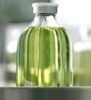
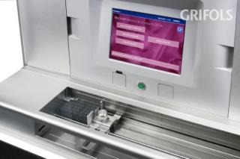
Business Divisions & Engineering
Grifols has three primary business divisions that develop, produce and deliver products and services to patients and medical professionals around the world.
Grifols Engineering provides custom technologies and equipment for our manufacturing facilities and provides consulting services throughout the industry.
Grifols Bio Supplies division supplies biological products and raw materials to third parties.
Bioscience Division
Plasma-derived therapies
Diagnostic Division
In vitro diagnostics, analyzers and reagents
Hospital Division
Hospital logistics, IV solutions, medical devices
Hospital Division
Hospital logistics, IV solutions, medical devices
Grifols Engineering
Engineering and technology production
Bio Supplies Division
Supplier of biological products & raw material

Slide 6
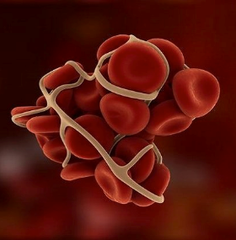
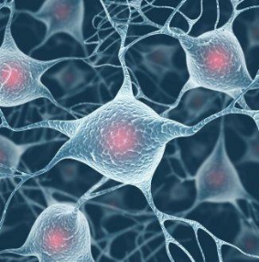
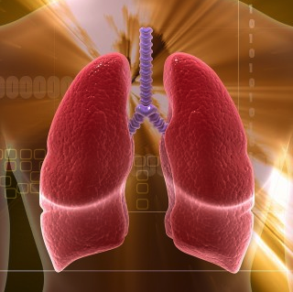
Recipients of Plasma Medicines
Primary Immune Deficiency
Body’s immune system does not function properly.
Estimated to affect 1 in every 1,200 people
Hemophilia
Missing or defective proteins, preventing the blood from clotting properly.
Estimated to affect 1 in every 5,000 live births
CIDP
Peripheral nerve disorder resulting in increasing sensory and motor loss.
Estimated to affect 1.5 – 3.6 people/million
Alpha-1 Antitrypsin
Deficiency
Form of genetic emphysema leading to irreversible lung deterioration.
Estimated to affect 1 in every 2,500 people

Slide 7
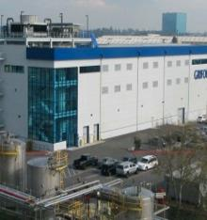
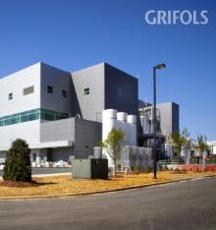
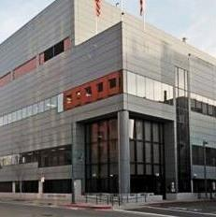
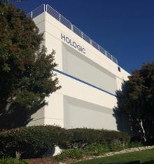
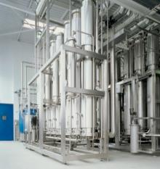
State-of-the-Art Manufacturing
LOS ANGELES
California
CLAYTON
North Carolina
EMERYVILLE
California
The geographic diversity of our manufacturing sites helps to ensure an uninterrupted supply of products.
Our state-of-the-art facilities provide the flexibility, capacity and expertise essential to maintaining access to products for health providers and patients around the world.
SAN DIEGO
California
PARETS DEL VALLÈS
Spain
MURCIA
Spain

Slide 8
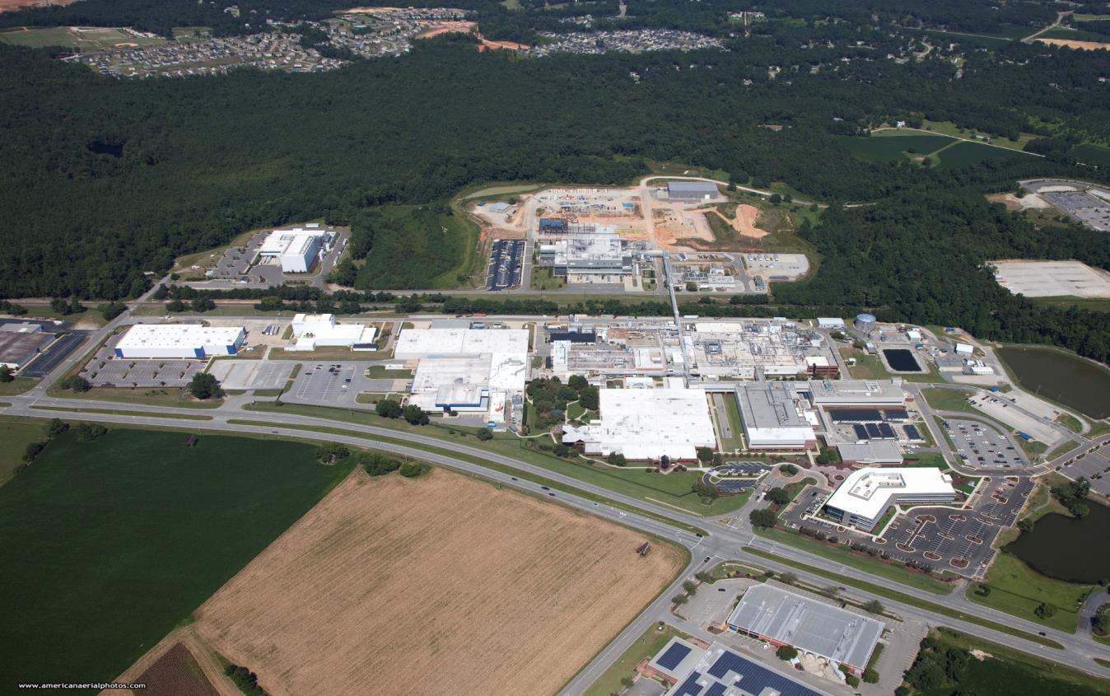
Clayton, North Carolina

Slide 9
Clayton Site
In Operation Since 1974 (Cutter Laboratories)
Original 242 acres of property, New Land Acquisition of 467 additional acres
Approximately 1,650 employees at Clayton (operations and support)
Operates 365 days a year, 24 hours a day, 7 days a week

Slide 10
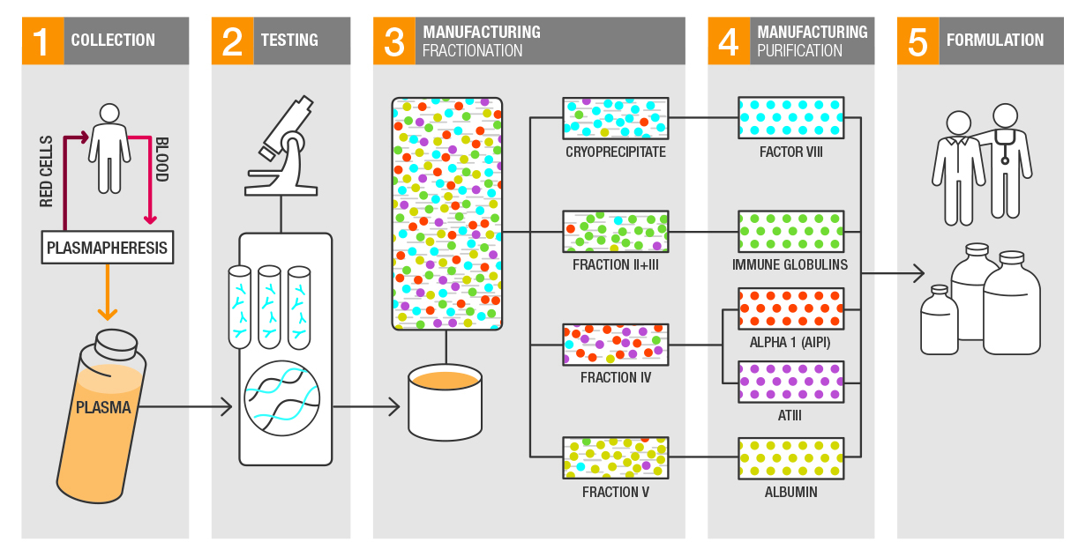
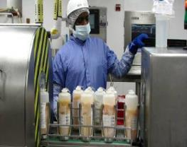
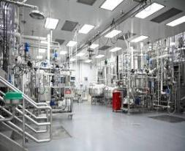
FRACTIONATION/PRODUCT MANUFACTURING PROCESS IN CLAYTON

Slide 11
Why Power is Critical to Grifols
Life saving therapies manufactured at the Clayton site 24/7.
There are only a few plasma companies in the world that produce these products.
Plasma is major raw material and a precious resource which must be stored at NLT -20°C.
Each in-process batch can be worth up to $2mm. Deviations in temperature, area classification, processing steps/specifications can result in their loss.
Critical systems include: Processing equipment, controls, high purity water, HVAC, refrigeration, solvent recovery, compressed gases, waste treatment, life safety, etc.
Short duration outages (<1 second) cause significant manufacturing disruptions.
Longer outages could result in loss of raw material, in-process materials, and final product.
Notes:
Source: Advanced Energy Corporation, Grifols Plant Visit Report Final Mike Stowe 11.14.2017, slide 24

Slide 12
Why Backup Systems?
North Carolina Service Regulations - The Company does not guarantee continuous service. It shall use reasonable diligence at all times to provide uninterrupted service, and to remove the cause or causes in the event of failure, interruption, reduction or suspension of service, but the Company shall not be liable for any loss or damage to a customer or customers resulting from such failure, interruption, single-phase condition, reduction or suspension of service which is due to any accident or other cause beyond its control, or to any of the following:
An emergency action due to an adverse condition or disturbance on the system ….
An Act of God, or the public enemy, or insurrection, riot, civil disorder, fire, or earthquake, …
Making necessary adjustments to, changes in, or repairs on its lines, substations, and facilities, and in cases where, in its opinion, the continuance of service to Customers’ premises would endanger persons or property.
Uptime Institute - Disruptions to the utility power are not considered a failure, but rather an expected operational condition for which the site must be prepared.

Slide 13
Levels of Criticality @ Grifols
1.) Normal
a. Normal utility feeder
2) Essential
a. Normal utility feeder
b. Alternate utility feeder
3) Critical
a. Normal utility feeder
b. Alternate utility feeder
c. Central diesel generation to the alternate distribution system
4) Super Critical
Normal utility feeder
Alternate utility feeder
Central diesel generation to the alternate distribution system
Local diesel generation connection capability
Non-electric backup (Liquid Nitrogen)

Slide 14
Example: Power Requirements for Plasma Logistics Center (PLC)
PLC is a nine story -35°C Plasma Storage Facility
There are five energy sources to protect loss of product:
Two normal feeder sources from Duke Energy
One alternate feeder source from Duke Energy
Central backup generation for the alternate feeder loop
Grifols owned backup generation at strategic areas
Liquid nitrogen at strategic location (PLC)

Slide 15
Grifols Therapeutics LLC, Clayton North Carolina
Normal Feeder Capacity 36 MW
Peak Demand > 20MW (Normal Power)
Alternate Feeder Capacity 18 MW
Emergency Generation 9.25 MW
Load Shed System
Auto load shed based on user requirements
Auto load control based on generator availability
Auto transfer back to Normal / Alternate sources

Slide 16
Clayton Industrial Substation
Grifols Load Control System
North Plant Delivery (24 kV)
Bank 2, 40 MVA
Main Campus Delivery (24kV)
Milburnie 115 kV line
Alternate Feed, 24 kV
Selma 115 kV line
Bank 1, 40 MVA
APS
G
G
G
G

Slide 17
Grifols Power Management System
Notes:
To protect your critical systems during times of utility power loss, Duke Energy Progress offers Premier Power Service, a backup power solution with an emphasis on reliability. With required equipment owned by Duke Energy Progress, you are free of the obligations of ownership, such as maintenance, repair, permitting and fueling. From design and installation through day-to-day operations, we take care of your backup generation needs for a single monthly fee.

Slide 18
Premier Power Service
This is a filed tariff listed with our other rate schedules; i.e., http://bit.ly/2t1cf7o
Min size is 50 kW and Max size per site is 18 MW
Monthly Services Payment = Capital Cost + Expenses
Capital includes generators, paralleling gear, transformers, power lines, switchgear, etc.
Expenses include maintenance, fuel, etc.
Notes:
This came from the DEP PPS web content and Brian Cail says that it is not correct.
To protect your critical systems during times of utility power loss, Duke Energy Progress offers Premier Power Service, a backup power solution with an emphasis on reliability. With required equipment owned by Duke Energy Progress, you are free of the obligations of ownership, such as maintenance, repair, permitting and fueling. From design and installation through day-to-day operations, we take care of your backup generation needs for a single monthly fee.

Slide 19
Custom Outsource Solution
Custom Solution
Vendor Neutral
One stop for
Design, Permitting, Construction, Commissioning
Testing, Fueling, Maintenance & Repairs
Notes:
Our technical experts review your applications’ backup needs and your site requirements to custom-design your Premier Power Service system. We assess the level of power protection your facility needs to remain continuously productive and carefully select vendor-neutral equipment to create your integrated system. All construction activities are managed by Duke Energy Progress, including the securing of all necessary emission, fuel, electric and construction permits.

Slide 20
Generation Design
We used advanced paralleling switches
If an outage is sensed load is transferred in 30 seconds or less
We can design for 10 second startup for life safety loads
Our standard design for fuel storage is 24 hours at full load which typically will give you more than 24 hours at actual load.
When utility power is restored, the APS automatically returns the load to the utility source.
Notes:
We design your Premier Power system to transfer your critical load as quickly as possible during times of outage.
Installations generally include an outside generator supported by an advanced paralleling switch (APS). Critical loads are segregated on the circuit, with the APS functioning as the source selector for power. At a minimum, the APS monitors the incoming utility power, and if it senses a power failure, it signals the backup generator, which will pick up the critical load in 30 seconds or less. (We can design for 10 seconds start up for life safety but this adds to cost and complexity.)
The backup generator, depending on the amount of fuel available on site, can support the load for hours, even days. Our standard design for fuel storage is 24 hours at full load which typically will give you more than 24 hours at actual load. When utility power is restored, the APS automatically returns the load to the utility source.
The advantage of APS vs. ATS is that we can run in parallel for testing.

Slide 21
Monitoring System
Installations include a permanent power quality monitor with independent communications capability. When it detects potential abnormalities and other monitored alarm conditions, it reports them both to on-call personnel and to a centralized 24/7 control center.
Our SCADA system monitors hundreds to thousands of points depending on the system and automatically email / text messages any detected anomalies to qualified staff.
At Grifols, the generator system is further integrated with Grifols load shedding system.
Notes:
DEP has a true SCADA system and monitors thousands of points and alarm as fast a 1 millisecond.

Slide 22
Testing
Weekly generator(s) are started, synced with the utility feed, and gradually assume load, while remaining in parallel with the utility.
In the unlikely event of a generation failure during testing, the generation trips off-line, while the utility feed remains operational. No disruption to the customer electrical system is seen.
Duke personnel are automatically notified, and technicians are dispatched to resolve the issue.
Notes:
The Premier Power system is automatically tested once/week. The generation system is started, synced with the utility feed, and gradually assumes load, while remaining in parallel with the utility grid. In the unlikely event of a generation failure during testing, the generation trips off-line, while the utility feed remains operational. No disruption to the customer electrical system is seen. Duke personnel are automatically notified, and appropriate technicians are dispatched to resolve the issue.

Slide 23
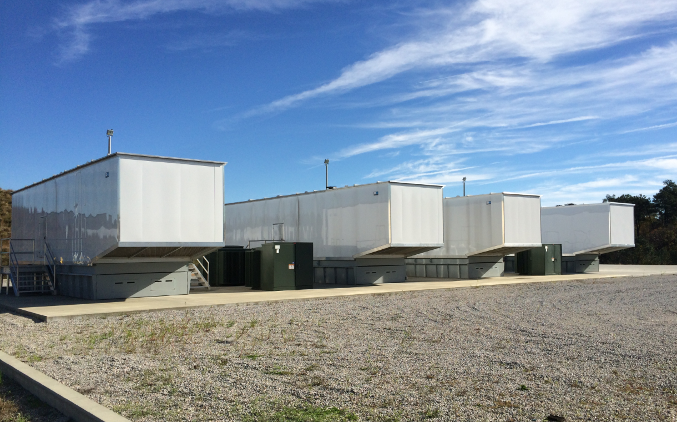
3–2250 kW and 1-2500kW Caterpillar generators owned by Duke Energy Progress.
(Space for 2 more generators with conduit in the ground.)
Notes:
Photo provided by Brian Cail, Duke Energy, Energy Services. Taken during the installation of the fourth gen set.

Slide 24
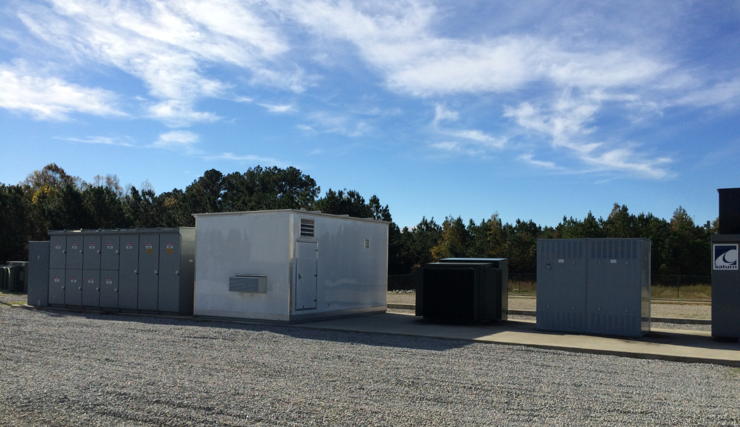
Pad TX (background), Medium Voltage Switchgear (gray), control room (white), Pad mount TX for load bank (also a spare tx), load bank control breakers and temp. generator connection point), 2.5 MW load bank (at the far right) which is only used for non-std. testing & trouble shooting.
Notes:
Photo by Brian Cail, Duke Energy, Energy Services

Slide 25
Crisis Management Principles (Source: NC BIO, Crisis Management Summit, 4.25.2017)
Crisis management seeks to prevent or lessen the negative outcomes of a crisis and thereby protect the organization, stakeholders, and industry from harm.
Interrelated factors:
Preparation/Prevention
Response
Recovery
Notes:
Themes from the NC BIO, Crisis Management Summit, 4.25.2017

Slide 26
Prepare
Identify priority and most likely scenarios and develop plans to address them
Account for low probability/high consequence situations
Prepare to address community upheaval and new or renewed government scrutiny
Implement a crisis training program
Test preparation for a crisis with drills or simulations
Notes:
Themes from the NC BIO, Crisis Management Summit, 4.25.2017

Slide 27
Respond
Grifols monitors process loads and load shed availability real time.
Critical information from the Duke generator fleet is fed into Grifols Load Control System to assure continuity at all times of critical loads.
Grifols Load Control System transfers critical loads to backup generation in <3 minutes from loss of power by block loading the generators to control load additions.

Slide 28
Summary
Emergency Preparedness and Response is a cooperative effort between Grifols and Duke Energy.
Partnering with Duke Energy made sense due to their ability to own and maintain the fleet of generators and integrated it into the electrical distribution system.
Grifols load control system assures that the critical loads will always be operational while reducing the need for even more backup generators.
Grifols was awarded “2017 Duke Energy Power Partner Award” for Solution Innovation

Slide 29
Questions ?

Slide 30
Thank you for attending
Need more help?
Contact us at
800.288.6807 or
Energyandmore@duke-energy.com
Powering your pharmaceutical success
Notes:
Roger

