Slide 1
Changing development & manufacturing paradigms in lyophilization through application of predictive process modeling
Jamie Sigmon
Suresh Nulu
ISPE CaSA Technology Conference · March 13, 2018

Slide 2
Overview
Intro to lyophilization
Paradigm shift: current state vs. new state
Mathematical basis for process modeling
Experimental heat transfer studies
Application and verification of the modeling tool
Cross-functional collaboration
Q&A

Slide 3
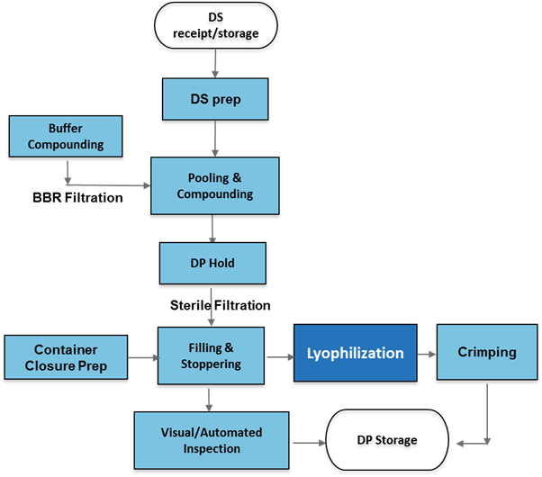
Drug product process overview

Slide 4
Why lyophilize?
Lyophilization is used to remove liquid from a formulation at low temperatures through the process of sublimation
Advantages to lyophilization:
Extend shelf life
Increased flexibility
(eg. reconstitution volume, concentration)
Minimize cold chain
Product A Before and After Lyophilization
Biogen RTP Optimization Cycles

Slide 5
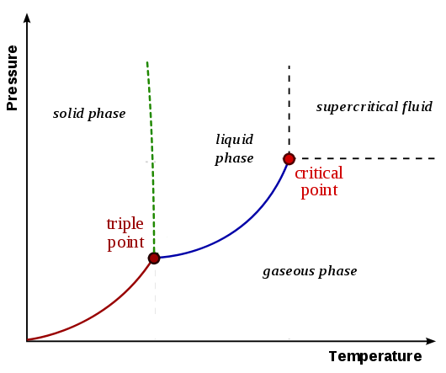
Lyophilization basic principle
The freeze drying process involves freezing a product and then placing under a vacuum, allowing the ice to change directly from solid to vapor without passing through a liquid phase
Under atmospheric pressure, ice converts to liquid (melting) when temperature increases
Freezing
Under low pressure, ice converts to gas when temperature increases
2. Sublimation
Notes:
Phase diagram of water

Slide 6
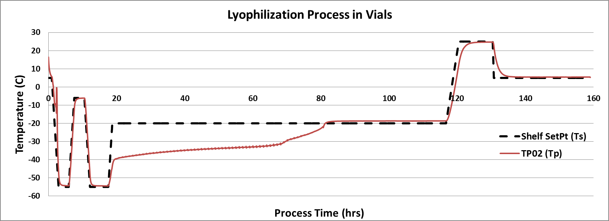
Lyophilization Process Overview
1
2
3
Freezing and Annealing
Primary Drying
Secondary Drying
Freezing
Sublimation
Desorption
Stochastic in nature
Physics well understood
Physics well understood
Primary drying is the longest step in a lyophilization process. Since the physics are well understood, we can apply modeling to enhance process knowledge and improve efficiency.
Notes:
Primary drying longest portion of the lyo process. Bulk of moisture is removed here.
Physics are well understood so apply model to better understand and improve efficiency
Other models for secondary drying and sometimes annealing/freezing. We will not discuss these here.

Slide 7
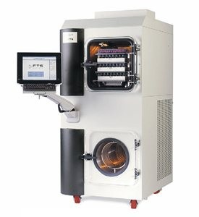
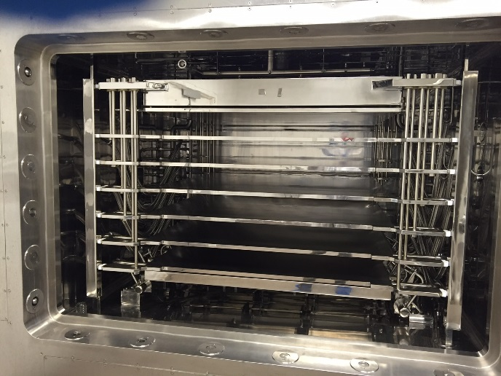
The Scale-Up Challenge
Development Scale
Commercial Scale at Biogen DP Site
19X
Total Shelf Area: ~ 4.6ft² (0.43m²)
Capacity: ~ 500 10R vials
Total Shelf Area: ~ 86ft² (8m²)
Capacity: ~ 13000 10R vials
Freeze dryers differ quite a bit between scales,
both in capacity and design
Notes:
Lab scale is the size of a normal home refrigerator.
Compare to manufacturing scale – about the size of a small meeting room.

Slide 8
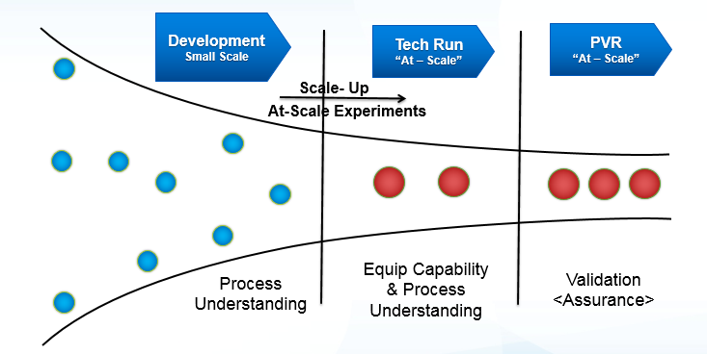
Current Development Paradigm:
Process understanding is achieved by collecting data at all scales using experiments
Notes:
Trial and error at scale – expensive and time consuming
At a CMO –
Time, scheduling, materials, protocols, data collection, analytical testing, etc.
Could cost upwards of $500,000 for a single development run at scale

Slide 9
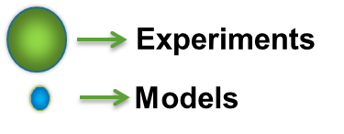
New Paradigm:
Leverage predictive models to minimize/eliminate experiments “at-scale”
Comprehensive Development
Small Scale
Pilot Scale
At Scale (Predictive Models)
At Site Verification
PVR
“At – Scale”
Scale- Up
Predictive Models
?
1
2
3
Increased Predictive Capability
Increased Process Understanding
Increased Assurance of At-scale Parameters
No “At-Scale” Development =
Notes:
More process understanding
Savings of time, money
Use high fidelity predictive models in lieu of experiments
Need high confidence in models to replace experiments
Most predictive and accurate models are 1st principle models
Derive from heat/mass transfer equations for sublimation

Slide 10
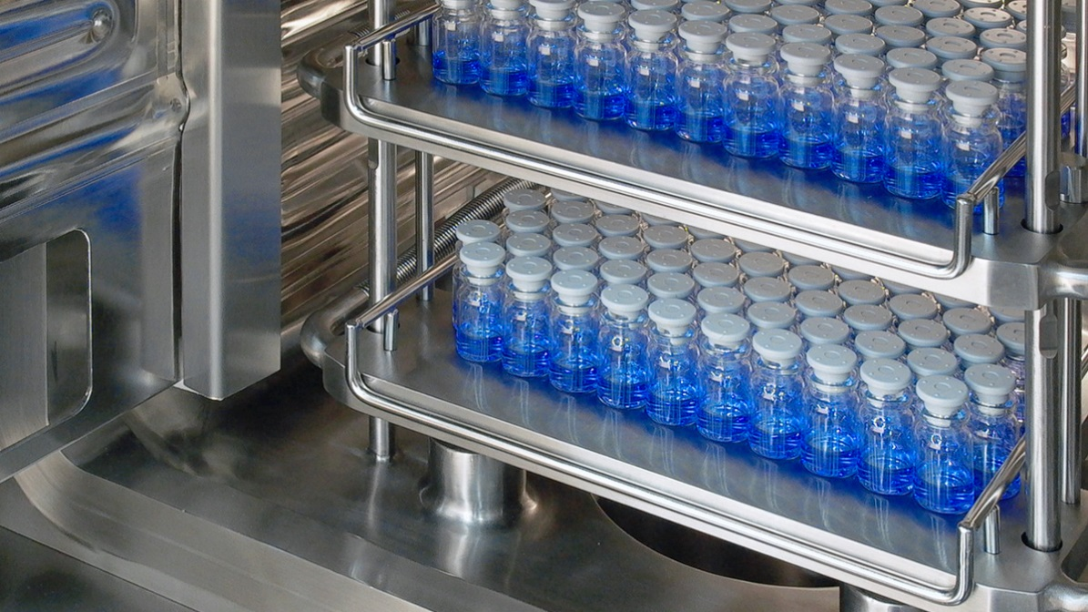
High level primary drying
Heat IN
Mass (vapor) OUT
(frozen liquid)
Sublimation
Frozen vials loaded on the shelf of a lyophilizer are subjected to heat transfer such that water vapor escapes via sublimation
Closed system → Heat in = Mass out
Notes:
Two important parameters:
-Heat transferred in
-Mass out

Slide 11
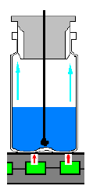
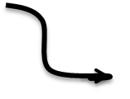
Physics of Primary Drying:
The basis for a mathematical model
Sublimation Physics
Heat IN
Mass (vapor) OUT
$$\frac{dq}{dt}$$
$$\frac{dm}{dt}$$
(frozen liquid)
Sublimation
$\frac{dq}{dt} \text{=} K_{V}A_{out}\left(T_{s}−T_{p}\right) = \frac{A_{in}\left(P_{o}−P_{c}\right)}{\hat{R_{p}}}$ $.∆H_{s}$= $\frac{dm}{dt}$ $.∆H_{s}$
Container + Equipment
dependent
Formulation + Freezing Profile
dependent

Slide 12
Four important parameters are used to model the performance of a freeze dryer
$$\frac{dq}{dt} \text{=} K_{V}A_{out}\left(T_{s}−T_{p}\right)$$
Heat Transfer Coefficient
$$K_{V}= f(Pc ,Ts , V_{fill})$$
$$\frac{dm}{dt} \text{=} \frac{A_{in}\left(P_{o}−P_{c}\right)}{\hat{R_{p}}}$$
Mass Transfer Coefficient
$$\hat{R_{p}}= f(Tn ,h_{dry})$$
$${\left(\frac{dm}{dt}\right)}_{max}$$
Freeze Dryer Limitations
$${\left(Pc\right)}_{min}$$
Maximum Sublimation Rate
Minimum Controllable Pressure

Slide 13
Heat Transfer Coefficient (K_{v})

Slide 14
Heat is transferred from the shelf to the vial by three different modes
Contact Conduction
$$Q_{cont}={−K}_{cont}{.A}_{out}.\frac{dT}{dx}$$
Radiation
$K_{rad}$ = ${\sum{ε.}A}_{in}.σ$.$\left({Ts}_{}^{4} −{TP}_{}^{4}\right)$
Gas Conduction
$$K_{gas}=\frac{α.δ_{0}.P_{c}}{1+l_{v}\left(\frac{α.δ_{0}}{φ_{0}}\right)P_{c}}$$
q_{cont} + q_{gas}
A “total heat transfer coefficient” (K_{v}) is used to combine all heat transfer into the vials
Notes:
$δ_{0}$ = free molecular heat conductivity of gas at 0 C.
$α$ = Energy accommodation coefficient
$l_{v}$ = Effective Distance – characterizing gap between shelf and vial bottom
$φ_{0}$= heat conductivity of gas at constant pressure
$ε$= Surface emissivity of material
$σ$ = stefan boltzmann constant

Slide 15
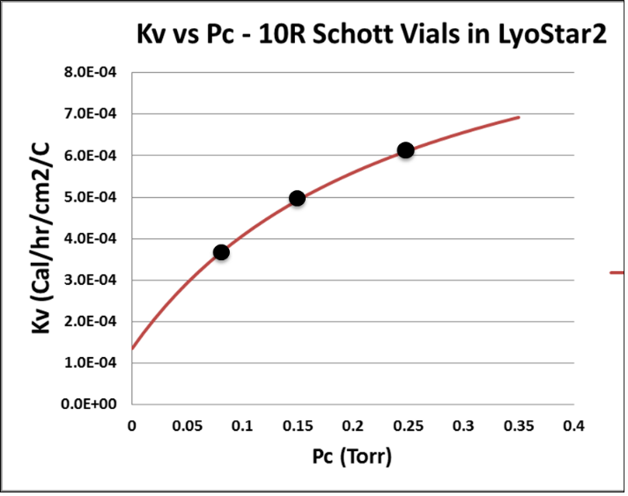
Total Heat Transfer Coefficient (K_{V}) has a strong dependence on P_{c}
$$K_{V}=K_{cont}+K_{rad}+K_{gas}$$
$$K_{V}= f(P_{c})$$
$$K_{V}=a+\frac{b.P_{c}}{1+c.P_{c}}$$
3 data points are needed to fit K_{v} vs P_{c} data to the above equation using regression
Notes:
Fill volume and shelf temperature were assessed and had little contribution to Kv

Slide 16
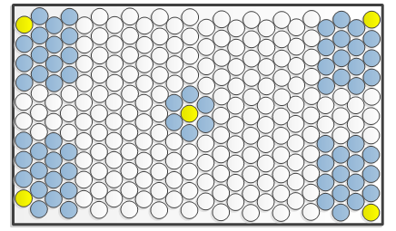
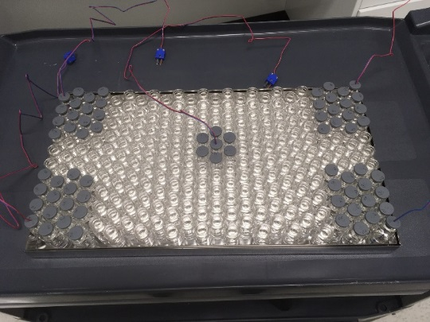
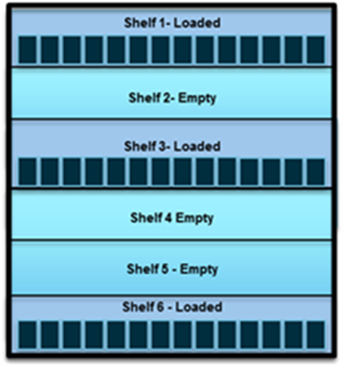
What does this mean for us? Experimental basis
$\frac{dq}{dt} \text{=} K_{V}A_{out}\left(T_{s}−T_{p}\right) = \frac{A_{in}\left(P_{o}−P_{c}\right)}{\hat{R_{p}}}$ $.∆H_{s}$ = $\frac{dm}{dt}$ $.∆H_{s}$
Experimentally determined
Known
Measured with probe
Measured as water loss
Development
Manufacturing

Slide 17
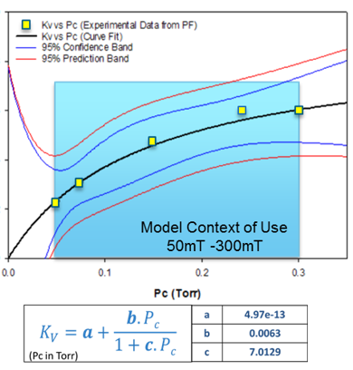
K_{v} studies were performed on the lab and manufacturing lyophilizers
Experimentally determine K_{v} for a given P_{c} (≥ 3 P_{c} setpoints)
Fit regression to data
Solve for a, b, c

Slide 18
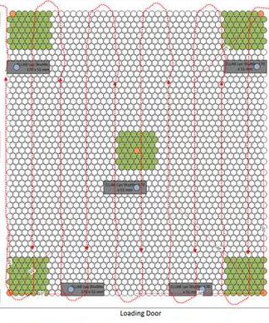
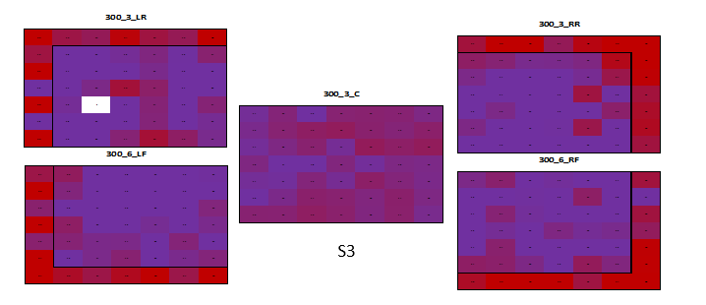
Heat maps show hot and cold spots on shelf
Warm
Cool
No data
Experimental
Shelf Layout
Heat Map
Edge Effect
Kv_{(center)} / Kv_{(edge})
Notes:
Heat map based on Kv of each location

Slide 19
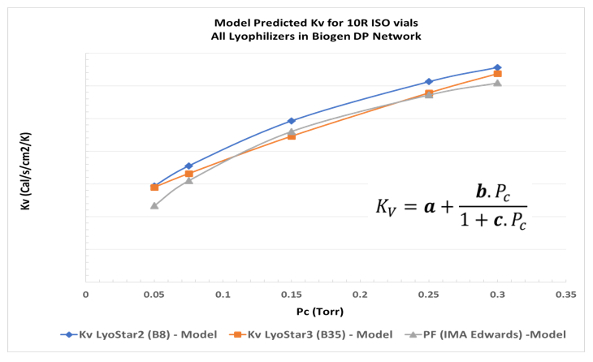
K_{v} has been mapped for all Biogen lyophilizers
$\frac{dq}{dt} \text{=} K_{V}A_{out}\left(T_{s}−T_{p}\right) = \frac{A_{in}\left(P_{o}−P_{c}\right)}{\hat{R_{p}}}$ $.∆H_{s}$= $\frac{dm}{dt}$ $.∆H_{s}$
We can now model processes in all Biogen lyophilizers and predict performance when transferring a process between lyophilizers

Slide 20
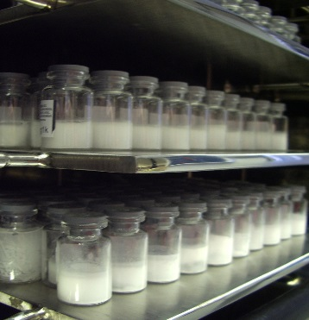
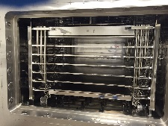
Predictive models are used to assist with scale up between the lab and manufacturing lyophilizers
EXCEL BASED
1st PRINCIPLES MODEL
Eliminates the need for expensive “at-scale” experiments during development

Slide 21
From Lab to Manufacturing with full Design Space Understanding in 30 mins

Slide 22
Product A: Model verification in lab lyophilizer
Model predicted T_{p} matches thermocouple measured T_{p}
Model predicted drying time equals experimentally determined time
Model predicted R_{p} comparable to MTM calculated R_{p}
Notes:
3 Data Types:
Model
Thermocouple
Experimental (MTM)

Slide 23
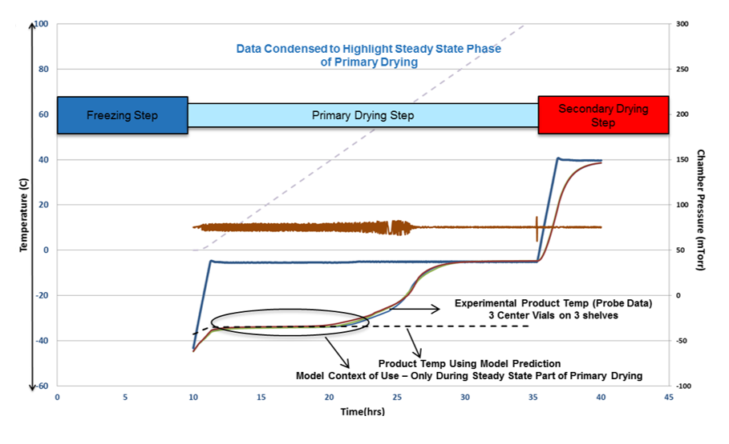
Product B: Model verification in manufacturing lyo
Model predicted T_{p} matches probe measured T_{p} (steady state)
Model predicted drying time aligns with end of primary drying

Slide 24
Our road to success
was built on clarity, unity & agility
PREPARATION
+
Agile Team Dynamics
Unified Goals With INTENT
Clear Roles & Responsibilities

Slide 25
An Extremely Collaborative & Cross-Functional Team Effort
TD
MS
Manufacturing
Maintenance

Slide 26
Acknowledgements
Suresh Nulu
Mehak Mehta
Cherie Parkhurst
Soham Bhatt
Josh Briggs
Chris Shirley
Mark Lee
Benjamin Young
Wendy Hinton
Cassandra Williams
Augustine Mbella
Sheridan Dickens
Robert Archer
Sam Black
David Coley
Daouda Faye
Sean Goudy
Kevin Maloney
Nicole Onyeneho
Stuart Wang

Slide 27
References
Costantino, H., & Pikal, M. (2005). Lyophilization of Biopharmaceuticals (pp. 75-110). AAPS Press.
Pikal, M., Roy, M., & Shah, S. (1984). Mass and heat transfer in vial freeze-drying of pharmaceuticals: role of the vial. J Pharm Sci, 73(9), 1224-37.
Tchessalov, S (ND). Heat and Mass Transfer during Lyophilization: Generation of Inputs for the Primary Drying Model. Breckenridge BPOG Workshop.
Tchessalov, S., Dassu, D., Latshaw II, D., & Nulu, S. (2017). An Industry Perspective on the Application of Modeling to Lyophilization Process Scale up and Transfer. American Pharmaceutical Review. Retrieved 23 May 2017, from http://www.americanpharmaceuticalreview.com/Featured- Articles/335416-An-Industry-Perspective-on-the-Application-of-Modeling-to-Lyophilization- Process-Scale-up-and-Transfer/

Slide 28
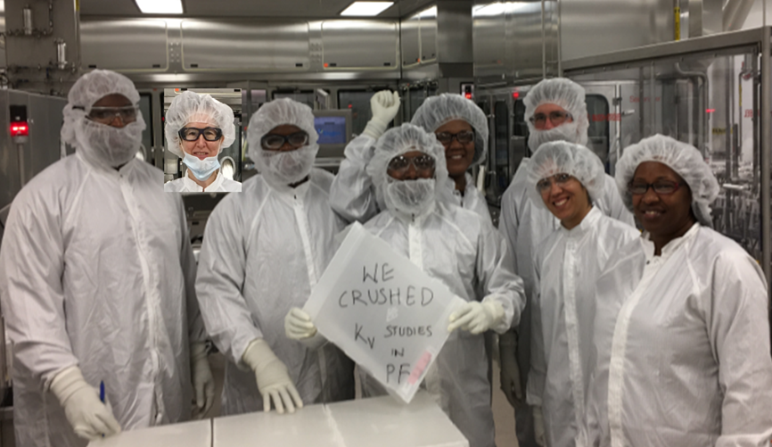
Questions?

Slide 29
Backup Slides

Slide 30
Primary Drying Mathematical Model: High Level Logic
$K_{V}A_{out}\left(T_{s}−T_{p}\right) \text{=} \frac{A_{in}\left(P_{i}−P_{c}\right)}{\hat{R_{p}}.∆H_{s}}$
Heat In Mass Out
${1P}_{i}$ = $\frac{{K_{V}A_{out}\left(T_{s}−T_{p}\right)\hat{R_{p}}.∆H}_{s}}{A_{in}}$ + $P_{c}$
$$\sum_{i=1}^{i}{\left({1P}_{i}−2P_{i}\right)}2→0$$
P_{i} - predicted by mass & heat transfer balance
${2P}_{i}$ = $e^{\left(24.0185 − \frac{6144.96}{T_{P}+273−K_{v}P_{c}(T_{s}−T_{P})\frac{h_{ice}−h_{i}}{\text{l} \text{ice}} }\right)}$
P_{i} - predicted by vapor pressure equilibrium
Solve Numerically by Changing T_{p}

Slide 31
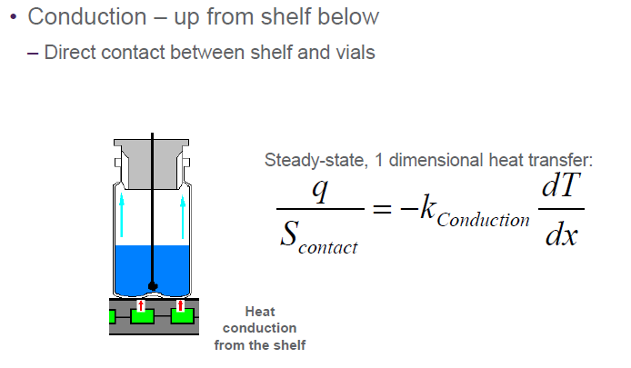
Heat Transfer into vials through direct contact Conduction from shelf
Tchessalov, S (ND)

Slide 32
Heat Transfer into vials through direct contact Conduction from shelf
Tchessalov, S (ND)

Slide 33
Heat Transfer into vials by Radiation from walls and shelves
Tchessalov, S (ND)

Slide 34
Heat Transfer into vials through Gas Conduction and Convection
Tchessalov, S (ND)

