Slide 1
End-to-End Overview of biopharmaceutical Process Development
Juan Cueva
Brandon Moore
Jamie Sigmon
ISPE-CaSA Technology Conference
13MAR18

Slide 2
Disclaimer
The processes and perspectives stated in these slides are generalized to biopharmaceutical manufacturing and do not represent those of Biogen

Slide 3
GOAL OF TALK:
To provide students, who will soon enter the workforce, with an end-to-end overview of biopharmaceutical process development

Slide 4

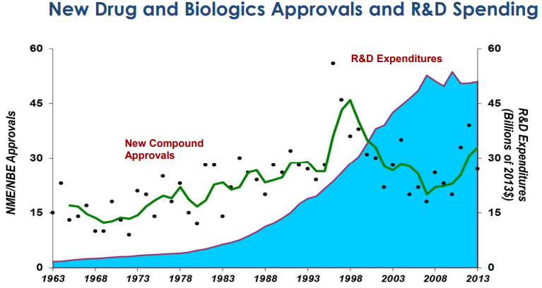
R&D Costs in Biomanufacturing
$2,558 MILLION per new drug approved
Tufts University Center for the Study of Drug Development
Dr. Joseph A. Dimasi, Director of Economic Analysis
Title: Cost of Developing a New Drug (November 18, 2014)
Notes:
To launch one drug per year, the pipeline needs to be populated as shown
# of pipeline units by stage per year required for 1 Launch/year
Pipeline units account for program and indication (e.g. HSP 90 is 2 pipeline units, 3 if early research program in immunology is included
Probability of success is higher in this example than historical Big Pharma
Costs increase rapidly as programs move into larger clinical trials

Slide 5
Biopharma Development Paradigm
Process understanding is achieved by collecting data at all scales by executing experimental runs
Development
Small-Scale
Tech Run
“At – Scale”
PVR
“At – Scale”
Scale- Up
At-Scale Experiments
Equip Capability
& Process Understanding
Validation
<Assurance>
Process Understanding
Small/pilot scale
At-scale

Slide 6
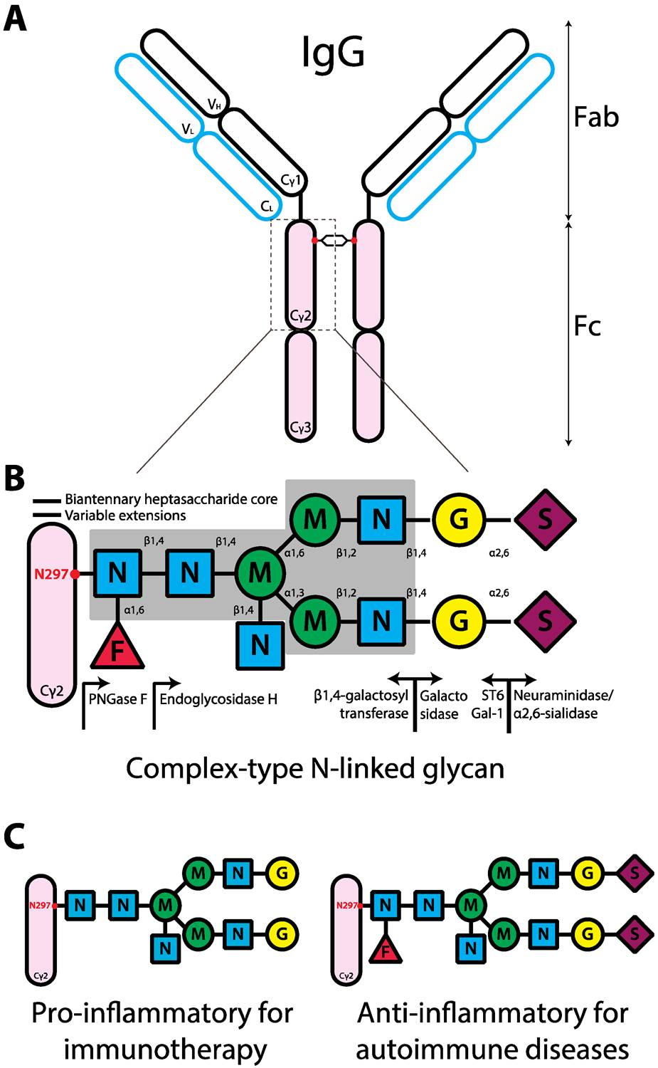
Biopharma Development Example:
Antibody (mAb) Process
Considerations before process development begins:
DRUG TARGET
Unintended effects?
Glycosylation?
ANTIBODY PROPERTIES
Sequence analysis – is anything prone to
modification?
Prone to self-interaction?
pH stability issues?
Thermal stability issues?
Prone to aggregation/unfolding/modification?
Shade, K.-T.C.; Anthony, R.M. Antibody Glycosylation and Inflammation. Antibodies 2013, 2, 392-414.

Slide 7
Approximate Biopharma Development Timeline
Drug Candidate Screening and Transfer
RESEARCH
Cell Line Development
Cell Line Selection
Process Development
Process Characterization
Transfer to MFG
Continued Process Support
UPSTREAM
Process Development
Process Characterization
Transfer to MFG
Continued Process Support
DOWNSTREAM
Developability/Pre-formulation
Formulation
Formulation Robustness
Continued Process Support
FORMULATION
Process Development and Tech Transfer
Test Development
Test Transfer to Quality
Continued Process Support
ANALYTICAL
Testing Support
Year 1
Year 2
Year 3
Year 4
Year X

Slide 8
Process Development Stages
Cell Culture “Upstream” Development
GOAL: Productivity
Purification “Downstream” Development
GOAL: Purity
Drug Product “Formulation & Fill/Finish” Development
GOAL: Stability, Minimize stress conditions
All of development shares the goals of:
Safety
Efficacy
Consistency

Slide 9
Upstream Process Development
“Make more cells which each make more product.”
Early stage
  Cell lines are transfected as suggested by research
  Cell line (clone) selection
Mid-stage
  Process optimization occurs (Seed train, media, controlled parameter set-points, etc.)
  Work closely with downstream development at this stage
Late-stage
  Experiments are performed to fully characterize the process (process characterization, PC)
  Process is locked and headed to manufacturing

Slide 10
Concept: Scale-Down Model (SDM)
Small-Scale
5L Glass BRX
Pilot Scale
~200-500L BRX
Full Scale
2,000-18,000L BRX
Scale-up
Scale-up
Scale-down Verification
Scale-up data should build confidence that the process we are running in MFG is the same as the process we developed on the bench (and changes we make on the bench will have the same impact in MFG!)
Must-haves:
Consistent performance between scales
Independent and dependent variables same between scales

Slide 11
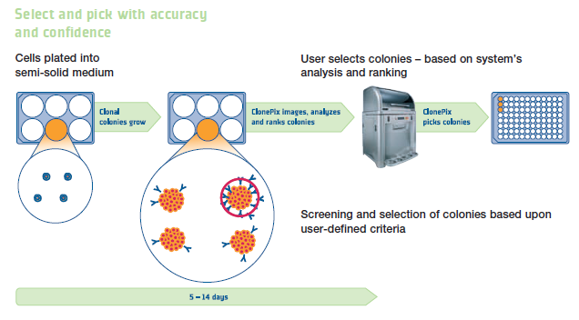
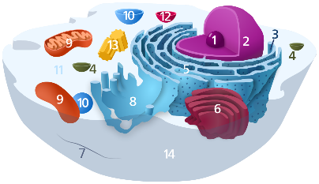
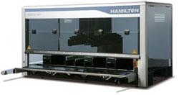
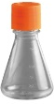

Early-Stage Upstream Development
Cell Line (Clone) Development
Cell Line (Clone) Selection
mAb DNA
Clone Pool Created
Clone Performance Evaluated
Robot picks clones
*Clonality confirmed manually
Clones scaled-up
Clones evaluated in BRX
Productivity
Product Quality
Top clones confirmed in larger BRX
PLATFORM…

Slide 12
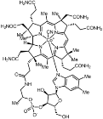
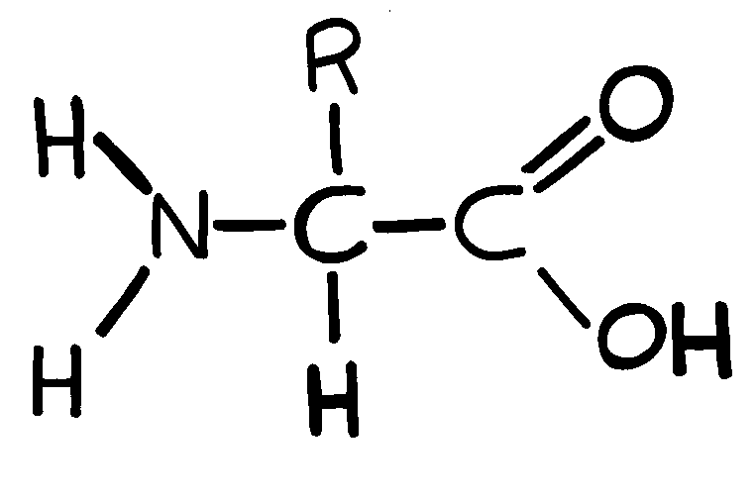

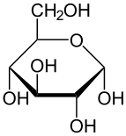
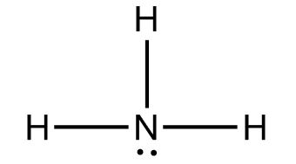

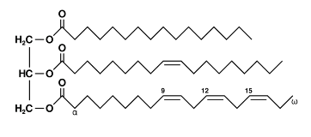
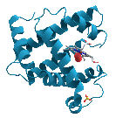
Mid-Stage Upstream Development
Optimization Considerations:
Temperature
Vitamins
Oxygen
CELL
Amino Acids
Product (mAb)
Osmolality
Sugars
Waste
pH
Lipids
Host Cell Proteins (HCPs)
How many cells?
How long is the process?
What is the target Product Quality profile??

Slide 13
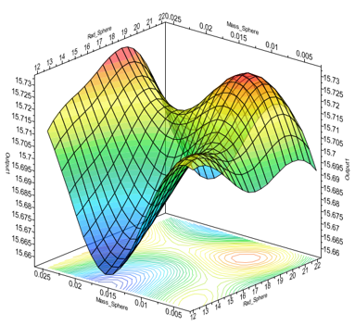
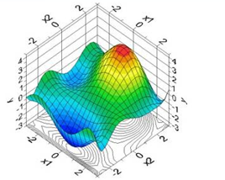
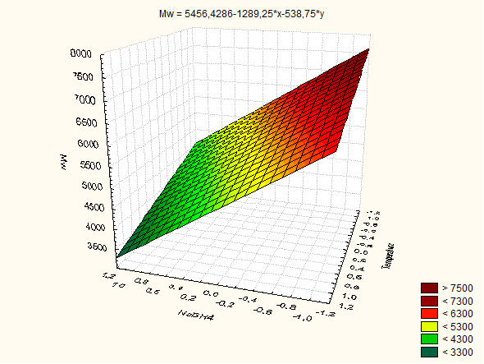

Late-Stage Process Development and Scale-up
Process Characterization Experiments (run at small-scale, can be a lot of vessels!)
Use “Design of Experiment” DoE statistical modelling to design experiments in order to fully understand the impact of important process parameters (seed density, temperature, pH, DO…)
Scale-up and Tech Transfer
Vessel-to-vessel scaling with oxygen transfer rate:
$$OTR=kLa(C∗−C)$$
k_{L}a is a property of the system (sparger size, impeller size, vessel geometry, etc.)
Can be calculated, but is typically empirically derived for each vessel
Productivity
Safety
Efficacy
Consistency

Slide 14

Downstream
Processing
We are into PURITY!
Purification: Steps that purify the target protein while maintaining product integrity and yield
Resins
Filters
Flocculants
Buffers
Excipients
Means:
Notes:
Recover therapeutic protein from producer cell
Purify the protein from product-variants, host cell protein and other contaminants
Formulate the protein into final product
Monitor every step of this process
…and Repeat all-of-the-above Consistently!
Processing steps use strategy of orthogonal chromatography (columns or filters) to purify product from impurities and contaminants

Slide 15
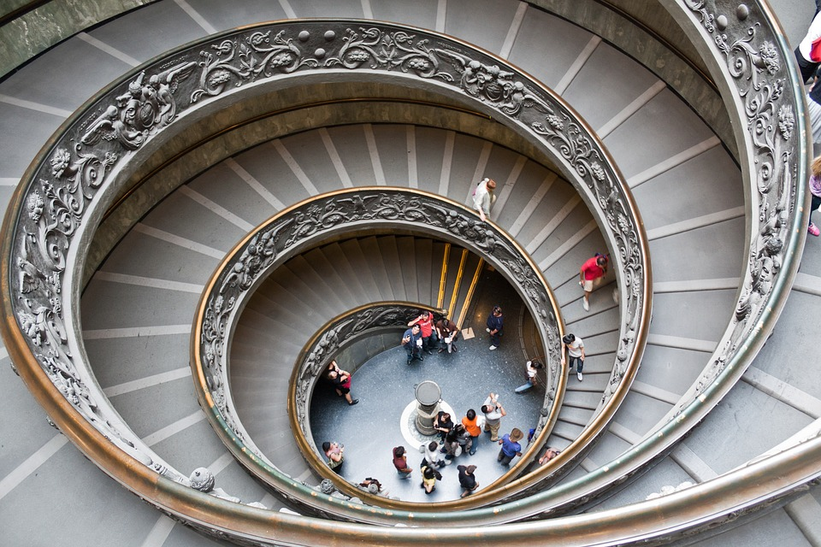
Think of purification media as a long stair case in which product and impurities will travel down at different rates
Notes:
Think of products and impurity “binding” on a column each at different “on” rates (usually diffusion limited) and “off” rates (tight binding means a slower “off” rate)

Slide 16
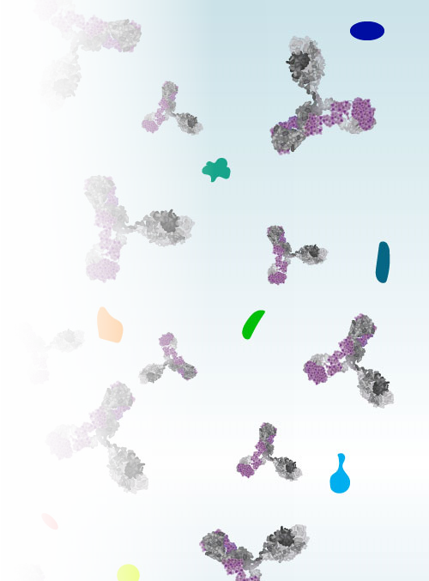
Contaminants & Impurities
Impurity (internal to process)
    Product Variants (aggregate, clipped, etc)
    Host Cell Proteins (HCP)
    DNA
    Buffer and cell culture additives
Contaminant (external to process)
    Viruses
    Bacteria, endotoxin

Slide 17

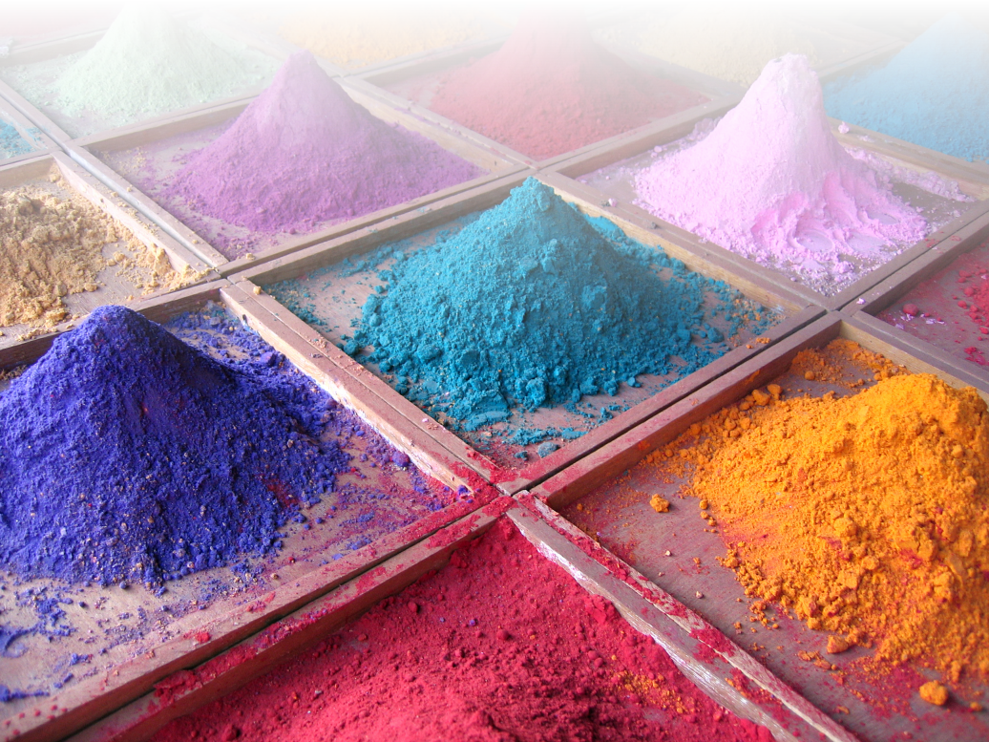
Balance of Yield vs. Purity
A high yield is not always great news!

Slide 18
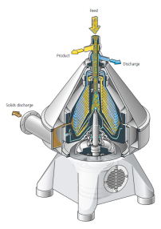
Purifying mAbs Platform
Virus Filter
Centrifuge/
Depth Filtration
Affinity
AEX
HIC
UF/DF
Small-scale models → compare model outputs to at-scale runs
Notes:
Harvest and Recovery
Purification step 1 (Reduce volume while purifying)
Purification step 2 (Further purification from host proteins and removal of product-variants)
Purification step 3 (Polishing step)
Viral filtration step for mammalian system
Formulation and Bulk Fill

Slide 19
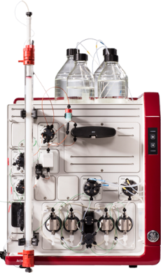
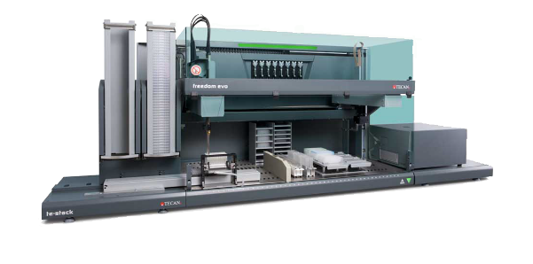
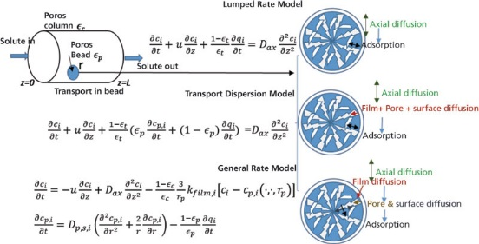
Development Tools
Automated scale-down chromatography systems
High throughput technology
Mechanistic modeling
Notes:
Mechanistic modeling and simulations for chromatographic performance prediction.
These technologies allow process scientists to better understand critical process parameters and optimize processes rapidly without the need for pilot-scale runs and extensive experimentation. Additionally, they require significantly less material than traditional scale-down models.

Slide 20
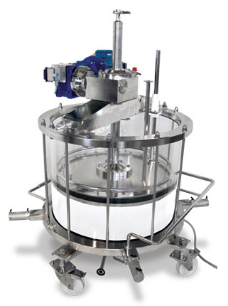
Chromatography
Scale-Down Principles and Parameters
Notes:
Large-scale processing is:
Expensive (facility time, raw materials expense is also scaled up)
Resource heavy (numerous people to manage it)
Restriction to facility (difficult to open up even a single purification suite for testing during commercial production)
Lab-scale processing is:
Less expensive (facility time and raw materials)
Multiple experiments can be performed efficiently and side-by- side with less equipment, cost and people
Results are scalable (when proper scaling of parameters are considered)
Lab-scale studies are routinely used during development, Design of Experiment (DoE), trouble-shooting and preliminary Process Validation (PV)

Slide 21

Chromatography
Scale-Down Principles and Parameters
    Scaling Input Parameters:
      Column Bed Height (cm)
      Linear Velocity (cm/hr)
      Column Loading (g/L resin)
      Column Volume (CV)
      Elution collection criteria
      Temperature
    Monitored Parameters:
      Absorbance (A₂₈₀, A₃₀₀, or A₃₁₃)
      pH (at development and pilot-scale, only)
      Conductivity (mS/cm)
      Column Pressure (psi or bar)
1 : 50,000
Notes:
Other scaling parameters: Solution pH, conductivity, protein conc., composition.
Procedures for preparation of buffers and solutions for scale-down studies should be according to established protocols used in large-scale manufacturing, since subtle changes in ionic strength or pH could lead to altered elution and purity profiles. Further, the quality of buffers and salts used for preparing solutions for scale-down studies should also be consistent with those used in manufacturing. For chromatographic resins, the base matrix, functional groups, and ligand densities should be similar to large-scale manufacturing since these parameters could have an impact on impurity removal [14]. Resins with the same functional group but differences in base matrices or porosities have yielded different levels of virus and DNA removal, respectively [14].
Temperature is another variable that could affect the retention time of proteins on chromatographic resins. Scale-down models should be run at the same temperatures as large-scale manufacturing. Fluctuations in temperature could lead to changes in pH and conductivity of certain buffers, which could affect retention of proteins.
Scalable input parameters
Load Product Quality: (representative material with equivalent impurity levels and product concentration)
Resin Load: (normalized amount of product to resin, i.e., grams product per liter resin)
Column height: (albeit diameter is proportional to scale via surface area, i.e., height in cm)
Column Packing Integrity: (HETP and Asymmetry)
Linear Velocity: (normalize flow rate to surface area, i.e., units of cm/hr … multiply this by the column surface area in units of cm² to get flow rate in mL /hr… then convert to L/min)
Buffer conditions: (pH, conductivity)
Processing Conditions: (temperature)
Scalable output parameters:

Slide 22
Chromatography
Scale-Down Principles and Parameters
    Scaling Output Parameters:
      Step Yield
      Impurity clearance
      Eluate concentration
      Eluate/product formulation
      Processing time
    Assessment Methods:
      Step yield % (UV, HPLC, Activity)
      Chromatographic profile (UV, Cond, pH)
      Purity (SDS-PAGE, HPLC, Activity)
      Impurity levels (SDS-PAGE, SEC-HPLC, ELISA, DNA)
      Product isoform distribution (HPLC, IEF)
1 : 50,000
Notes:
One consideration to keep in mind when scaling down column diameter is wall effects, which could impact chromatographic performance, column diameters less than 1.0 cm.
Scalable output Parameters
Step Yield: (% product recovered/product loaded)
Impurity Clearance: Assay for this
Eluate Concentration
Eluate/product Formulation: (solution conditions)
Processing Time:

Slide 23
AEX FT Characterization
Function
    Control process related impurities (HCP, DNA and ProA leachate)
    Control product related impurities (charge variants and HMW)
    Robust viral clearance step
Experimental Details
    Design: face centered RSM (20 model + 2 confirmation runs)
    Input Factors: mass load, load pH and wash volume
    Response Elements: yield, HMW and acidic isoform reduction
Factors | Parameter | Range
1 | Mass Load (g/L) | 100 – 475
2 | Load/Wash Buffer pH | 6.7 – 7.5
3 | Wash Volume (CVs) | 2 – 5

Slide 24
AEX FT: Yield Contour Plots
0.6 mL OPUS® RoboColumns™
6.5 mL Lab Scale Columns
Near identical response surfaces across both platforms

Slide 25
AEX FT: HMW Reduction Contour Plots
0.6 mL OPUS® RoboColumns™
6.5 mL Lab Scale Columns
Near identical response surfaces across both platforms

Slide 26
Scale-up Predictions
OPUS® RoboColumns™ generated models predicting MFG performance
0.6 mL vs. 204 L for AEX (340 000 X)
0.6 mL vs. 322 L for HIC (536 667 X)
Notes:
HTPD Challenges
Lack of in-line monitoring, including pH, conductivity, and pressure
Small bioreactor volumes limit the amount of development experiments
Analytical Support and Data Management
Large sample numbers can quickly overwhelm analytical groups
Require effective IT infrastructure to manage large amounts of data

Slide 27
Drug product development is much more than just filling drug substance into containers!
Formulation
Container Closure System and Integrity
Fill/Finish Process
Lyophilization Process (when applicable)
Directions for Handling and Administration (DHA)
Notes:
Goal of DP Dev:
Take bulk DS and deliver safely to patient
Formulation
Ensuring stable, bioavailable, and proper dosage form for intended route of administration
Container closure system and integrity
Final container is appropriate for use and the closure is integral
Fill/finish process
Getting from bulk into final formulation and container aseptically while minimizing stress conditions
Lyophilization process
if not stable in liquid or the need demands, the product is lyophilized
Visual inspection
The product is visually free from defects (particles, foreign objects, color, clarity, etc.)
Directions for handling and administration (DHA)
How to administer to patient

Slide 28
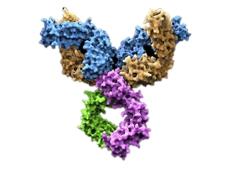
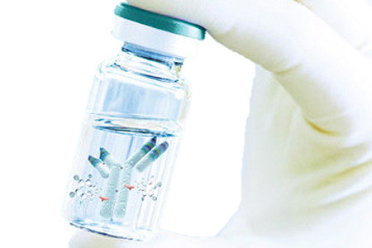
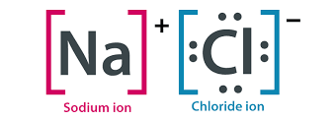
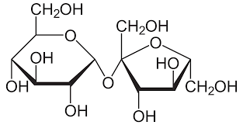
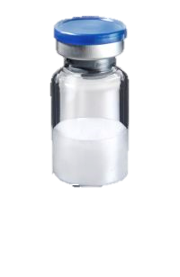
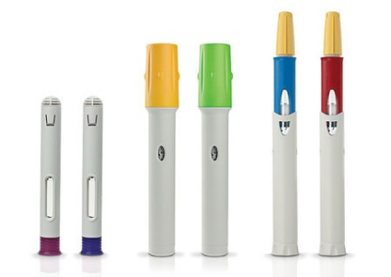
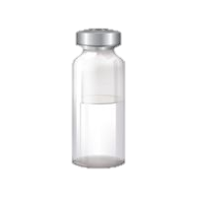
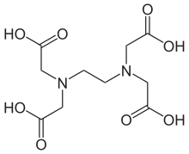
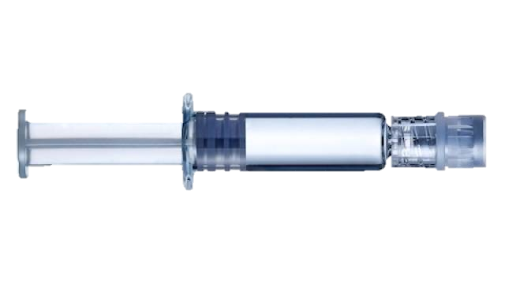
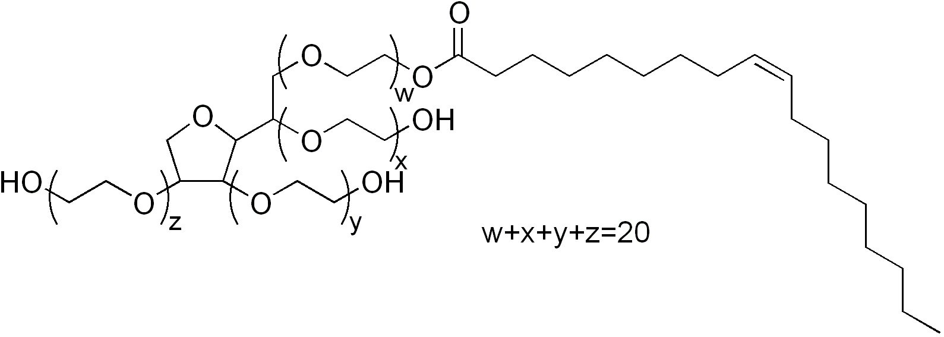
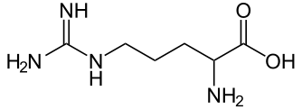
What goes into a drug?
API
Buffer
Tonicity Agent
Bulking Agent
Delivery Method
Surfactant
Antioxidants
Stabilizers
Adapted from Krebs, Mark (ND)
http://vertassets.blob.core.windows.net/image/edeed819/edeed819-ebdc-4740-a75b-22f87105997e/adc.jpg
Notes:
The role of drug excipients
Buffer – to maintain the chosen pH
Tonicity agent – obtain the desired tonicity; e.g. NaCl
Bulking agent – if going with lyo, this protects the protein and helps control drying; e.g. sucrose, trehalose
Surfactant – to minimize surface interactions; e.g. Tween
Antioxidants – prevent oxidation; e.g. Met, EDTA
Stabilizers – contribute to stability through one of several means; e.g. Arg, Pro

Slide 29
How do we know which excipients
and how much to add?
Excipient | Candidates | Concentrations | Combinations
pH | 3 | -- | 3
Buffer | 3 | 3 | 9
Tonicity | 4 | 3 | 12
Surfactant | 3 | 3 | 9
Antioxidants | 4 | 3 | 12
Stabilizers | 4 | 3 | 12
Total number of possible combinations:
3 × 9 × 12 × 9 × 12 × 12 = 419,904
Too many to try!
Krebs, Mark (ND)
Notes:
DOE can help,

Slide 30
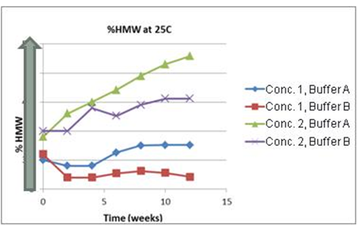
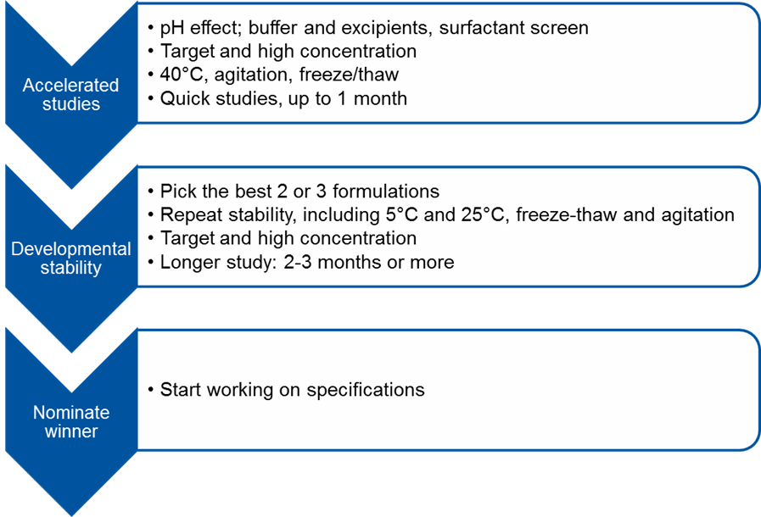
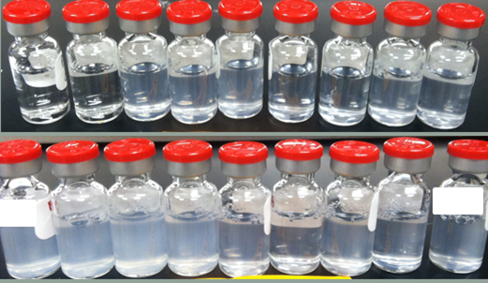
Formulation Development Process
Krebs, Mark (ND)

Slide 31
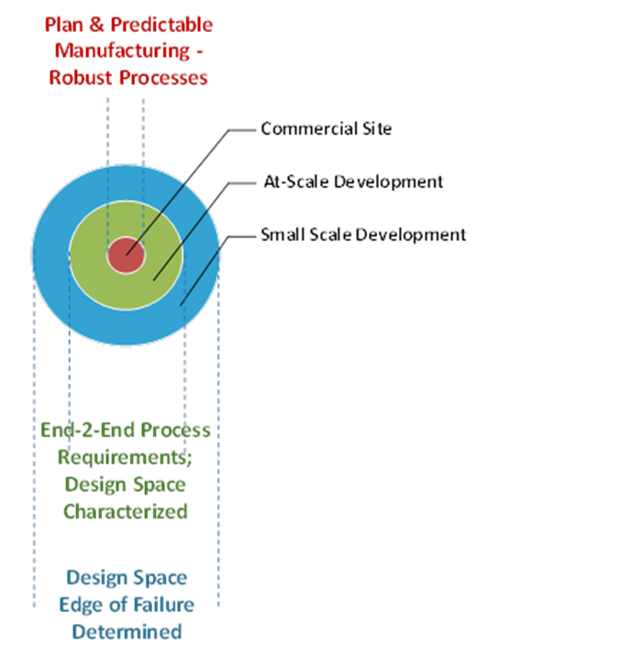
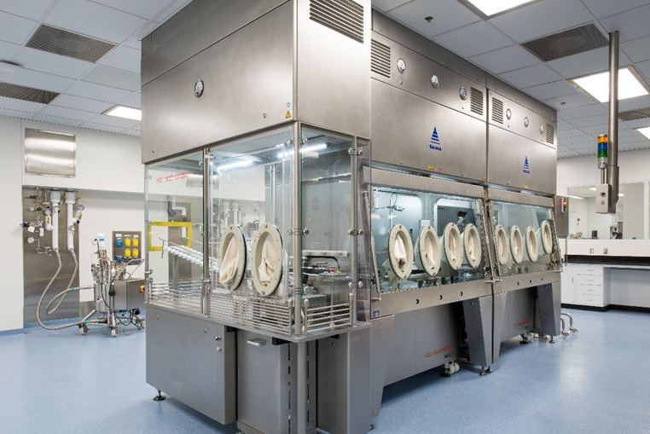
Fill/Finish Process Development
Remember: Product quality is central
to everything we do!
Notes:
Design process to:
Ensure product quality
Reduce product loss
Maximize yield
Maintain strength and efficacy of product

Slide 32
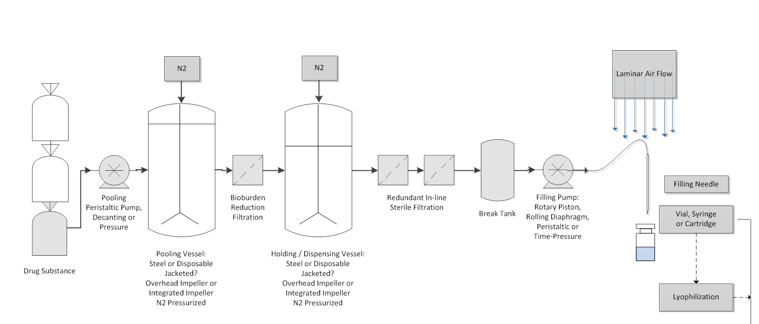
Liquid Drug Product Fill Process
Development and Scale-up
Bulk Drug Substance
Final Container
Adapted from Fernandez, Jason (ND)

Slide 33
Liquid Drug Product Fill Process
Development and Scale-up
For characterization, the process is divided into distinct unit operations
Early Development
Initial process design space assessment → small scale characterization of processing stress
Identify red flags
At-scale Manufacturing
Assess integrated process holistically
Overall process performance
Adapted from Fernandez, Jason (ND)

Slide 34
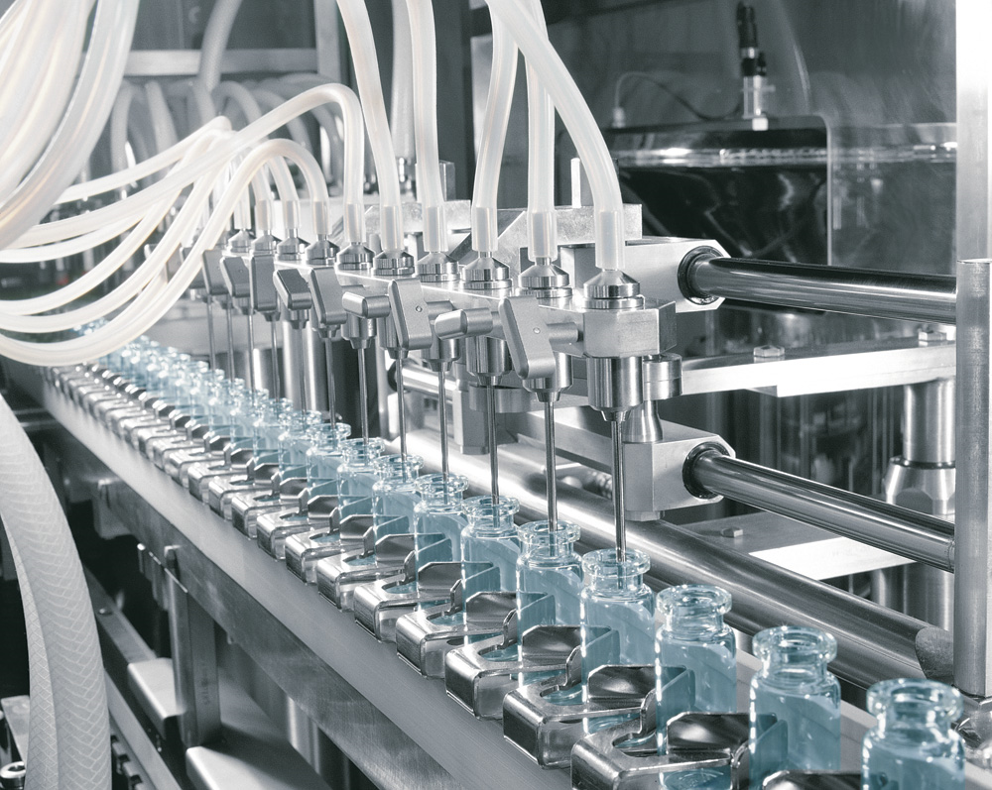
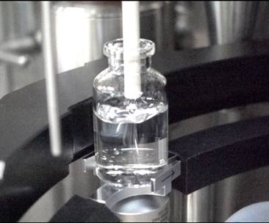
Fill/Finish Scale Up
A fill/finish process is scaled-up by increasing line speed through addition of pumps and filling heads
Scale-up
http://www.imacare.it
Small Scale | At Scale
Preliminary fill parameter screening (pump, fill needle, drying) | Demonstration of operational filling parameters
Assess molecule sensitivity to filling shear | Support filling performance (Cpk and/or Ppk)
Adapted from Fernandez, Jason (ND)

Slide 35
Example: Filling Pump Selection
Various pumping mechanisms are available for drug product filling each with benefits and flaws
  Peristaltic, rotary piston, time-pressure and rolling diaphragm
Rotary piston is highly accurate
  Can lead to particles or precipitate high concentration proteins
Peristaltic is common for proteins
  Tubing spallation, drift
Time pressure is emerging
  Accuracy vs. fill volume
Rolling diaphragm
  Ideal for high viscosity?
Fernandez, Jason (ND)

Slide 36
Drug product bridges the gap between bulk manufacturing and the patient
Deliver safe and efficacious drug product to the patient:
Optimize formulation for stability and bioavailability
Appropriate dosage and presentation for administration route
Sterile, container closure integrity, low particles
Minimize stress conditions (mechanical, environmental, physico-chemical)
http://vertassets.blob.core.windows.net/image/edeed819/edeed819-ebdc-4740-a75b-22f87105997e/adc.jpg
Notes:
Drug product bridges the gap between bulk manufacturing (drug substance) and the patient
Evaluate Stress Conditions:
Mechanical stresses eg. Shear, agitation, freeze/thaw
Environmental, eg. Light exposure, needle drying
Physico-chemical, eg. Oxidation, aggregation, fragmentation

Slide 37
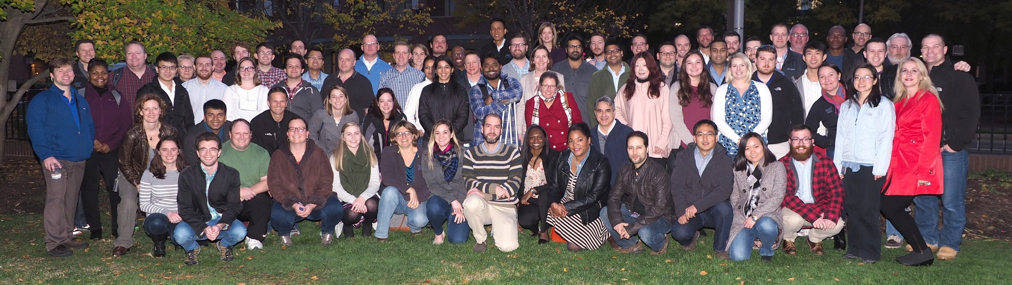
Acknowledgements
Mark Krebs
Jason Fernandez
Sean Goudy
Ed Koepf
Greg Runyon
Biogen TD Drug Product Development Team
Biogen TD Process Biochemistry Team
Biogen TD Cell Culture Development Team

Slide 38
Questions?

Slide 39
Backup Slides

Slide 40
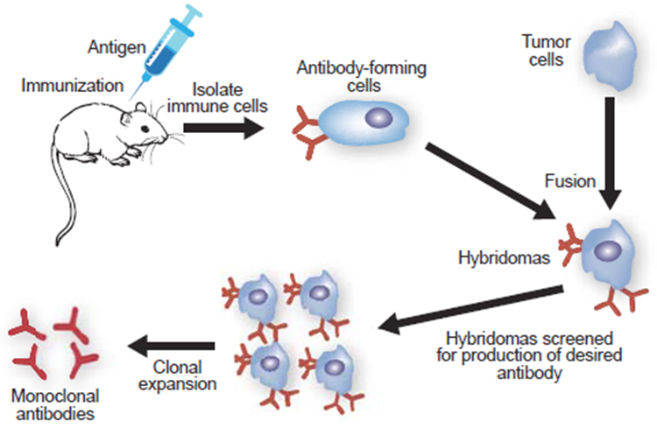
Discovery—
How do we know which antibody to make?
Methods to Approach New Drug Discovery:
High level disease area e.g. CNS, Neurology
Biological reasons to think that it would work
Select a group of molecules whose reactions correlate with disease indicators e.g. if they activate immune system, they potentially can treat autoimmune disorders
Generate drug candidates using methods such as hybridoma technology or phage display
https://www.genscript.com/gsimages/genscript/antigen_immunization_figure.jpg
Notes:
ID a Target → Generate antibodies against it (hybridoma technology) → Screen for binding → Humanize → Animal trials
Phage display → Screen for binding

Slide 41
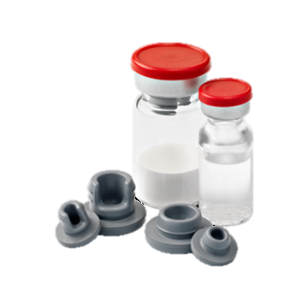
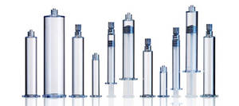
Container Closure System (CCS) Development
CCS
Container type
Influencing Factors
Physical presentation (liquid vs. lyo)
Product Contact Controls
USP Type 1 material requirements
Container size
Stopper size
Stopper material formulation
Stopper configuration (serum vs. lyo)
Drug product concentration
Dosing volume
Manufacturer and format
Stopper elastomer – low extractable content, etc.
Stopper configuration, size, coating
Container Development
Extractables & leachables
Container Closure Integrity Testing (CCIT)
Delamination Assessment
Stage in development/life cycle

Slide 42
Thaw
(Equilibrate)
Bioburden
Reduction
Filter
Hold
Dual Sterile Filter
Fill
Lyo
(if needed)
Cap
Inspect
Pool &
Compound
Generalized Drug Product Process (with Lyophilization)
Development Activity
Freeze / Thaw Studies | Pooling Stress & Mixing Studies | Filter Sizing Studies | Hold Time Support, Material Compatibility & Process E/L | Filter Sizing, Design Space, Flush Studies & Validation | Pump, Fill Vol Ppk, Density, Needle selection, VHP Evaluation & Drying Studies | Cycle Development & Robustness | Capping Pressure & CCI Method Validation | Defect Library Support

