Slide 1
The Life Cycle of a Project – START to FINISH
Ashley Harp, PE, CRB
Dean Landers, CRB
ISPE – CaSA 2018 Technology Conference
March 13, 2018

Slide 2
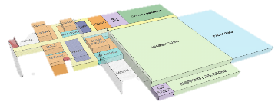
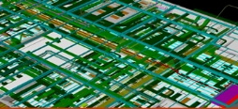
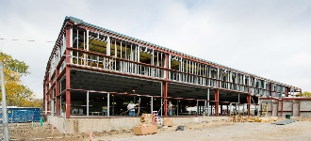
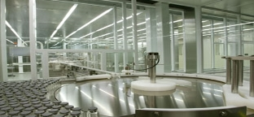
The Lifecycle of a Project
_{CONSTRUCTION}
_{STRATEGIC CONSULTING}
_{CONCEPTUAL ENGINEERING}
_{COMISSION/QUALIFY}
_{PLAN}
_{DESIGN}
BUILD
COMPLIANCE
_{OPERATIONS}
_{DETAILED DESIGN}
_{PRE-CONSTRUCTION}
_{REGULATORY}
_{PLANNING}
_{PROCESS MODULES /}
_{SKIDS}
_{FACILITY MAINTENANCE}
To be successful at any one of these steps, you need two things:
Experience and Skills

Slide 3
The Cost of Change
Flexibility
Cost
Time

Slide 4
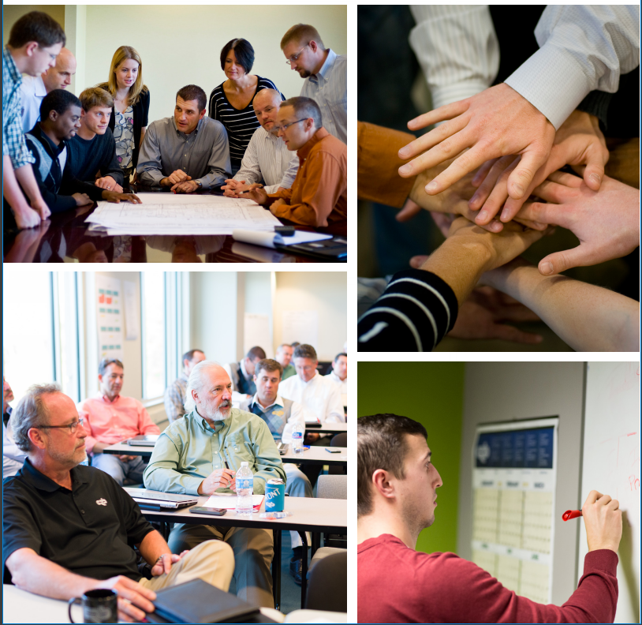
Strategic Consulting
What is Strategic Consulting?

Slide 5
Who does Strategic Consulting?
Stakeholders such as…
Operations, Engineering, Management, Quality
Experience with…
Facility Operations
Contributing to Codes & Guidelines
Technical Speaking
Skilled at…
Communicating
Innovation
Listening
Dealing with Ambiguity
Facilitating Groups
Discussing Regulatory Compliance and Industry Trends

Slide 6
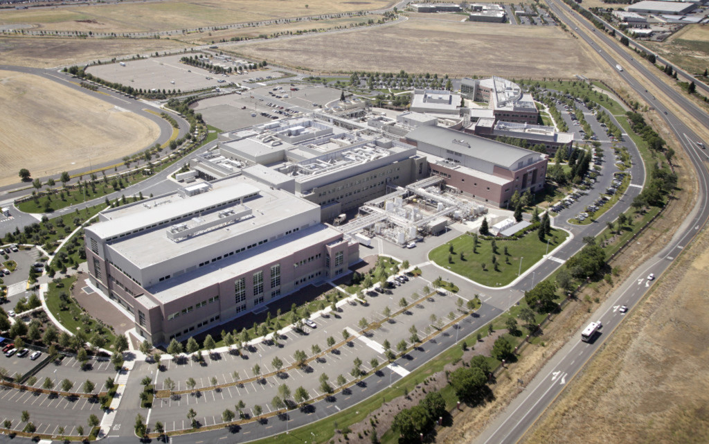
Planning
What does the Planning phase look like?
Notes:
Identify the need. Develop a URS. Do site master planning. Might or might not even engage the AEC firm at this point. Do a high level feasibility study. RFP is issued. UR traceability is established.

Slide 7
Who is involved in the Planning phase?
Stakeholders such as…
Operations, Legal, Finance, Safety, Engineering, Management, Quality
Experience with…
The full life cycle of a project
Your specific discipline
Skilled at…
Communicating
Questioning the status quo
Flexible thinking
Listening
Spatial Reasoning
Seeing and understanding industry trends

Slide 8
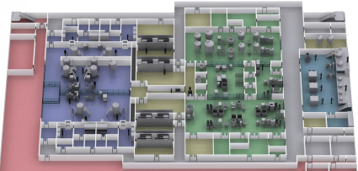
Conceptual Engineering
What does Conceptual Engineering look like?
Notes:
The AEC or consulting firm is probably involved now. This is a high level approach. A BOD developed. There are vendor audits and a risk analysis. The URS is finalized. Schedule is finalized.

Slide 9
Conceptual Engineering
Stakeholders such as…
Operations, Engineering, Management, Quality, Safety
Experience with…
Facility construction
Operational improvement
Skilled at…
Communicating
Data analysis
Cross discipline coordination
Developing and understanding simulations
Technical writing

Slide 10
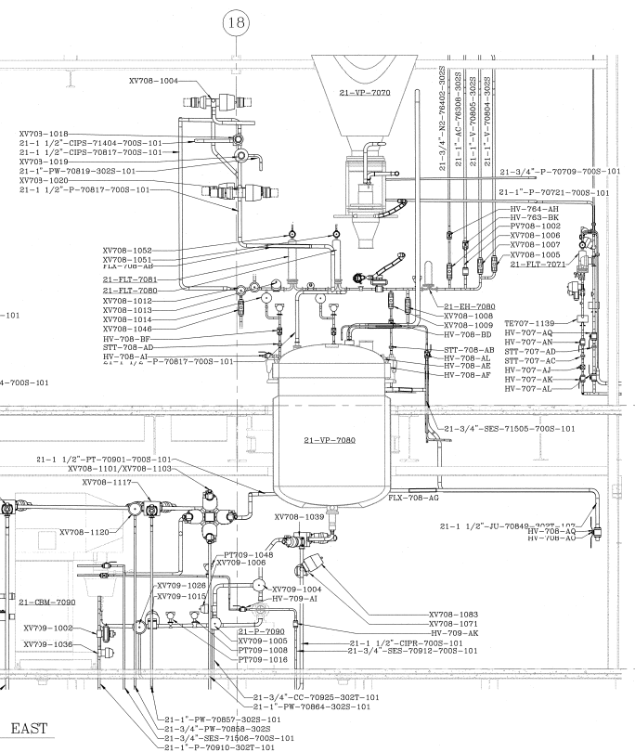
Detailed Design
What does Detailed Design look like?
Notes:
The design documents are being generated (drawings, specs, etc). Owner (or owner’s rep) is overseeing the development to make sure it remains in alignment with the URS. Estimate is developed. Bid packages go out. Equipment packages start coming in (depending on type and lead time).

Slide 11
Detailed Design
Stakeholders such as…
Operations, Engineering, Management, Quality, Safety, Maintenance
Experience with…
Equipment Operation
Skilled at…
Communicating
Attention to Detail
Cross Discipline Coordination
3D Modeling
Data Analysis
Vendor Management
Knowledge of Industry Principles
Detailed Calculations

Slide 12
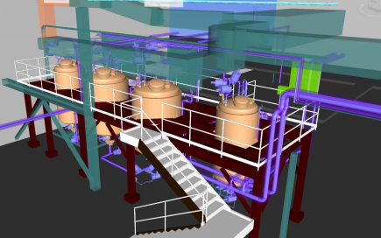
Preconstruction
What does Preconstruction look like?
Notes:
Final design documents are reviewed. Coordination with trades begins. Equipment packages continue to come in. RFI’s begin. Submittals begin. FAT’s are ongoing. Owner begins to develop documents for maintenance and controls systems (SOP’s as well).

Slide 13
Preconstruction
Stakeholders such as…
Operations, Finance, Engineering, Management, Quality, Safety, Maintenance
Experience with…
Construction Management
Procurement
Skilled at…
Communicating
Visualization
Estimation
Scope Development

Slide 14
Construction
What does the Construction phase look like?
Notes:
Building. System shake downs. System punch lists. SME’s are involved from the owner side, equipment side, and AEC side. Owner’s business begins to orient itself to accommodate for the project.

Slide 15
Construction
Stakeholders such as…
Operations, Legal, Finance, Safety, Engineering, Management, Quality, Maintenance
Experience with…
Managing people and resources
Industry specific trades
Skilled at…
Communicating
Leadership
Time Management
Motivation
Negotiation
Reading and Interpreting Drawings and Specifications
Decisiveness
Vendor Management

Slide 16
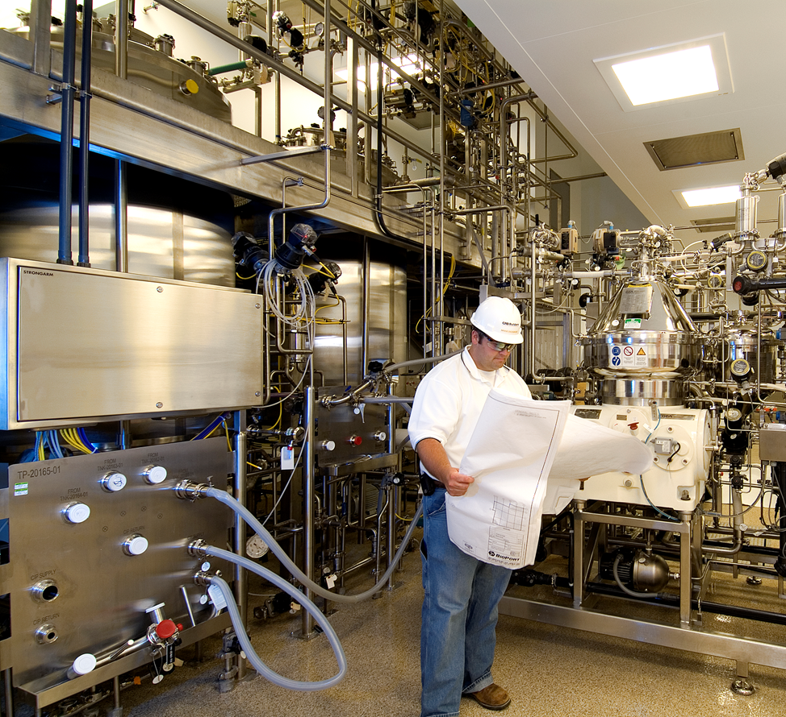
Process Modules/Skids
What does the design and construction of process modules look like?
Notes:
Model reviews, ergonomic reviews, maintenance reviews, facility move in reviews.

Slide 17
Process Modules/Skids
Stakeholders such as…
Operations, Legal, Finance, Safety, Engineering, Management, Quality, Maintenance
Experience with…
Equipment Operation
Skilled at…
Communicating
Attention to Detail
Computer Modeling

Slide 18
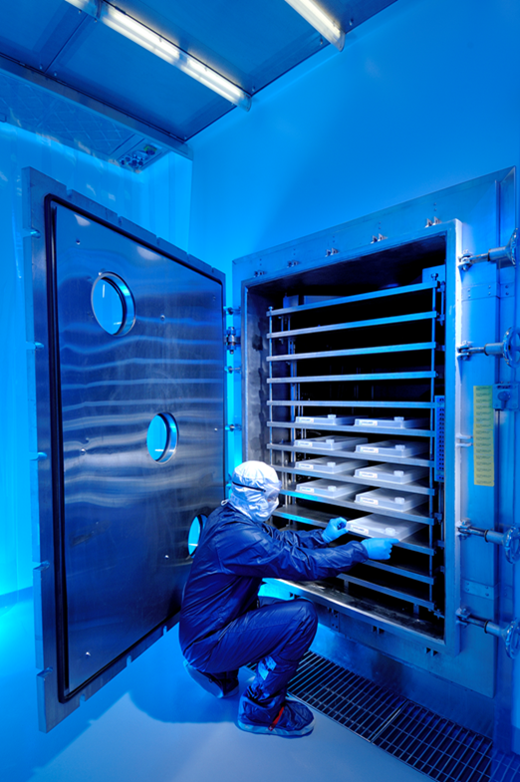
Regulatory Compliance
What does Regulatory Compliance look like?
Notes:
This is a consulting period where SME’s will review the new facility for its effectiveness to deliver the final product as planned. Building code – code inspectors.

Slide 19
Regulatory Compliance
Stakeholders such as…
Operations, Engineering, Management, Quality, Safety
Experience with…
Systems
Standards and codes
Guidances
Industry Standards
Skilled at…
Communicating
Interpreting codes and standards

Slide 20
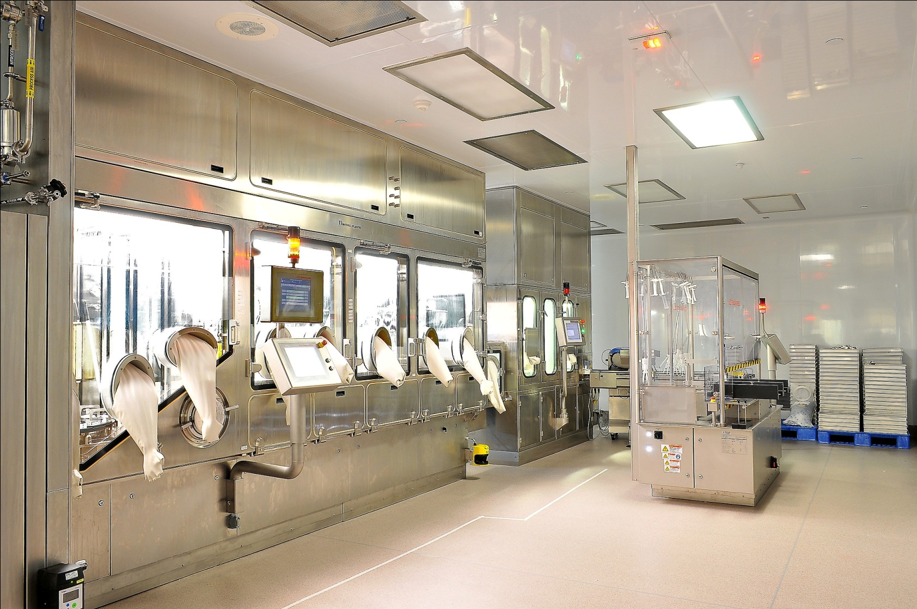
Commissioning and Qualification
What does Commissioning and Qualification look like?
Notes:
Does the facility, equipment, and process meet the spec requirements as stated in the design documents (and URS)? Have the URS changed?

Slide 21
Commissioning and Qualification
Stakeholders such as…
Operations, Safety, Engineering, Management, Quality
Experience with…
Test Development
SOP Development
Skilled at…
Communicating
Analytics
Details
Interacting with a wide range of Customers & Technical Issues

Slide 22
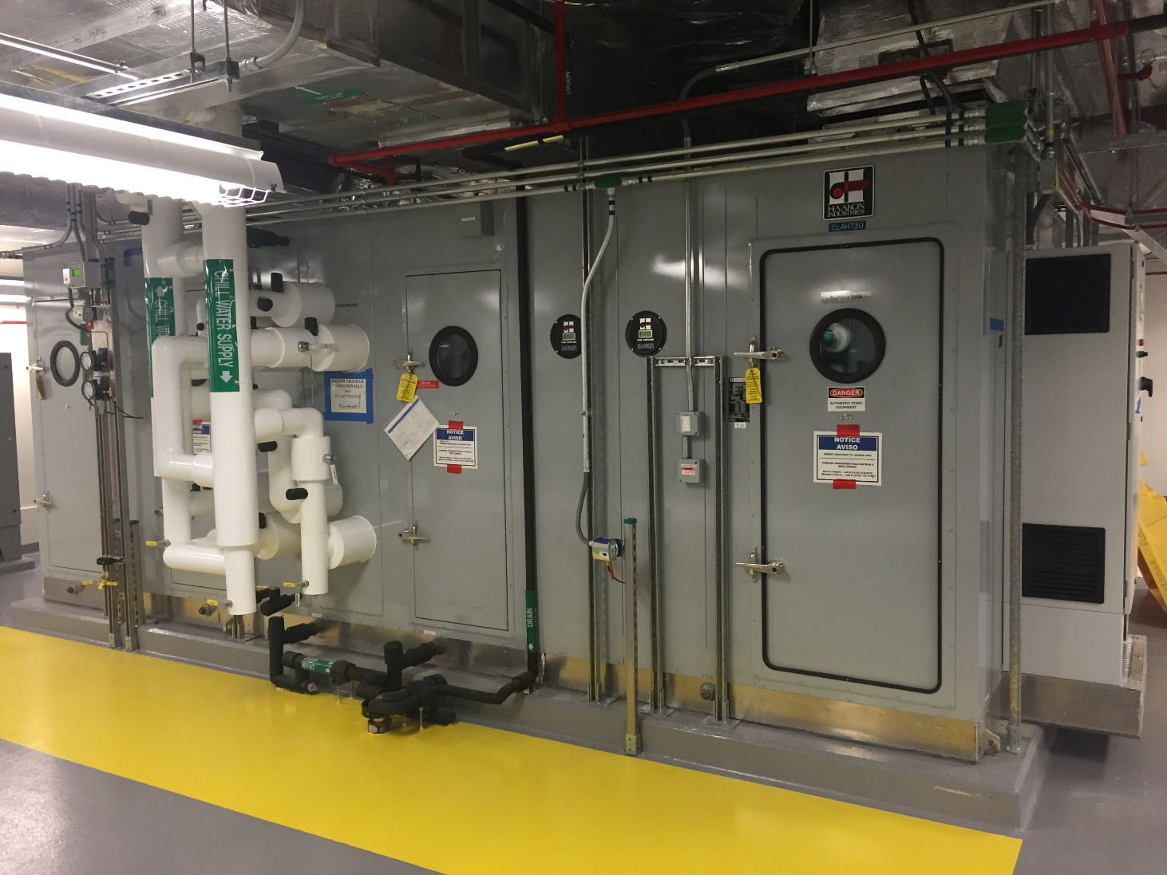
Facility Maintenance
What does Facility Maintenance look like?
Notes:
Keep it working!

Slide 23
Facility Maintenance
Stakeholders such as…
Operations, Safety, Engineering, Management, Quality, Maintenance
Experience with…
Operations Improvement
Mechanical systems
Control systems
Equipment Operations
Skilled at…
Communicating
Problem Solving
Data Analysis
Troubleshooting

Slide 24
The Cost of Change
Flexibility
Cost
Time

Slide 25
Panel Discussion
Inter Discipline Engineering
Architecture
Construction Services

Slide 26
Questions?

