Slide 1
Avoid the pitfalls of pivoting between modalities
Emily Thompson, DPS Group
Faryal Khan, DPS Group
February 15, 2022

Slide 2
AGENDA

Slide 3
Agenda
Industry Updates
Case Study
Conclusions
Novel Therapies Overview

Slide 4
INDUSTRY UPDATES
Novel Therapies

Slide 5
Industry Updates
New modalities are driving innovation in biotechnology
Past
Small Molecules
Today
Small Molecules
Future
Small Molecules
Vaccines
Monoclonal Antibodies
Recombinant Proteins
Vaccines
Monoclonal Antibodies
Recombinant Proteins
Oligonucleotides
Gene Therapy
Cell Therapy
mRNA
Vaccines
Monoclonal Antibodies
Recombinant Proteins
Oligonucleotides
Gene Therapy
Cell Therapy
mRNA
Exosomes
Microbiome
Oncolytic Viruses
Gene Editing

Slide 6
Manufacturing Capacity Crunch
10-20
Novel therapies/year are expected to be reviewed by the FDA by 2025
80%
Viral vector manufacturing outsourced to CDMOs
50%
Cell therapy manufacturing outsourced to CDMOs
18
Lead time for CDMO manufacturing slots
month

Slide 7
Product vs. Facility Lifecycle
New facilities are designed and constructed prior to product approval
Pre-Clinical
Clinical Phase I
Clinical Phase II/III
Commercialization
Tox (Mice)
File
IND
First in Human
File
BLA
Commercial Runs
Design
Construction
C&Q
Validation

Slide 8
NOVEL THERAPIES OVERVIEW
AND FACILITY DESIGN CONSIDERATIONS

Slide 9
Novel Therapies Portfolio
Cell therapy
Microbiomes
Gene therapy
Oligonucleotides
Exosomes
mRNA
WANT mRNA, CT, GT to be highlighted somehow. Other NT can fade

Slide 10
Process Overview
mRNA
(IVT)
plasmid
linearization
TFF
IVT
Digestion
TFF
chrom
bulk fill
Viral Vector
cell expansion
vector production
depth filtration
chrom
TFF
fill/finish
CAR-T
Cell Therapy
apheresis
gene transfer
expansion
harvest
cryopreservation

Slide 11
Facility Design Considerations
Special Considerations
Biosafety level
GMP flows
HVAC
mRNA
BSL-1
Bidirectional
Grade C
Ethanol Handling
Viral Vector
BSL-2
Unidirectional
Grade C/D
Containment
CAR-T
Cell Therapy
BSL-2
Unidirectional
Grade B
LN2 distribution

Slide 12
CASE STUDY

Slide 13
Case Study – Introduction
1
2
3
Facility
Results
Repurpose
Dedicated facility for potential COVID-19 mRNA vaccine
Disappointing clinical trial results
Can the facility be repurposed for cell or gene therapy product manufacturing?

Slide 14
Case Study - Layout
Overall unidirectional flow of personnel & materials
Bidirectional flow of personnel & materials within each production space
Production rooms had no airlocks to general corridor
Not BSL classified
Grade C background
LOBBY/
OFFICES
SUITE 1
SUITE 2
SUITE 3
WAREHOUSE
LOCKER ROOM
PAL IN
MAL IN
PAL OUT
MAL OUT
SUITE 4
SUITE 5
SUITE 6
GRADE C
GRADE D

Slide 15
Case Study – Facility as Designed
Two floors – one mRNA production, second LNP formulation
Ceiling heights – 9 feet
Critical utilities
Modular pre-fabricated cleanrooms – already in construction!
Floor loading limited

Slide 16
Case Study Challenges – Cell Therapy Retrofit
mRNA
CAR-T Cell Therapy
Change/Impact
HVAC designation
Grade C
Grade B
High
GMP flows
Bidirectional
Unidirectional
High
Utilities
WFI, process gases
LN₂
Low
Ceiling height
9 feet
Benchtop equipment
None
Floor loading
150 lb/ft²
No isolators
Low

Slide 17
Case Study Challenges – Gene Therapy Retrofit
mRNA
Viral Vector
Change/Impact
HVAC designation
Grade C
Grade C
None
GMP flows
Bidirectional
Unidirectional
High
Utilities
WFI, process gases
Decon autoclave, biowaste system
Moderate
Ceiling height
9 feet
Limits BRX to 250L
High
Floor loading
150 lb/ft²
Limits BRX to 250L
No isolator for fill/finish
High

Slide 18
CONCLUSIONS

Slide 19
Flexible Design
Unidirectional flows
Segregated PAL/MAL
Design to BSL-2
Dedicated air handlers
Once-through air
Grade C background
LOBBY /OFFICES
RETURN CORRIDOR
WAREHOUSE
MAL/
PAL
MAL/
PAL
MAL/
PAL
SUITE1
SUITE 2
SUITE 3
MAL
PAL
MAL
PAL
MAL
PAL
SUPPLY CORRIDOR
Suite 1
Suite 2
Suite 3
Suite 4
MAL
PAL
MAL
PAL
MAL
PAL
SUITE 4
SUITE 5
SUITE 6
MAL/
PAL
MAL/
PAL
MAL/
PAL
RETURN CORRIDOR
GRADE C
GRADE D

Slide 20
Case Study – Conclusions
1
2
3
Facility
Flexibility
Invest
Dedicated facilities can be difficult to retrofit
Design for flexibility even if you don’t think you need it!
Pre-invest for future products and technology:
- HVAC flexibility
- Airlocks
- Ceiling height

Slide 21
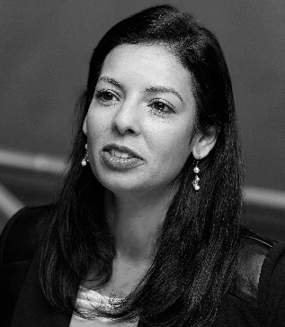
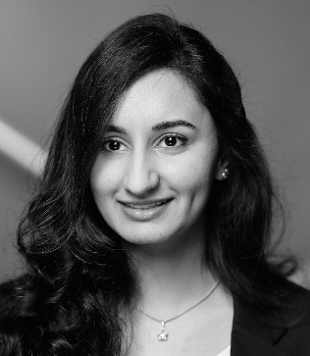
Contact Us
Emily Thompson, PE
US Director New Process Technology
DPS Group
emily.thompson@dpsgroupglobal.com
Faryal Khan
Process Engineer
DPS Group
faryal.khan@dpsgroupglobal.com

