Slide 1
Beyond Transformation – The Hidden benefits of building resiliency
Stephenie Robertson
Fujifilm Diosynth Biotechnologies
Eric Bennett
Duke Energy Sustainable Solutions
Notes:
This version was submitted to Wes Champion – Head of Education Committee

Slide 2
Agenda
Causes of Power Disruption
Top Four Reasons for a Robust Resiliency Plan
Impacts of Unplanned Downtime
Fujifilm Diosynth Biotechnologies – Resiliency Planning and Overview
Notes:
Do we say something about our companies?

Slide 3
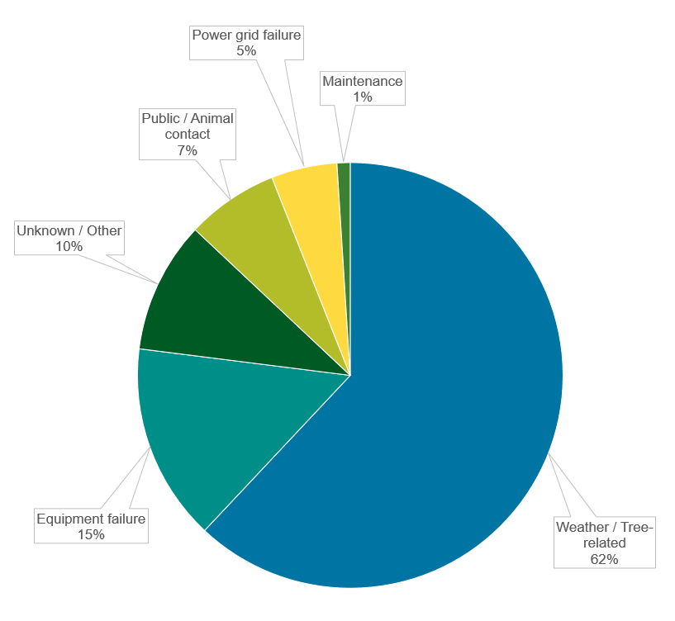
Causes of Power Disruption
Notes:
Can we both contribute to each slide-Sort of a point counter point?
Pending inclement weather preparations SR

Slide 4
Power Disruption
Notes:
Change the heading/title
Overlay with hurricanes in U.S.

Slide 5
Robust Building Resiliency
Reduce negative impacts from possible catastrophic failure
Personnel safety
Reduce nuisance failures – i.e., short duration/momentary power interruptions causing equipment to trip offline
Avoid unnecessary costs of downtime
On average, U.S. electricity customers experienced just over eight hours of electric power interruptions in 2020, the most since we began collecting electricity reliability data in 2013.
Source: EIA
Notes:
Product and personnel protection –SR – failed batch,
Post work involved with momentary – Agitator, equip resetting, nuisance is mild,
Critical equip on UPS
Investigation team looking at reasons why let alone product lost batch
Complexity adding to reliability of power grid

Slide 6
Impacts from Unplanned Downtime
Tangible Costs
Productivity
Equipment Damage
Product/Inventory
Direct Labor
Capacity
Delivery Delays
Materials Damage
Revenue
Customer Loss
Intangible Costs
Employee Stress
Company Reputation
Human Lives
Employee Health
Stock Price/Investment Loss
Customer Perception
Service Fees
Slower Responsiveness
Notes:
Tangible – The real, measurable costs associated with downtime due to a power outage.
Intangible – Harder to quantify, but absolutely no less important.
Even a single power outage can have a significant and last effect on revenue, productivity, capacity and labor.

Slide 7
Fujifilm Diosynth Biotechnologies
Location – RTP, NC
Prevailing Situation:
The current emergency power system was no longer meeting the needs of the facilities and operational objectives.
Initial assessment of current system revealed:
Mismatched system requirements.
Poor performance leading to increased costs and downtime.
Lack of adequate maintenance program.
Campus expansions outgrew the initial resiliency design.
Costs time, money and potentially, reputation.
Batch materials scrapped, testing default, internal investigations.
Notes:
Remove Why and How
Where does Fujifilm come into, working with LAM introduction, internal initiative to bring recommendations, included Duke,
Problem statement

Slide 8
Fujifilm Diosynth Biotechnologies
Location – RTP, NC
The Challenge:
Design a campus resiliency solution that met operational and financial objectives.
Supports critical infrastructure
Site utilities – high purity water systems, chillers, boilers, air compressors, etc.
Processing equipment – bioreactors, fermenters, etc.
Product and raw material cold storage
Reliable source of emergency power, managed by energy subject matter experts
Operation, maintenance and fueling all maintained by Duke Energy
Meets budget constraints
No capital investment for new generators
Monthly fee as operational cost
Designed for onsite expansion
Modular design allows for future expansion of emergency power system
Install occurred during a major manufacturing facility expansion
Notes:
Duke provide overview of solution(s), references,

Slide 9
Fujifilm Diosynth Biotechnologies
Location – Morrisville, NC
Solution:
Collaboration with Fujifilm’s architectural and engineering firms
Designed 5MW backup power system supporting existing facilities and planned expansion
Equipment included generators, switch gear, monitoring equipment, electrical panels, fuel tank, battery and charger
Project timeline = 15 months from contract signature to turnover

Slide 10
Site Images
Notes:
Modify pics?

Slide 11
Site Images

Slide 12
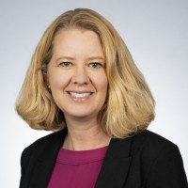
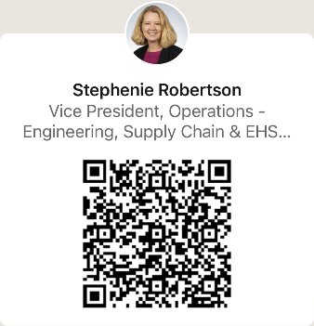
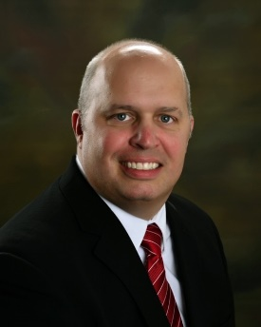
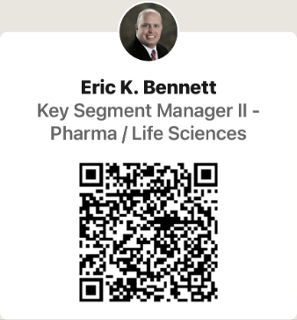
Stephenie Robertson, VP, Operations – Engineering, Supply Chain and EHS
Fujifilm Diosynth Technologies
Stephenie.Robertson@Fujifilm.com
Eric Bennett, Key Segment Manager II – Pharmaceuticals and LifeSciences
Duke Energy Sustainable Solutions
517-672-0340
Eric.Bennett@Duke-Energy.com

