Slide 1
Circular EHS:
Driving EHS Outcomes in design, construction, and operations
Matt Kunz
Novo Nordisk Pharmaceutical Industries, LP
Senior Engineer, EHS Programs
Bailey Forrest
Fluor
Director, Construction Management
Notes:
Matt and Bailey

Slide 2
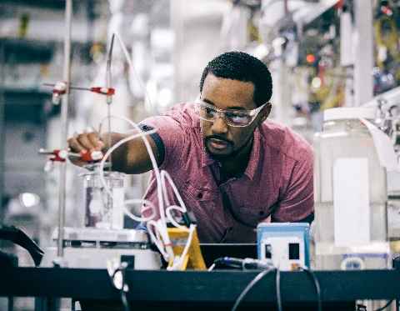

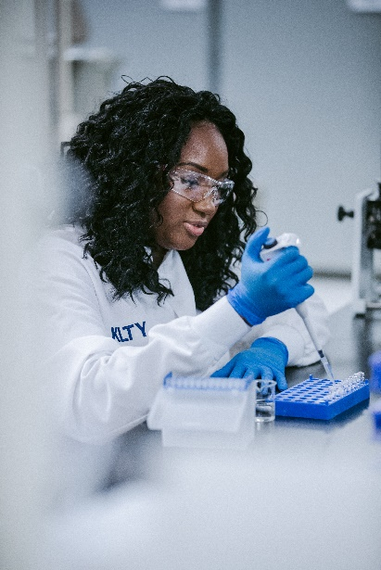
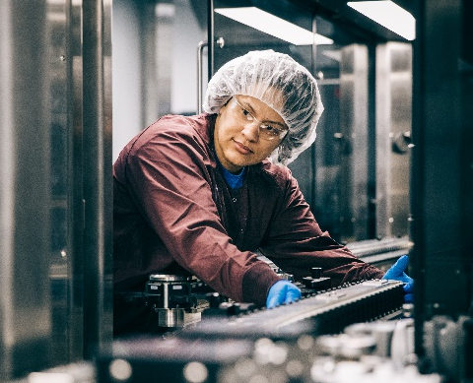
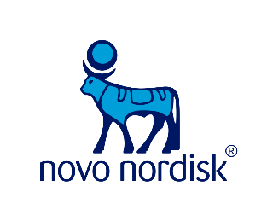

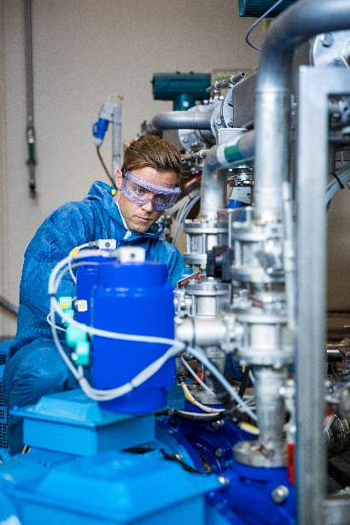


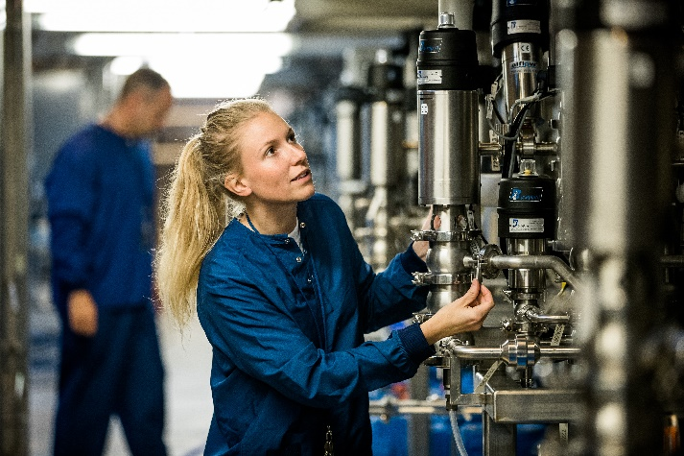
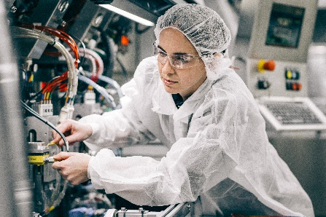
PRODUCTS SUPPLIED TO
14 COUNTRIES
$2B
NOVO NORDISK
PHARMACEUTICAL INDUSTRIES LP
NORTH CAROLINA
EXPANSION
INVESTMENT
USD76
MILLION
ANNUAL EXPENDITURES WITH NC VENDORS & SUPPLIERS
in 2018
SINGLE LARGEST MANUFACTURING ECONOMIC DEVELOPMENT PROJECT in NC
EMPLOYS APPROXIMATELY
1,200 PEOPLE
3 DIABETES
PRODUCTION SITES
FINISHED PRODUCTS, DIABETES API, TABLET MANUFACTURING
IN JOHNSTON & DURHAM COUNTIES
OF EMPLOYEES
ARE VETERANS
19%
SOLAR ENERGY
INVESTMENT
$70M
PROVIDING PRODUCT OPTIONS TO
30,000,000
PEOPLE LIVING WITH DIABETES IN THE US
PUBLIC-PRIVATE PARTNERSHIPS
WITH LOCAL
COMMUNITY COLLEGES &
UNIVERSITIES
FIRST OPERATIONAL
NORTH CAROLINA SITE
1996
Notes:
Global company in 170 countries – strongest US manufacturing presence in Clayton, NC (NH acquired in 2014)
Responsible for half the world’s insulin - currently manufactured in Kalundborg, DK
Serve nearly 28M patients per day – including 30M Americans and over 1 million in NC
Novo Nordisk Fdn is the primary stakeholder, reducing vulnerability and increasing sustainability
Triple bottom line drives our business model, including social responsibility . . . .
16 production sites include Clayton’s facility

Slide 3
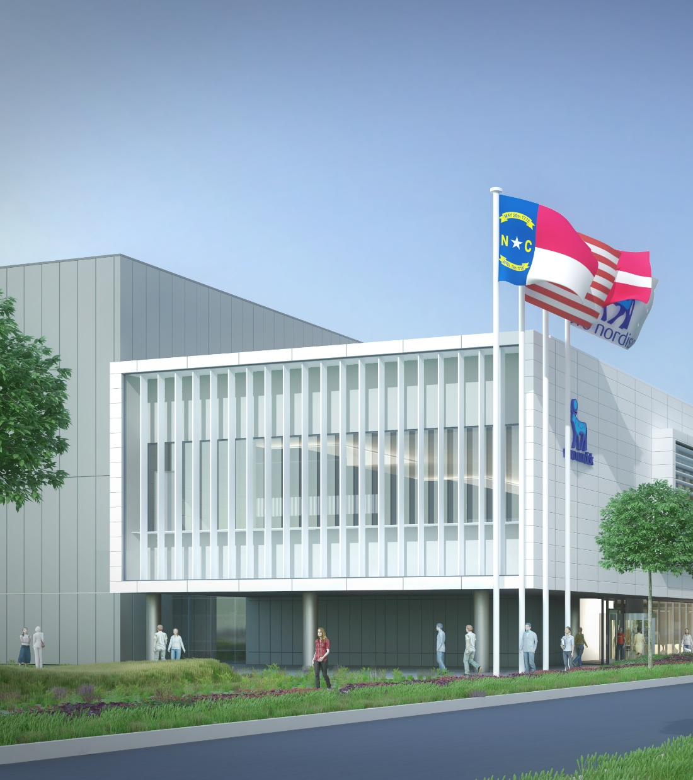
Novo Nordisk invests in a green field facility to produce API…
DFP Clayton
1993
1996
1998
2016
DAPI US
2016
2017 - 2019
2019 - 2022
Establishment of site
First Vial batch shipped
First cartridge batch shipped
DAPI US project initiated
Ground breaking
Design & Construction
Validation & Regulatory
Deep-dive DFP Clayton
The facility assembles and packages FlexPen® and FlexTouch® insulin delivery devices for the US market and EU
Deep-dive DAPI US
The facility will deliver API a new innovative oral treatment of diabetes that is approved by the FDA
The facility is currently employing ~850 people
The facility will employ several hundred employees when in operations
Annually operation costs of ~ 170mUSD
Total project costs (TPC) estimated to
~USD 2 billion
Roughly 450,000 square feet covering app. 8 acres of land
Roughly 825,000 square feet (57,000 m²) covering app. 19 acres of land (77,000 m²)

Slide 4

It is time for a new
ambition
“As the biggest investment in the history of Novo Nordisk and the largest single private investment in the history of North Carolina, it is our responsibility to humbly establish a new baseline and stretch the boundaries of EHS sustainability.”
Morten Nielsen
SVP, Novo Nordisk
Jan 2016
Notes:
Matt
For two decades, our company has been at the forefront when it comes to environmental responsibility.
At this moment, we are now close to achieving 100% renewable electricity in our production plants all over the world.
This is something we can be proud of, especially because this target – when we announced it – was very bold and ambitious.
We have a proud legacy of swift and timely response to major global challenges and meeting the expectations of our stakeholders.
But today, it’s no longer enough to focus on the environmental impact of our manufacturing processes.
We have to think beyond that.
To continue to raise the bar and make a lasting difference, we must define new ambitious goals and set new aspirations

Slide 5
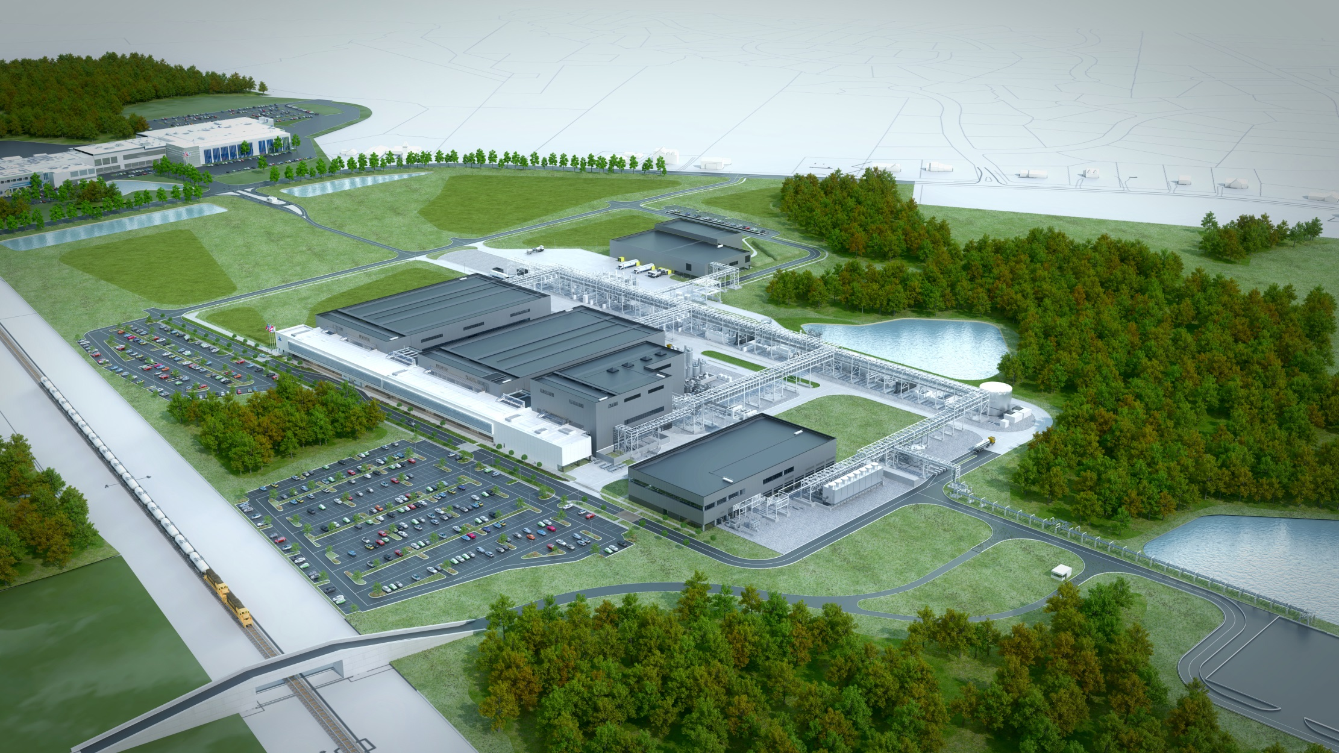
825,000
SQUARE FEET of Operations & Administrative
125,000
TEMPORARY OFFICE SPACE
3,700
PEAK SITE STAFF
+1,000
DOORS
480,000
LINEAR FEET PIPING
16,000
VALVES

Slide 6

Table of Contents
Designing for EHS
Establish key partnerships
“At Novo Nordisk, our ambition is bold and simple: to have zero environmental impact. To get there we are adopting a circular mindset – reshaping our business practice to minimize consumption and eliminate waste.”
Construction safety
Construction health
Life Critical
Sustainability in Action
Operational Readiness

Slide 7
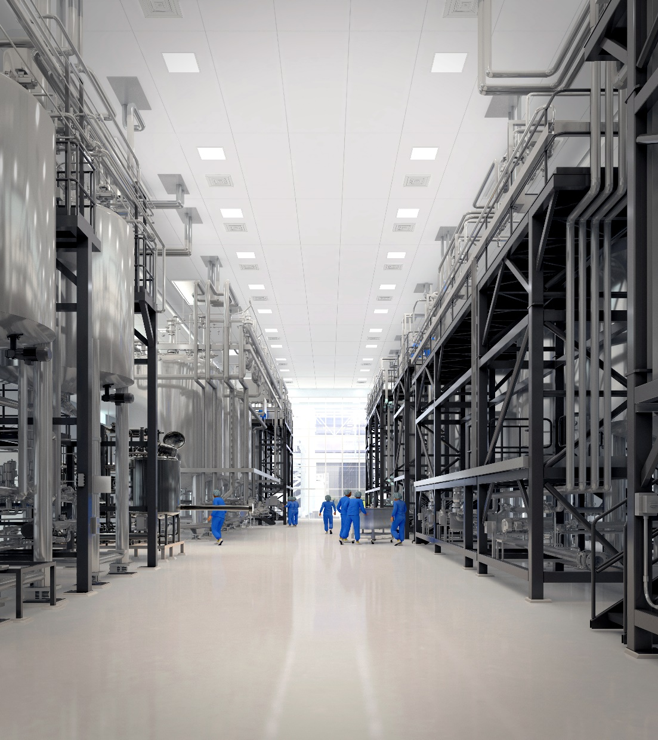
Designing for EHS
Distinctive Strategies:
Use of EHS Technical Specifications
3D Modelling for review of Maintenance and Serviceability
100% Containment of Firewater
Minimized Open Systems
Separation of Personnel from Manufacturing
Rigorous PSM/PHA/LOPA
“Compliance Is Not Enough”
Notes:
Matt

Slide 8







Establishing Key Partnerships
Notes:
Matt

Slide 9
Construction Safety
Novo Nordisk DAPI US vs Industry
(Lower values are better)
Distinctive Strategies:
Rigorous Contractor Pre-Qualification
HSE Professional Representation Requirement
Safer Together Engagement
Craft HSE Committee
STA Quality/Adopt-a-crew
Biscuits
Hazard Elimination Cards
Daily Area ‘Board Meetings’
Leading Indicator Tracking
Gift Awards
Monthly & For Cause Drug Screening
LTIR = Lost Time Incident Rate
DART = Days Away, Restricted, or Transferred
TRIR = Total Recordable Incident Rate
Notes:
Bailey

Slide 10

Construction Safety
Graph of lagging statistics and vs. averages
Key challenges 2018
Notes:
Bailey

Slide 11










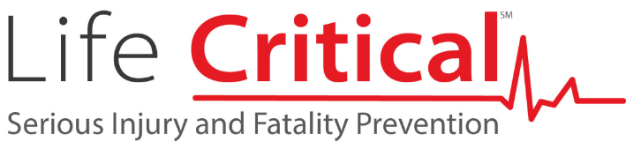
Construction Safety: Life Critical
Work at height
Cranes and rigging
Motorized heavy equipment
Trenching and excavations
Motor vehicle operation
Electrical work
Material handling
Hazardous energy control/
line breaking
Confined space entry
Notes:
Bailey

Slide 12
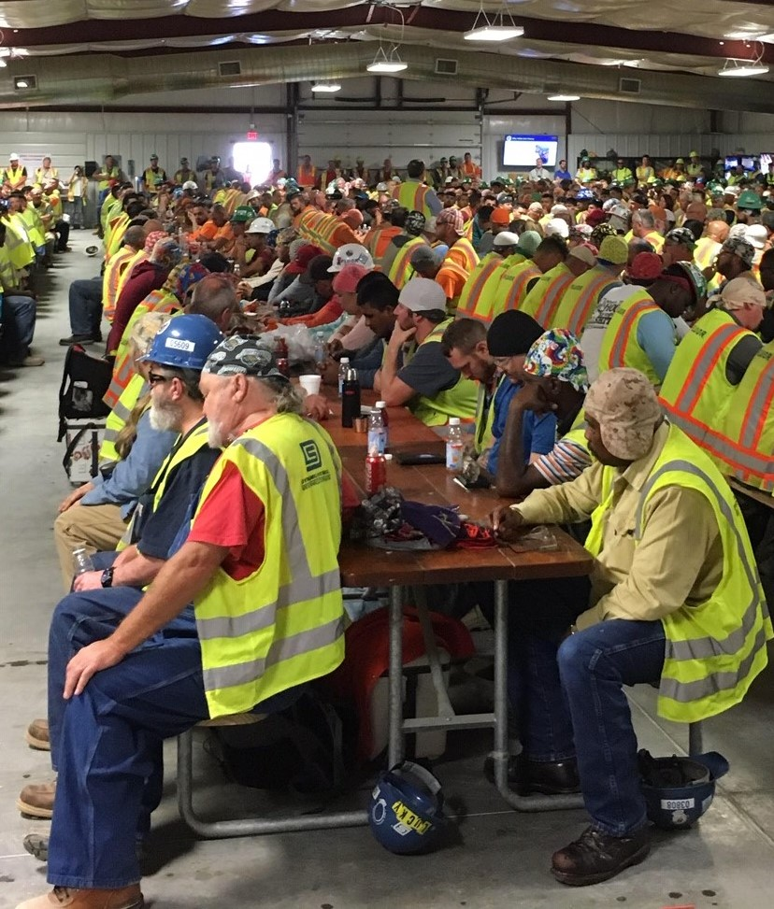
Construction Health
Distinctive Strategies:
People-Focused Logistics:
  Conditioned Canteens
  Conditioned Toilet Trailers
  Lunch Service
  Traffic Management
  Do not ‘walk and talk’
Medical Services:
  Full-Time Physicians Assistant
  On-site medical facility
  Health initiatives
Notes:
Bailey

Slide 13

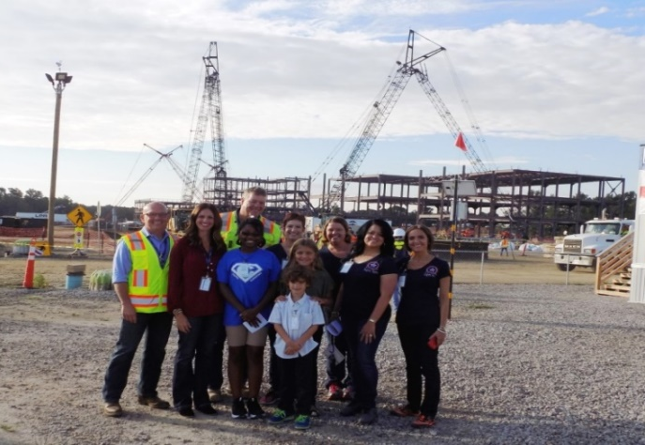
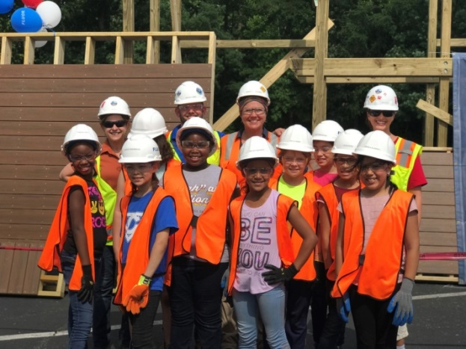
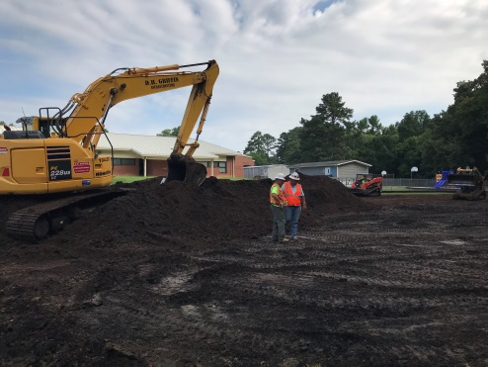
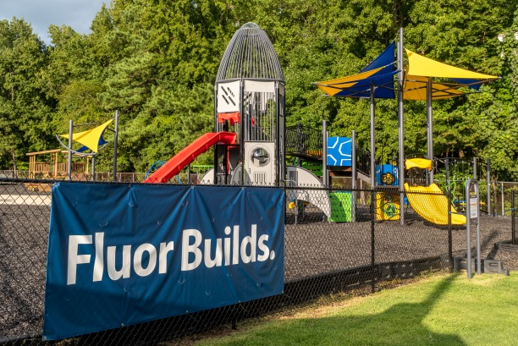
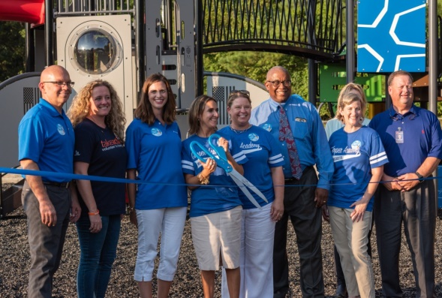
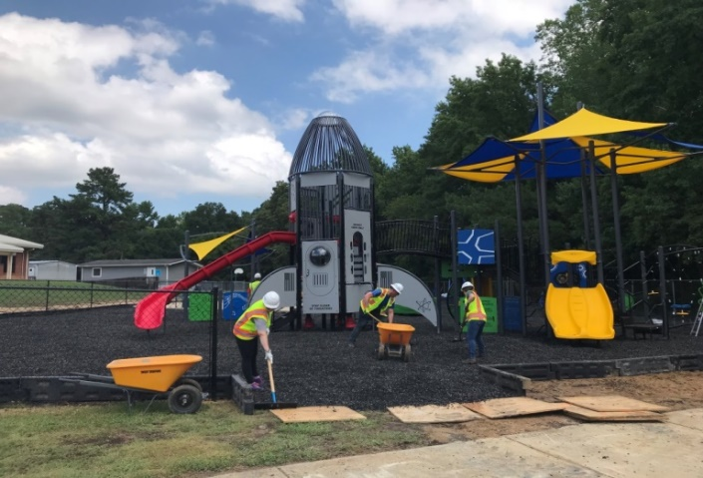
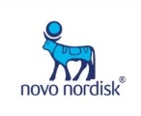
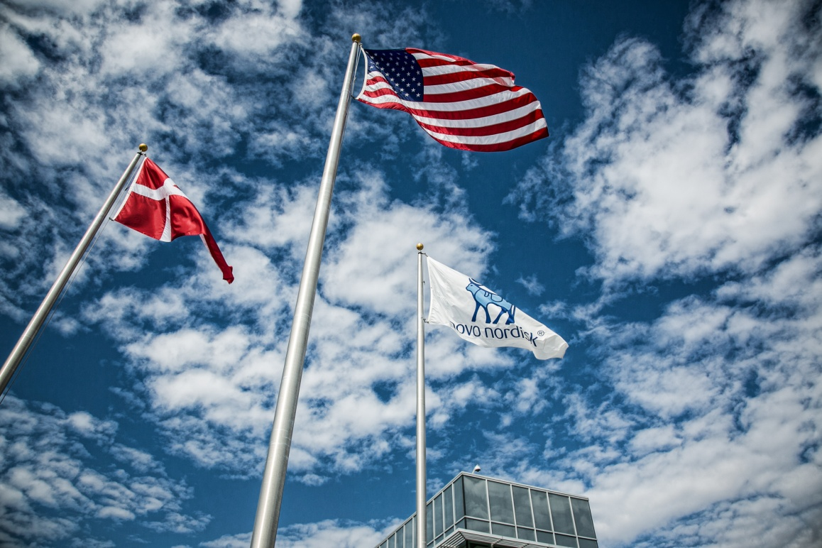
Construction Health: Community Relations
Notes:
Bailey

Slide 14
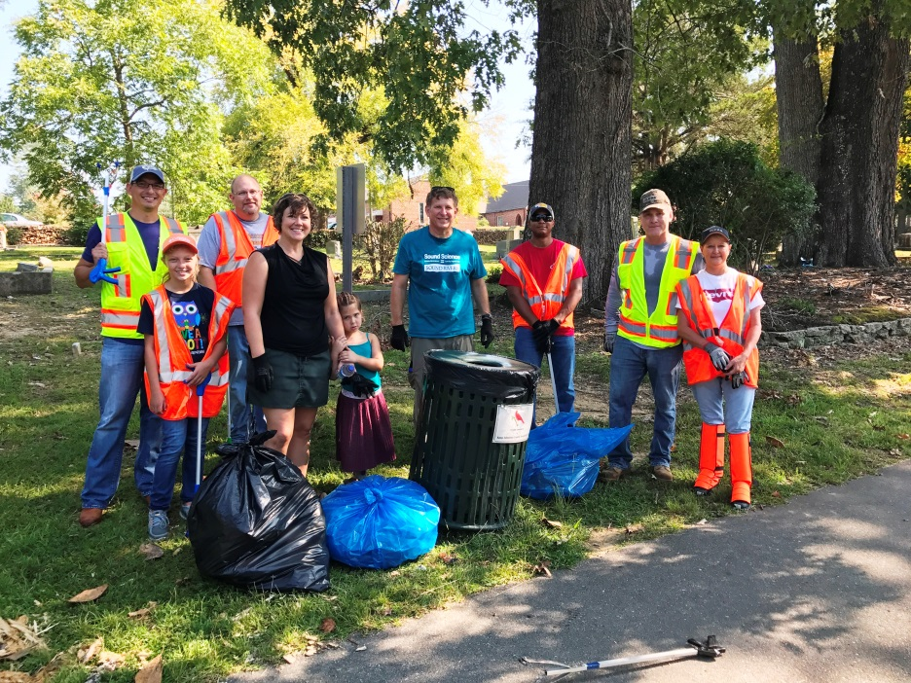

Sustainability in Action
Distinctive Strategies:
  LEED Aspirations
  Mitigation of waste
  Utilization of Resources
#1 in Class
LEED Silver certification for a pharmaceutical production site in NC
87% waste
Recycled during construction
88K gal/day
Savings of water
Diabetes screening in Ghana

Slide 15
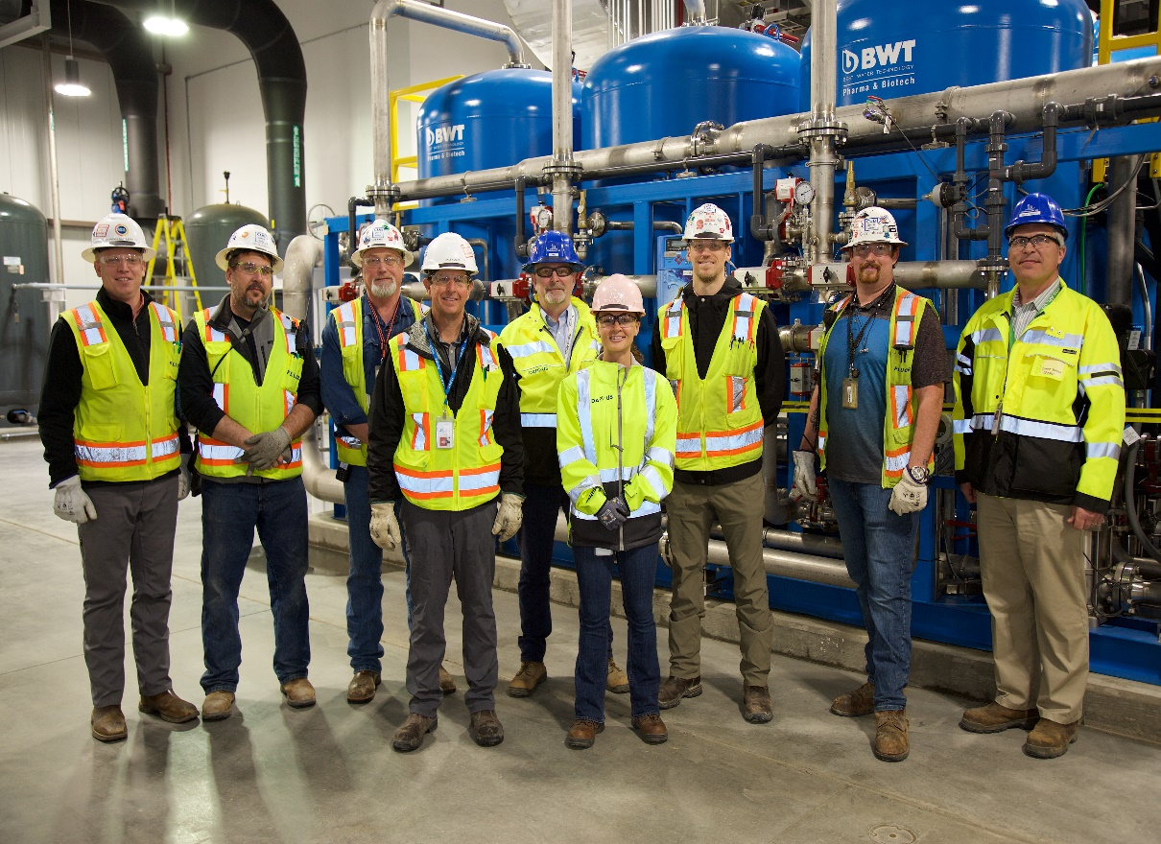

Strategies for transition to Operations
Distinctive Strategies:
  Leverage knowledge of site expertise
  Transition program ownership
  Systematic start-up of equipment
  Communication across boundaries
Notes:
Matt

Slide 16
Operational Readiness
Distinctive Strategies:
  Foundation of Compliance
  Situational Awareness
  Introduction of Chemicals
  Environmental Symbiosis
Notes:
Matt

Slide 17
What
?
QUESTIONS
or
comments…
Notes:
Matt and Bailey

Slide 18
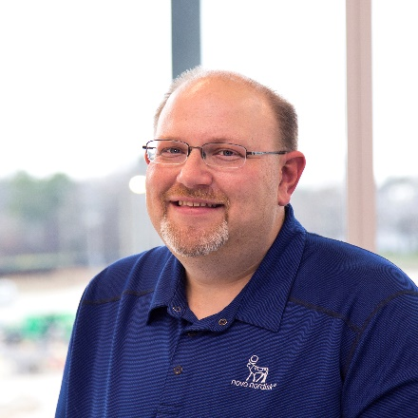
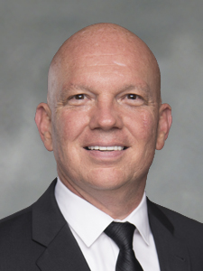
Contact Information
Matt Kuntz
Novo Nordisk Pharmaceutical Industries, LP
Senior Engineer, EHS Programs
3611 Powhatan Road, Clayton, NC 27547
MWKN@novonordisk.com
Bailey Forrest
Fluor
Sr Director, Project Management, RTP Office
1001 Aviation Parkway, Suite 100, Morrisville, NC 27560
bailey.forrest@fluor.com | Mbl: 919.868.1356 | Off:919.213.2552
Notes:
Matt and Bailey

