Slide 1
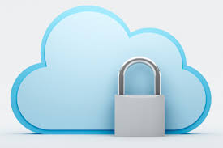
Why Critical Data is More Secure FOR LIFE SCIENCES in the Cloud
Jeff Miller
Chief Technologist, Avid Solutions Inc.
3:00pm – 3:45pm
March 14, 2017

Slide 2
A fast-growing system integrator specializing in industrial automation and information solutions.
Identifies and selects best-in-class platforms, designs and implements systems, and provides verification and validation documentation and services.
Turnkey capabilities include UL panel fabrication and installation and system commissioning.
Exceptional depth in PLC, HMI, DCS, and information applications in the following process industries: chemical, food & beverage, life sciences, power generation and pulp & paper.
Find out more at www.avidsolutionsinc.com.

Slide 3
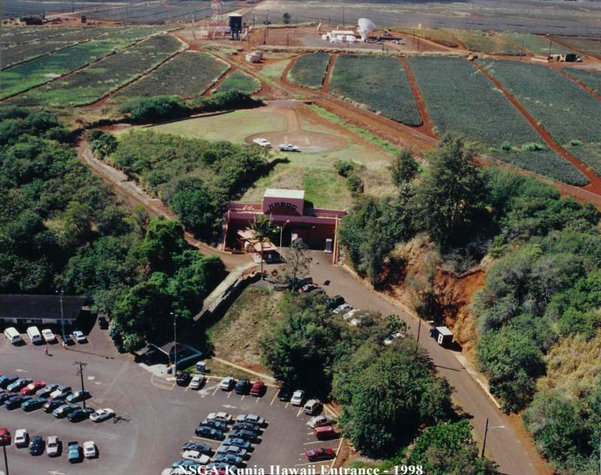
Jeff Miller
Background Information
Kunia Operations Center in Hawaii
Worked as cryptologist at Kunia Regional SIGINT
Operations Center in Hawaii
May 2013 - NSA employee Edward Snowden incident
Breach revealed system failure and lack of security
Information is not safe in private data centers
Public secure data centers are shifting the paradigm

Slide 4
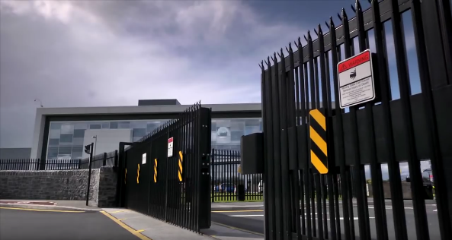
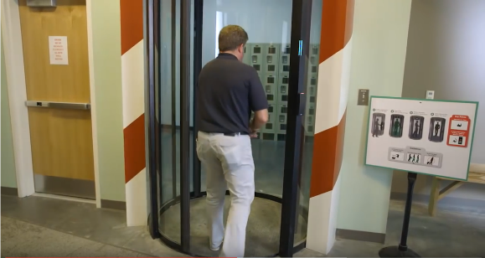
Physical Security
Public Data Centers
Access is tightly controlled
Secured by:
Biometric Scanners
Intrusion Detection Systems
Two-factor Security
Badge Readers
Video Surveillance
Mantraps
All hard drives are destroyed after decommissioning
via magnets and shredding
Restricted Access
Mantrap

Slide 5
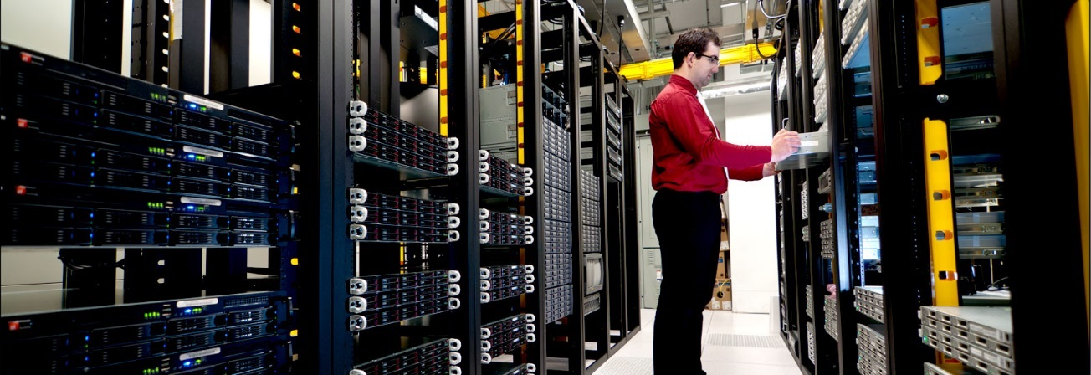
Non-Dedicated Resources
In traditional data centers – staff has many roles
Problems can get overlooked
Level of distraction/Lack of attention
In public data centers – staff is on hand 24/7
Identifying failed hardware
Leveraging technology that predicts failures
Regularly executing proper system maintenance
System Maintenance

Slide 6
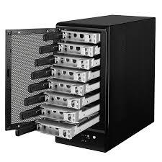
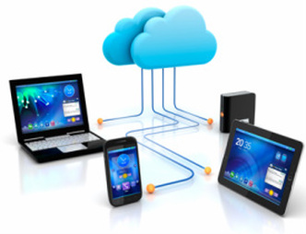
Data Integrity
Traditional Data Centers
Rely on manual backups and local RAID
Ask integrators for programs from
projects completed years earlier
Public Data Centers
Data is stored across servers, rooms and containers
Data is replicated across different
geographic locations
Data can move; reducing network latency

Slide 7
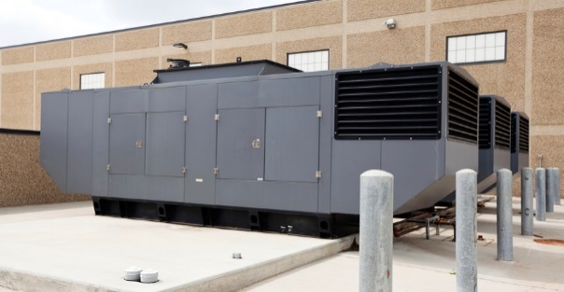
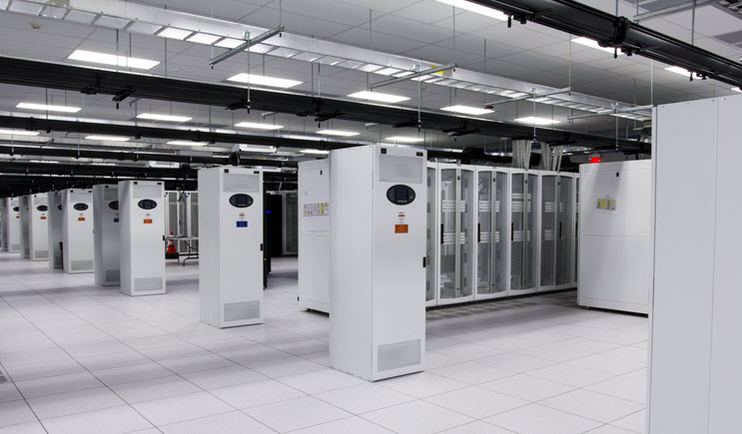
Data Availability
Traditional Data Centers
Power outages cause problems with servers, storage arrays and routing systems
Generators are used for long term outages, but are not designed to keep data centers running
Public Data Centers
Always on – powered by multiple sources
Cooling systems only work on necessary components – saving energy
Generator
Cooling System

Slide 8
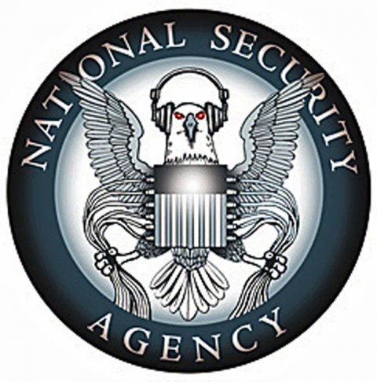
Data Security
Public Data Centers
Data is encrypted in transit and at rest
So secure it is approved by the NSA to
encrypt Top Secret information
Data separated by:
Customer
Database
Separate Networking Resources
Network traffic directed to specific hosts

Slide 9
Summary and Conclusions
But, as Amazon senior vice president of web services Andy Jassy told Fortune Magazine recently, news of Amazon's selection by the CIA gave other security-conscious companies cover to follow suit. "They would say 'well, if the security and performance is good [enough] for the CIA, then it's probably good enough for us’," Jassy said.
The future is the cloud - embrace it like a soft fluffy pillow.

Slide 10
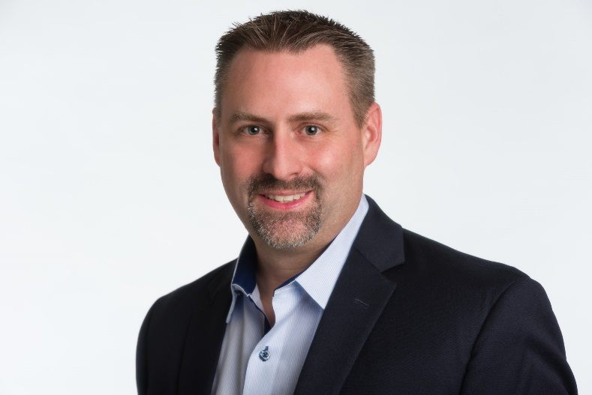
Jeff Miller Chief Technologist Avid Solutions Inc.
jmiller@avidsolutionsinc.com
Direct Line 919.228.6637

