Slide 1
Control System Virtualization- Minimizing Validation Impact at Biogen
Steve Austin
Jon Thompson

Slide 2
Speakers
Steve Austin - Biogen
Steve is the Senior Manager of Automation Engineering for Biogen and has over 25 years of experience in the Life Sciences industry. Steve holds an AS in Electronic Engineering and a Bachelor of Applied Sciences degree in Information Technology/Computer Systems.
Jon Thompson- Avid
Jon graduated from Indiana University with a BS in Chemistry and holds an MBA from Indiana Tech. He started his career in Specialty Chemicals but moved quickly into a Life Sciences role and has been in that industry for over 20 years.

Slide 3
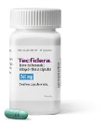
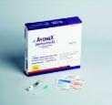
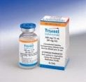
Biogen
Company Bio
Through cutting-edge science and medicine, Biogen discovers, develops, and delivers to patients worldwide innovative therapies for the treatment of neurodegenerative, hematologic and autoimmune diseases.
Noteworthy Products

Slide 4
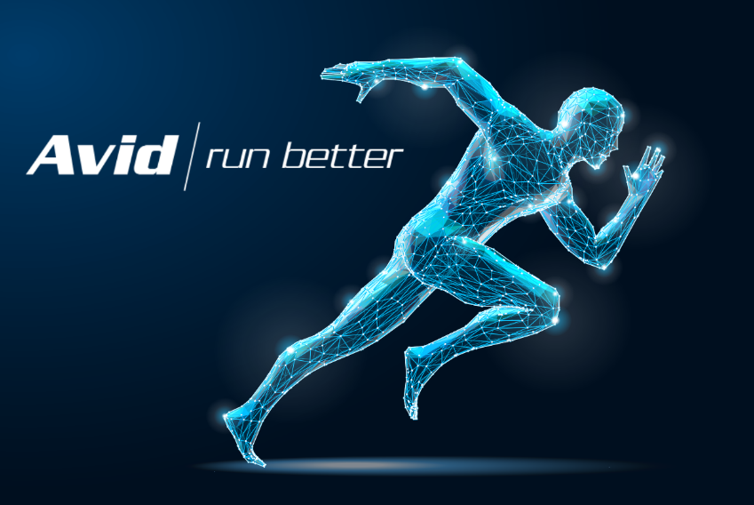
Avid Solutions
Systems Integrator
Established in 1987 - Three Offices
Winston Salem
Raleigh
São Paulo
Over a Millennia of Automation Experience
Extensive Upgrade & Migration Experience
CSIA Certified Integrator
Wonderware Endorsed System Integrator

Slide 5
Legacy System and Project Objectives
Roadmap to improved operations through strategic Solutions

Slide 6
Project Overview
Legacy System
Between 2007 and 2009 a greenfield Parental Filling facility was built in Research Triangle Park. Avid Solutions was picked as the automation integrator for this project, named Parenteral Control System (PARCS)
The system was comprised of:
Batch Management (custom built)
Asset Management (custom built)
Operator interfaces (System Platform 3.0 SP2 / InTouch)
Recipe Management (FMO)
Batch Reporting (PEM, SSRS)

Slide 7
Increase supportability and scalability
Increase redundancy in hardware
Decrease production downtime for failures/maintenance
Create Automated backups for completed Disaster Recovery
Ability to upgrade/replace hardware in real-time

Slide 8
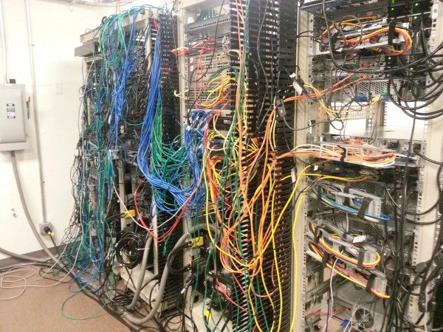
Hardware: Issue
Existing Problems
Existing server hardware was 10+ years old
Obsoleted hardware including servers and individual components
Power supplies
Hard drives
No hardware redundancy
Consumes multiple server racks

Slide 9
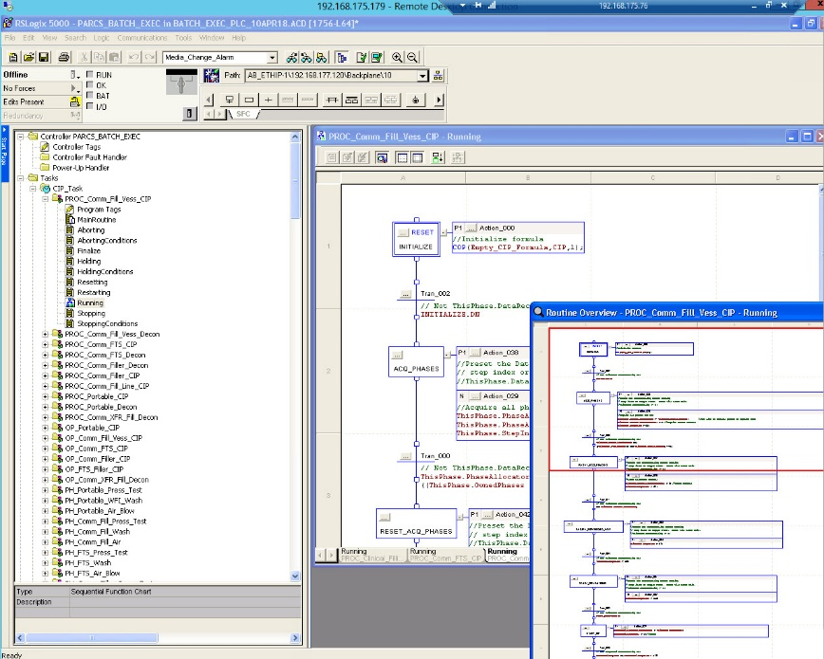
Batch Software: Issue
Existing Problems
The original solution consisted of a code within a ControlLogix PLC and used Wonderware’s Sequencing Objects to create a very complex batch engine. Over time, several issues with this solution became apparent.
Difficult for Biogen to update and or support
Lacking standard documentation, training new employee’s on use or maintenance of the system was prohibitive
Not supportable by Wonderware

Slide 10
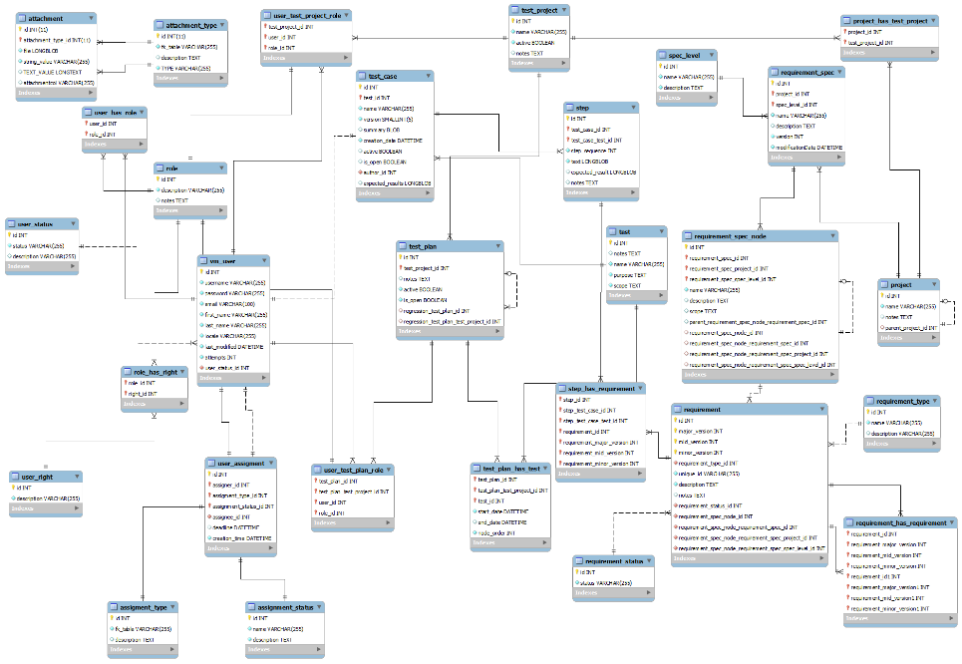
MES: Issue Summary
Existing Problems
The custom asset management system consisted of an excessive amount of custom SQL tables, views, and stored procedures. As it had evolved over the life of the original project there was a significant amount of zombie code and enough spaghetti to feed a family. It suffered from the following:
Custom tables not indexed correctly
Difficult for Biogen to update or support
Data maintenance prohibitively difficult, resulting in loss of performance over time

Slide 11
Production Events Module: Issue
Existing Problems
The Production Event Monitoring objects were a key component used to gather the data required for the batch reporting.
Transactional data from equipment skids
Key cycle events
Software was obsoleted by Wonderware

Slide 12
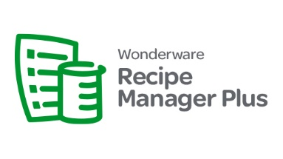
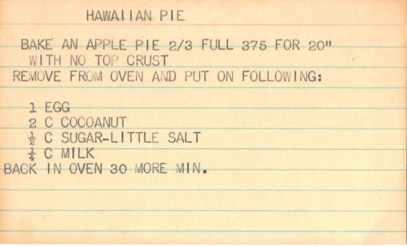
Recipe Management: Issue Summary
Existing Problems
Formula Management Object (FMO) was obsoleted by Wonderware
These objects were used with system platform to create an automated recipe download template applied to all equipment
Replacement software needed to replicate FMO functionality without modifying equipment skids

Slide 13
Production Simulation: Issue
Existing Problem
Validation efforts using physical equipment would have required months of downtime and likely incurred overtime costs in multiple departments
Shutdown period only allowed for 2 weeks for validation activities using equipment and manufacturing support

Slide 14
Upgraded Solution
Leveraging Out of the Box and Virtualization for Improved operations and minimized Validation

Slide 16
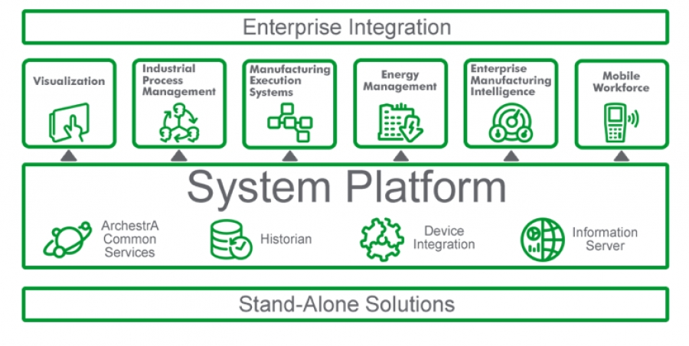
Wonderware Upgrade Overview
Design Solution
The PARCS upgrade project consisted of the following:
Virtualization of solution hardware
Upgrade the existing Wonderware System Platform components from 3.0 SP2 to the latest supported version (2016)
Replacing the custom batch system with Wonderware InBatch
Replacing the custom asset management solution with Wonderware MES Operations
Replace the obsolete FMO solution with Wonderware Recipe Manager Plus
Migrate the functionality from the obsolete PEM objects to the updated Operations OCO option
Segregation of production lines

Slide 17
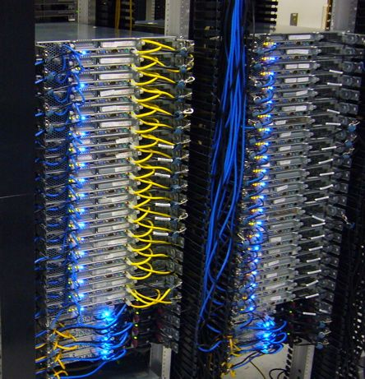
Hardware: Upgrade Solution - Virtualization
How did we fix the problems?
3 server cluster VMware Solution
Redundant Storage Arrays
Automated image backups using Veeam
Redundant network/server components
Switches
Power Supplies
Difficult to maintain backup solution

Slide 18
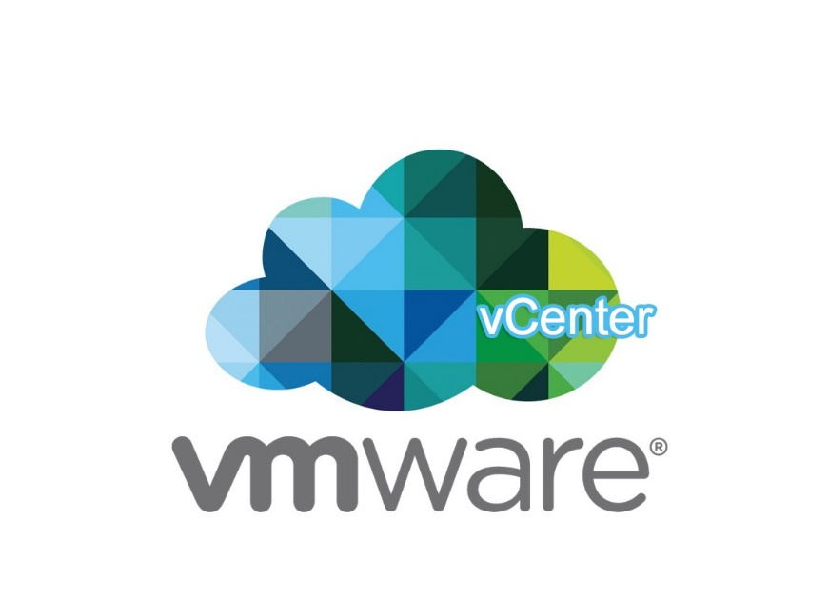
Virtualization: Benefits
What were the customer benefits?
Sized for future expansion
Full hardware/application redundancy
Decrease in production downtime due to failures/maintenance
Automated backups for completed Disaster Recovery
Ability to upgrade hardware resources in real time

Slide 19
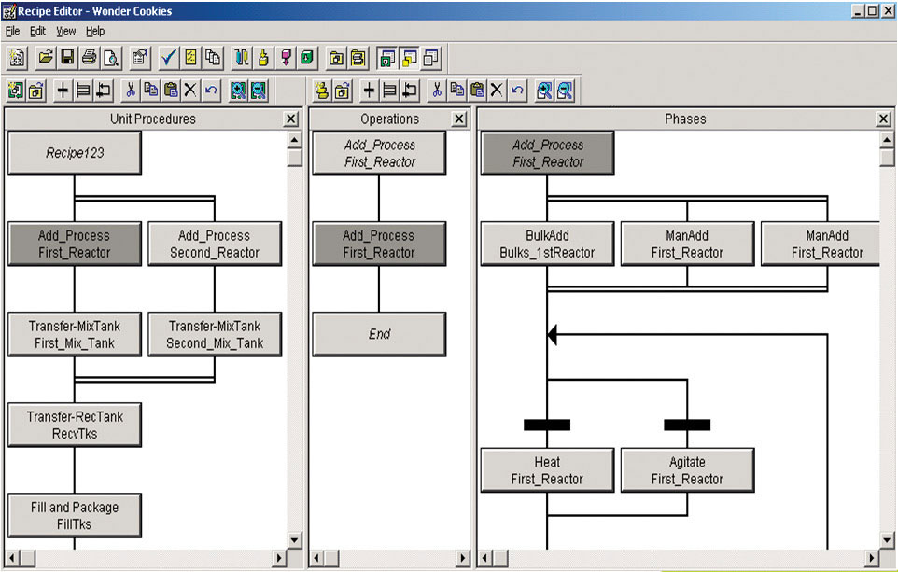
Batch Software: Upgrade Solution - InBatch
How did we fix the problems?
Off the shelf batch solution that provides ISA-88 compliance
CFR Part 11 Compliant
Windows UI based standardized recipe and batch management

Slide 20
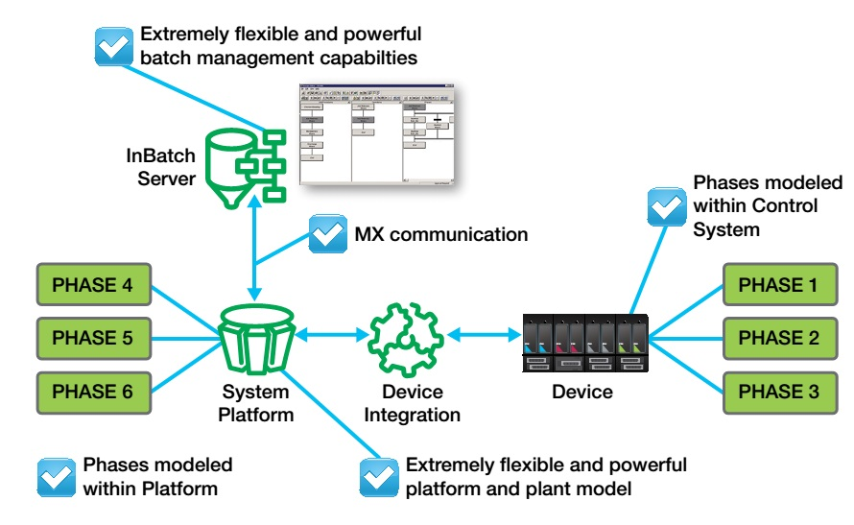
InBatch Benefits
What were the customer benefits?
Full ISA-88 compliance
Easily updated Recipe modules and parameters vs custom PLC logic
No knowledge of control system required
Standardized data model for reporting
Supportable by Wonderware and extended integrator ecosystem

Slide 21
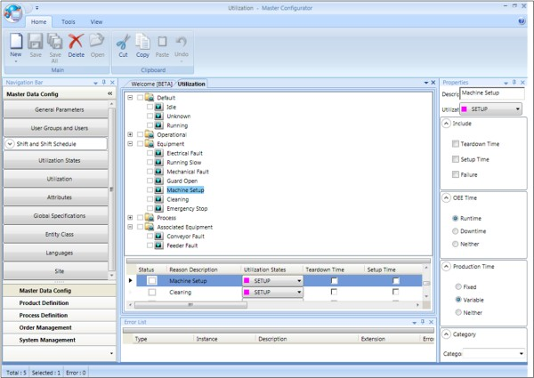
MES: Upgrade Solution – MES Operations
How did we fix the problems?
Off the shelf MES software used for asset and item tracking as well as standard MES functionality such as consumption, production, and quality metrics
Uses standardized schema with ability to configure to customer requirements
Direct integration with System Platform

Slide 22
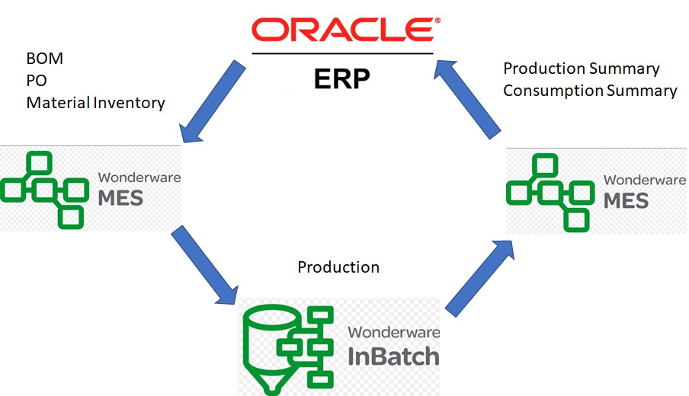
MES Operations Benefits
What were the customer benefits?
Fully supported by Wonderware
Use of standard System Platform APIs
Sync between InBatch and MES for work orders and batch data
Tracking of asset statuses such as sterilization and location
Tailor user interface to Biogen requirements
Standard data model for reporting
Included database maintenance tools

Slide 23
PEM Module: Upgrade Solution – OCO
How did we fix the problems?
Standard replacement path for PEM objects
Allows for replication of original PEM object functionality
Used to record transactional data with custom associations

Slide 24
Operations Capability Object: Benefits
What were the customer benefits?
Lowered engineering requirements to replace original PEM software
Easy to maintain internally by Biogen
Fully supported by Wonderware

Slide 25
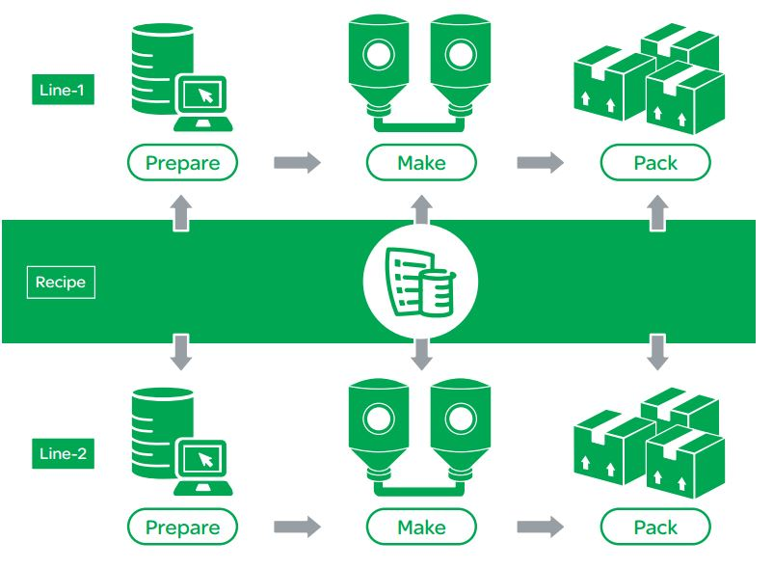
Recipe Management: Upgrade Solution – Recipe Manager Plus
How did we fix the problems?
Web based management interface
Built in reporting capability
Recipe enforcement
Direct integration with System Platform

Slide 26
Recipe Manager Plus: Benefits
What were the customer benefits?
Recipe modifications can be completed via web interface
Full traceability with recipe editing and downloads to equipment
Similar in design to FMO which allowed for easier migration
Fully supported by Wonderware

Slide 27
Production Simulation: OI Sim
How did we fix the problems?
Used the Simulation DAS to create virtual objects replicating the physical equipment I/O
Used System Platform scripting to emulate equipment functionality and handshaking
Simulation modules tied to Production Intouch application

Slide 28
Production Simulation: OI Sim - Benefits
What were the customer benefits?
Allowed for fully simulated testing environment
Completed 6 week validation effort using simulation without affecting production schedule
Completed remaining validation activities in 8 days during scheduled shutdown
Can be used for training engineers and manufacturing associates
Scalable for future upgrades

Slide 29
Conclusion
Project Benefits
Fully supportable off the shelf base software packages configured to Biogen requirements
Reduction of downtime validation activities from 8 weeks to 8 days
Ability for Biogen to support, maintain, and improve the solution internally
Reduction in future downtime with validated simulation environment

Slide 30
Q&A

