Slide 1
Digitization of Large Molecule Biologics Technology Transfer
Kyle Anderson
Clay Schaeffer

Slide 2
Who is Biogen?
Introduction

Slide 3
Forward-looking statements
This presentation contains forward-looking statements, including statements made pursuant to the Private Securities Litigation Reform Act of 1995, relating to:
Biogen’s strategy and plans; potential of our commercial business and pipeline programs; clinical development programs, clinical trials and data readouts and presentations; the potential safety and efficacy of our products and investigational therapies; regulatory filings and the timing thereof; and anticipated benefits and potential of investments, collaborations and business development activities.
These forward-looking statements may be accompanied by such words as ‘aim,’ ‘anticipate,’ ‘believe,’ ‘could,’ ‘estimate,’ ‘expect,’ ‘forecast,’ ‘goal,’ ‘intend,’ ‘may,’ ‘plan,’ ‘potential,’ ‘possible,’ ‘will,’ ‘would’ and other words and terms of similar meaning. Drug development and commercialization involve a high degree of risk, and only a small number of research and development programs result in commercialization of a product.
Results in early stage clinical trials may not be indicative of full results or results from later stage or larger scale clinical trials and do not ensure regulatory approval. You should not place undue reliance on these statements or the scientific data presented.
These statements involve risks and uncertainties that could cause actual results to differ materially from those reflected in such statements, including those risks and uncertainties that are described in the Risk Factors section of our most recent annual or quarterly report and in other reports we have
filed with the SEC.
These statements are based on our current beliefs and expectations and speak only as of the date of this presentation. We do not undertake any obligation to publicly update any forward-looking statements.

Slide 4

Our MISSION is clear.
We are PIONEERS in neuroscience.

Slide 5

Transforming
neuroscience through
RESEARCH &
DEVELOPMENT
EMPLOYING SOME OF
THE WORLD’S BEST
IN NEUROSCIENCE
RESEARCH
~20%
OF ANNUAL REVENUES
INVESTED INTO R&D
OVER PAST DECADE
ONE OF THE LARGEST &
BROADEST PROGRAMS IN
THE BIOPHARMA INDUSTRY
>$2b
SPENT ON R&D
IN 2018 ALONE
~30k
PATIENTS ENROLLED
IN ACTIVE STUDIES*
170+
ACTIVE STUDIES**
* Active patient data source: IMPACT clinical trial management system (CTMS).
** Active studies include studies between pre-Study Management Team (SMT) Formation and the Clinical Study Report (CSR) and are defined by internal systems (Clarity) as of October 17, 2019.

Slide 6
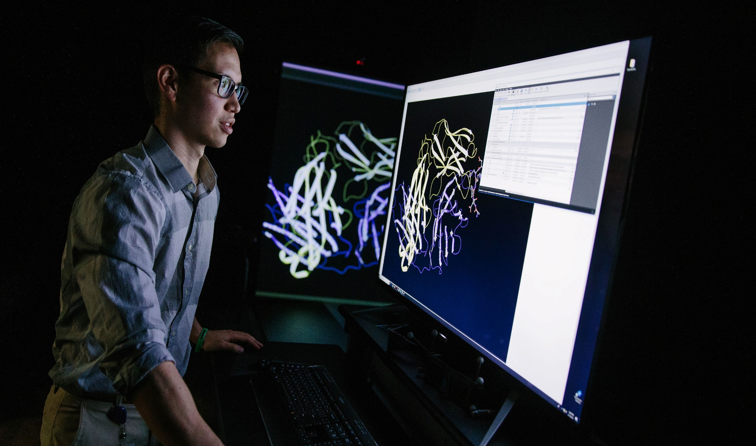

Continuing
to build a
MULTI-FRANCHISE
PORTFOLIO
as we work to diversify
within neuroscience
NEUROCOGNITIVE DISORDERS
PAIN
IMMUNOLOGY / OTHER
IMMUNOLOGY / OTHER
OPHTHALMOLOGY
OPHTHALMOLOGY
STROKE
ACUTE NEUROLOGY
MOVEMENT DISORDERS
MOVEMENT DISORDERS
ALZHEIMER’S DISEASE
ALZHEIMER’S DISEASE
SPINAL MUSCULAR ATROPHY
NEUROMUSCULAR
NEUROMUSCULAR
MULTIPLE SCLEROSIS
MULTIPLE SCLEROSIS
MULTIPLE SCLEROSIS
MULTIPLE SCLEROSIS
YESTERDAY
TODAY
EARLY 2020s
OUR VISION
BIOSIMILARS
BIOSIMILARS
BIOSIMILARS

Slide 7
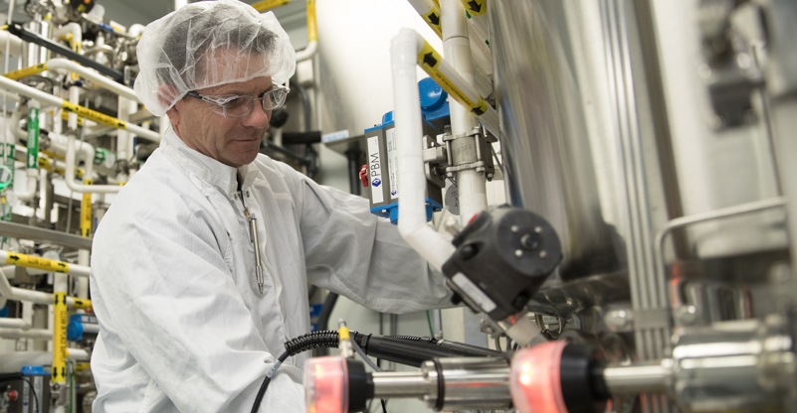
Working to bring
our high-quality
MEDICINES
TO MARKET
ONE OF THE
LARGEST PRODUCERS
OF BIOLOGICS
IN BIOTECH
102
COUNTRIES RECEIVE
OUR PRODUCTS
248k L
OF BIOREACTOR
CAPACITY GLOBALLY*
39
DIRECT AFFILIATE
MARKETS
2
MANUFACTURING
SITES
North Carolina, U.S.
Solothurn, Switzerland#
* Includes anticipated capacity of Solothurn, Switzerland, which is
expected to be partially operational by the end of 2020.
# Expected to be partially operational by the end of 2020.

Slide 8







COMMITTED
to our employees,
diversity and inclusion,
and environmental
sustainability
7,300+
EMPLOYEES WORLDWIDE
CARBON NEUTRAL
COMPANY SINCE 2014
46%
OF DIRECTOR-LEVEL
POSITIONS & ABOVE HELD
BY WOMEN GLOBALLY*
~70%
REDUCTION IN
POTABLE WATER
INTENSITY
IN 2018**
76%
Reduction in
operational
carbon intensity
SINCE 2006
6
CONSECUTIVE YEARS
“BEST PLACE TO WORK for
LGBTQ EQUALITY”
100%
RENEWABLE POWER
COMMITMENT
* Biogen data on file as of September 30, 2019.
** As of December 31, 2018.

Slide 9
What’s the problem?

Slide 10

Biogen?
Tech Transfer
Transmission of product manufacturing knowledge from one business center to another.
Required for different needs:
Process development: transfer of processing knowledge and scale up from R&D to Pilot to Clinical Scale to Production.
Asset Transfer: moving product manufacturing from one site to another, internal or external to the company.
Requires development, review and validation of
key quality and control parameters,
process sequencing,
materials and equipment definition,
operating procedures.
Introduction

Slide 11

Problem statement
  How do we continue to efficiently manage our tech transfer process when we have the following challenges:
  Large and growing product portfolio
  Pressure for faster time to market accelerating tech transfer times
  Multiple documentation systems for managing knowledge
  Multiple Manufacturing Assets: Site differences
FDA: “Firms should implement meaningful and effective strategies to manage their data integrity risks based upon their process understanding and knowledge management of technologies and business models”
  Partner expectations
  Regulatory expectations around data
  Culture
Notes:
Last year there was a top down directive to implement Recipe Driven Operations across Biogen. This evolved into two initiatives. The first is to standardize manufacturing systems for the execution of product recipes and the second is to modernize our tech transfer process to utilize standardized recipe management tools.
Large product portfolio
About dozen products on the market
Clinical products in manufacturing
Partner products
Manufactured at multiple facilities including in CMO partners
Accelerated knowledge transfer
Speed to market and clinic is critical
Highly utilized plants with tight production schedules requiring multiple tech transfers every year
Typical tech transfer is about 6 months
Custom tools to manage knowledge in Word documents and Excel spreadsheets developed over time because no standard alternative.
Knowledge still retained as tribal knowledge.
What about data integrity requirements
How are differences in site capabilities accounted for when products are moved between sites?
How do recipes need to be adapted to account for different equipment and procedures?
Partners have different expectations about content and format of product information.
Often time is spent determining format
Culture built around flexibility and individual contributors.
How can this be maintained while improving standardization?

Slide 12
Turning Lab Results into Manufacturing Operations
Manual Transcription

Slide 13
Knowledge Transfer Challenges
Knowledge transfer is achieved through discussion and transcription
  40+ individual solution recipes
  10+ major process steps
  15+ batch records
A process flow diagram routinely has >16,000 pieces of information
  >5000 are numeric parameters (setpoints, limits, quantities)
  Multiple new programs per year, on top of clinical and commercial restarts
This information is transcribed to secondary lists before ultimately being entered into the appropriate system
Alignment between manufacturing sites requires timely communication and manual document updates

Slide 14
Tech Transfer Digital Transformation
Digitization and standardization of our tech transfer is essential
  Ever increasing process complexity and reduced timelines
  Ensure robust and efficient knowledge transfer between development and manufacturing
  Redeploy resources from non-value added transcription activities towards increased process understanding and improvement
Collaboration between Biogen and Neo PLM to develop an enterprise recipe management solution for complex large molecule processes

Slide 15
Process Design Case Study – Media Prep
18 Component Additions
  Multiple units of measure
  Different mixing duration ranges between additions
  Several solution expiries
  >$50,000 in material costs
  One of eight similar media preparations

Slide 16
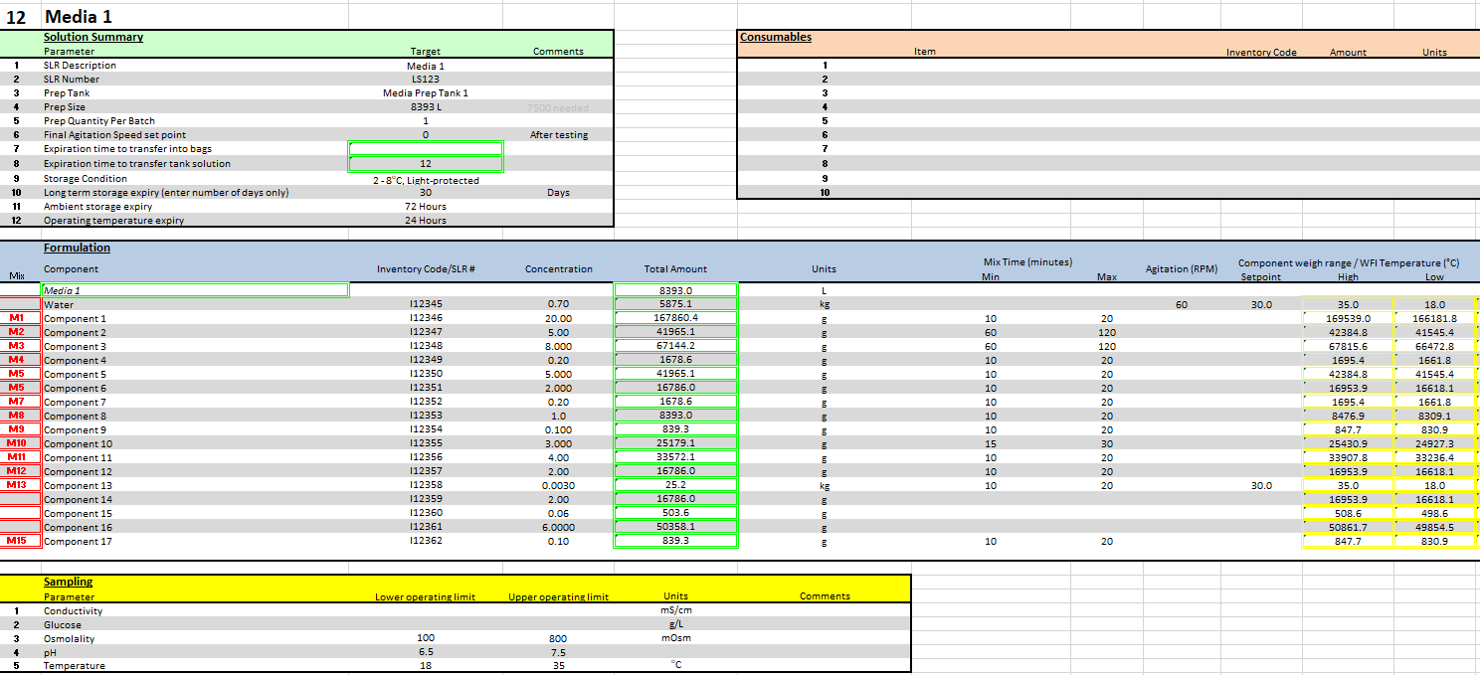
Current State

Slide 17
Current State – Challenges
Solutions tab in excel is ~1000 rows long
Information is duplicated elsewhere in the document
Historical documentation used as source for process information
Material item codes
Equipment operating ranges
Minimal visibility to similar (or even identical) solution processes

Slide 18
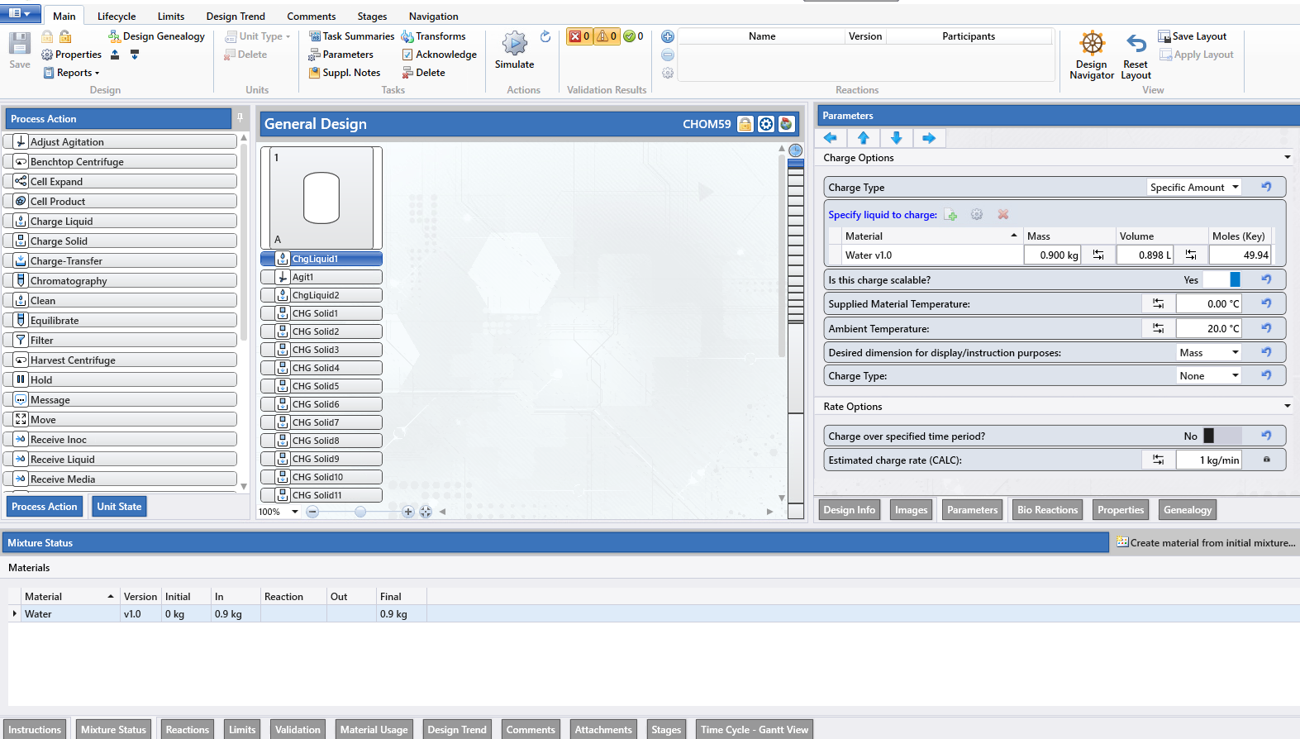
Future State - Neo PLM
General Design
Abstract, equipment independent representation of the process
Information organized and standardized via process actions
Foundation for all equipment dependent recipes for this material

Slide 19
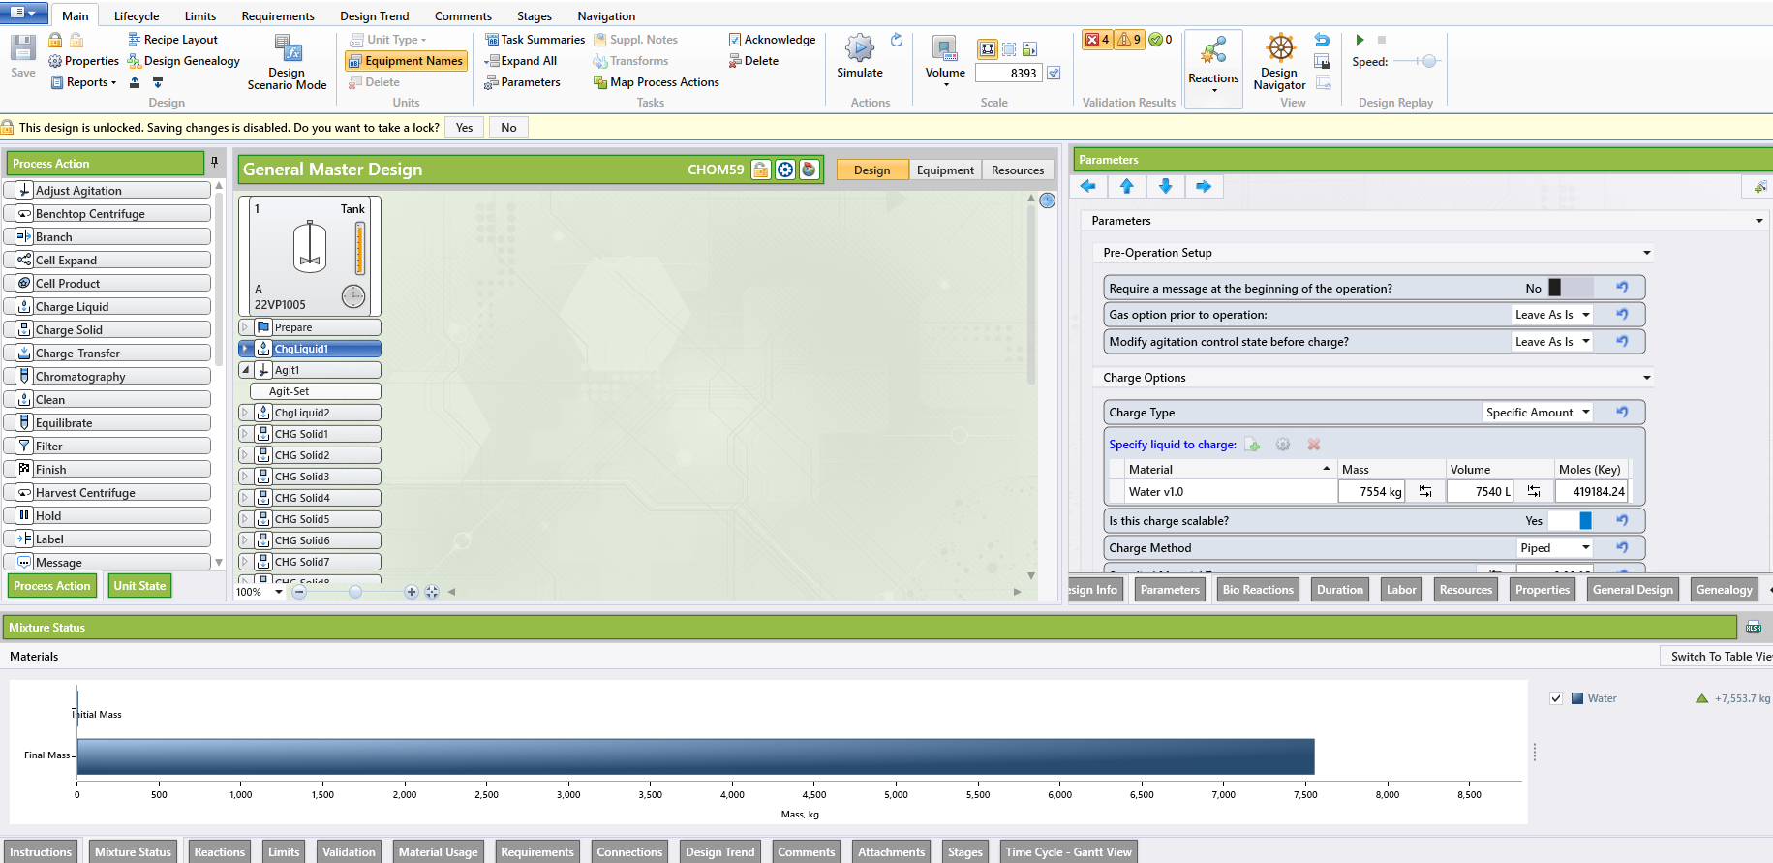
Neo PLM General Master Design
Process steps, parameters, limits, comments, material requirements automatically populated
Scale is applied and calculations are performed
Equipment selected and assessed for suitability
  For example, if agitation is required, tanks without agitation capability will be marked unsuitable
Equipment specific parameters are set
Local materials are selected
  Specific item codes, pack sizes, consumables, etc

Slide 20
Benefits
Standardization and visibility
  Simple navigation of process designs and ability to drill down to parameters, materials, limits as needed
  Designs for solutions, cell culture, and purification steps use the same building blocks and user interface
Process data is entered ONCE
  Scalable parameters and unit conversions performed automatically
  Designs are derived from one another
Direct extraction of process information
  Automation configuration files, bill of materials, batch instructions, etc
  Eliminate transcription
  >250 total pieces of information, 125 numeric values per solution
Process genealogy
  Changes to the general design cascade down to general master and master designs for change control as needed
  Related designs are immediately visible to prevent unnecessary duplication

Slide 21
Thanks and Acknowledgments
Biogen Team
Clay Schaeffer
John Campbell
Jyotika Sharma
Josh Walker
Tim Meinig
Jacqui McNamarra
Eric Carr
Neo PLM Team
Cathal Strain
Majdi Rajab
Shreyas Reddy
Kamila Lapkiewicz

