Slide 1
DRIVING CONTINUOUS PROCESS IMPROVEMENT (CPI) OF FLUID TRANSFER Processes THROUGH EMERGING TECHNOLOGIES
John W. Batts IV – Senior Technical Trainer
Avantor Fluid Handling
Life Sciences Technology Conference
February 15, 2022

Slide 2
Educational sessions III
technology

Slide 3


Driving Continuous Process Improvement (CPI) of
Fluid Transfer Processes through Emerging Technologies

Slide 4

Avantor’s leading bioproduction solutions are designed to meet the unique challenges of the industry
Customized products and solutions
(e.g., bag size, design, fill solutions)
Tailored processes and services
(e.g., supply chain data analysis)
that cater to complex needs
Cell culture components characterized & specified
for customer scale up
Flexible solutions
(e.g. Single Use fluid transfer)
for efficiency & security
Production chemicals specified for customers’ processes
High-purity customized excipients supporting drug stability & shelf life
UPSTREAM
DOWNSTREAM
FILL/FINISH
  10 of
  top 10
  biotech and
  pharma
  companies
  Downstream buffer
  product line covers
  100% of the
  traditional
  buffers packages
  used in a
  biopharmaceutical
  process
  A global network of
  cGMP
  manufacturing
  and ISO-certified
  distribution
  facilities present on
  3 continents
  Formulation
  product line covers
  95% of the
  excipients
  used in commercial
  mAbs
  Avantor’s solutions
  specified in
  >80% of the
  top 20
  biologic drugs
4
Learn more at www.avantorsciences.com

Slide 5
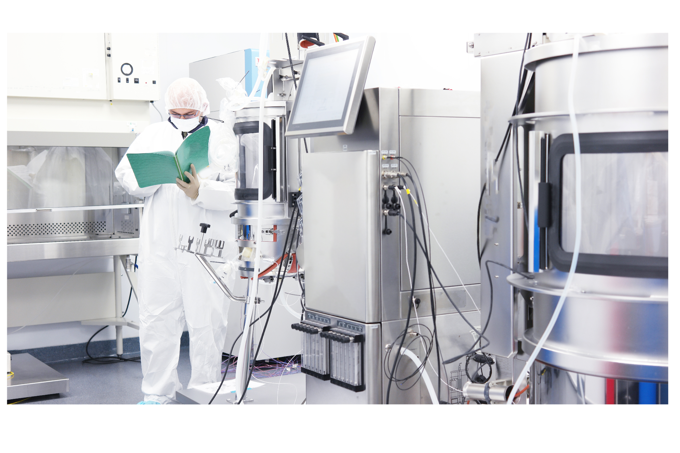
Driving Continuous Process Improvement (CPI) of
Fluid Transfer Processes through Emerging Technologies

Slide 6
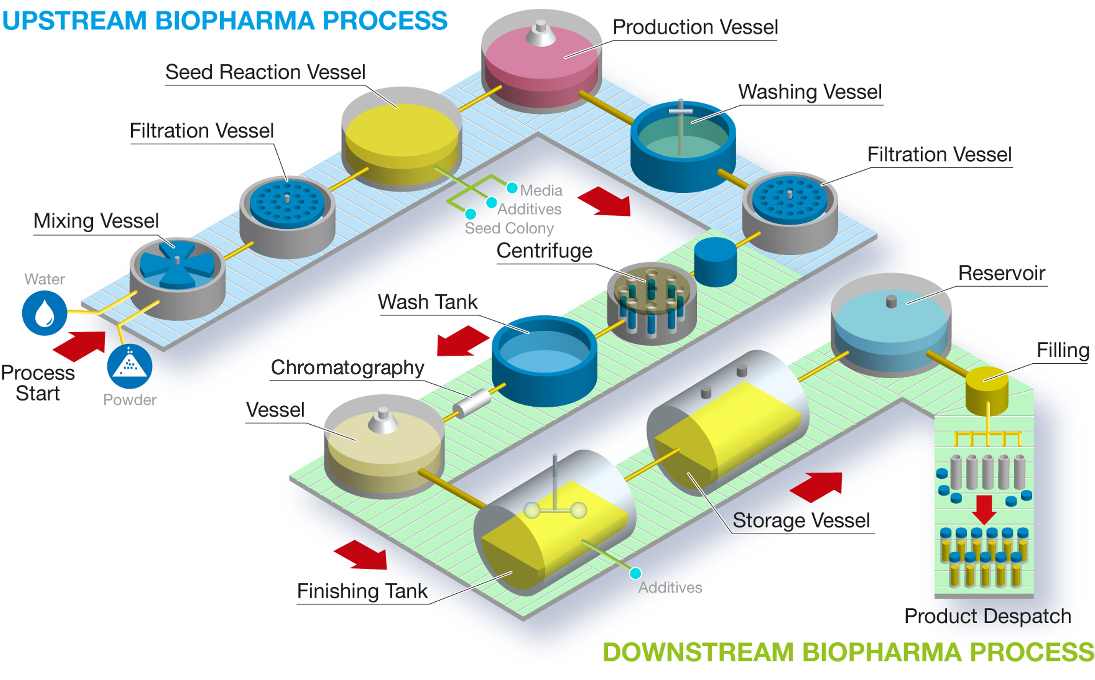
Driving Continuous Process Improvement (CPI) of
Fluid Transfer Processes through Emerging Technologies
3 Stages of Development
R&D
Pilot Plant
Production

Slide 7
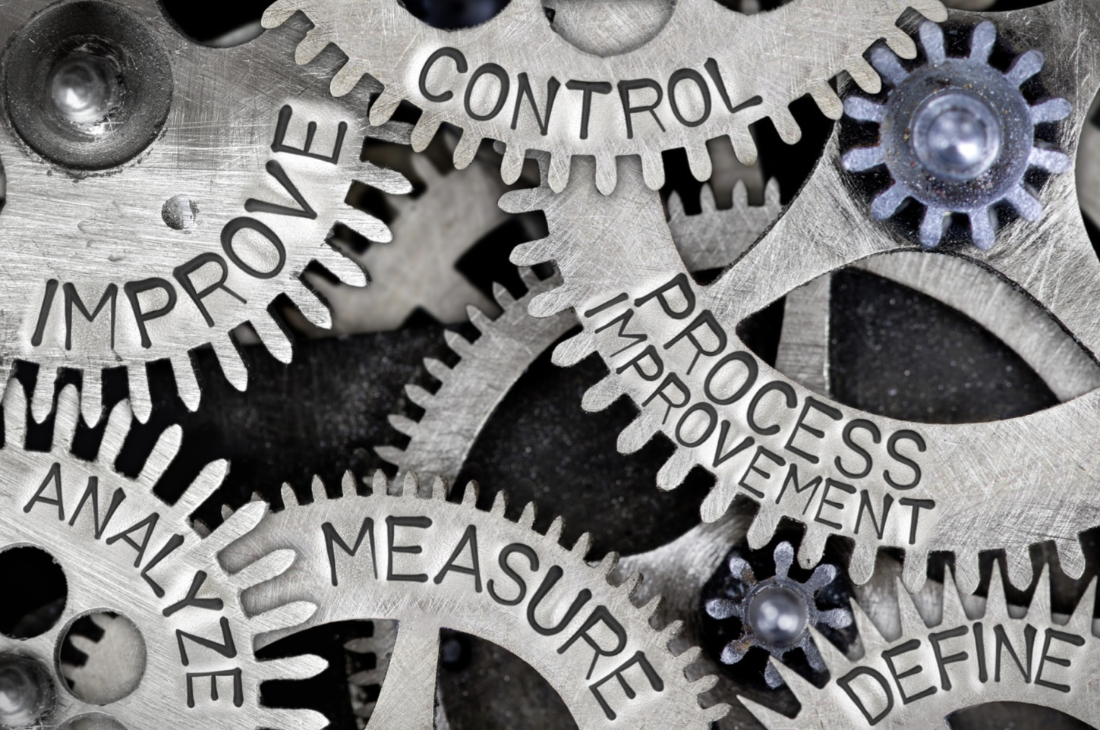
Driving Continuous Process Improvement (CPI) of
Fluid Transfer Processes through Emerging Technologies

Slide 8



Driving Continuous Process Improvement (CPI) of
Fluid Transfer Processes through Emerging Technologies
REDUCE
DOWNTIME
IMPROVE
PRODUCTIVITY
WORKFLOW
CPI Drivers
Safety
Efficiency
Ease of Use
INCREASE
PRODUCTION
YIELD
IMPROVE
CASHFLOW &
PROFITABILITY
$

Slide 9
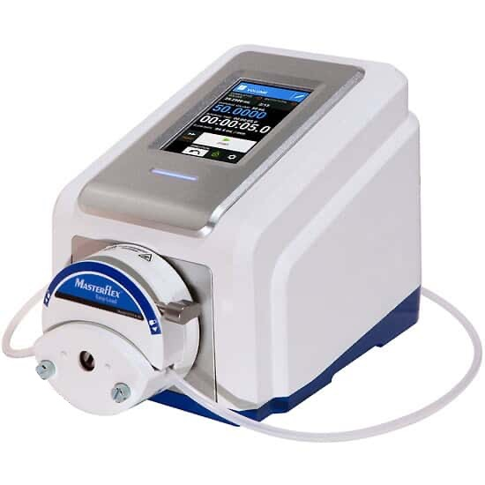
Driving Continuous Process Improvement (CPI) of
Fluid Transfer Processes through Emerging Technologies
The hardware you choose can help
you achieve your
top CPI priorities!

Slide 10
Driving Continuous Process Improvement (CPI) of
Fluid Transfer Processes through Emerging Technologies
Peristaltic pump technology offers critical advantages for bioprocessing fluidic transfer pathways

Slide 11
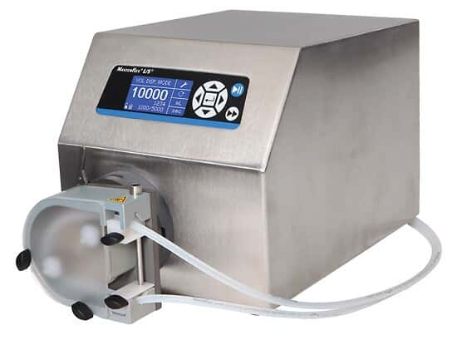
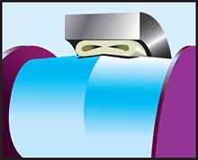
Driving Continuous Process Improvement (CPI) of
Fluid Transfer Processes through Emerging Technologies
Unique pump head design can lower shear forces and improve overall yield

Slide 12
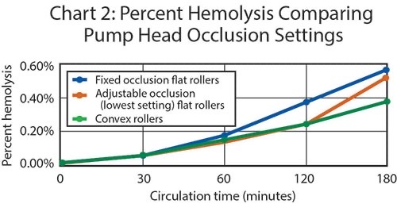
Driving Continuous Process Improvement (CPI) of
Fluid Transfer Processes through Emerging Technologies

Slide 13
Driving Continuous Process Improvement (CPI) of
Fluid Transfer Processes through Emerging Technologies
A Look @ the Value
$50 Million Annual Process Revenue
Yield Improvement of 0.2%
$100,000 Additional Revenue
Notes:
.

Slide 14
Driving Continuous Process Improvement (CPI) of
Fluid Transfer Processes through Emerging Technologies
Intelligent options available through the graphic user interface can also help achieve CPI!

Slide 15
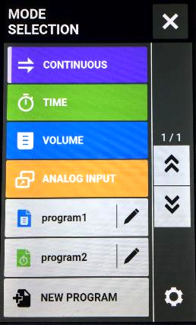
Driving Continuous Process Improvement (CPI) of
Fluid Transfer Processes through Emerging Technologies

Slide 16
Driving Continuous Process Improvement (CPI) of
Fluid Transfer Processes through Emerging Technologies
A Look @ the Value
Makes daily set-up processes easier and less time-intensive
Helps eliminate errors
More instrument uptime, improved productivity

Slide 17
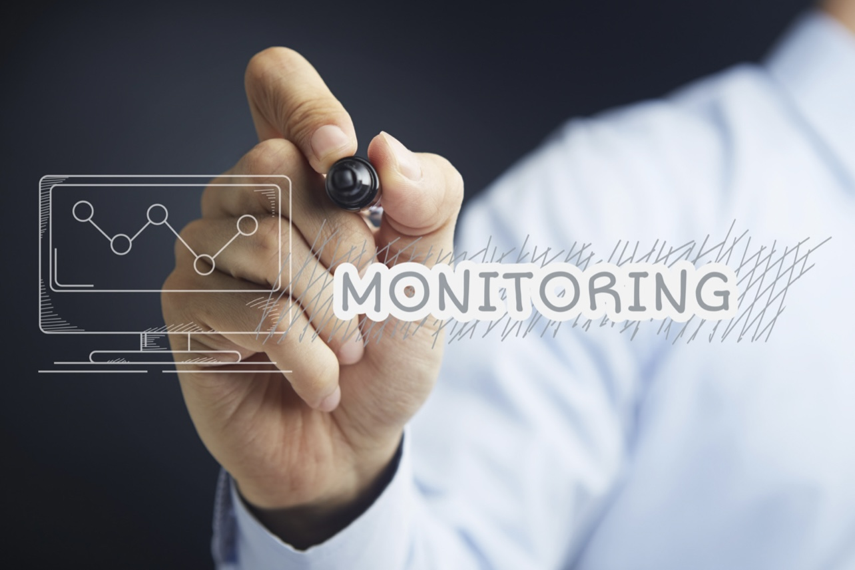
Driving Continuous Process Improvement (CPI) of
Fluid Transfer Processes through Emerging Technologies
Monitoring –
and controlling – your pump
hardware can help you achieve CPI!

Slide 18
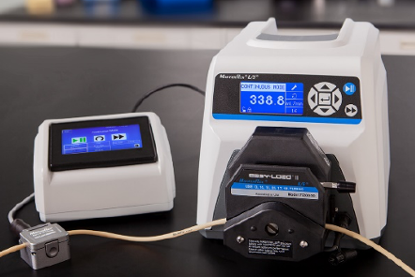
Driving Continuous Process Improvement (CPI) of
Fluid Transfer Processes through Emerging Technologies
Using a non-invasive ultrasonic flow sensor combined with a real-time flow controller can bring real value!

Slide 19
Driving Continuous Process Improvement (CPI) of
Fluid Transfer Processes through Emerging Technologies
A Look @ the Value
No need for tubing break-in or calibration
Accurate flow rates, measured in real-time
Can result in hours of increased uptime per year, per device

Slide 20
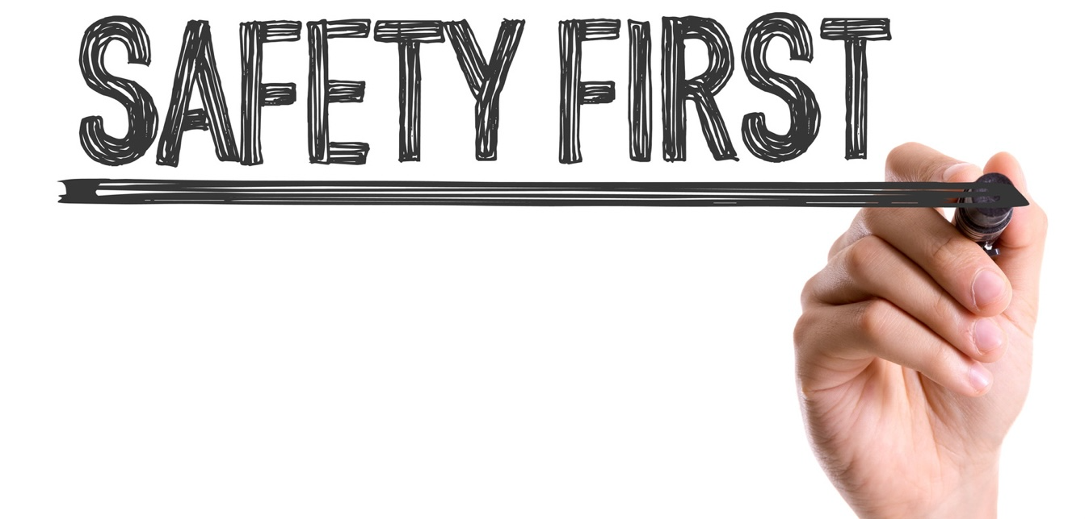
Driving Continuous Process Improvement (CPI) of
Fluid Transfer Processes through Emerging Technologies

Slide 21
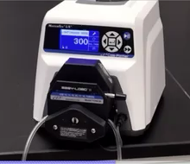
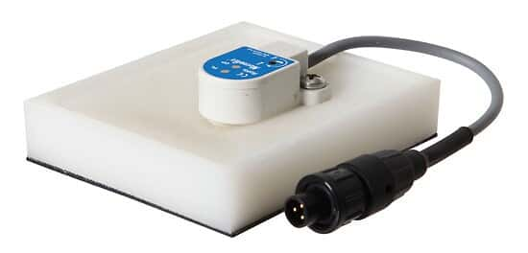
Driving Continuous Process Improvement (CPI) of
Fluid Transfer Processes through Emerging Technologies
Open-Head Sensor
Leak-Detection Sensor

Slide 22
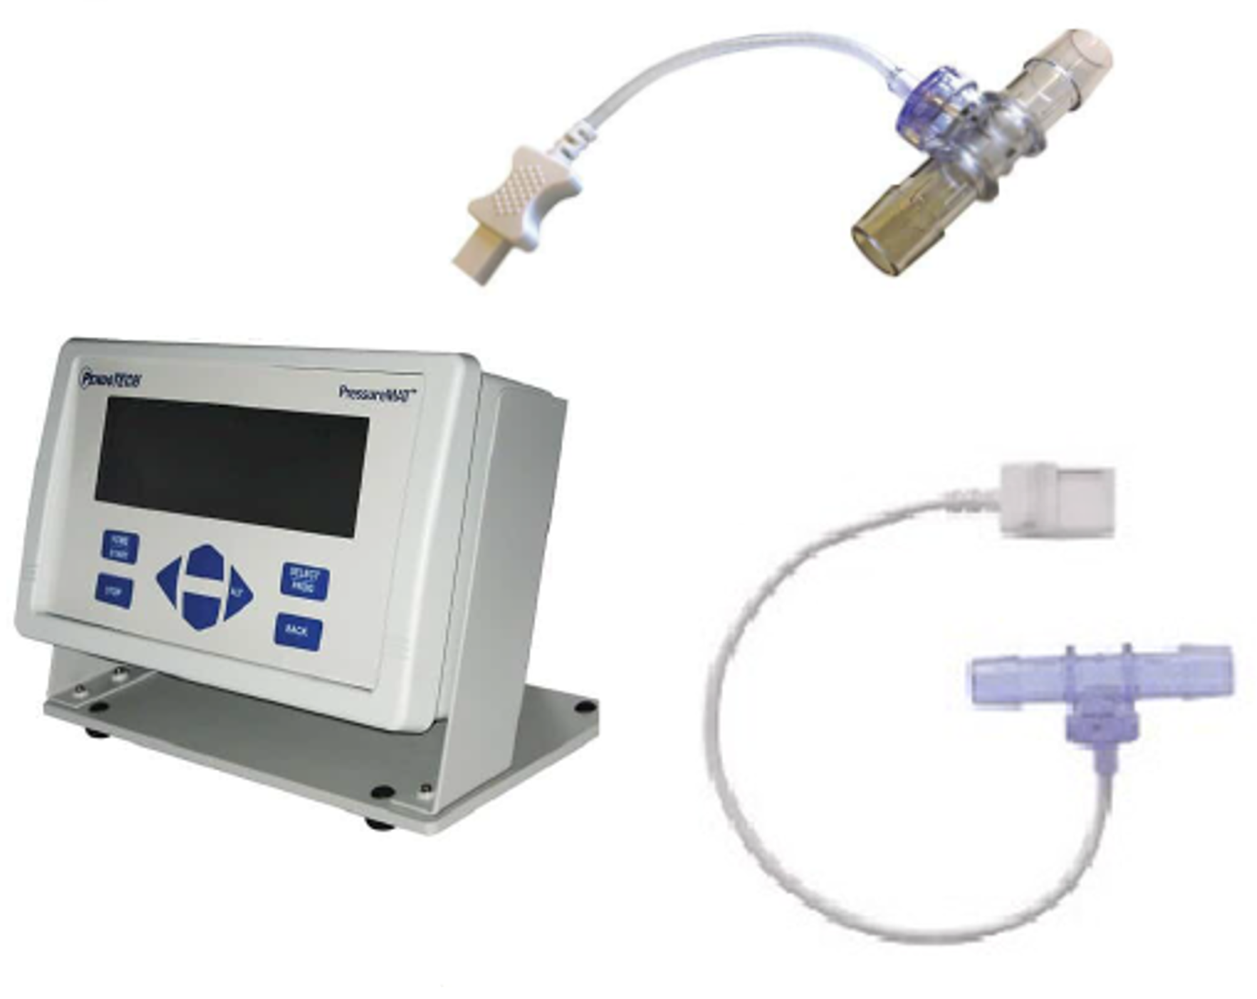
Driving Continuous Process Improvement (CPI) of
Fluid Transfer Processes through Emerging Technologies
A Look @ the Value
Keep operators
safe
Help prevent over- and under-pressure events
Prevent costly spills
Inline Pressure Sensors

Slide 23
Driving Continuous Process Improvement (CPI) of
Fluid Transfer Processes through Emerging Technologies
REDUCE
DOWNTIME
IMPROVE
PRODUCTIVITY
WORKFLOW
CPI Drivers
Safety
Efficiency
Ease of Use
INCREASE
PRODUCTION
YIELD
IMPROVE
CASHFLOW &
PROFITABILITY
$

Slide 24
Driving Continuous Process Improvement (CPI) of
Fluid Transfer Processes through Emerging Technologies
The hardware you choose can help
you achieve your
top CPI priorities!

Slide 25
DRIVING CONTINUOUS PROCESS IMPROVEMENT (CPI) OF FLUID TRANSFER Processes THROUGH EMERGING TECHNOLOGIES
THANK YOU FOR ATTENDING!

