Slide 1
Enhancing Your ISPE Experience
March 14, 2017
Ken Ewan
KME Leadership Associates

Slide 2
Persuade
Notes:
This is about you not me.
If you want to know more about my story, there is a bio on the table or you can ask me questions

Slide 3
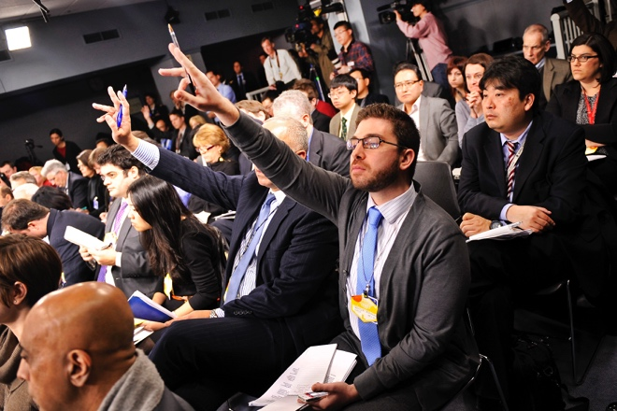
What would
you want
to ask me?

Slide 4
Let’s start with questions

Slide 5
Why are you here?
Will this investment
in time be worth it?

Slide 6
Be intentional about getting your “time’s
worth” from your experience at the Tech
Show and with ISPE!

Slide 7
Relationships

Slide 9
Many communicate… few connect!

Slide 10
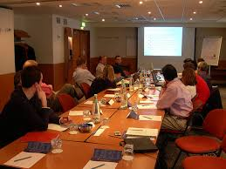
Communication

Slide 11
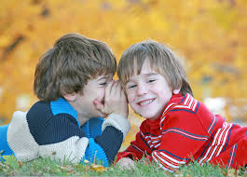
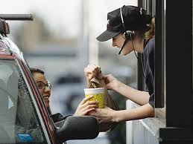
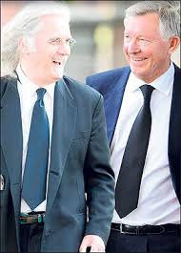
Connection
Notes:
True connection begins early.
But it is more difficult to make connection as the “stakes” rise.
How do you practice connection in your daily life.

Slide 12
Just listen

Slide 13
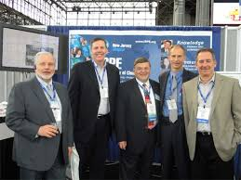
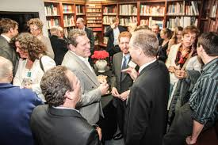
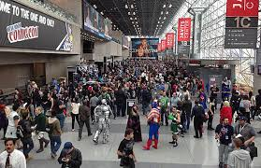
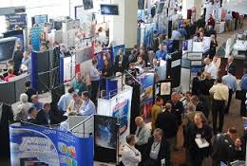
Hang around with people that do what you want to do!
Notes:
Thought leaders
People that don’t agree with you
Corporate leaders
Phenomenal intellects
Fascinating technologies
Amazing stories
What are the questions you would ask?
What were defining moments in their career?

Slide 14
Discussion
How will you use your time here?
Notes:
Your story
Business cards
Writing follow-up notes
Thank you cards with another copy of your business card
LinkedIn

Slide 15
Trajectory
Notes:
How can you increase the trajectory of your career?

Slide 16
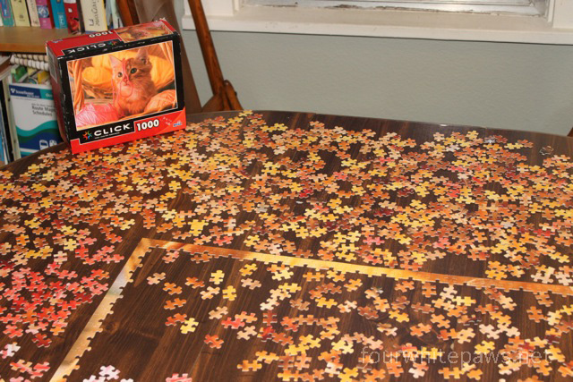

Slide 17
Future state
What would a “day in the life” look like in 1 year,
3 years, 5 years?
What would be important?
What isn’t important?
What has to change?

Slide 18
Why?

Slide 19
You are not your resume! ... how to become intentional about your career.
Notes:
Can you tell me about who you are without mentioning your job?

Slide 20
Will you become the person you dreamed that you could be?

Slide 22
Notes:
How do you stand out?

Slide 23
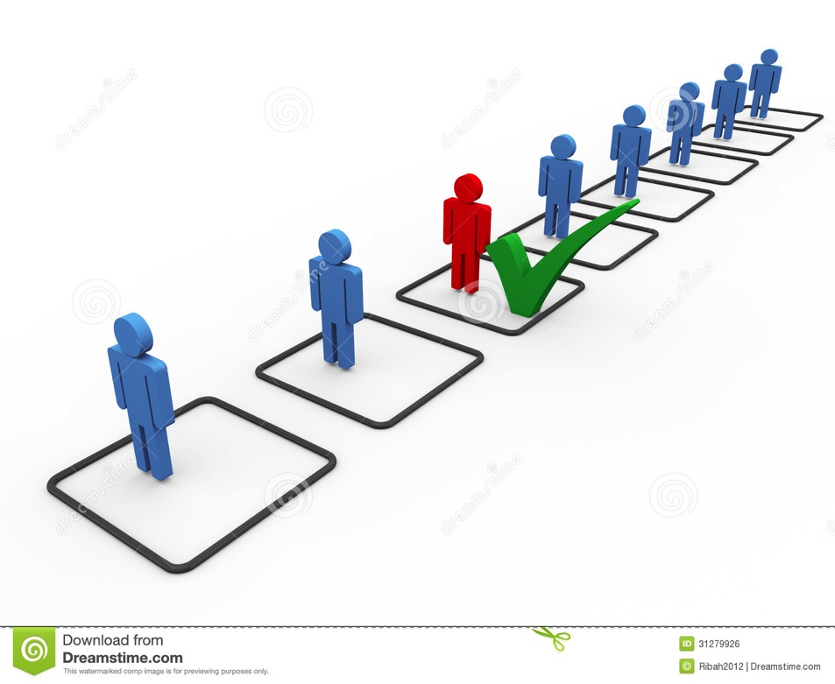

Slide 25
Me to We!

Slide 27
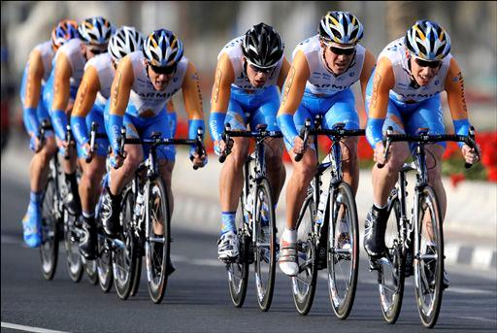

Slide 28
Key job qualification issue?
FIT !

Slide 30
Notes:
KEN
Concept:
Your way of being - Observation of behaviors one might observe if they shadowed you.
Principles & Values - Names to describe the behaviors that you believe represent who you are or how you want to work.
Relationship - The closer your Principles & Values are aligned, the stronger the relationship.
Teaching & Learning - The stronger your relationship, the greater chance you have of being "heard" or that the "lesson" you are conveying is learned.
Corrective Action - The more what you are trying to teach/convey is understood, the less time and effort you spend on dealing with things that go wrong!
Commentary:
The concept builds from your behaviors.
If you are consantly "Dealing with s**t that is going wrong, start at the top and analyze down until you diagnose where the problem is.
This holds true for ALL relationships - business, personal, friendships, family, dating, marriage

Slide 31
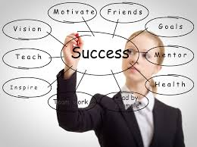
Success vs Fulfillment
Notes:
How do you show up?
What are the voices in your head saying to you?
IBSC

Slide 32
What did you notice
about my slides

Slide 33
What will be your story?
Notes:
What have you overcome to get here today?
Don’t live someone else’s life!
Try to understand how many lives you get to touch in a career and determine just what you are going to do with that privelege.
Next series of slides come right out of my leadership and career development talks

Slide 34
What are you willing to do?
Notes:
Take a minute and reflect on what you have been thinking during this presentation.
What are you willing to do immediately to take control of your leadership education?
I fundamentally believe, as an eternally optimistic person, that someone in this room has been affected by what they have heard, or who they have met, in way that will change the direction of their life forever.
Is it you?
Why not?
Lead the parade!

