Slide 1
Fit for manufacturing (ffm) program Biogen RTP, NC
Adam Tessneer – Quality Technical Services
Alex Lopez – Quality Technical Services
David Davis - Engineering
Dean Mattiace – Facility Operations
Mike Perkins – Manufacturing Tech Ops
Tolga Musa - Manufacturing
ISPE CaSA – 15 February 2021

Slide 2
Biogen RTP, NC
Overview

Slide 3
Our MISSION is clear.
We are PIONEERS in neuroscience.
~ONE BILLION PEOPLE
affected by neurological disorders worldwide
MULTIPLE
SCLEROSIS
SPINAL
MUSCULAR
ATROPHY
AMYOTROPHIC
LATERAL
SCLEROSIS
PARKINSON’S
DISEASE
PROGRESSIVE
SUPRANUCLEAR
PALSY
DEMENTIA
60-70% HAVE
ALZHEIMER’S
DISEASE
Huge impact to the global healthcare system

Slide 4
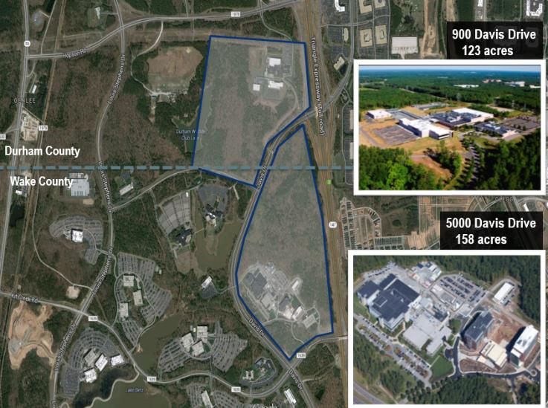
Biogen RTP Operations

Slide 5
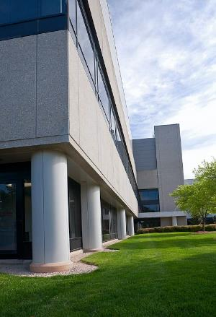
RTP Bio Site (5000 Davis Dr.) Overview
Broke ground on NC operations in 1995
RTP site includes 7 buildings and a central utilities area
Approximately 1,120 site employees
Mammalian Cell Derived Therapeutic proteins.
Commercial and Clinical production
Batch processing through multiple Bioreactors 60 L – 15,000L
Batch purification through column chromatography and filtration
Final facility output is liquid bulk DS which is either frozen or stored at 2-8^{ᵒ} C
24 x 7 Operations

Slide 6
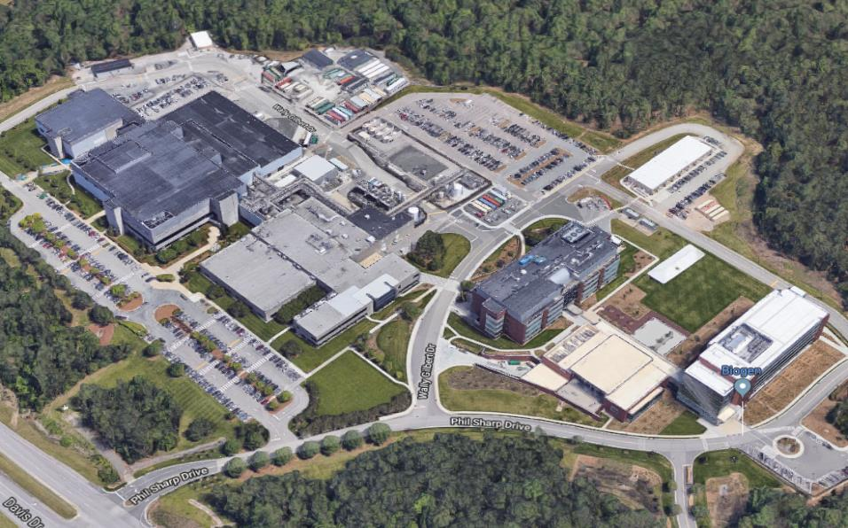
RTP Bio Site (5000 Davis Dr.)
2001
1996
2002
2003
2012
2015
B25: 35 kft2
LSM Purification Suite 2
B23: 45 kft2
Warehouse & Dispensary
Central Utilities
B24: 150 kft2
QC Laboratories
Stability & Sample Control
Technical Development
B25
B23
B22
B21
B24
B20
B26
B22 and B25
3rd Purification Suite
3rd Harvest Centrifuge
B22: 170 kft2
Manufacturing: 6 x 15,000L
3 Seed Trains
Purification Suite 1
Clean Utilities
B21: 92 kft2
Manufacturing: 3 x 2000L
2 Purification Suites
Single Use Suite
Central Utilities
B20: 37 kft2
Office Space
Analytical Development
Manufacturing Sciences
B26:208 kft2
Administration

Slide 7
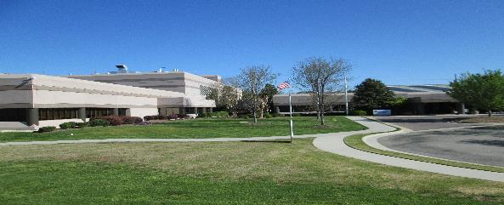
RTP Pharma Site Overview
Original building built in1997 – Additions in 2008 and 2010
RTP site includes 2 buildings and a central utilities building
Approximately 300 site employees
Parenteral Filling – 2 Vial filling lines for commercial/clinical and 1 development line
Oral Solid Dosage Manufacturing
Anti-sense Oligonucleotide Manufacturing Suite

Slide 8
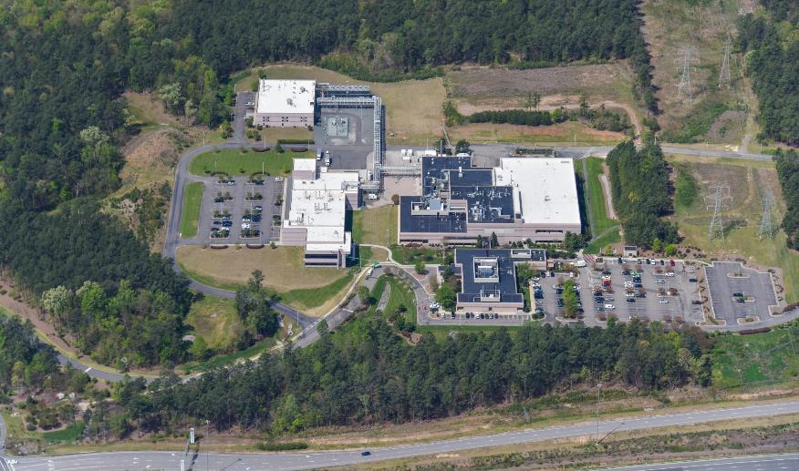
RTP Pharma (900 Davis Dr.) Site
BLDG. 34 – CUB Utility
BLDG. 35 – OSM, PF Line 3
BLDG. 36 – PF Line 1 and 2 QC Micro
BLDG. 35 – Quality Control Labs
Notes:
Miles

Slide 9
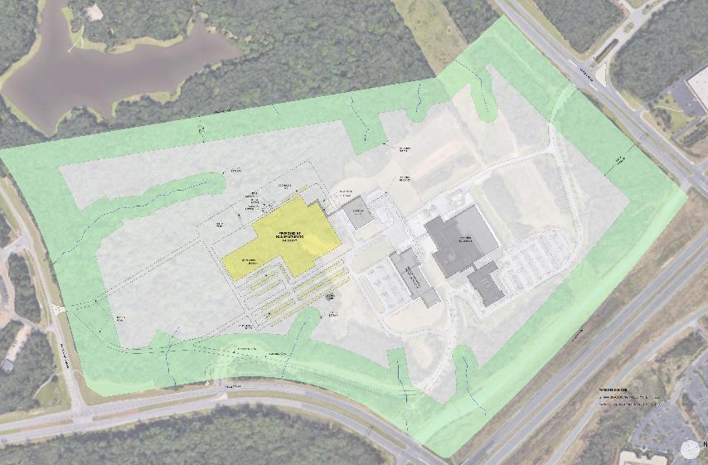
Coming Soon: RTP Gene Therapy Manufacturing (GTM)
Gene Therapy Manufacturing Facility

Slide 10
FIT for Manufacturing program

Slide 11
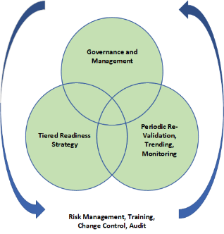
Fit for Manufacturing Lifecycle
A multi-tiered program that includes a series of verifications and control points to ensure system, service or area meets its defined purpose and is fit for GMP manufacturing.
Initial
Fit for Manufacturing
Program Elements
Fit for Manufacturing
FFM
Installation
Commissioning
Qualification
Design
System Release

Slide 12
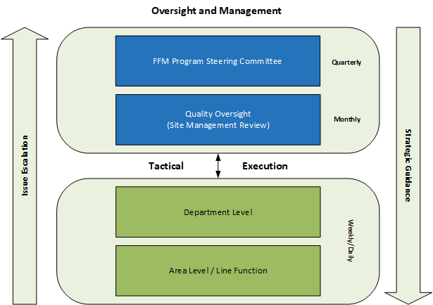
Governance and Management

Slide 13
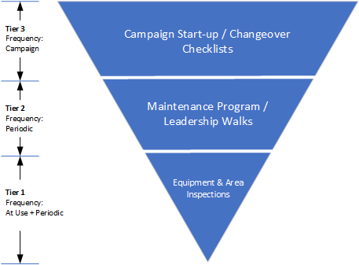
Tiered Readiness Strategy

Slide 14
Fit for Manufacturing (FFM) Hierarchy
FFM Procedure
Equipment “At Use” Inspections
Equipment / System Inspections
Area Inspections
Leadership GEMBAs
Small Parts
Planned Maintenance Schedules, PM Work Orders, Job Plan Checklists

Slide 15
FFM Procedure Outline
Governance
Quarterly Site Management Review (SMR)
Monthly SMR Report
Preventative Maintenance
Corrective Maintenance
Deviations associated with FFM
Inspection Process
Equipment
Equipment Area
Processing Areas
Support Systems
Inspection Escalations
Inspection Matrix

Slide 16
Inspection Matrix
Item | Type | Frequency (Minimum) | Record | Responsibility
Process Equipment | At Use | After Pre-Use | Master Production Record | Manufacturing
 | Periodic | 90 days | Work Order | Manufacturing
 | Periodic (Invasive) | Per Procedure | Work Order | Maintenance
Process Utilities (e.g., CIP Systems) | Periodic | 90 days | Work Order | Engineering
AHU | Periodic | 90 days | Work Order | Maintenance
Clean Utilities | Periodic | 90 days | Work Order | Maintenance
Process Support Systems (e.g., Autoclaves, Parts Washers, COP Baths) | Periodic | 30 days | Work Order | Manufacturing
Small Parts | Periodic | 90 days | Work Order | Manufacturing
Environmental Chambers | Periodic | 90 days | Work Order | Engineering
Unidirectional-Flow Clean Air Devices | Periodic | 90 days | Work Order | Manufacturing / Quality Control
Biological Safety Cabinets | Periodic | 90 days | Work Order | Manufacturing / Quality Control
Classified Areas | Periodic | 60 days | Work Order | Manufacturing
Non-Classified Areas | Periodic | 90 days | Work Order | Manufacturing

Slide 17
Areas and Types of Inspections
Areas / Types of inspections
Manufacturing
Quality Control
Labs
Warehouse
Utilities
Facilities / Rooms
Small Parts

Slide 18
Equipment “At Use” Inspections
Scope
System Critical Attributes
Adequate labeling/status tagging
Pre-use visual inspection - *Requires adequate light source confirmed upon inspection
Absence of leaks
Criteria
Performed after pre-use CIP (batch to batch)
Performed by Manufacturing
Documented in Master Production Record

Slide 19
Equipment/System Inspections
Scope
Process Equipment & Skids, Utilities, Support Systems, Chambers, Hoods
Review latest monthly Overdue Work Order report. Identify and follow-up on open work orders related to findings from equipment inspection activities.
Perform Invasive Inspection checking original validated visual inspection locations (GMP Process Equipment)
Inspect EXTERNAL surfaces for rouge, staining or debris.
Inspect insulation for damage or disrepair.
Inspect piping penetrations through walls, ceilings and floors. Ensure finishes remain intact (e.g., caulking).
Ensure absence of leaks.
Verify equipment logbook adheres to closure and periodic review.
Ensure documentation adheres to Good Documentation Practices.
Inspect gearboxes, lifts, mechanical components for oil/fluid leaks.
Criteria
Performed Quarterly except for Support Systems (monthly) and Process Equipment (variable)
Performed by Manufacturing
Driven by PM
Executed in CMMS

Slide 20
Small Parts
Scope
Glasswasher and Autoclave Support Areas
Review latest monthly Overdue Work Order report per procedure. Identify and follow-up on open work orders related to findings from previous small parts inspection activities.
Inspect for rouge, scratches and damage per Small Parts Visual Inspection and Management procedure
Create Work Orders for all required follow-up inspections and remediation activities
Evaluate storage conditions of small parts in the area
Remove parts identified as ‘out of service’ from the area
Criteria
Performed quarterly
Performed by cross functional associate team
Driven by PM
Executed in CMMS

Slide 21
Area Inspections
Scope
Non-Classified and Classified Manufacturing Areas
Review latest monthly Overdue Work Order report per procedure. Identify and follow-up on open work orders related to findings from previous area inspection activities. Review Area Cleaning Logbooks to ensure adherence to cleaning procedure, including fixed vessel cleaning per procedure.
Room Finishes (Walls, Doors and Windows): Inspect for damaged paint (chipped/scratched/holes), cracks, missing or damaged caulking, damaged doors, windows, frames & hardware.
Room Finishes (Ceilings/Floors): Inspect for damaged paint (chipped/scratched/holes), cracks, missing or damaged caulking; damaged suspended ceiling trim and panels; sprinkler head escutcheons are sealed. Inspect floor drains for function and debris.
Transfer piping: Inspect for leaks, damaged or missing labels, loose hangers, insulation & escutcheons, and drain air gaps if required
Pest Control: Inspect for insects, ensure bug lights are operational, traps are in locations, as applicable. Ensure the Pest Control Activity Trending Report is reviewed per procedure
HVAC: Inspect return/supply grills/vents for cleanliness & blockage. Inspect duct insulation, for pooling condensation, AHU condition.
Electrical: Inspect switches, outlets, wiring, lighting fixtures (include caulk condition where applicable) to be in proper working condition. Inspect for items blocking panelboards.
Criteria
Performed 60 days (Classified Space)
Performed Quarterly (Non-Classified Space)
Performed by Cross functional Associate Team
Driven by PM
Executed in CMMS

Slide 22
Leadership Area GEMBA
Scope
Inspect Classified and Non-Classified Area Boundary
Audit representative Equipment and Systems
Audit representative system logbooks and ensure they are within expiry and the review is current
Walls, Doors & Windows
Ceilings / Floors
Room Finishes
Pest Control
Piping
HVAC
Electrical
Criteria
Classified and Non-classified
Performed every 6 months
Performed by Cross functional Leadership Team
Driven by PM
Executed in CMMS

Slide 23
Governance and Oversight
Work Orders should provide sufficient information to facilitate the continual improvement process and provide an accurate asset history. Governance activities such as trend analysis, review of overdue work, deviations, and performance reporting are examples where feedback from work execution process can be valuable to understand Fitness for Manufacturing
Trend maintenance activities as a means of achieving a higher level of asset performance
Establish control limits based on facility/equipment history along with age of asset
Establish periodic reporting to document and affirm fitness for manufacturing
Report elements may include:
Corrective Work Order Trends
Review of deviations related to critical failures/findings and decisions to continue manufacturing at risk
Review Overdue PM Work
Procedural summary – changes that could affect the FFM program and/or recommendations for improvement
CAPAs/Pending Capital Work
Follow-up actions/decisions

Slide 24
Recommendations & Lessons Learned
Apply resources to form a team to track end of life and reliability for equipment systems.
Reference ISPE Guide for Maintenance and Reliability.
Ensure procedures are in place for handling rouge / scratches / small parts.
Proactively determine work scheduling (Preventive Maintenance, Corrective Maintenance) and resource loading.
Utilize CMMS software and other systems to perform effective queries and tracking of progress.
Form and maintain partnerships between involved departments (Engineering, Facilities/Maintenance, Manufacturing, Quality, etc.)
Seek commitment from executive leadership.
Establish in-house capabilities for system maintenance / remediation (e.g., passivation) where feasible.

