Slide 1
Expanding Pharmaceutical Workforce development in eastern north Carolina
Loren Limberis, PhD
Assoc. Professor of Engineering
Coordinator, Bioprocess Engineering Concentration
Director, Eastern Region Pharmaceutical Center
East Carolina University
James Menke
Director, National Security Initiatives
Division of Research, Economic
Development and Engagement
East Carolina University
ISPE CaSA Life Sciences and
Biotechnology Conference
February 15, 2022
Raleigh, NC

Slide 2
Talent
Pathways to recruit, train, and retain talent in the pharmaceutical industry

Slide 3
Overview
Demand for skilled workers
Eastern Region Pharmaceutical Center
Motivation
Focus
Collaboration
Resources
Industry input and engagement

Slide 4
Demand for Skilled Workers
Explosive growth last two years
2020
$3B bioscience-related investments
4,800 life science jobs
2021
$4B bioscience-related investments
4,800 life science jobs
Levels and talent of skilled workforce needed
Certificate, Associate’s Degree, Bachelor’s Degree
Manufacturing, automation, validation

Slide 5
Demand for Skilled Workers
Industry of Dreams
Now that we’re building it…from where will they come?

Slide 6
Immediate Needs
Pharma career awareness
Highlight opportunities
Emphasize demand
Provide opportunities
Present pathways
Clarify
Educational opportunities
Time investment
Gained skills
Salary range
Emphasize career growth

Slide 7
Eastern Region Pharmaceutical Center
(ERPC)
Established to meet workforce demand
Possible by Golden LEAF
$1.9M and match from ECU
Motivation
Meet growth demands
Maintain pace of growth
Provide meaningful and enriching careers
Focus
Facilitator of regional workforce development
Career Pathways for workforce development
Certificates, Associate’s Degree, Bachelor’s Degree
Pharma courses in undergraduate programs, short courses, minor
Industry training for incumbent workers

Slide 8
Eastern Region Pharmaceutical Center
(ERPC)
Facilitator of regional workforce development
Community College Partners
Extend reach into eastern North Carolina
Remote engagement with VR/ER
BSIT program at ECU (2+2)
Military engagement
Industry Partners
Collaboration with in-house, remote, and on campus training

Slide 9
ERPC Collaboration
East Carolina University
Community Colleges
Pitt, Johnston, Nash, Edgecombe, Wilson
BioPharma Crescent
CMP Pharma - Novartis/Sandoz
Grifols - NeoPac USA, Inc.
Mayne Pharma - Pfizer
Novo Nordisk - RTI Surgical
Thermo Fisher Scientific
Fresenius Kabi
Purdue Pharmaceuticals
Merck

Slide 10
ERPC Support
Pitt County Economic Development
Greenville ENC Alliance
NC Biotechnology Center

Slide 11
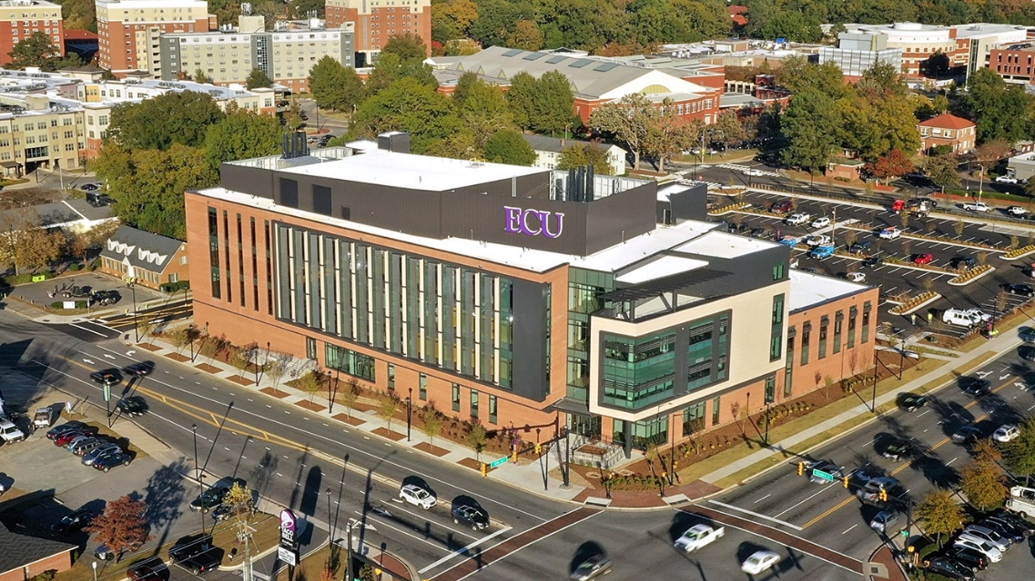
Resources for ERPC
Life Sciences and Biotechnology Building
New construction
$90M Connect NC Bond
Research building
Dept. of Biology
Dept. of Engineering
Dept. of Physics
First floor
Bioprocess engineering teaching labs
Upstream (bench scale), downstream (bench scale), research, pilot scale

Slide 12
ERPC Pilot Scale Teaching Lab Resource
Capabilities
Batch biomanufacturing
Continuous biomanufacturing
Highlight single-use
Integrate Industry/Pharma 4.0
Cyberinfrastructure and security
Integrated access
Face-to-face and virtual/remote concurrently
Hybrid student teams
ER/AR/VR technologies
Allows reach to students in eastern NC

Slide 13
Needs for Industry
Success of ERPC comes from industry input and engagement
BIG QUESTIONS
What skills are in highest demand?
What skills are in high demand?
What new/different skills will be in demand in the future

