Slide 1

FACILITY DESIGN 101
Stacy Sodomsky
Durham, North Carolina
March 10, 2020

Slide 2
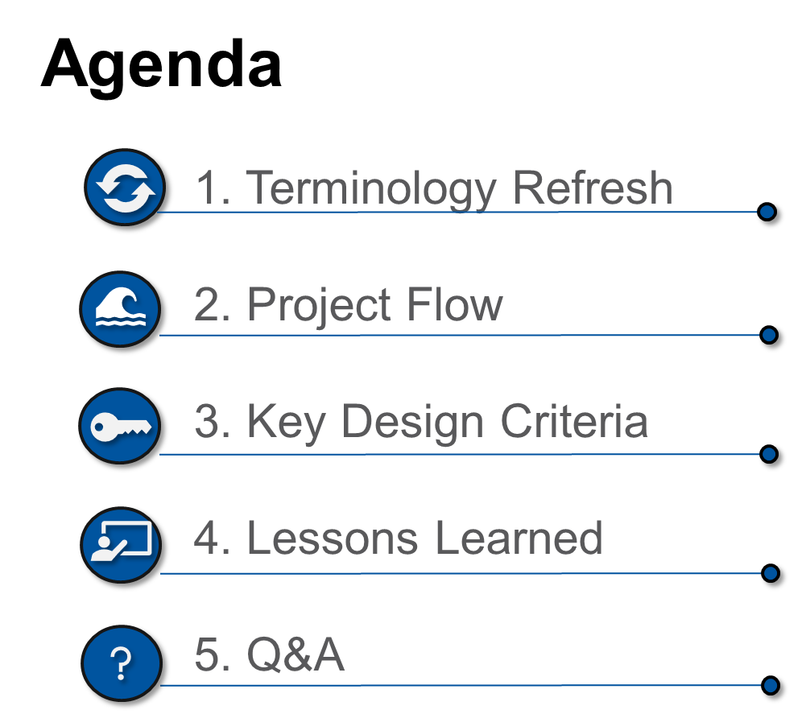

Slide 3

1. Terminology refresh

Slide 4
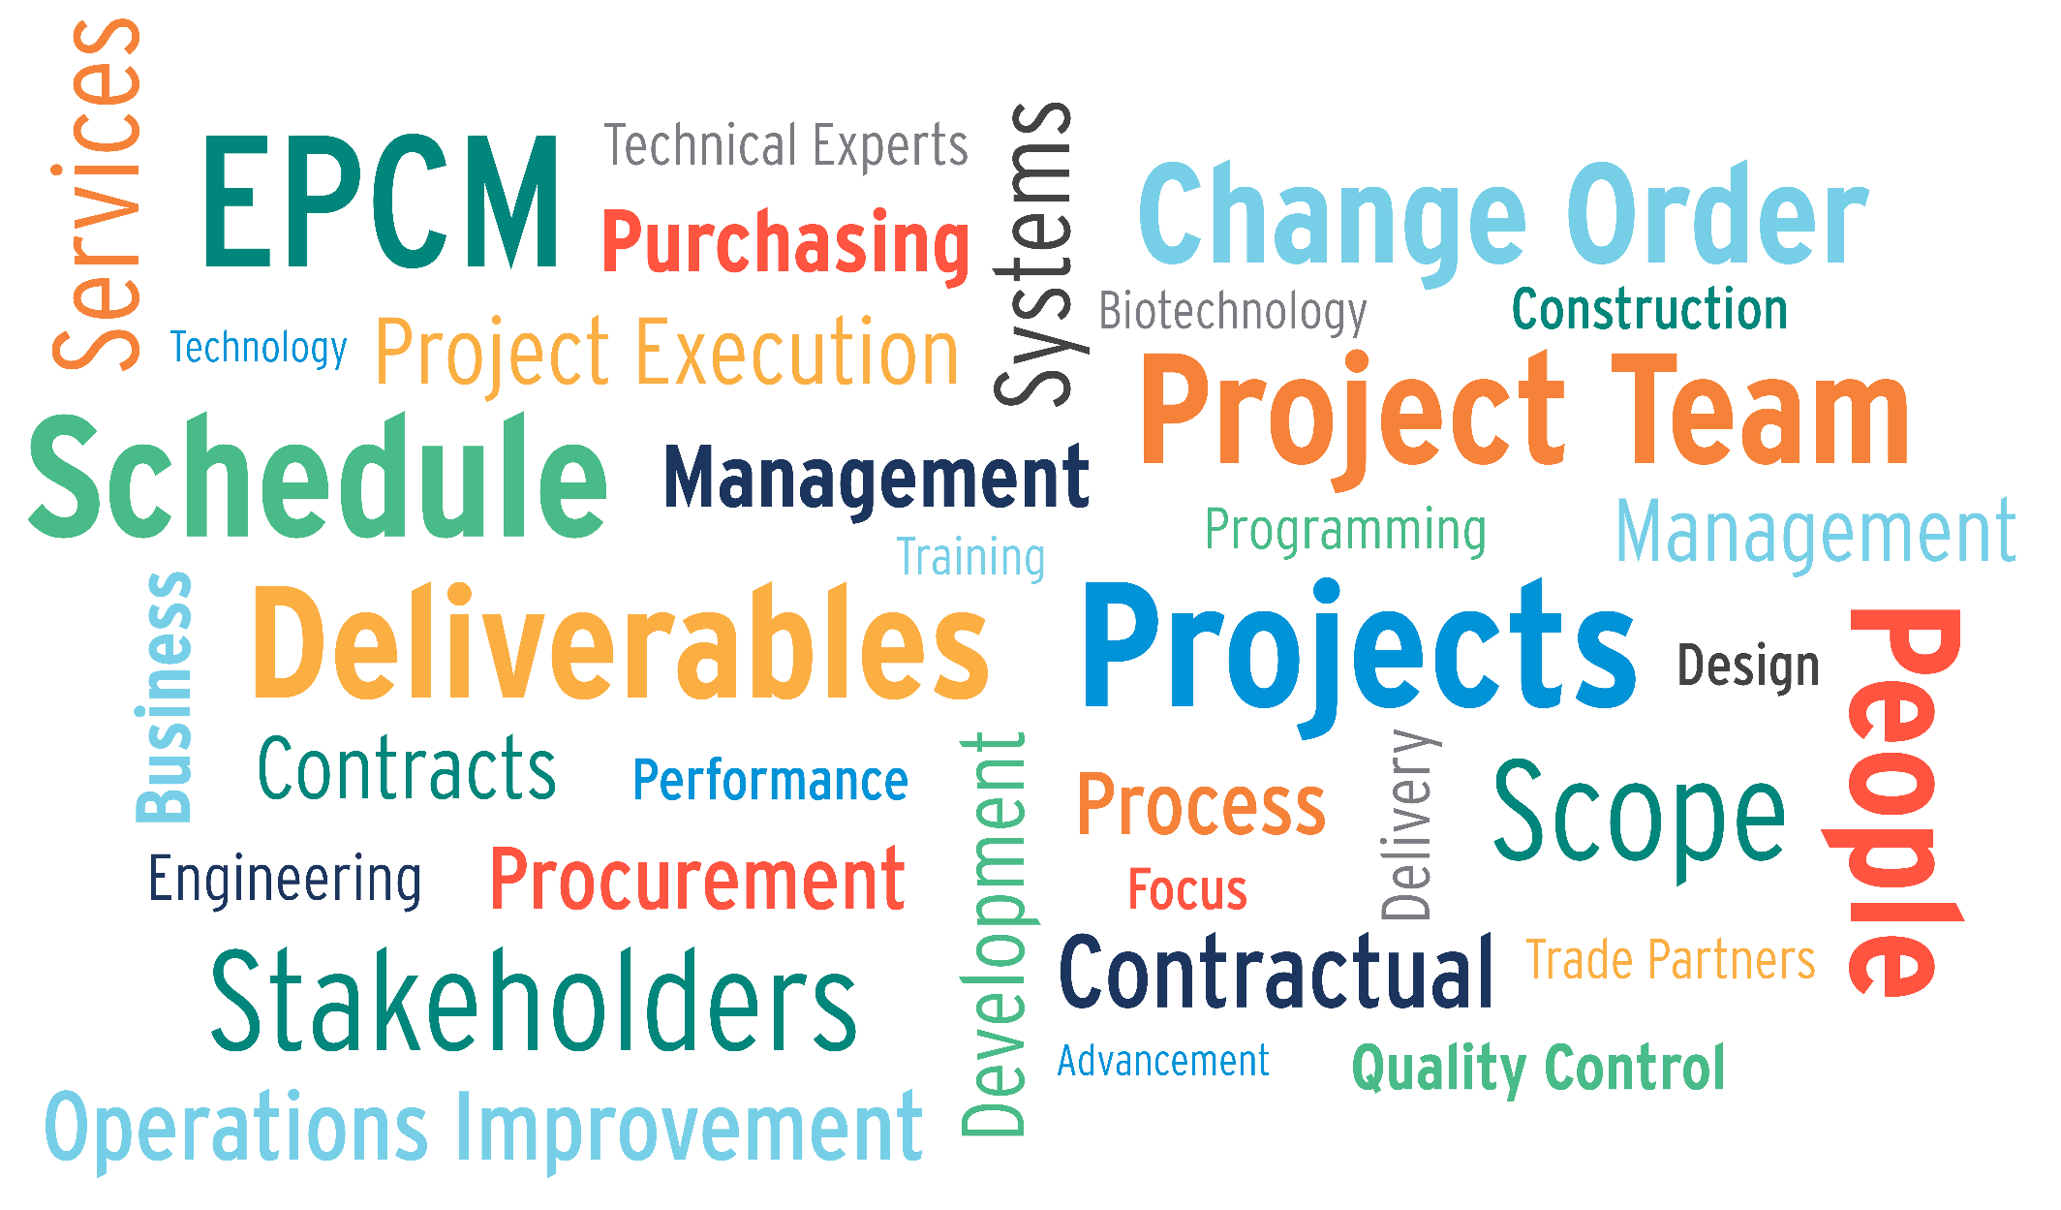

Slide 5


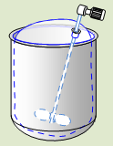
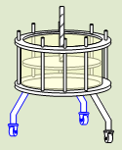
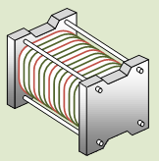
Bioprocessing
Downstream Processing
Stage of manufacturing where microbes or cells are processed to meet purity & quality product requirements
  Cell disruption
  Purification/polishing
Upstream Processing
Stage of manufacturing where microbes or cells are grown
  Inoculation
  Cell Culture
Notes:
Upstream – think bacterial or mammalian cell lines in bioreactors

Slide 6

2. PROJECT FLOW

Slide 7
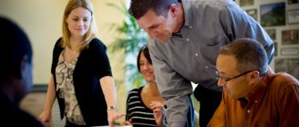
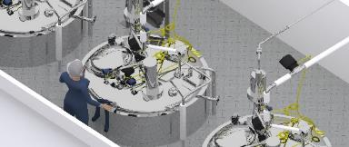
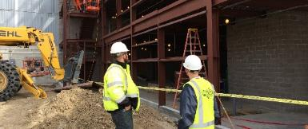
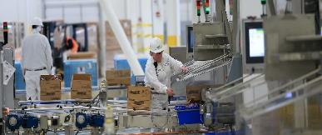
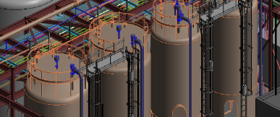
Project Flow
Plan
Design
Build
Commission
Improve

Slide 8
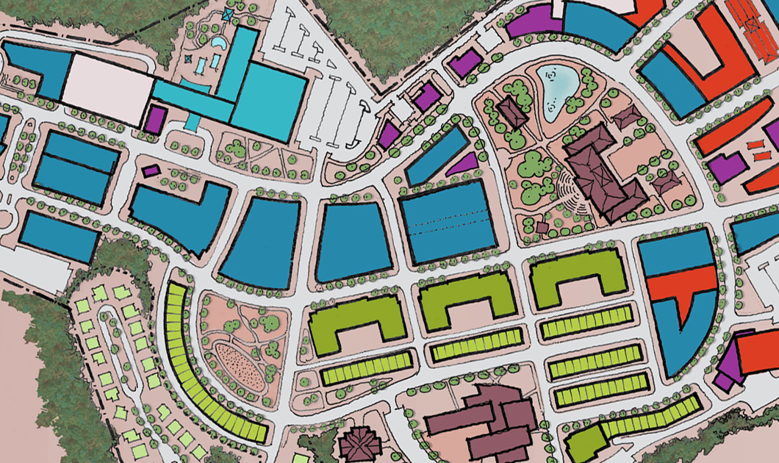
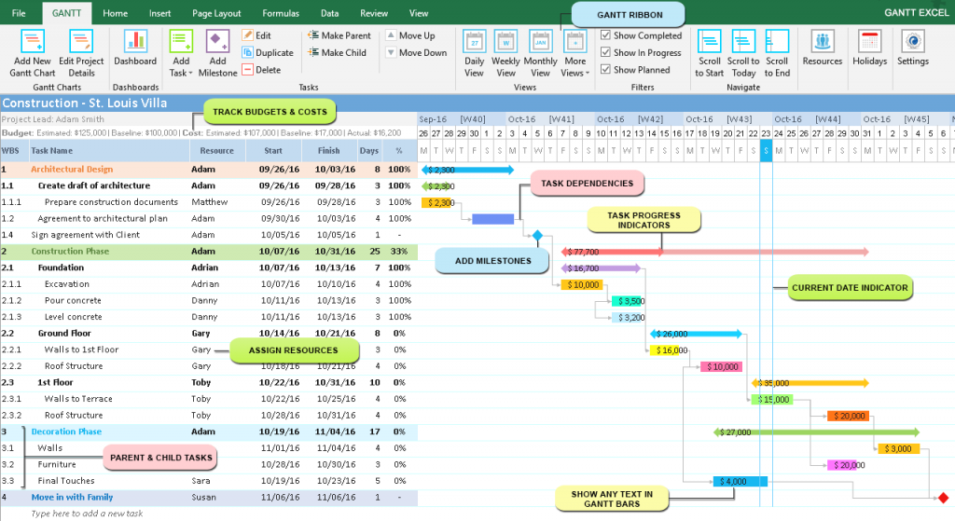
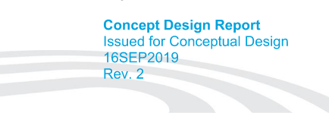
Plan

Slide 9
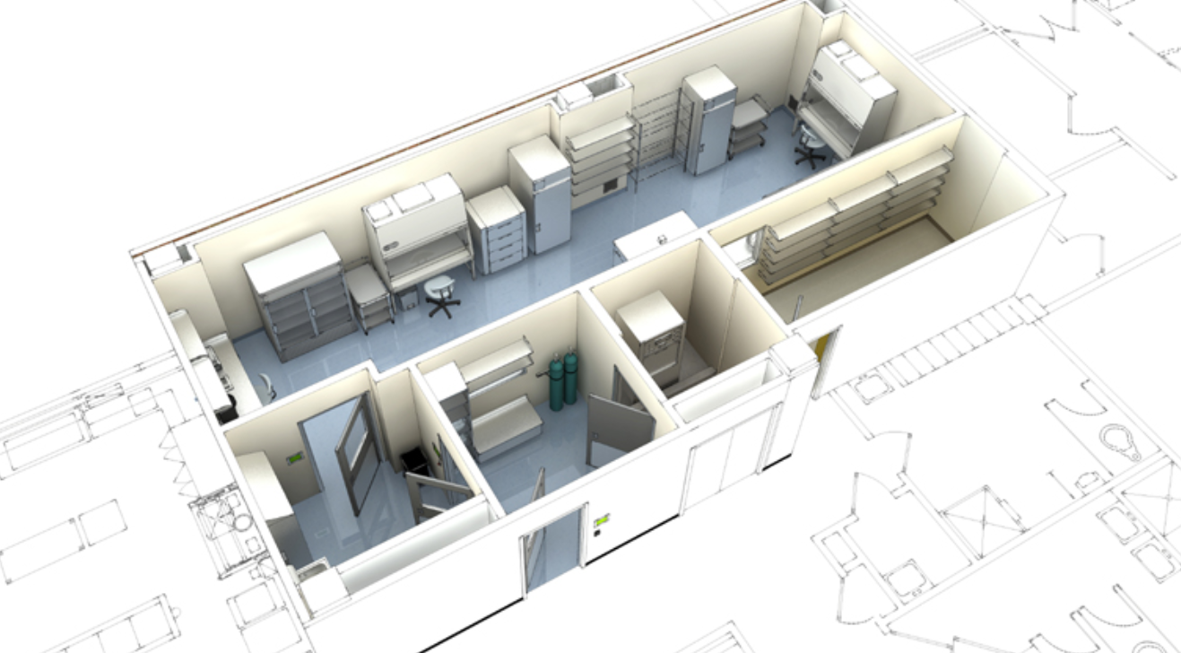
Design
Notes:
Modeling, Drawings
Conceptual Design typically started first
Basis of Design – what assumptions do we need to make? What do we predict the space will start to look liked?
Detailed design -

Slide 10
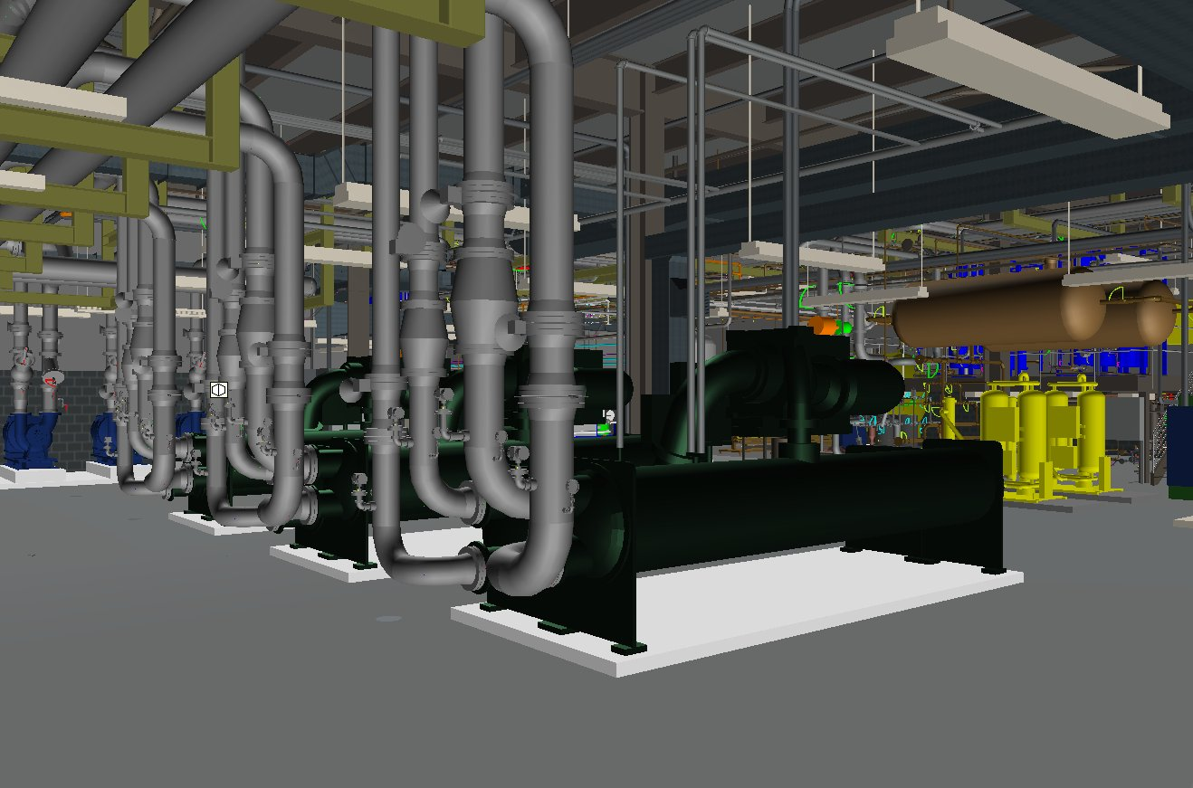
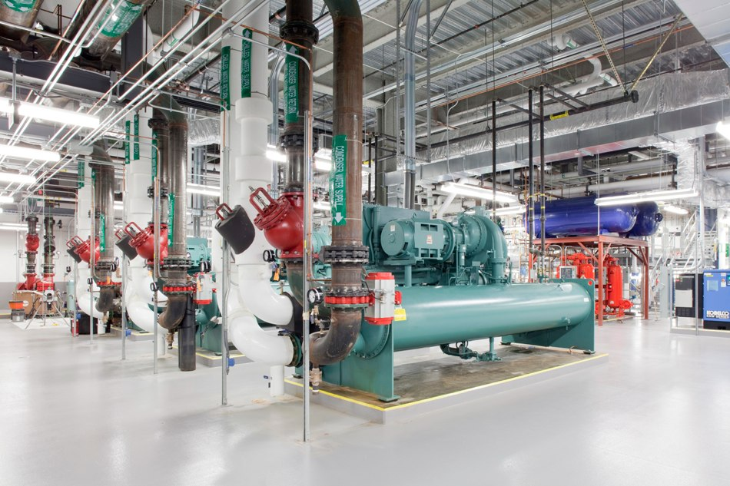
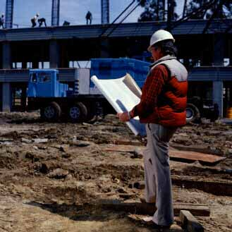
Build

Slide 11
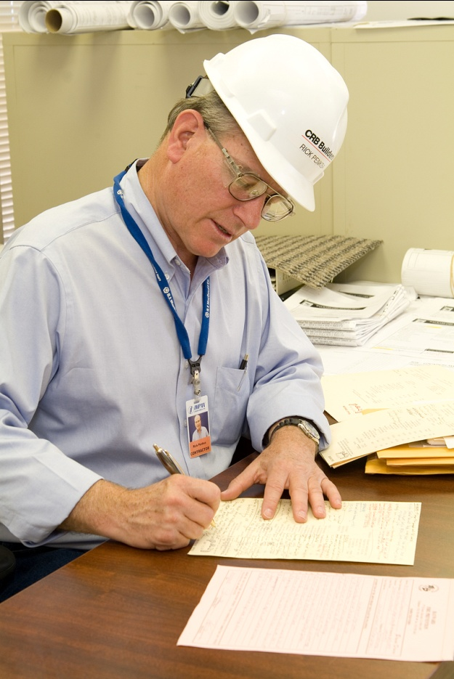
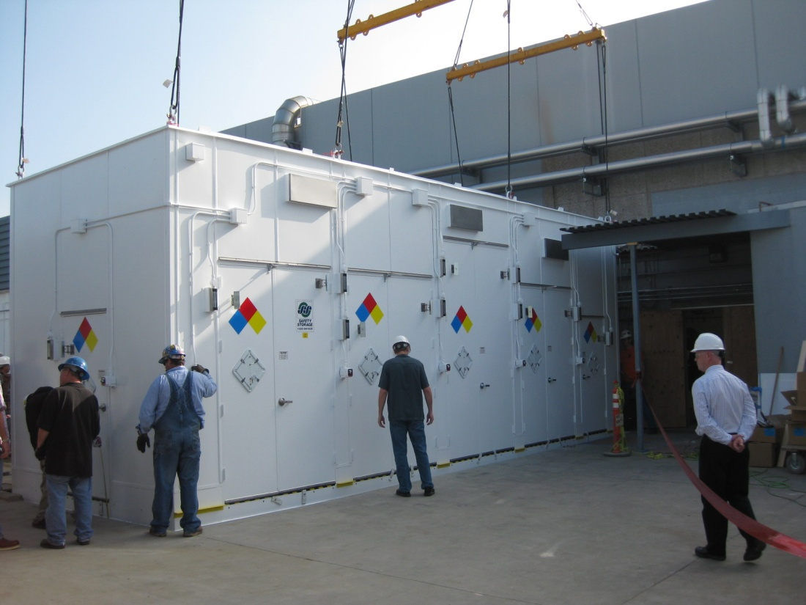
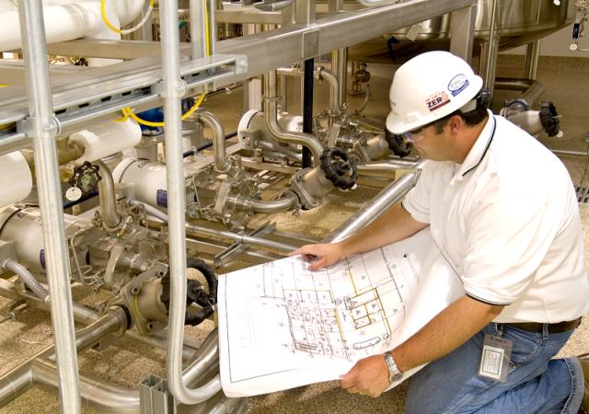
Commission

Slide 12
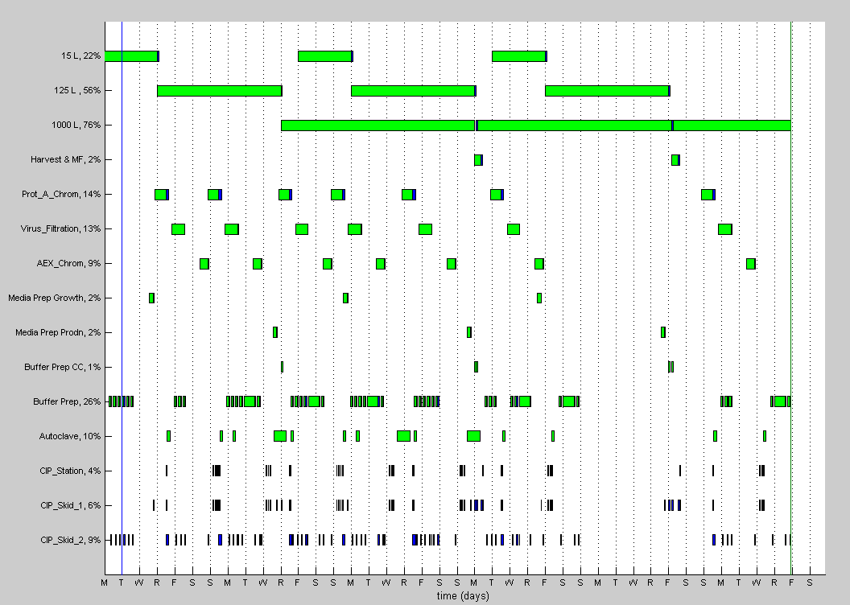
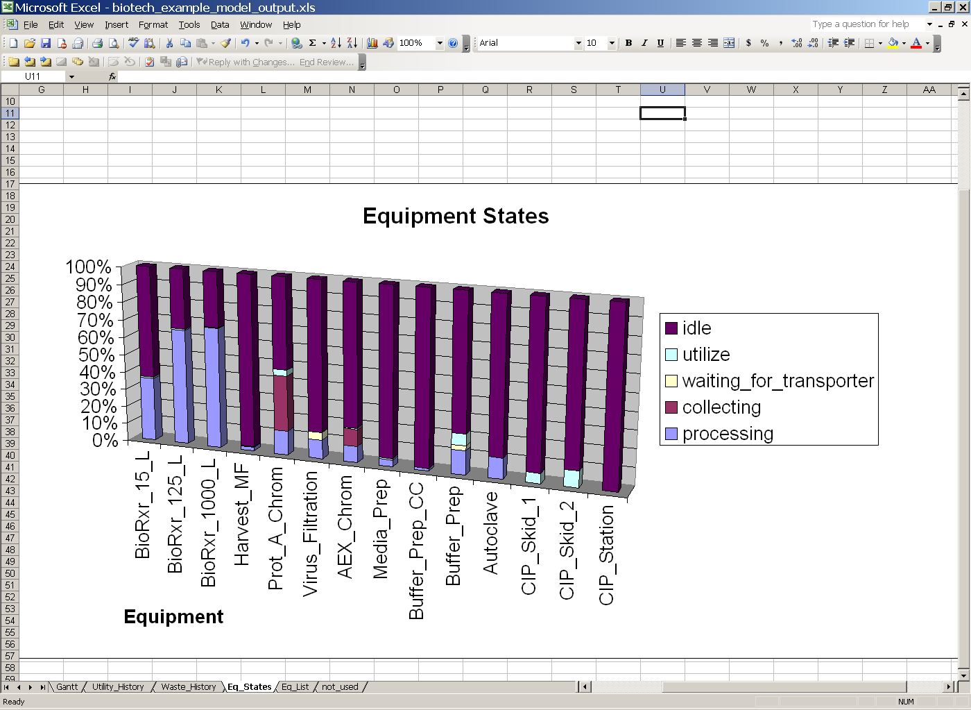
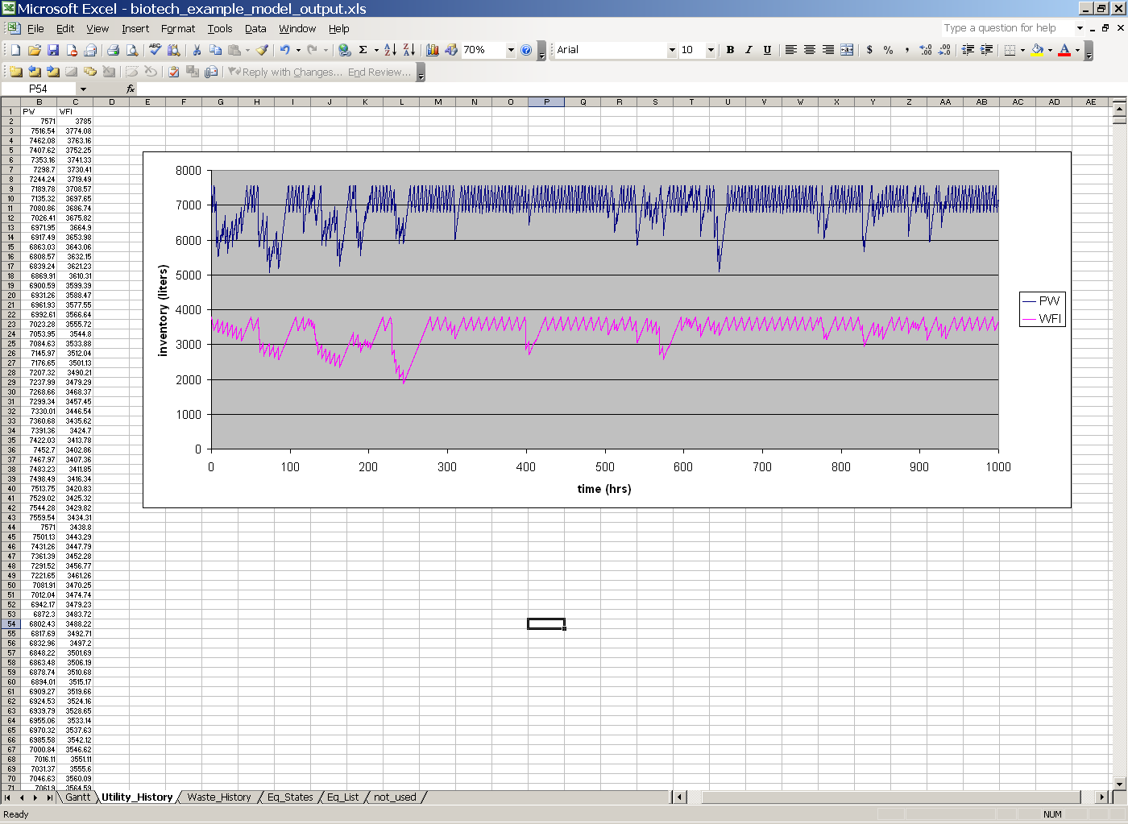
Improve
    Process evaluation
    Risk assessment
    Process modeling
    De-bottlenecking
    Cost of goods optimization
    Lessons Learned

Slide 13

3. KEY DESIGN CRITERIA

Slide 14
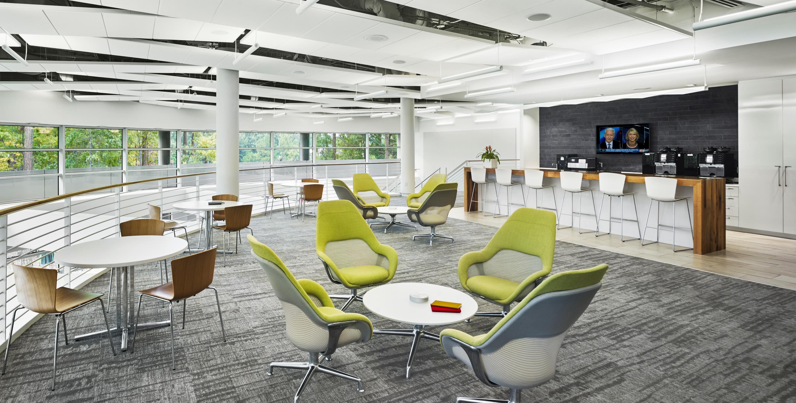
Notes:
Insert image of lovely office space to talk through principles
Open
Functional
Purposeful
Safe
Natural Light!

Slide 15
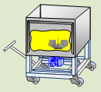
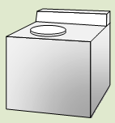
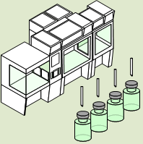

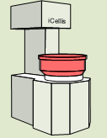

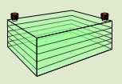
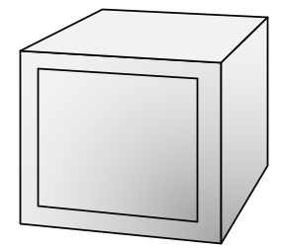

Purposeful
mAb
Up to 20,000L
Cell Culture/Harvest
Purification/Formulation
Fill/Store
Viral Vector
200L – 2,000L
Cell Culture/Harvest
Purification/Formulation
Fill/Store
Allogeneic
Cell Therapy
Up to 2,000 L
Cell Culture/Harvest
Purification/Formulation
Fill/Store
Notes:
Blood fractionation
Hardly any upstream, but huge emphasis on downstream processing
mAb
SS dominant
Very large facilities – 100K+ sq ft
Complex piping & support systems
Large utility demand
Viral vector
Pilot plant scale
Plug & play operations with SU portable skids
Cell Therapy
Similar to laboratory / hospital environment
Work stations dedicated to a single patient
Multiple patients within a processing room

Slide 16
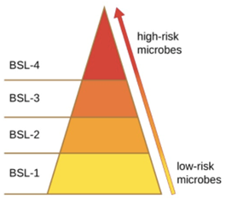
Purposeful
CGMP
Biosafety
Process Suite
Process Suite
Process Suite
Notes:
Multiple products in the same facility: cross contamination & Biosafety v. cGMP
Gene & cell therapy involves recombinant viruses and human cells and are subject to BL2 guidelines
Wuhan research facility - Coronavirus BSL-2

Slide 17
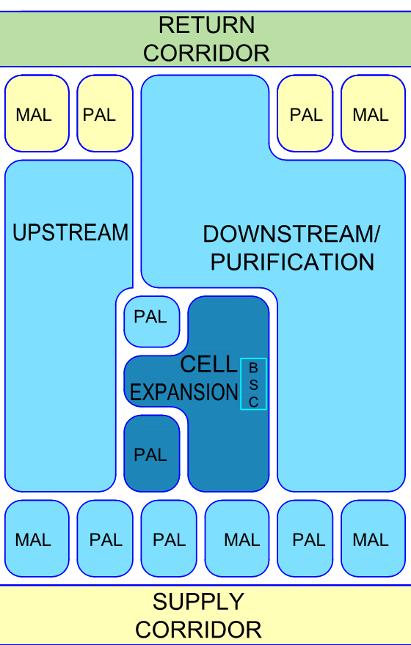
Purposeful
    What rooms do we need to support our processes?
    What are our layout requirements?
        Flows of People?
        Flows for Materials?
        Flows for Product?
        Flows for Waste?
Notes:
Unidirectional ATMP flow

Slide 18
Functional
Notes:
How clean do our rooms need to be?
Cleanrooms are designed to maintain extremely low levels of particulates, such as dust, airborne organisms, or vaporized particles.
Cleanrooms have a cleanliness level quantified by the number of particles per cubic meter at a predetermined molecule measure.
ISO – international organization for standardization
The ambient outdoor air in a typical urban area contains 35,000,000 particles for each cubic meter in the size range 0.5 μm and bigger in measurement, equivalent to an ISO 9 cleanroom

Slide 19
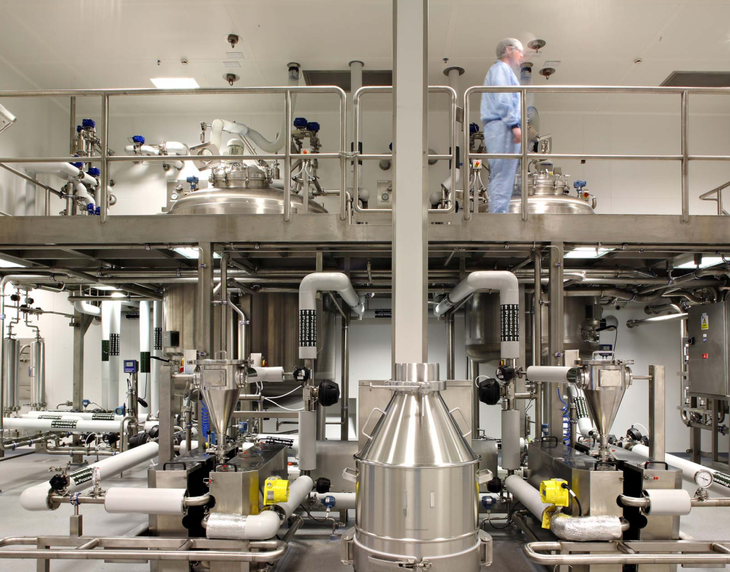
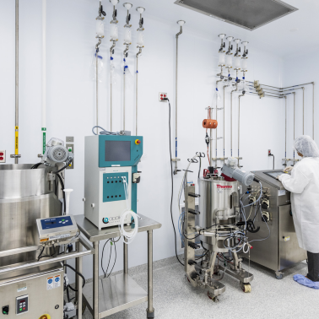
Functional
Notes:
What utilities are required? Do we need PPE storage throughout the facility? What access does maintenance need? What materials of construction make sense for our facility?

Slide 20
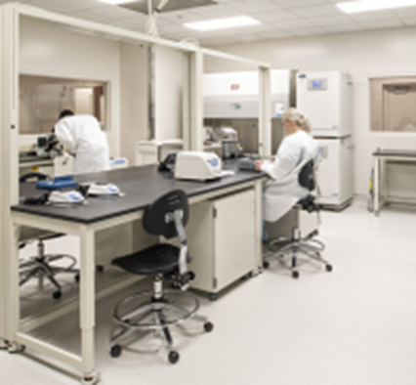
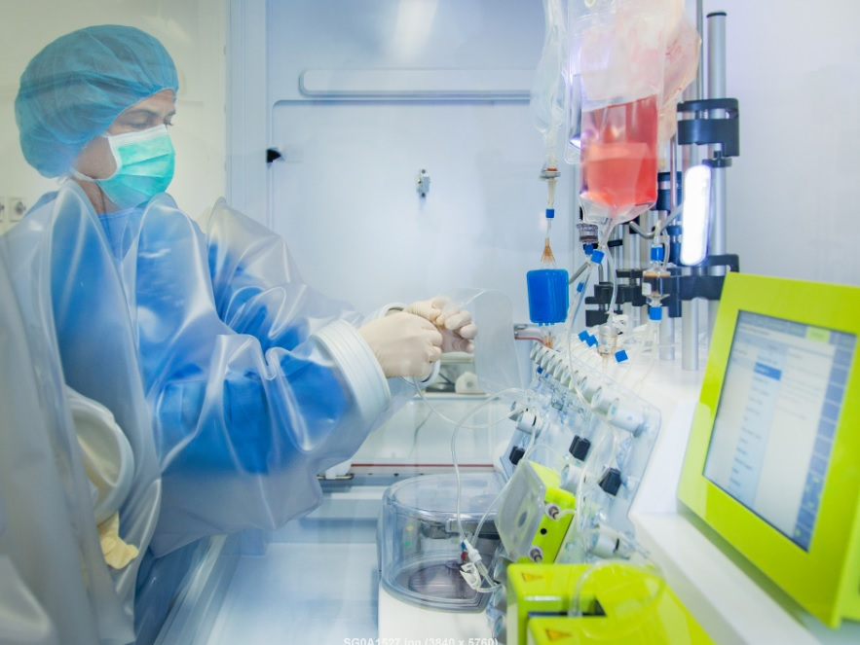
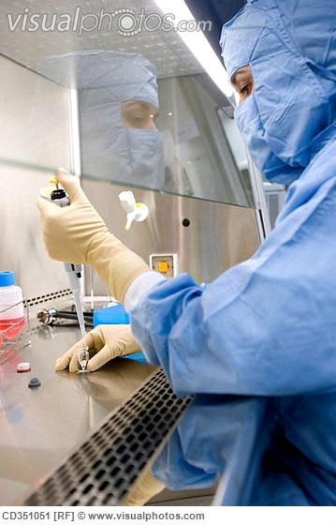
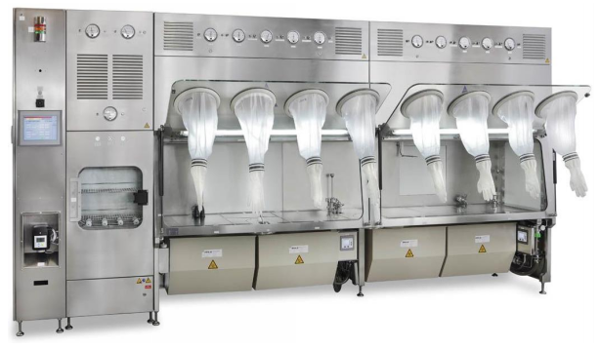
Open Processing
Closed Processing

Slide 21




Safe
Safe
    Construction and Manufacturing Safety
    Regulatory Compliance
    Accessibility
    Quality
Notes:
Regulatory Compliance, Quality, Construction Safety, Accessibility.

Slide 22



To reiterate:
    Schedule
    Cost
    Scope
Notes:
Cost & Schedule & adherence to scope!

Slide 23
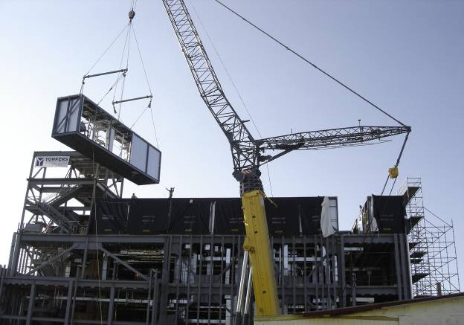
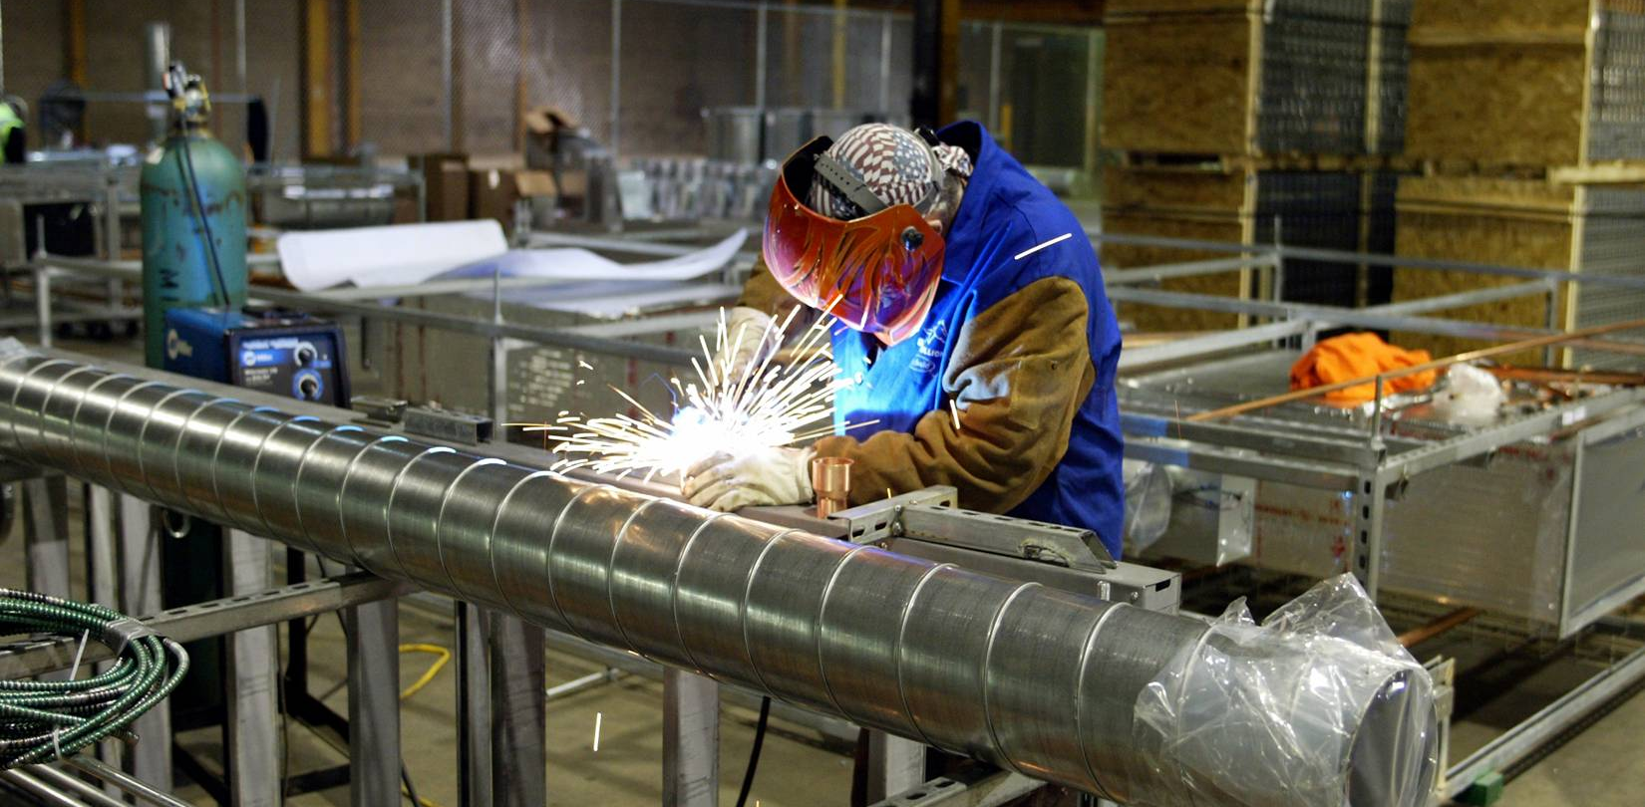
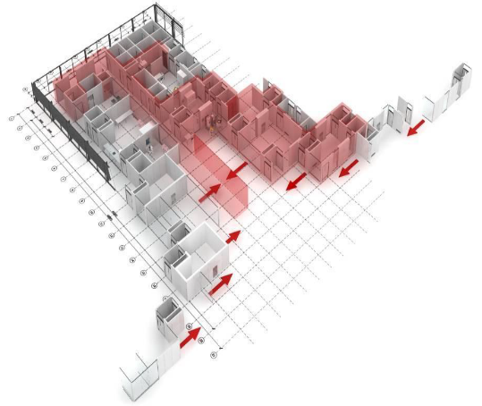
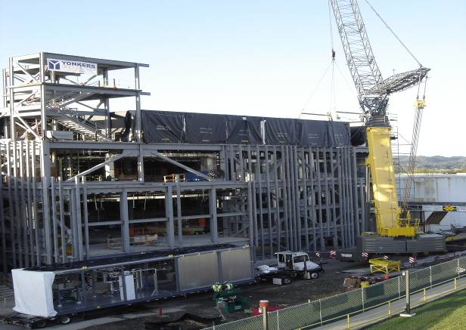
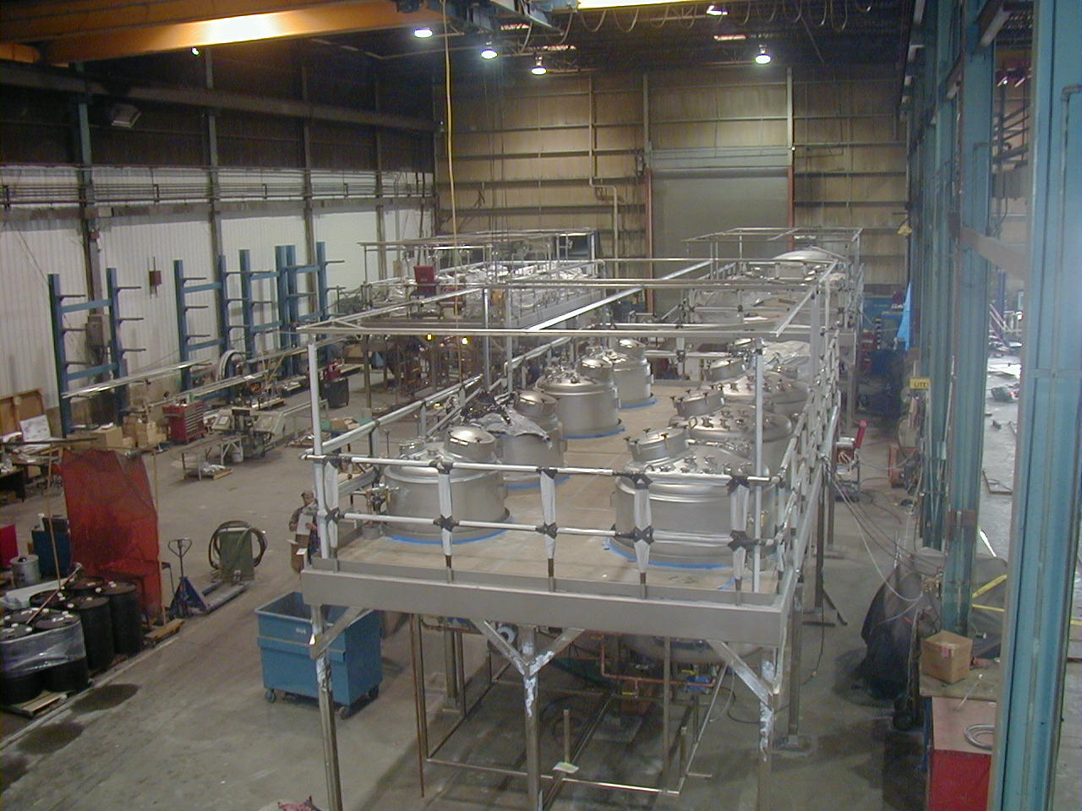
Cost & Schedule Solutions
    Offsite Construction
    Modules
Notes:
What is modularization? - prefabrication, to simplify and streamline the work.

Slide 24
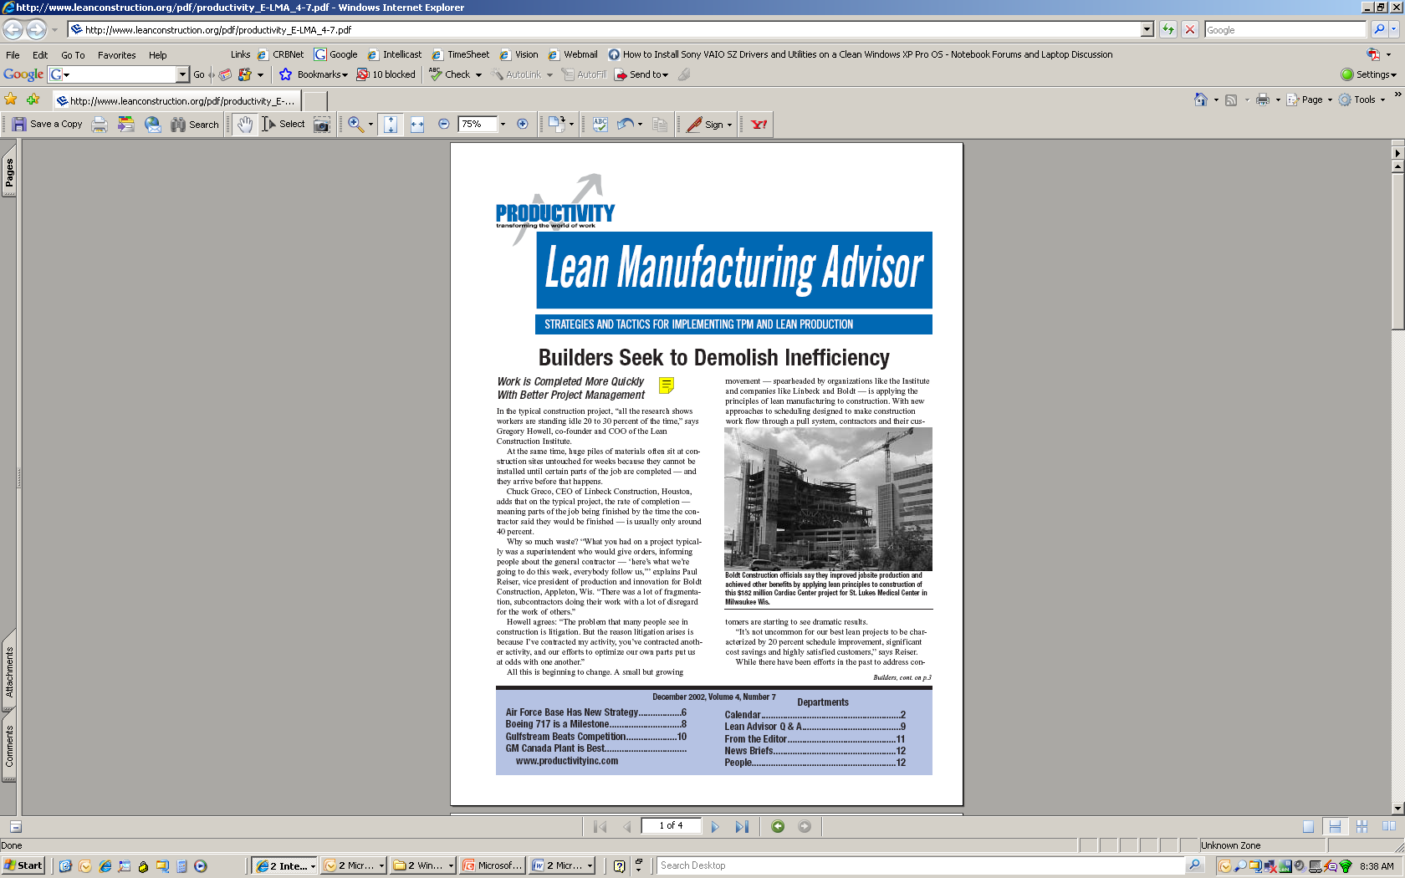
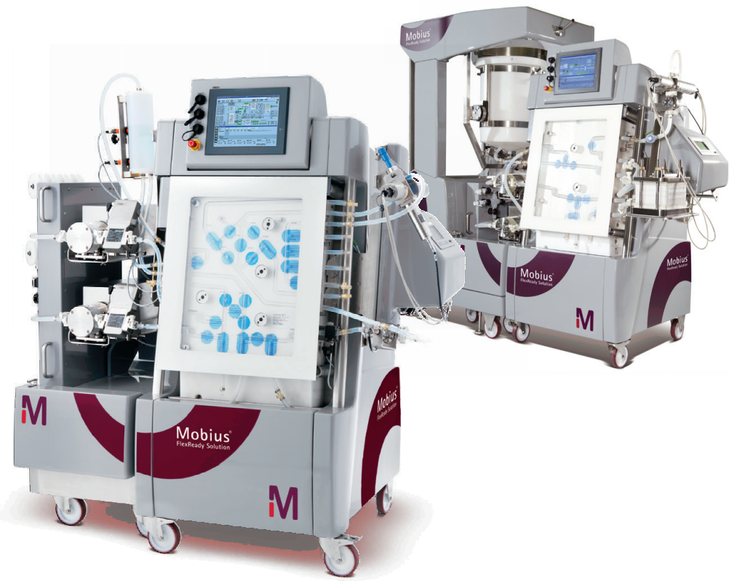
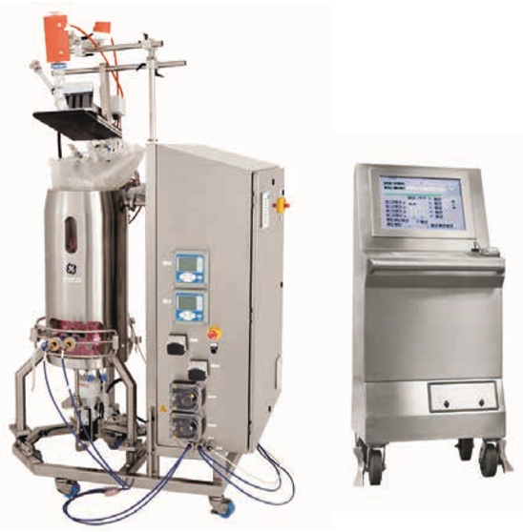
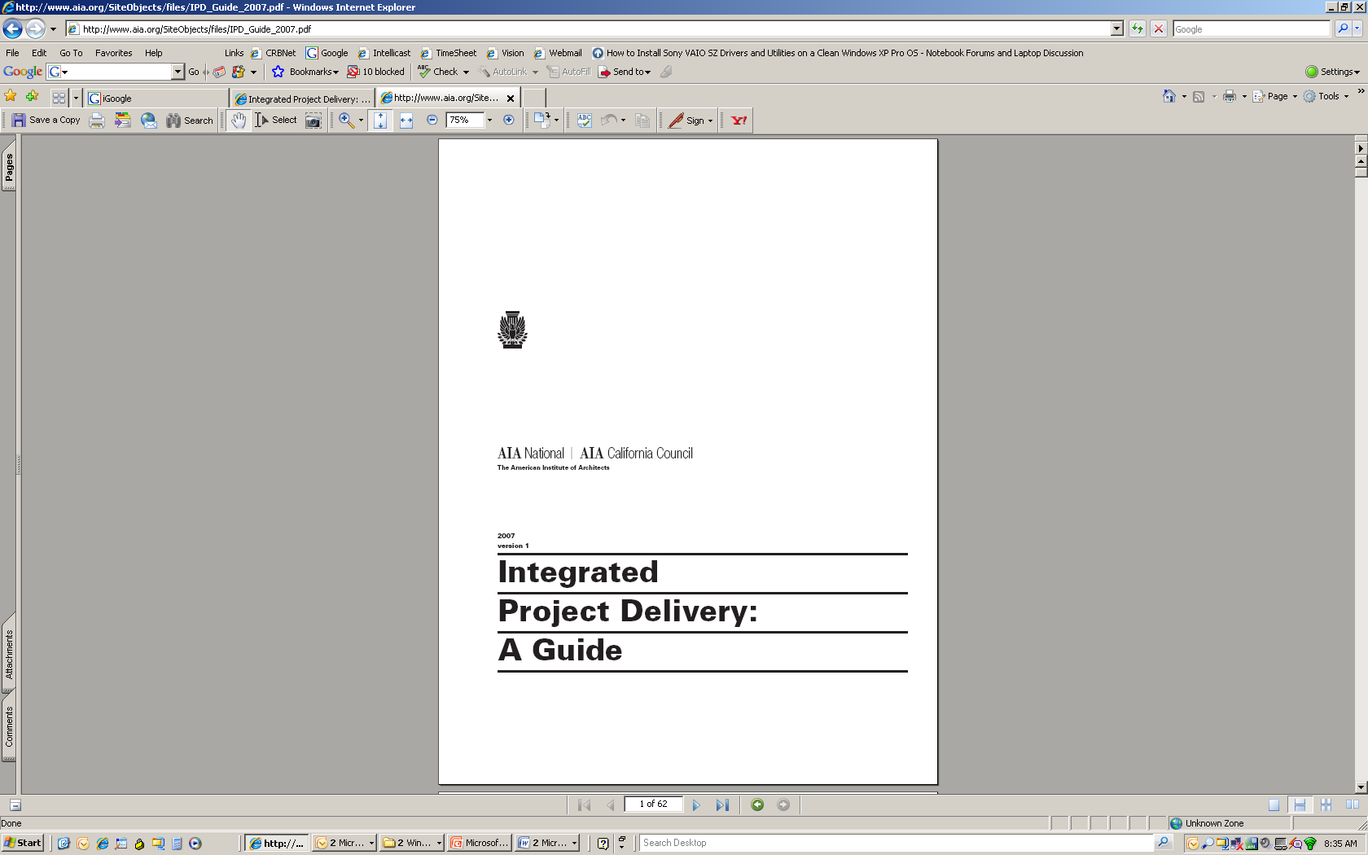
Cost & Schedule Solutions
    Integrated solutions to condense project schedule
    Single Use Equipment within Flexible Facilities
    Single Use Bioreactor
    GE Xcellerex XDR
    Single Use Chromatography Skid
    Millipore Mobius FlexReady

Slide 25

4. LESSONS LEARNED

Slide 26



Lessons Learned
    Contract Manufacturing Organizations
    Utilities
    “Match Existing”
Notes:
CMOs/flexible facilities require a lot of initial discussion
Utilities – make them make sense. Don’t run your electrical conduit below your water pipes. If you don’t think about utilities initially, you’re going to have difficulty incorporating them later. It’s great to have equipment, it’s even better to have functional equipment
"Match existing" - balance between making appropriate recommendations based on what we've learned from previous projects but also making sure a client's "existing" is still cGMP. A lot of the time client's understandably want to match existing to ensure there isn't conflict with FDA filings. (A dance that most young engineers/students likely won't be involved in, but it's important to know the whys!)
Takeaways - ask why! If you're following an SOP and your trainer deviates and has a solid reason, ask why the SOP hasn't been updated to reflect operator knowledge. Sometimes it's just a matter of awareness-the person who wrote the SOP isn't always the person performing the tasks, and updates may be required

Slide 27

5. Q & A

Slide 28
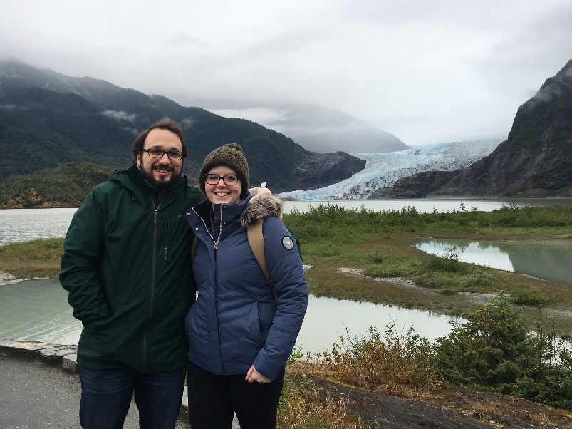

    Stacy Sodomsky
    Stacy.Sodomsky@crbusa.com

