Slide 1
Delivering Superior Service to Clinical Sites and Patients
Greg Hottell
Director, Supply Chain Group Lead
GSK – Target to Patient Supply Chain
March 2017

Slide 2
Delivering Superior Service
Session Agenda
Introduction & review agenda
Section One: Overview of the CenterWatch Survey
Section Two: The GSK Improvement Journey
Section Three: What we learned along the way
Open Forum; Q&A
Greg Hottell – March 2017

Slide 3
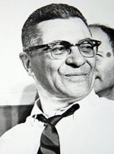
Section One – Overview of the CenterWatch Survey
Measuring sponsor performance at the clinical site
“If winning isn’t everything, why do they keep score?”
Vince Lombardi
Hall of Fame Football Coach
1913 – 1970
Source: http://www.lombardifoundation.org/about-the-cancer-foundation/history-and-mission/lombardi-what-it-takes-to-be-1.aspx
Greg Hottell – March 2017

Slide 4
Introduction to the CenterWatch Survey
Providing context for those unfamiliar with the survey
A global survey of clinical sites & investigators
Conducted every 2 years
~2,000 responses
Looking at key sponsor <-> site relationship factors
Ranking of sponsors based on their relative performance
Comparisons to prior survey results to detect trends and opportunity areas
Source: 2015 CenterWatch Global Investigative Site Survey; General Sponsor Analysis, April 2015.
Greg Hottell – March 2017

Slide 5
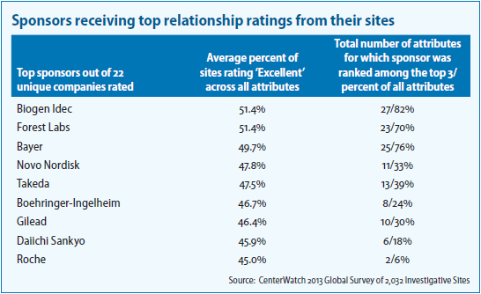
Looking at 2013 Results (Baseline)
GSK was not recognized as top tier based on performance
GSK was not ranked as a top-tier sponsor in 2013
Opportunity: Not on the leader board for performance
Consolation: Considered one of the top-5 sponsors by reputation:
Source: The CenterWatch Monthly March 2013; Volume 20, Issue 03
“…the 2013 survey, for the first time, measured the reputations of sponsors among sites. The top five companies, based on reputation alone, were Novartis, Roche, Sanofi, GlaxoSmithKline, and Pfizer.”
Greg Hottell – March 2017
Source: The CenterWatch Monthly March 2013; Volume 20, Issue 03

Slide 6
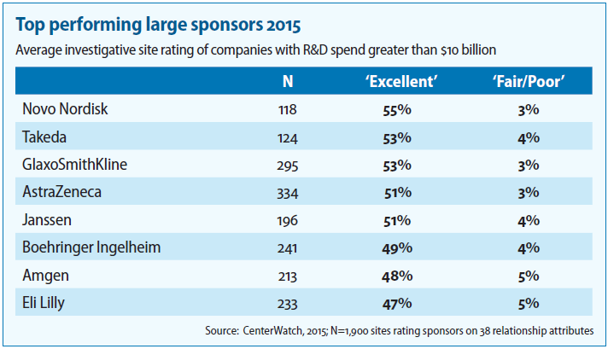
How the GSK Clinical Supply Chain Scored in 2015
Significant improvement in results from the 2013 baseline
GSK was recognized by CenterWatch Monthly as a top-performing sponsor
Source: The CenterWatch Monthly March 2015; Volume 22, Issue 03
Including top-tier performance in “Timely Drug Availability” for clinical sites
Greg Hottell – March 2017
Source: 2015 CenterWatch Global Investigative Site Survey; General Sponsor Analysis, April 2015.

Slide 7
How Did We Do It?
Explaining the change in performance from 2013 to 2015
The change in results from 2013 to 2015 was a tremendous success for our team
The culmination of persistent focus on a few key improvement areas…
Greg Hottell – March 2017

Slide 8
Section Two – The GSK Improvement Journey
Taking action to improve service for sites and patients
“What patients want is not rocket science, which is really unfortunate because if it were rocket science, we would be doing it. We are great at rocket science. We love rocket science. What we’re not good at are the things that are so simple and basic that we overlook them.”
Laura Gilpin
Nurse, Author, and Poet
1950 – 2007
Source: https://www.amazon.com/Putting-Patients-First-Practicing-Patient-Centered/dp/0787964123
Greg Hottell – March 2017

Slide 9
The GSK Improvement Journey
4 key action areas to improve performance for sites and patients
Getting back to the basics
Consistent execution of the fundamentals
Implementation of an end-to-end planning platform
Overage and waste reduction emphasis
Proactive risk management
Clear accountability for on-time patient delivery
Defining and enhancing the interface with Clinical
Relationships across functions
Cross-functional steering committee
1
2
3
4
Greg Hottell – March 2017

Slide 10
1. Clinical Supplies – Getting Back to the Basics
1
Refocusing on our primary reason for existence
We had to get on the same page as to who our customers are and our reason for existence:
“To design and execute clinical supply chains that deliver on-time to patients while supporting the potential of the R&D pipeline.”
It is our responsibility to create effective plans that are able to survive in the real world…
Greg Hottell – March 2017

Slide 11
1. Clinical Supplies – Getting Back to the Basics (cont.)
1
The reality of clinical supplies management
In our business, pressure comes from uncertainty and the need to serve 2 masters:
On-time, Every time
PRESSURE!
At minimal cost / least waste
DEMAND
SUPPLY
Cost pressures continue to mount for many Pharma companies dealing with declining revenues due to patent losses for blockbuster medicines.
Greg Hottell – March 2017

Slide 12
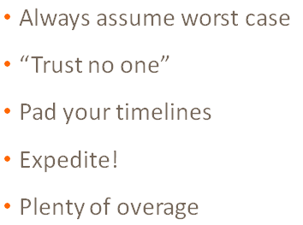
1. Clinical Supplies – Getting Back to the Basics (cont.)
1
Building a framework for a consistent tool kit
One global organization (vs. regional model)
Clear mission and sense of purpose
Core skills reinforced:
Defining and documenting key assumptions
Demand modeling & demand planning
Aligning on deliverables and due dates
Supply planning & inventory management
Risk Planning & Risk logs
vs. ‘Brute Force’ Approach:
Greg Hottell – March 2017

Slide 13
2. Implementing an End-to-End Planning Platform
2
Planning extends from API to Patient Consumption
On a monthly basis, translate patient enrollment (demand) information into a plan for supply activities needed to support GSK studies…
Patient Kit consumption rates
Packaging Activity
Manufacturing Activity
Patient Enrollment projections
Linking patient demands all the way back to manufacturing provides end-to-end visibility for how a change in clinical demand translates into revised requirements for operations or how a change in supply availability might impact delivery for patients.
Planning occurs at multiple levels:
Patient Kit Demand
Secondary Packaging
Primary Packaging
Drug Product
API
Greg Hottell – March 2017

Slide 14
2. Implementing an End-to-End Planning Platform (cont.)
2
Linking the Clinical supply chain from API to Patient Kit
Involved closing gaps and building interfaces across disparate systems
SIMPLIFIED ILLUSTRATION:
Clinical Development Plan
PLANNING
IP Demand Modeling & Demand Planning
Supply Chain Strategy & Supply Planning (API to Patient Kit)
MRP + Inventory Management
DRP
IRT
Drug Substance Manufacture
Drug Product Manufacture
Packaging and Labeling
Distribution and Logistics
Patient Dispensing & Site Inventory
EXECUTION
This fundamentally changed the nature of the Study Lead role
New-found visibility allowed us to challenge decisions and intervene…
Greg Hottell – March 2017

Slide 15
2. E2E Planning Enabled Significant Improvements
2
Leveraging E2E planning to drive value through the supply chain
Demonstrating the value of Supply Chain Management:
Shifting focus from “Overage” planning to “Forward Cover”
Challenging spend events & delaying expenses to be as close as possible to the need / trigger
Tangible results:
£10M to £20M in savings and cost avoidance realized annually
Reversed expansion trend in pilot plant capacity
Improved supply responsiveness
Greg Hottell – March 2017

Slide 16
3
3. Clear Accountability for On-Time Patient Delivery
On-time delivery to the patient as the overarching goal
Before, it was too easy to pass the issue along to someone else (“they should have done something differently…”)
We were not doing a good enough job of getting to true root cause
Corrective actions were not driving significant improvement fast enough
Stock Out Cause…
Solution: Establish a single, visible owner for on-time delivery
Leverage E2E planning platform for visibility and ‘single voice’
Drive cross functional alignment to an improvement plan and actions
Especially important at key interfaces where gaps tend to form
Greg Hottell – March 2017

Slide 17
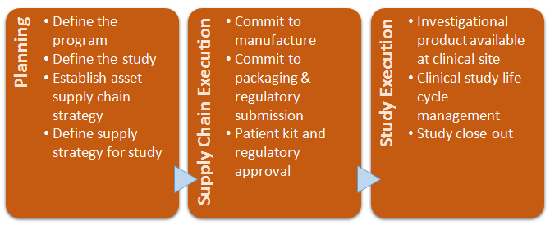
4. Defining and Enhancing the Interfaces with Clinical
4
Improving the interfaces between supply and demand
Cross-functional initiative to identify and improve the barriers to higher performance
Focused on key milestones and defining a RACI for deliverables and handoffs to other teams
Highlighted (and addressed) a lack of understanding of upstream and downstream activities
Greg Hottell – March 2017

Slide 18
What Did We Learn?
As with any journey, learning was a critical component
Back to Basics
The improvement from 2013 to 2015 was the culmination of significant effort over the course of several years
We weren’t always perfect, but we learned a lot along the way…
E2E Planning Platform
Focus on Patient Delivery
Enhanced Interfaces
Greg Hottell – March 2017

Slide 19
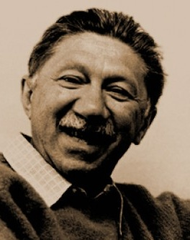
Section Three – What We Learned Along the Way
Key lessons learned from a multi-year journey
“I suppose it is tempting, if the only tool you have is a hammer, to treat everything as if it were a nail.”
Abraham Maslow
American Psychologist
1908 – 1970
Source: https://en.wikipedia.org/wiki/Abraham_Maslow
Greg Hottell – March 2017

Slide 20
What We Learned Along the Way
Key lessons from the journey to improved performance
Training, Culture and Relationships as a foundation
E2E visibility and control over the supply chain is crucial
Overages and Waste are often a ‘red herring’
Ultimately, Supply Chain Agility is key
Greg Hottell – March 2017

Slide 21
1. Training, Culture and Relationships as a Foundation
The softer side of change is the most important first step
GUIDING PRINCIPLE:
“If your people don’t know what they are doing, nothing else really matters.”
Upgrading and changing business tools and processes without considering the necessary skill sets was an early misstep
Any improvement initiative MUST consider the human side of change
GUIDING PRINCIPLE:
“If people can’t agree in times of ease, they will be at each other’s throats in times of pressure.”
If the root causes of conflict are not addressed, improvement initiatives will simply delay the inevitable.
Focus on creating positive reinforcement cycles
Greg Hottell – March 2017

Slide 22
2. End-to-End Visibility and Control
E2E planning framework is a key enabler to higher performance
GUIDING PRINCIPLE:
“If you can’t see it, you can’t manage it.”
Disconnected systems and lack of visibility = delays & supply risk
This creates the “Jump Scare” of clinical supplies (the problem you don’t see coming till it is too late…)
Supply Chain Strategy + Demand & Supply Planning
MRP + Inventory Management
DRP
IRT
Drug Substance Manufacture
Drug Product Manufacture
Packaging and Labeling
Distribution and Logistics
Patient Dispensing & Site Inventory
The solution does NOT have to be a full-blown ERP platform (although it can certainly help…)
Greg Hottell – March 2017

Slide 23
3. “Overages” and Waste are Often a Red Herring
It can be easy to get distracted by alternate goals…
When it comes to our primary objective, Waste and Overages are often red herrings…
They are outcomes of the process, as opposed to the primary deliverable.
GUIDING PRINCIPLE:
“If you can’t explain simply what the inventory is for, you don’t really have an inventory plan.”
Greg Hottell – March 2017

Slide 24
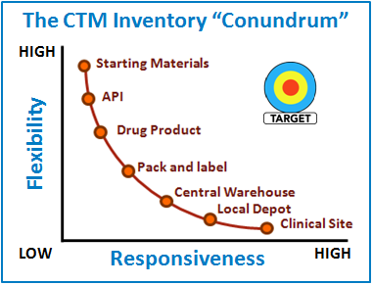
3. Overages as a Potential Red Herring
Utilizing inventory to help us achieve our primary objective
“CTM supply needs to be highly flexible, yet immediately responsive”
Flexibility allows us to reallocate stock…
From one dose form to another
From one study to another
From one language pool to another
From one clinical site to another
While minimizing waste
Responsiveness to meet patient needs…
The right dosage forms
For the right study
In the right quantities
At the right places
At the right time
Greg Hottell – March 2017

Slide 25
4. Ultimately, Supply Chain Agility is Key
Using an agile approach to replace the need for high overages
GUIDING PRINCIPLE:
“If a key part of the plan is predictably unpredictable, formally prepare your supply chain to adapt.”
The necessary tradeoff between flexibility and responsiveness means that inventory alone only gets us so far in achieving our primary objective
The supply chain needs to be designed and operated to ensure it is ‘agile’:
“…supply chain agility can be defined as a firm’s ability, in conjunction with its key suppliers and customers, to quickly and effectively react to changes in environment.”
Source: Blome, Constantine, et al. “Antecedents and Enablers of Supply Chain Agility and its Effect on Performance: A Dynamic Capabilities Perspective.” International Journal of Production Research. Vol. 51, No. 4., 15 Feb 2013.
Agility does not have to be about cutting edge or highly advanced production capabilities – in many cases, it is about getting the fundamentals right
Greg Hottell – March 2017

Slide 26
4. Ultimately, Supply Chain Agility is Key (cont.)
An illustration of what I mean by agility…
We know that variability is a huge factor in our business, leading to supply risk:
In a basic supply chain, supply risk is a function of variability during the replenishment lead time. Agility helps to address the risk and assure supply:
Source of Agility:
Inventory at node
Cycle Time
Upstream reserve
‘Supplier’
DEMAND
‘Customer’
Source of Risk:
Demand variability
Supply variability
Lack of visibility
SUPPLY
How we have chosen to approach agility:
Maintain some internal packaging, labeling & distribution capability
Leverage externalized capabilities where appropriate
Strategic inventory placement (relative to capability) along the supply chain
Strong emphasis on E2E visibility & rapid identification of hot spots
Greg Hottell – March 2017

Slide 27
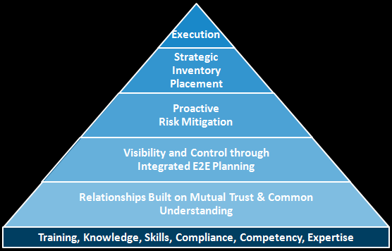
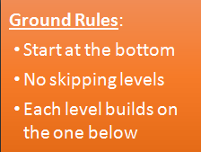
Bringing it All Together
The Journey to Improved Delivery for Sites and Patients
Greg’s Roadmap for Improved Performance:
Following through relentlessly on the plan AND its myriad contingencies
Optimal placement of inventory relative to capabilities to ensure rapid response
Collaborative planning for what might happen with disciplined planning for contingencies
Establishing the “control tower” with an appropriate infrastructure
Healthy & engaged teams working collaboratively across functions
Mandatory fundamentals
Greg Hottell – March 2017

Slide 28
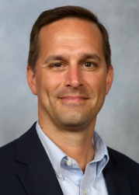
About the Presenter:
Greg Hottell is a Director in the Clinical Interface team at GSK, where he is responsible for the cost-effective, patient-focused supply of investigational product for GSK’s pharmaceutical development portfolio. Since joining GSK in 2011, Greg implemented an end-to-end planning platform for clinical supplies, helped redesign GSK’s approach to clinical supply blinding and unblinding risk management, was a core team member for the Investigational Material Supply
strategic planning initiative, all while consistently delivering top-tier performance with on-time supply of investigational product to patients.
Greg has been a Supply Chain professional since 1999, most recently holding positions of increasing responsibility at Eli Lilly & Company and Fisher Clinical Services prior to joining GSK. Greg has a diverse background in the Pharmaceutical Industry spanning roles that include clinical trial materials management, demand planning, site inventory management, IRT utilization, drug product supply planning, temperature excursion management, study drug expiry dating extensions, customer service, operations planning & scheduling, and procurement.
Greg holds a bachelor’s degree in Operations Management, an MBA, and is a Certified Fellow in Production and Inventory Management (CFPIM) through APICS.

