Slide 1
Just in Time Labelling in the EEA
Duncan J Donald
VP Quality Europe
Yourway transport Biopharma Services

Slide 2
Introduction
What is “Just in Time” labelling?
Is this something new?
What is the difference between is “Just in Time” labelling and “On Demand” labelling?
Advantages and Disadvantages
Release of clinical trial material in the EEA

Slide 3
1. JiT labelling at the point of distribution
In this scenario, your drug product can be packaged with a primary label and then stored, awaiting a request for distribution to clinical sites, warehouse or distribution depots.
Getting part of the labelling process out of the way means that when a request for product comes, it is a relatively quick job to apply an ancillary label which further identifies the product, adding for example a patient ID number, material ID numbers and/or protocol numbers. This method is well-suited for smaller labelling projects.

Slide 4
2. JiT labelling for pooled Supplies
In the case of pooled supplies, the label cannot be finalized until the moment of request. Requests may vary by dosing, country of shipment, language, regulatory requirements and so on. As such, the pooled supply is either unlabelled or partially labelled until it is needed, at which point it is processed specific to each protocol/study or compassionate use (a situation in which a clinical study is completed, but distribution is allowed to continue for patients who experienced significant benefits), and readied for distribution.

Slide 5
3. JiT labelling for retest/expiry dating
In situations where a product is already labelled it may be necessary to apply an ancillary label that has been dedicated for a particular drug study program.
Expiry date and retest date labelling are the most common JiT labelling requests.
If this this method is used then QP co-operation is imperative for the JiT labelling to be successful.
Approval from QP and processes set up at the depots weigh heavily in this type of labelling form.

Slide 6
Examples (Just in Time Labelling)
Just in Time labelling is labelling that is performed to meet a predicted demand.
Labelling , packaging, release and shipping takes place so the patient receives his medication immediately prior to when he needs it
As an example
A site predicts that it will require medication for a patient on October 11th 2015
The medication is labelled, released and shipped so the medication is available on that date.

Slide 7
Examples (labelling on demand)
Labelling that is performed to meet a specific requirement;
Labelling, packaging, release and shipment takes place in response for a specific need.
A patient attends a site for a check, perhaps blood sample.
The results from the check up indicate that the patient is to be prescribed.
The packaging site label a specific patient pack and this is released and shipped to the site for the patient to collect or shipped directly to the patient.

Slide 8
Is JiT a New Way of Working ?
No!
There have been a small number of trials conducted using a just in time approach
Recently gained a much wider appeal with the increased use of IRT
( INTERACTIVE RESPONSE TECHNOLOGIES)
Better visibility of demand
Better understanding of when product is required
Demand for greater flexibility in use of supplies to reduce wastage

Slide 9
Advantages of JiT Labelling
Solves a Number of Potential Problems
Lack of supply
Patient recruitment
Short shelf life/limited stability information
Storage/transport /packaging conditions
Use of new markets/countries
Costs

Slide 10
Advantages of JiT Labelling
1. Lack of Supply
Several trials ongoing with the product
Satisfy the demands of all of the ongoing trials
How do you maximise supply chain efficiency without committing drug to a trial until its required?

Slide 11
Advantages of JiT Labelling
1. Lack of Supply
Several trials ongoing with the product
Satisfy the demands of all of the ongoing trials
How do you maximise supply chain efficiency without committing drug to a trial until its required?

Slide 12
Advantages of JiT Labelling
2. Patient Recruitment
High recruiting sites vs. low recruiting sites
Poor recruitment
Extend study
Add new countries/site
How do you manage these changes?
JIT provides the flexibility to manage change

Slide 13
Advantages of JiT Labelling
3. Short Shelf Life/ Limited Stability
Company keen to get drug into the clinic
Often lead lot of clinical trial material is on concurrent stability
How do you manage the stability program?

Slide 14
Advantages of JiT Labelling
4a. Storage/transport/Packaging Conditions
Is the product temperature sensitive?
Storage requirements
Frozen -70/-40/-20°C
Refrigerated (2 to 8°C)
Ambient storage
Transport requirements
Strict requirements vs. flexibility

Slide 15
Advantages of JiT Labelling
4b. Storage/transport/Packaging Conditions
Packaging requirements
Pack product at ambient temperatures
Special packaging requirements
Refrigerated packaging
Packaging in dry ice
Storage/Transport/Packaging
Conditions may affect choice of packaging material
e.g. Labels
Label adhesives.

Slide 16
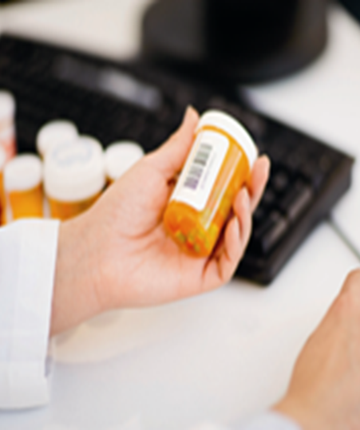
Advantages of JiT Labelling
5.Use in New Markets
Flexibility to bring in new countries quickly;
No requirement to update booklet labels
Single panel label with the country specific requirements

Slide 17
Disadvantages of JiT Labelling
Increased number of packaging runs
Increased Documentation
More releases
Reduced Timelines
Costs

Slide 18
1. Increased Number of Packaging runs
Multiple of smaller packaging runs
One run producing one pack for multiple countries
Multiple runs producing country specific packs
More room set ups
Line clearances
Short sharp packaging runs with changeovers between each run

Slide 19
2. Increased documentation
Increase in the number of batch documents.
Increase in the amount of In process work to be performed
Increase in the number of QP release activities.

Slide 20
3. More Releases
More batch records to review
Shorter with less In Process data to check
Standardised format from use of templates
Review easier?
QP availability to release shipments in time for distribution
Use of checklists to standardise process

Slide 21
4. Reduced Timelines
Previously:
Several weeks or months to have supplies at site
Now:
Must hit a specific shipping date for supplies to be at site.
Miss a specific date will cause problems
Supplies late

Slide 22
5. Costs
Increased packaging runs;
Increased number of releases
Increased shipments
Potential reorganisations
Offset against potential drug savings

Slide 23
Considerations For Release in the EEAs
In the EEA Clinical Trial Material is assessed in the same manner as commercial product.
API must be sourced from GMP/audited sites
It must be transported in a secure supply chain
It must be manufacture in a EEA audited and approved site
Product must be transported in a compliant manner.
Any relabelling must be undertaken in an approved site. The site should be audited by the releasing QP.
All materials must be released by a QP

Slide 24
Considerations For Release in the EEAs
Communicating with your contract manufacturer/ distributor about QP release at their depot is crucial.
Ensuring that the QP is aware of any changes to the stability profile or changes in the supply chain. Before release the QP must be aware and have had time to assess the changes

Slide 25
Considerations For Release in the EEAs
If a delay in your process arises, this is usually where it will be:
The product is labelled and ready to ship, but the QP is tied up on other projects and unavailable to sign off.
This causes the whole project to be needlessly delayed.

Slide 26
Considerations For Release in the EEAs
Quality Assurance review and approval
Qualified Person release
Process can require 1 to 15 days notice, dependent upon any changes made to the clinical trial material and the availability of the Qualified Person

Slide 27
Summary
Increasing complexity of trial design, product classes and geographic reach mandates greater flexibility in managing and customizing clinical supply
Increasing pressure to reduce overall costs associated with clinical supplies management
Decreasing timelines to First Patient in trial
Lack of sufficient stability data before clinical supplies go to the sites.

Slide 28
Summary
Under JIT labelling high overages and large quantities of wasted supply are a thing of the past.
However in the EEA it is the QP who has the final decision in the labelling of Clinical Trial Material and must be consulted at all time during the Process. From the initial decisions to the final release of packed product.

Slide 29
Thank You
Any Questions?

