Slide 1
Web software/cloud computing + integrated sensor connectivity for significant Process improvement
Patrick McGrath
General Manager
Berlinger USA
March, 31, 2016

Slide 3


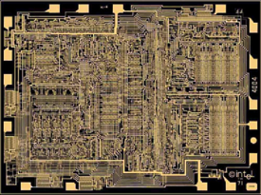
Technology & Innovation
1971
Ferrari = fastest car:
Top speed 174mph
Twin Towers = tallest bldg:
Height 1,362 ft
Intel 1st microprocessor:
2,300 tiny transistors
The Economist March 12, 2016, pg.11
CONFIDENTIAL

Slide 4
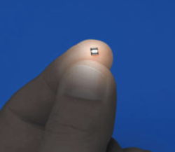
Technology & Innovation
Today
Half billion of them
Fill the space of the
1971 processor
Intel Skylake processor
1.75 billion transistors
The Economist March 12, 2016, pg.11
CONFIDENTIAL

Slide 5

Technology & Innovation
Today
Ferrari 1971:
Top speed 174mph
Ferrari today:
1/10th speed of light
67million MPH
The Economist March 12, 2016, pg.11
CONFIDENTIAL

Slide 6


Technology & Innovation
Today
Twin Towers 1971:
Height 1,362 ft
Tallest building today:
120,000 miles tall
Halfway to the moon
The Economist March 12, 2016, pg.11
CONFIDENTIAL

Slide 7
Technology & Innovation
Are you getting as much out of all this technology as you should?
CONFIDENTIAL

Slide 8

Technology & Innovation
Through innovation you can leverage the power of technology
CONFIDENTIAL

Slide 9
Technology & Innovation
What is INNOVATION and what does it take to INNOVATE?
CONFIDENTIAL

Slide 10
Technology & Innovation
INNOVATION = in a new way
The successful conversion of new concepts and knowledge into new processes, services, or products that deliver new customer value
The executive guide to innovation, ASQ Quality Press 2013

Slide 11
Technology & Innovation
PROCESS INNOVATION:
Is finding a better way to do what you already do
The executive guide to innovation, ASQ Quality Press 2013

Slide 12
Innovation Vs. Process Improvement
Process Improvement
New
Technologies
Innovation Space
Innovation
Space

Slide 13
Technology & Innovation
How can you think like an INNOVATOR in your company?

Slide 14
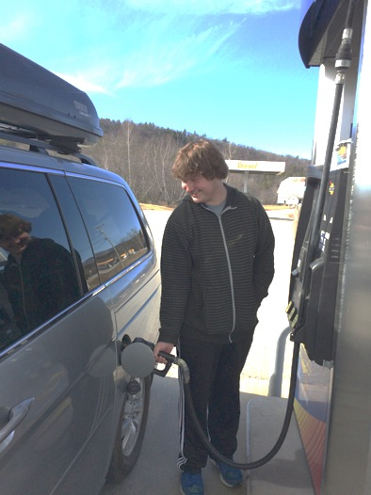
Process Innovation Examples

Slide 15
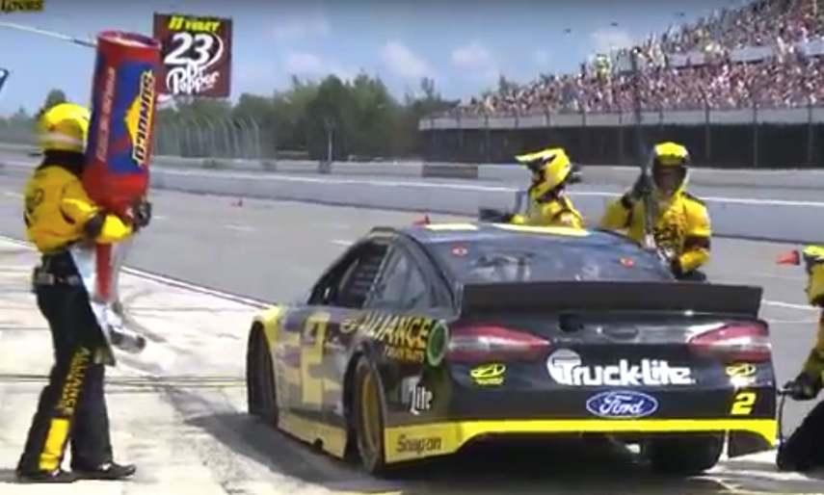
Process Innovation Examples
How long does it takes them to fill up?

Slide 16

Process Innovation Examples
CONFIDENTIAL
Info.us@berlinger.com

Slide 17
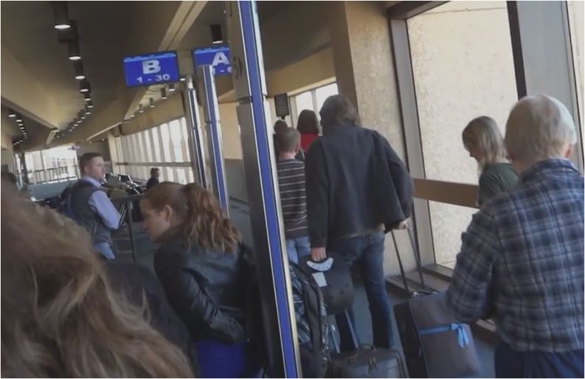
Process Innovation Examples

Slide 18
Process Innovation Examples
How are companies leveraging technology to achieve innovation?

Slide 19
Process Innovation Examples
Freight company issues:
Truckinginfo.com 2015
Supplychain247.com 2015
Notes:
Driver turn over = 76 – 100% annually
More employees dedicated to finding & hiring drivers then in customer service
Average driver age = 54 years
Who wants to grow up to be a truck driver
Over-the-road hauling = 2-4 week routes
Creates stress and motivation to find new job

Slide 20
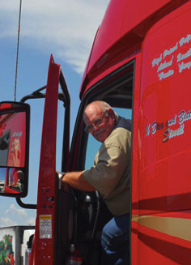
Process Innovation Examples
Freight company issues:
Issue:
Driver turn over: 76-100% annually
Average driver age: 54 years
Over-the-road hauls: 2–4 wks from home
Truckinginfo.com 2015
Supplychain247.com 2015

Slide 21
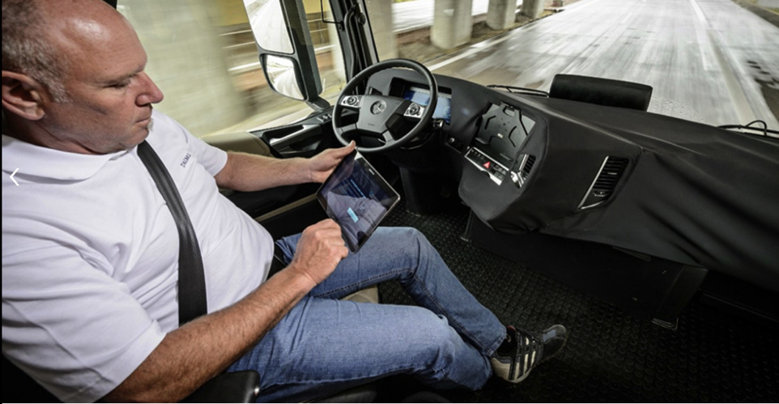
Process Innovation Examples
“Driverless trucks
By 2025” - Mercedes
Mercedes.com website

Slide 22
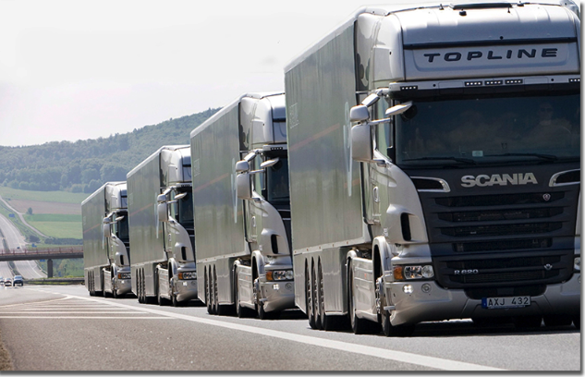
Process Innovation Examples
6 truck linked convoy
3 drivers in lead cab
Fast: 24/7 driving
Secure: never stop
Safe: lead driver in charge
Mercedes.com website

Slide 23
Process Innovation Examples
Limited accountability of air freight handlers
Information on goods is historic, not real-time
Freight damaged, delayed and lost
Freight forwarder issues:
Notes:
Freight forwarder issues:
Air freight: limited accountability of freight handlers
Airlines do not sign separate service contracts
Information on goods is historic, not real-time
Cannot proactively fix issues
Freight damaged, delayed and lost
Increased costs and losses

Slide 24
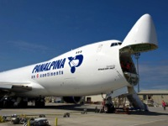


Process Innovation Examples
Issue:
Panalpina is a global freight forwarder that wanted to have real-time visibility on its international pharmaceutical shipments and storage facilities
Solution:
Shipments are equipped with SmartPoint sensors OR wireless data loggers. Trucks and warehouse hubs are equipped with Connect Gates that act as wireless hotspots.
Benefits:
No more temperature excursions
Increased process efficiency
Compliance with EU GDP regulations

Slide 25







Real-time monitoring
Alerting
Automatic shipment monitoring
Up to 7 year storage
Manufacturer
Luxemburg Hub
Alabama Hub
Customer
Wireless networks installed at Luxemburg and Alabama hubs

Slide 26
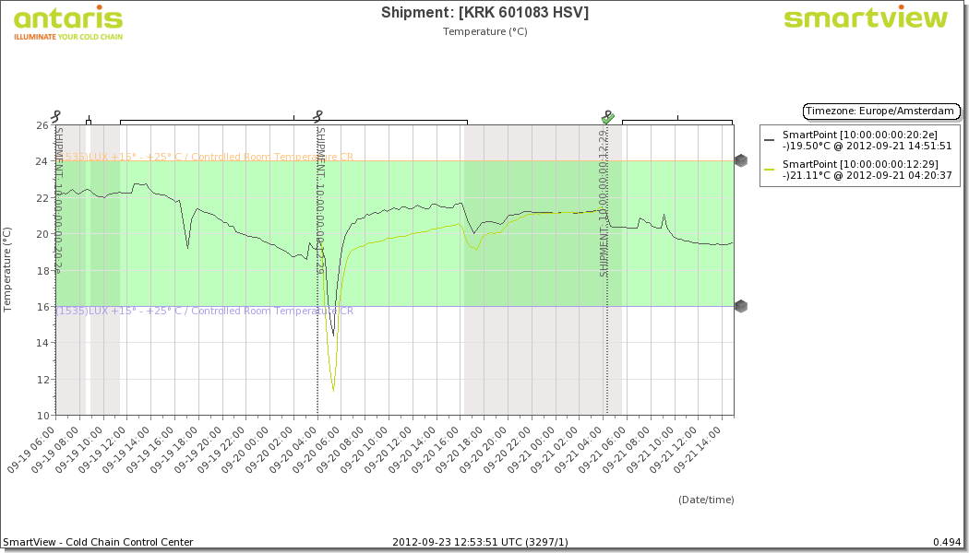
Example pro-active intervention

Slide 27
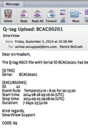

Process Innovation Examples
Automated notification

Slide 28
SmartView Shipment Alert
This is like a Twitter or Facebook Update, directly from your shipment.
15ºc to 25ºc materials in
13.5ºc environment

Slide 29
Operational response
Within 15 minutes after alert, the problem has been identified and resolved to prevent any damage to the product
Real-time data and engaged employees TRUMP continuous monitored storage

Slide 30
Process Innovation Examples
Problem solved in real time
Notes:
Driver turn over = 76 – 100% annually
More employees dedicated to finding & hiring drivers then in customer service
Average driver age = 54 years
Who wants to grow up to be a truck driver
Over-the-road hauling = 2-4 week routes
Creates stress and motivation to find new job

Slide 31

Process Innovation Examples
Clinical material temperature management:
Issue:
3 days to clear clinical materials for patient use
Clinical Sites (CS) manually enter Min/Max temperatures for every shipment
CS manually attach data logger reports to IVR system
Temperature data not truly connected to each product in clinical study

Slide 32
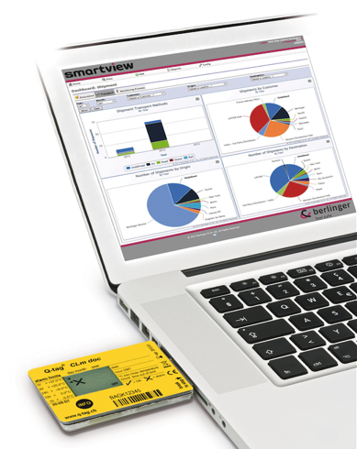
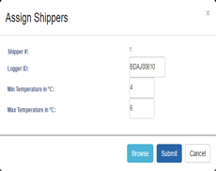


Process Innovation Examples
Notes:
Driver turn over = 76 – 100% annually
More employees dedicated to finding & hiring drivers then in customer service
Average driver age = 54 years
Who wants to grow up to be a truck driver
Over-the-road hauling = 2-4 week routes
Creates stress and motivation to find new job

Slide 33
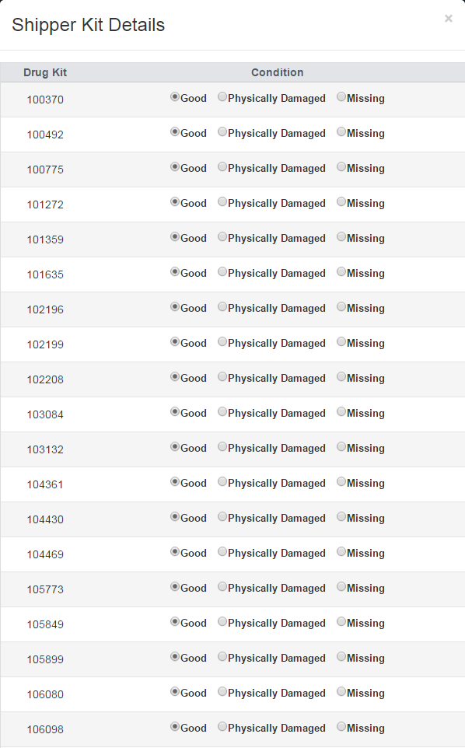
Process Innovation Examples
Y-Prime IRT system automatically integrates data logger files with IRT product data base
Notes:
Driver turn over = 76 – 100% annually
More employees dedicated to finding & hiring drivers then in customer service
Average driver age = 54 years
Who wants to grow up to be a truck driver
Over-the-road hauling = 2-4 week routes
Creates stress and motivation to find new job

Slide 34
Process Innovation Examples
How can technology be leveraged to create exponential process improvement in your business?
Remote site monitoring?
3PL accountability?
Global connectivity?
End-to-end information?
Notes:
Driver turn over = 76 – 100% annually
More employees dedicated to finding & hiring drivers then in customer service
Average driver age = 54 years
Who wants to grow up to be a truck driver
Over-the-road hauling = 2-4 week routes
Creates stress and motivation to find new job

Slide 35

Technology & Innovation
Questions?
222 Turnpike Road
Suite 3
Westborough, MA 01581
USA
www.berlinger.com
Patrick McGrath
General Manager
508-366-0084
Info.us@berlinger.com
CONFIDENTIAL
Info.us@berlinger.com

