Slide 1
Implementing the New ATMP Guide:
A Focus on Autologous cell therapy manufacturing
Erich Bozenhardt, PE
Lead Process Engineer, Regenerative Medicine Operations
United Therapeutics
Jeff Odum, CPIP
Global Chair, Biotechnology CoP
Biotech SME

Slide 2
Introduction to the ATMP Guide
The Guide is:
The Guide is not:
An introduction to baseline concepts supporting current alignment of design, compliance, and control for the manufacture of ATMPs
A reference to the recognized product-process-facility body of knowledge for autologous CT operations
The primer for developing sound facility design and operational attributes focused on risk
A resource for defining and expanding current thinking around aseptic manufacturing techniques applied to patient-driven therapies
An all-inclusive data reference to the entire scope of ATMPs
Intended to advance all current thinking around fed-batch driven aseptic manufacturing
Addressing rapidly changing regulatory and technology advances
Focused on redefining established practice applicable in key areas of manufacturing support and product protection
Addressing allogeneic CT operations

Slide 3
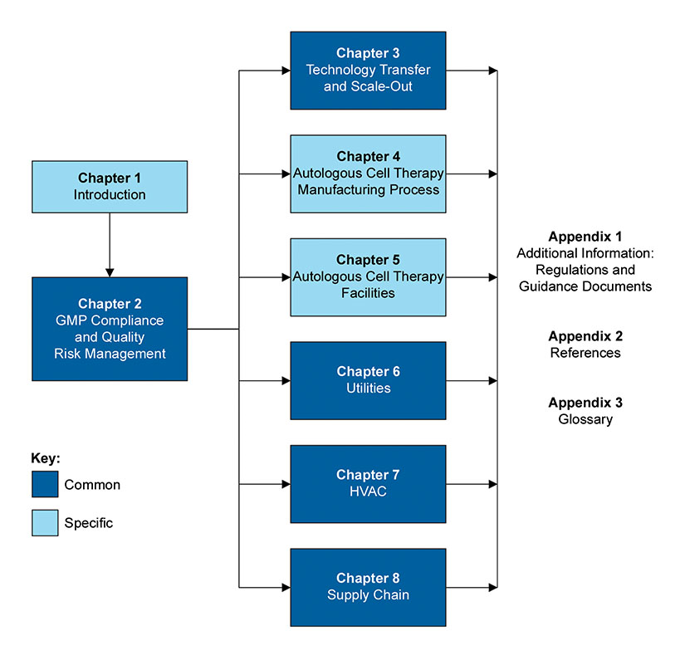
Content Structure
Supporting Guidance
  ISPE Baseline Guide Volume 3 – Sterile Product Manufacturing Facilities (Third Addition)
  ISPE Baseline Guide Volume 6 – Biopharmaceutical Manufacturing Facilities (Second Addition)
Identification of Common BoK elements
Core topics can be easily revised in the future
Appendices used to advance data presentation as in other Guides

Slide 4
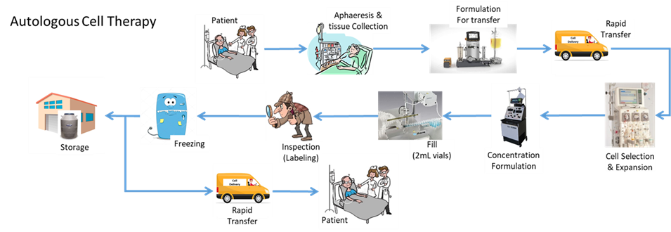
Autologous Cell Therapy Products
The Guide stays primarily at a facility level and establishes the guiding design principles to be considered during rapidly evolving science and regulatory guidance.
The Guide is written from the perspective of a manufacturing-driven solution for the specific product “family” discussed.

Slide 5

Process Understanding
1 Batch = 1 Patient
“Liquid” Cancers
~190,000 patients
Example facility, 8,000 CAR-T /yr
~420 batches in process at one time
>40 batches of product released / day
-Raw material release
-Intermediate batch records
-Chain of custody / identity tracking
Traditional Batch Release
depositphotos.com
Notes:
In autologous manufacturing we need to be prepared to work with massive amounts of data.
Traditional methods and systems will fail under commerical load. Integrated data collection / management systems are essential.

Slide 6
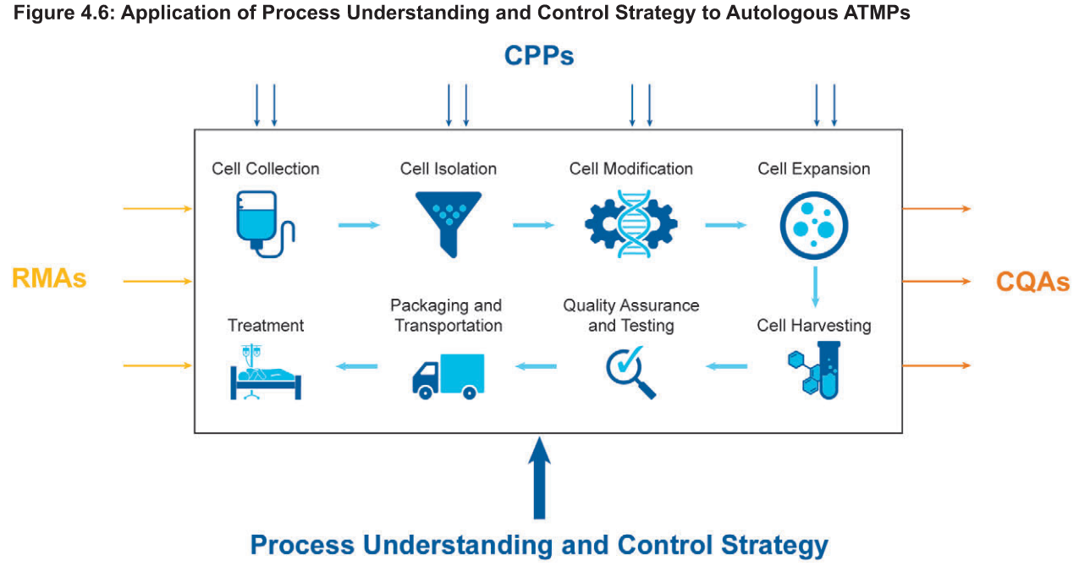
Process Understanding
1 Batch = 1 Patient
Difference in genetics/ epigenetics
Difference in distribution of cell types
Plus novel / highly variable other raw materials
Notes:
In addition to the volume of data, there is a lot of variation for AT cell therapy.

Slide 7
Process Understanding
How to Characterize
Identify variances
-can’t control what isn’t measured
Risk assess variances
-may have to revisit
Development modeling
-manageable steps
-integrated process
Criticality assessment
Test control strategy
Notes:
In addition to the volume of data, there is a lot of variation for AT cell therapy.

Slide 8

Process Understanding
Modeling / Testing Variability
One size process equipment
-screen with scale down analog
Manual steps
-evaluate operator variability
Limited patient samples
-banked cell analogs
Notes:
These processes don’t look like traditional PD.

Slide 9
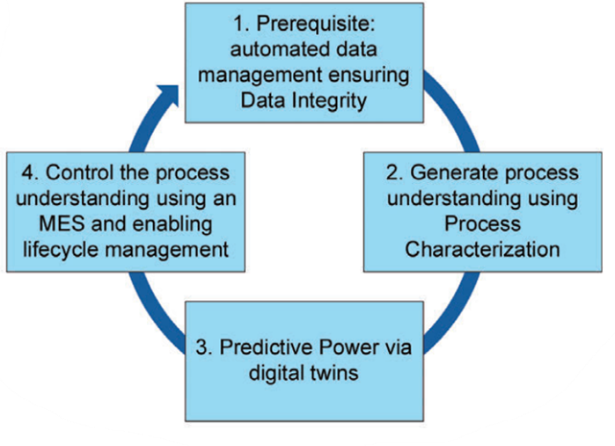
Process Understanding

Slide 10
Today vs Tomorrow
Today
It worked, determine MoA
Paper on glass, mostly manual review
Limited characterization
Open loop control (e.g. bake for time)
Mix match of closed / open steps
Tomorrow
Rational design to MoA
Manual review only for exceptions
Focused predictive models
Feed Forward Control
More closure, reduced risk for open

Slide 11
Facility Design: The Product-Process-Facility Relationship
The Biomanufacturing Primer
“The process defines the product”
  Define (What?) – Define the product’s critical quality attributes (CQAs) and associated product and process requirements to meet patients’ needs with respect to capacity and cost, etc.
  Design (How?) – Design the process and provide the manufacturing capacity necessary to achieve the goals set in the define stage, then develop the process through the following two execution stages to provide the product for clinical testing and commercial supply.
  Qualify (Will it work?) – Before any important process is operated to produce material for therapies, it should be appropriately tested within the commercial manufacturing facility to assure it will reliably produce safe and effective high-quality product. As the product moves through its development life cycle, all product material should be qualified to achieve its necessary quality goals to assure successful development and patient safety and efficacy.
  Operate & Verify (Did it work?) – If properly designed, the process should both control and provide proof of control such that the product can be used with a very high degree of assurance that it meets the required quality goals.

Slide 12
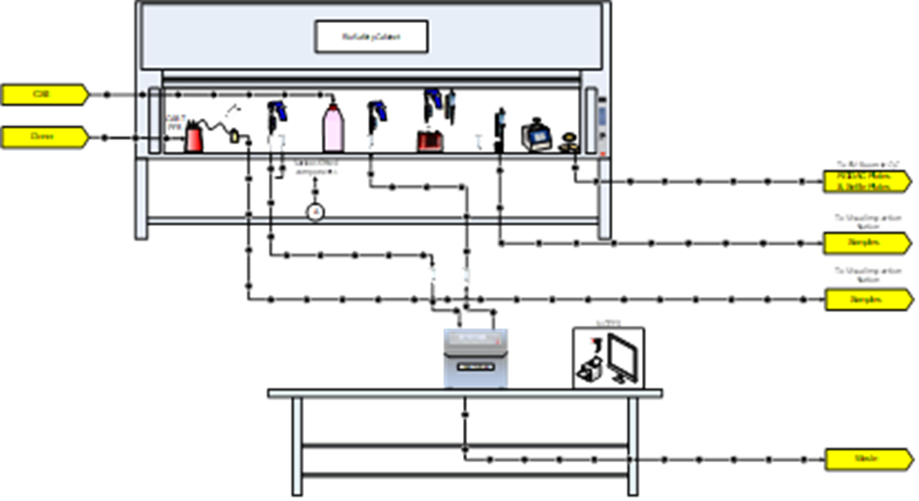
The Current State of Autologous Cell Therapy Manufacturing
The majority of autologous cell therapy facilities in operation today are manufacturing patient doses for clinical supply
Comparatively few facilities in commercial operations
Many of these facilities are first generation facilities utilizing open processing and limited automation
This technology is in its infancy at this time but is expected to mature in the future due to rapid market growth

Slide 13
Manufacturing Attributes – Process Closure
The combination of small patient populations, small volumes, product contamination risk, and process variability provide the backdrop for driving process design to implement closed processing.
The “open process foundation” of process development has created process design challenges to implement closed system attributes that meet current Aseptic Manufacturing Guidance
Question:
Are the open process and the closed process equivalent to each other?
You must define equivalent:
Different risks, different steps, different capabilities

Slide 14
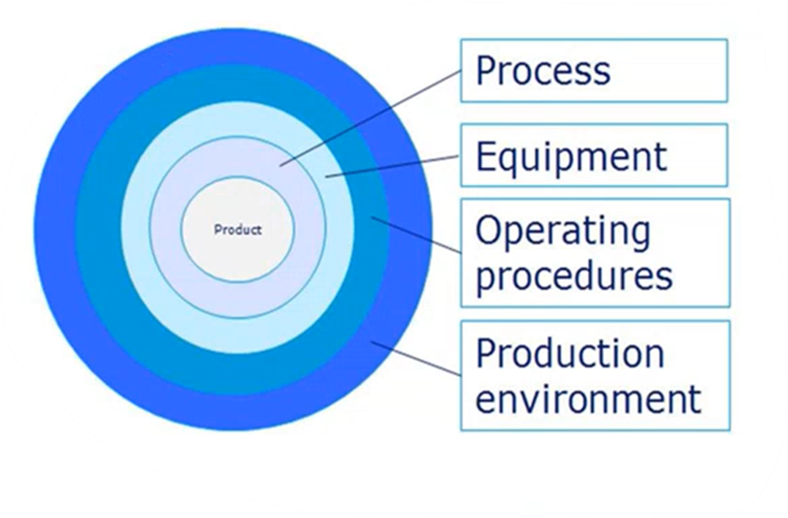
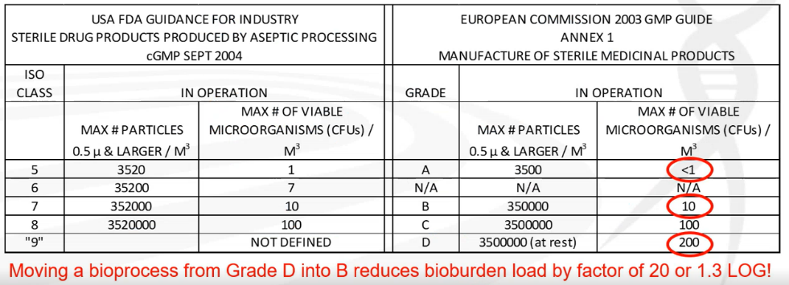
Why is Process Closure so Important?
Control of the production environment ring presented has a small impact on bioburden compared to the layers below.
As shown in the table below, moving the bioprocess from a Grade D into a Grade B only reduces the volume of bioburden by a factor of 95%.
This mean one of every two microbial contaminates is still present in the much more expensive-to-maintain production environment.

Slide 15
System Closure and Assessing Risk
Contamination rate: 2 to 14%
Evolving processes & equipment
-increase in purpose designed
-increased adaptation of existing
-most steps can be closed
Incoming material challenges
-patient samples
-materials in small cyrovials
Sampling
-small volumes
-varying containers at final fill
Single Use Systems
-process fit
-transfer in/out
Aseptic Connectors
-cost & size
-medical practice vs manufacturing
Tube Welding
-watch material through out process
-testing / qualification
-can add particles

Slide 16
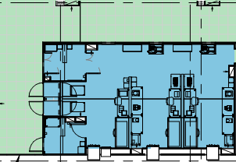
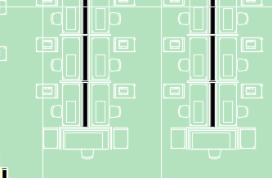
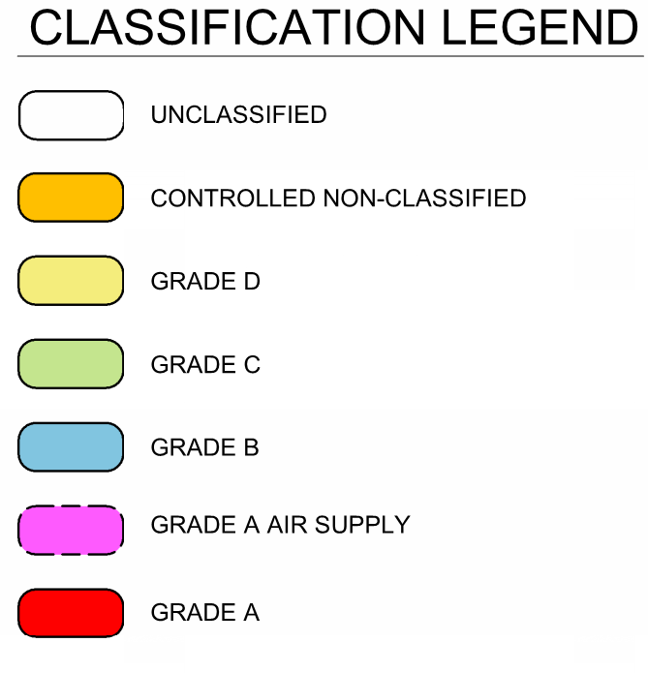
Case Study
Open
Manual
Lower Risk
Higher Capacity
Online Monitoring
MES driven
Closed
Automation by operation
Instrumented

Slide 17

Questions & Wrap up

