Slide 1
Matching today’s talent and skills with new technology
Jeff Hall, Associate Director, CAI
Todd Troutman, Engineering Director, AstraZeneca
ISPE CASA Conference
15 February 2022

Slide 2
Today we will talk about…
The need to develop the knowledge and skills of new employees and staff with new technology.
Implement methods to ensure employees and staff stay current with design, operations, and maintenance requirements for new technologies.
Present methods to consistently transfer knowledge and skills throughout the organization to include engineers, operators and technicians.
Notes:
Why we are here
Methods and importance – who and how is best?
Who do you start with? How? What have we done recently?

Slide 3
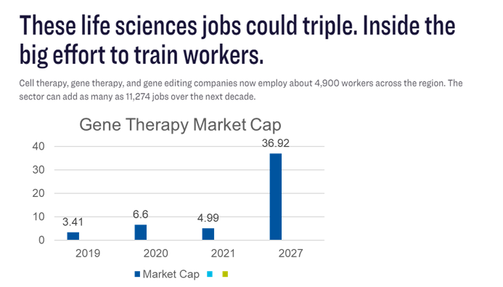
Cell and Gene Therapies are driving changes in the Life Sciences industry
There are over 5000 job openings in cell and gene therapy….and expected be many more….according to several sources
Notes:
https://finance.yahoo.com/news/cell-gene-therapy-market-size-123200121.html?fr=sycsrp_catchall

Slide 4
So…today we will talk about several things
Describe cases or situations where the need to transfer knowledge and skills to new plant operators and technicians is required
Discuss methods to utilize plant and process engineers to transfer knowledge and skills to newly hired engineers
The importance of ensuring subject matter experts and lead engineers stay current with changing technologies
Emphasize the “how” when using industry professional organizations and best practices to train engineering, operations, and maintenance team members
Recognize the need to implement these industry best practices with the current company operating and maintenance procedures

Slide 5
Process VARIABILITY & CONTROL – people matter the most
SITE PRODUCTION VARIABLES
PEOPLE
PROCEDURES
PHYSICAL PLANT
Product
QUALITY SYSTEM CONTROLS
The skills of our people play an important role
Notes:
There comes a point in the very near future (if you haven’t already hit it) when people represent your greatest risk to predictable outcomes, but they also represent your greatest competitive advantage (it’s what truly differentiates you).
Where do these people come from?
Sure you have to hire well, but it’s also the expectations you set and the performance environment that makes them perform and makes them stay!
Dare I say “culture”?

Slide 6
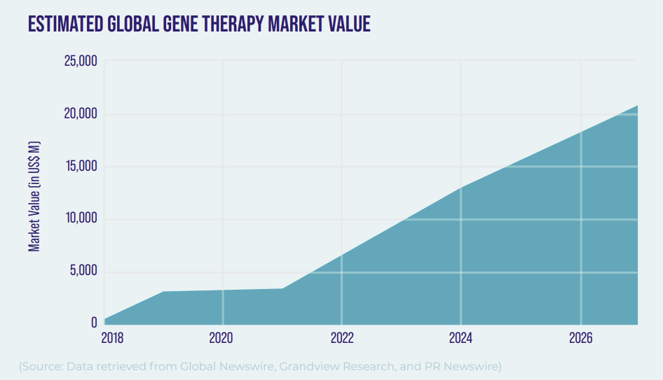
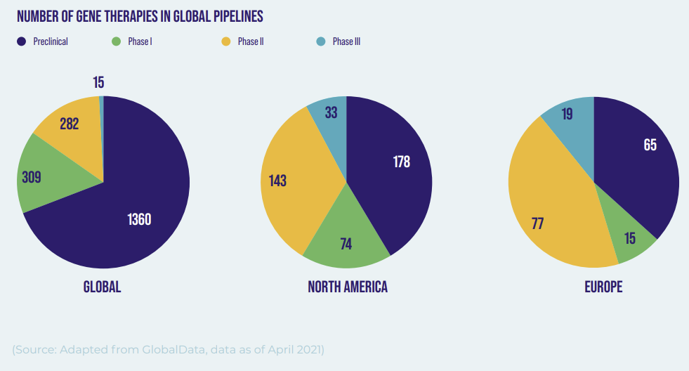
A brief history lesson
For years, the pharmaceutical and biotechnology industry has relied on hiring talent with manufacturing experience and using internal programs and tribal knowledge to train new and inexperienced employees who are new to the industry.
In recent years with the introduction of gene and cell therapy manufacturing, new innovations in technology are being constantly introduced.
The number of startups is increasing rapidly and the availability of experienced talent is being stretched to the limits.
There is more emphasis and importance being placed on speed to market with these new products.

Slide 7
So…our problem statement is….
You have 200 job openings in your new company
The talent pool in your region only supports 25% of your needs
Your workforce is aging, and key senior people are preparing to leave
This Photo by Unknown Author is licensed under CC BY-NC
This Photo by Unknown Author is licensed under CC BY-ND
Notes:
Todd T. slide

Slide 8
The cost of hiring and training a new person is expensive….
At least one study indicates the cost of each employee’s turnover ranges from 70 to 300 percent of the annual salary of that employee.
And the replacement costs are about 2.5 times the salary of the individual.
A recent survey with life science professionals indicated that 67% will be looking for a new job in the next 12 months.
Such a statistic could be crippling in an industry with such specific talent needs.
68% are having issues finding talent
…so, we need to minimize the cost related to lost knowledge and experience and capture what we can
Notes:
Todd to speak
https://www.biospace.com/article/retaining-employees-in-the-life-sciences-industry/
Reference 1: https://www.weareams.com/blog/number-one-hiring-challenge-pharma-biotech/
Reference 2: White Paper: https://www.weareams.com/whitepapers/transforming-talent-acquisition-for-future/

Slide 9
Where do we go from here?

Slide 10
What are you experiencing now?
Hiring and talent management struggles?
What are typical concerns around staffing and hiring?
What are things you are struggling with?
We are all face with the same challenges
Notes:
Question for the audience

Slide 11
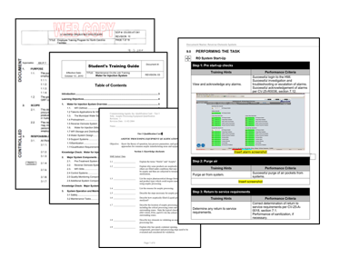
How does knowledge transfer take place today?
Procedures and manuals
Internal training
External training (vendors and other institutes)
How do we retain the tribal knowledge and experience of the senior people we are losing and map it to new technology / processes?

Slide 12
How do we retain the tribal knowledge and experience of the senior people we are losing?
How do you retain knowledge?
How do we prevent loss of industry knowledge?
Is it this easy?
Distance Learning....
We need to find better solutions…..today!
Notes:
Distance Learning.... YouTube Video

Slide 13
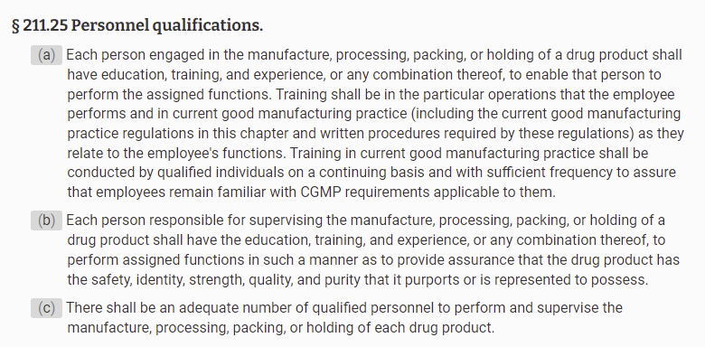
…and there are regulatory requirements
Employees in Manufacturing, Warehousing or Packaging
Education, Training and / or Experience
Supervisors / Managers
Education, Training and / or Experience
Qualified Personnel
The company needs to have enough qualified personnel to manufacture the product
Notes:
https://www.pharmaguideline.com/2017/12/requirements-of-fda-for-training.html

Slide 14
What can we do and how?

Slide 15
Recent Project Example with AstraZeneca
Align on the Client’s Objective
The Basic Process
Agree on the Target Audience
Roles and Responsibilities
Documentation and Industry Standards
Formalize and Memorialize the Information
Notes:
Jeff

Slide 16
Align on Client’s Objective – Target Area
Process to Procedure Map
(SOPs, work instructions, and eventually batch records)
Qualification Paths & Training Content by Role
Site Objectives
Process Map
SME & System Owner Roles Defined & Filled
Work Breakdown Structure
Map Roles & Procedures to Skills & Knowledge for Proficiency
i.e., production, cost targets
i.e., tasks within each process step
Process to
Roles Map
(descriptions and numbers)
Workplace Practices & Culture to Support Role Performance
COLOR KEY:
Site Leadership
SMEs & System Owners
Notes:
Jeff

Slide 17
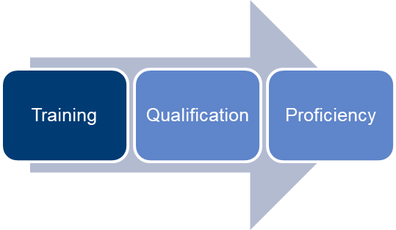
The Basic process
Skills matrix
Map processes
Brainstorm
Use process SMEs
Document tribal knowledge
Draft documents
Qualification cards
Use local references
Identify required skills
Perform gap analysis
Validate data with Industry Standards
Internal and external resources are typically required to support this type of work
Notes:
Jeff
Skill matrices by job role
Ranking of priorities by criticality
Safety
Process
Organizational capabilities / needs
Gap Analysis
Action Plan

Slide 18
Agree on the Target Audience
Six (6) technical Qualification Paths, as prioritized by the owner, that match the levels of progression for the identified roles to include training, OJT materials, and qualification cards
A structured model / reporting method to measure program effectiveness to support sustained continuous improvement
Technician
Senior Technician (Lead)
Supervisor
Engineer
Senior Engineer
Principal Engineer
Notes:
Todd
Initiative in place for techs
Scalable from engineer down, but not necessary the opposite

Slide 19
Roles and Responsibilities
Owner
Developed a skills matrix
Criticality assessment based on knowledge and skill priorities
External Support Team
Collected existing documents (SOPs, Guidelines, Job aids, etc.)
Organized needs by braining storming events with SMEs
How many people do we need?
Assess the current staff against the needs (gap analysis)
Look for external expertise / support to assist in program development
Applied industry standards
Developed Training Guides and Qualifications
Memorialized by placing in LMS procured access to industry standards
Outcome: Sustainable, scalable, current technical qualification program for Engineers
Notes:
Todd

Slide 20
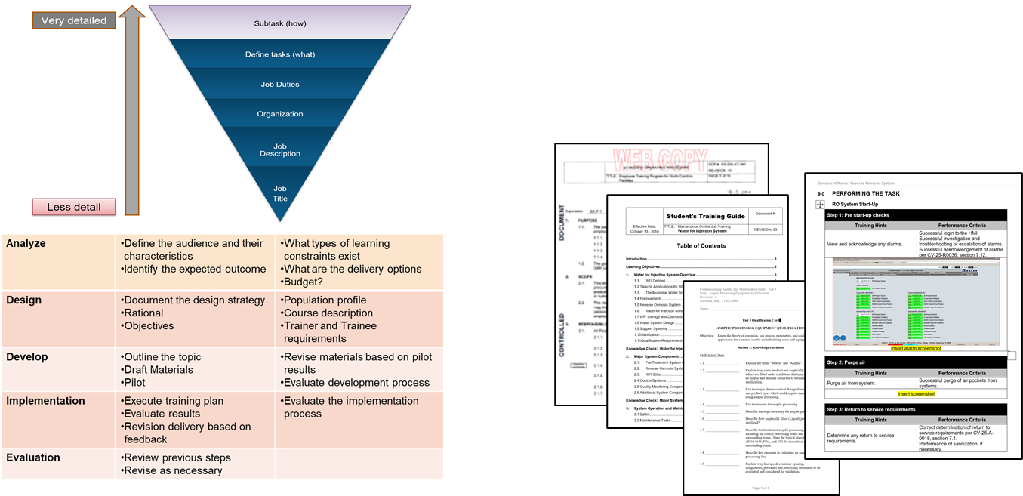
Documentation Development
Notes:
Jeff

Slide 21
Documentation Development and Industry Standards
Capture tribal knowledge and experience of senior people
Basic Training Manual – understanding of basic knowledge requirements
OJT Documentation – Combination of knowledge and skills
Qualification Cards (basic and advanced) – ensure people know how to do it correctly
Validate knowledge and experience periodically using industry standards
The availability of industry standards is incredible today!
Notes:
Jeff and Todd

Slide 22
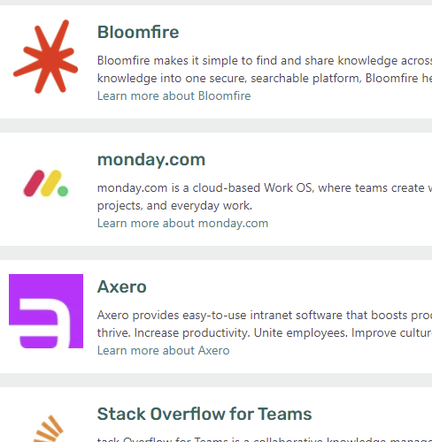
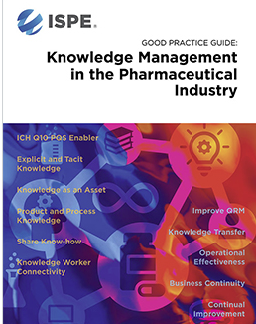
Formalize and Memorialize
Individual Development Plans (IDPs)
Learning Management System
Document Management System
Knowledge Management System and Owner
Notes:
Todd

Slide 23
Benefits of a structured knowledge management and talent development
Knowledge transfer for new hires
Build Bench Strength
Provide Talent Flexibility
Promote Career Progression
Reduce Competition for Talent
Create Process for Succession Planning
Retention
Expectation – close skills gaps
Notes:
Todd

Slide 24
Summary
The Life Science Industry is evolving
New and current knowledge and experience needs to be retained
Use of senior people and capturing tribal knowledge is essential
Tribal Knowledge
Industry Best Practices
Technology and
Talent Advantage
Notes:
Jeff

Slide 25
Question and Answers

