Slide 1
Multifaceted approach to Commissioning, Qualification, Validation, Calibration and Maintenance Support
Chad Merewether PE
Engineering Manager of Project Services
PCI
Pablo Hernandez
Director, Project Management Services
PEG Contracting Inc.
2020 Technology Conference

Slide 2
Agenda
Introductions
Purpose
What is a multifaceted approach to cqv, calibration and maintenance?
Typical Asset lifecycle
engineering data strategy and Central data group
Case Studies using a Multifaceted approach to CQV, Calibration and maintenance support
Conclusion

Slide 3
introductions
Chad Merewether pe
Engineering manager of project services
Pci
Pablo Hernandez
Director, project management services
Peg contracting inc

Slide 4
Introductions
Pharma/Biotech Representatives – Business and Engineering?
Construction/General Contractors?
Commissioning?
Qualification/Validation?
Calibrations/Maintenance/Inventory?
CMMS Administrators/Supervisors?

Slide 5
Purpose
To explain how a multifaceted approach to CQV, Calibration and Maintenance activities, that includes an engineering data strategy and a central data group can save time, decrease rework and duplication of effort and carry into the operational phase of asset lifecycle to save additional time and reduce delays.

Slide 6
What is a multifaceted approach to cqv, calibration and maintenance?

Slide 7

Multifaceted Approach to CQV, Calibration and Maintenance
A multifaceted approach to CQV, calibration and maintenance is one that includes not only the CQV, calibration and maintenance service providers, but also a central data group, engineering data strategy and an effective transition from capital projects into operational readiness.
Capital Projects
Operations

Slide 8
Typical Asset lifecycle
Assessment, Induction, operations, assessment, retirement

Slide 9
Critical Data Gathering starts here
Asset Data Loaded to CMMS Active
Notes:
Start-ups/Expansions (Sprinters)
Operations (Long-distance Runners)
This topic and overall strategy can be applied to both. For the sake of simplifying and getting a better sense of the impact this strategy has, I’m going to focus on the start-ups/expansions.
We have a new trend in the industry with gene and cell therapies and they can really benefit from what I’m presenting today.
Asset Lifecycle
Start running through flow diagram to approved submittals, click next
Approved Submittals
This is really where the Critical Data gathering for the asset is started. You’ll have manufacturer, model #, sometimes serial #, component data, and so on from the manuals or other submitted documents. Not necessarily 100% accurate but not much worry here as this should just be the early start to the critical data that is necessary.
Procurement
You’ve purchased the asset and it’s being fabricated or it’s on its’ way to the facility.
Assessment
Initial assessments performed when awaiting asset arrival or when onsite
Criticality/Impact
Calibration requirements
Maintenance/PM requirements
Spare Parts
This is when the Asset Data should be loaded to the CMMS and made Active, click next
Enrollment
Asset enrollment in CMMS. This is where all the critical data has been gathered (or nearly gathered) and should start getting loaded to the CMMS.
Collected Critical Data
Assigning the Asset ID
Attaining all necessary approvals
Loading to CMMS and verify
Set up Calibration/PM Plans and Schedules
Set up Spare Parts, PM parts and Critical Spares (not just a BOM)
Asset is now Active in the CMMS (all work associated with the asset is now in the work history audit trail)
Operations
Getting the asset into an operational state
Loop Checks and Initial Calibrations (if applicable)
Commissioning
Required/Necessary SOPs
Qualification/Validation (if applicable)
Following Calibration/PM Plan (Active plan)
Assessment
Assessments of asset performance data
Calibrations – Extend/Reduce interval based on passing/failing results
PMs – Extend/Reduce interval, Add/Remove task steps, Service Contract/In-house
Parts – Obsolete, Like-for-Like, Vendor Cost Analysis
Process – Effectiveness, Efficiency, Accuracy, Dependability
The assessments can lead to Asset Changes, through change requests and possibly Change Control if it’s a qualified asset. All assets will undergo change requests regardless if they’re qualified. Essentially, the change request is just authorizing the CMMS administrators to make the changes in the system.
Retirement
Removing asset from service for disposal/sale
Needs replacement, Nonfunctional
Asset no longer necessary, new processes
Closeout Calibrations
Re-Qualification/Validation
Decommissioning, Retire; Log books, PMs/Cal, Parts, Drawings, SOPs, etc

Slide 10
Multiple service arms
Commissioning, qualification/validation, maintenance, calibration, inventory, cmms data

Slide 11
Service Providers
Client
Commission
Qualification
Validation
Maintenance
Calibration
Inventory
CMMS
Notes:
The Service Providers here are typical contractors brought in to help the client ramp up.
Some/all of these may be handled internally, but generally services brought in to help handle heavy workloads.
Start-ups and expansions generally require help in these areas.
These service providers can be all one company or several companies.
Regardless, the teams are going to have to communicate and work together to accomplish their scope.
They all rely on one or another for critical data.

Slide 12
Service provider needs
Critical data required for successful project completion

Slide 13
Required Critical Data
Commissioning
What does the commissioning team require to complete their scope?
      Drawings/Specifications/Submittals/Manuals
      Asset Identification Numbers
      Initial Calibration Reports
Qualification/Validation
How about Qualification/Validation team?
      Similar to Commissioning
      Asset Identification Numbers and enrolled in CMMS
      Calibration Reports (Current and Scheduled)
      PM Plan Reports (Active/Scheduled)

Slide 14
Required Critical Data
Calibration
Calibration team needs?
      Asset Identification and enrolled in CMMS
      Calibration Plan (Ranges, Test Points, Tolerances, etc.) developed and ready to execute
      Test Equipment/Standards loaded in CMMS and ready for use
Maintenance
What is needed here?
      Asset Identification and enrolled in CMMS
      PM Plan (Job Plans, Task Lists) developed and ready to execute
      Spare Parts (PM and Critical) identified and available

Slide 15
Required Critical Data
CMMS Data
What does the CMMS Administrator or Supervisor need?
      Asset ID naming SOP
      Collect all asset Critical Data (Commissioning, Walk-downs, System Owners)
        Asset Master record
        Calibration Plan
        Maintenance Plan
        Spare Parts (BOM, Critical, PM)
Inventory
Inventory needs?
      Asset Identification and enrolled in CMMS
      PM and Critical spares identified and assessed
      Storage area set up and ready to receive parts and load locations to CMMS

Slide 16
Common problems
Delays from critical data acquisition

Slide 17
Delays from Critical Data Acquisition
Commission
Calibration
Qualification
Validation
Client
Data
Inventory
Maintenance
CMMS
Notes:
Commissioning
I can’t complete my CTP until you give me the Asset IDs
I’m waiting on the initial calibration reports to complete my ETOP
Qualification/Validation
I’m waiting on a current calibration report from the CMMS.
I can’t move forward without an Active PM Plan in the CMMS.
Maintenance
I can’t do any of the PMs until they’re built and in a work order.
Metrology
I’ll calibrate it as soon as it’s built in CMMS and ready for calibration.
Inventory
I can’t order any parts until I know which ones we’re actually storing onsite.
Can’t update the inventory until the parts and locations are built in the CMMS
CMMS Data
I’m waiting on the System Owner/Commissioning to get me the data I need to load.
As soon as the assessments are done and approved, I’ll get them loaded.

Slide 18
engineering data strategy & Central Data group
Compiling and disseminating Critical data and information through construction and cqv phase
Critical data flow through asset lifecycle

Slide 19
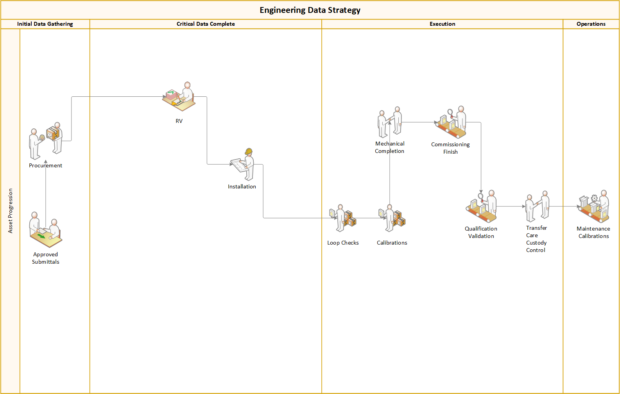
we want all data captured here so that the first calibration can be leveraged during validation and into the operational phase without change
Possible Third Calibration
Possible Second Calibration
First Calibration
Notes:
Engineering Data Strategy (Critical Data Flow through the Asset Lifecycle)
This strategy was coined by, now the president of our company, Rodney Perkins.
What you see on this slide is similar to the Asset Lifecycle flow diagram only zoomed in where I started discussing data. This makes it easier to see the flow of the data and help visualize what we found on several of our projects.
Approved submittals is where we started building our Master Data Template and collecting some of the necessary data. Notice the direction of data.
It goes through Procurement and then the Assessments begin (should). Those assessments will provide critical data to Cal and Maintenance Requirements for the asset. The Impact/Criticality will ultimately determine frequency schedules, level or severity of cal/maintenance, response requirements to deviations, etc.
Then the asset arrives onsite and goes through RV (maybe). More data can be attained at this point, like serial #s if you don’t have it already. The asset ID is now created or likely known and the asset will get tagged. Data still coming in.
Then the asset is installed. More data coming in. Why? Because we all know that somewhere in the facility the installer had several of the same asset and just decided to install it without verifying the serial number matched. Thus creating re-work and change requests if it’s already loaded, etc. So we walk it down and verify the data is accurate.
We are now ready, should be ready, to load all the data to the CMMS. We take the approved enrollment process, load the data, verify it’s in the CMMS correctly, Cal plan is correct and active, PM plan is correct and active, and we are ready to go!....so we hope
Critical Data collection is Complete and we are now in the assets’ data execution. Why is this the “execution”?
Now, the data is in the system, being tracked (audit history), and implemented. The calibrations can now be performed, yes that’s some data coming in, but the result is a passing calibration cert that several service providers are going to require (data going out). And, PM plans are active and reports can be printed which will also be need by service providers.
And finally, in operations, assets are getting enrolled or changes made and necessary reports printed.

Slide 20
Central data group
Cmms critical data sme with experience in all service provider scopes

Slide 21
Central Data Group
Client
Commission
Qualification
Validation
Maintenance
Calibration
Inventory
CMMS
Data Group
Commission
Qualification
Validation
Maintenance
Calibration
Inventory
CMMS
Client
Notes:
Service Providers
Understands the needs of all the service providers and when they will need it
Coordinates between service providers to keep schedule
Can help provide more accurate/current status reports
Client CMMS Administrator
Works with client CMMS administrator to get heavy lifting done
Set up the Calibration and Maintenance Plan
Assist with assessments, enrollment and change requests
Ensures accurate critical data is loaded to CMMS to prevent future changes/delays
Assists in providing the reports necessary to keep the service providers progressing
Allows for client to schedule internally/external vendors and get work orders created, assigned and completed

Slide 22
Data group effectiveness
Benefits of having a cmms critical data sme coordinate between service providers

Slide 23
Data Group Effectiveness
Positive Results
      Reduced schedule creep
      Reduced stress levels among service providers and client
      Faster asset induction and program set up
      Minimizes re-work from changes/delays
      Reduced risk of inaccurate data during audit
      Reduced discrepancies/deviations found
      Faster responses to discrepancies/deviations found

Slide 24
Case studies using a multifaceted approach to cqv, calibration & maintenance: Capital Projects to Operations
New Manufacturing facilities
Expansions
Site ownership transfers

Slide 25
New Facilities, Expansions, Site Transfers
Challenges Faced
      Meetings, Many and Often
      Employee deficit, client is still hiring to ramp up
      Aggressive schedule, a lot of assets coming quickly
      New Programs to be developed
      Storage and Space concerns
Services Needed
      Commissioning/Qualification/Validation
      CMMS Data Loads
      Asset Management, Calibration, Maintenance Program Development
      Initial and Scheduled Calibrations
      PM Task Lists and Execution
      Spare Parts Assessment, Setup, Acquisition and Storage

Slide 26
Multifaceted approach to cqv, calibration and maintenance support
Pros and cons

Slide 27
Multifaceted Service Approach
Pros
      Calibrations performed one time, less rework and reflect operational state
      Assets were approved in CMMS and schedules were active prior to required due dates
      CQV delays waiting on asset approvals, calibrations or maintenance reports greatly reduced
      Few Initial PMs were delayed waiting for parts to arrive
      Parts storage reduced
Cons
      Owner buy-in early on in capital projects phase to implement strategy
      Could be over-reliant on some service providers when project is completed

Slide 28
Conclusion
A multifaceted approach to CQV, calibration and maintenance is one that includes not only the CQV, calibration and maintenance service providers, but also a central data group, engineering data strategy and An effective transition from capital projects into operational readiness.
Notes:
Include statistics to support the time and cost savings that could be realized by using this approach. Possibly add up the time it takes to change the asset info, such as range and tolerance, the number of people involved a second time and how much delay there is by not having the info correct the first time through. Also capture reduced efforts in the operational phase because the calibration/maintenance activity can be leveraged and used into the operational phase.

Slide 29
Questions?

