Slide 1
An Overview of Automation and Qualification
Nate Beekman – Avid Solutions
Justin Cook – Sequence Inc

Slide 2
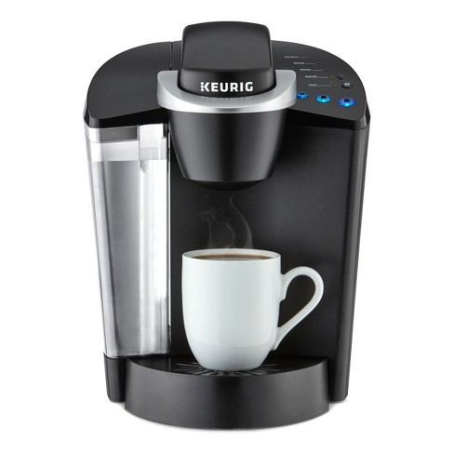
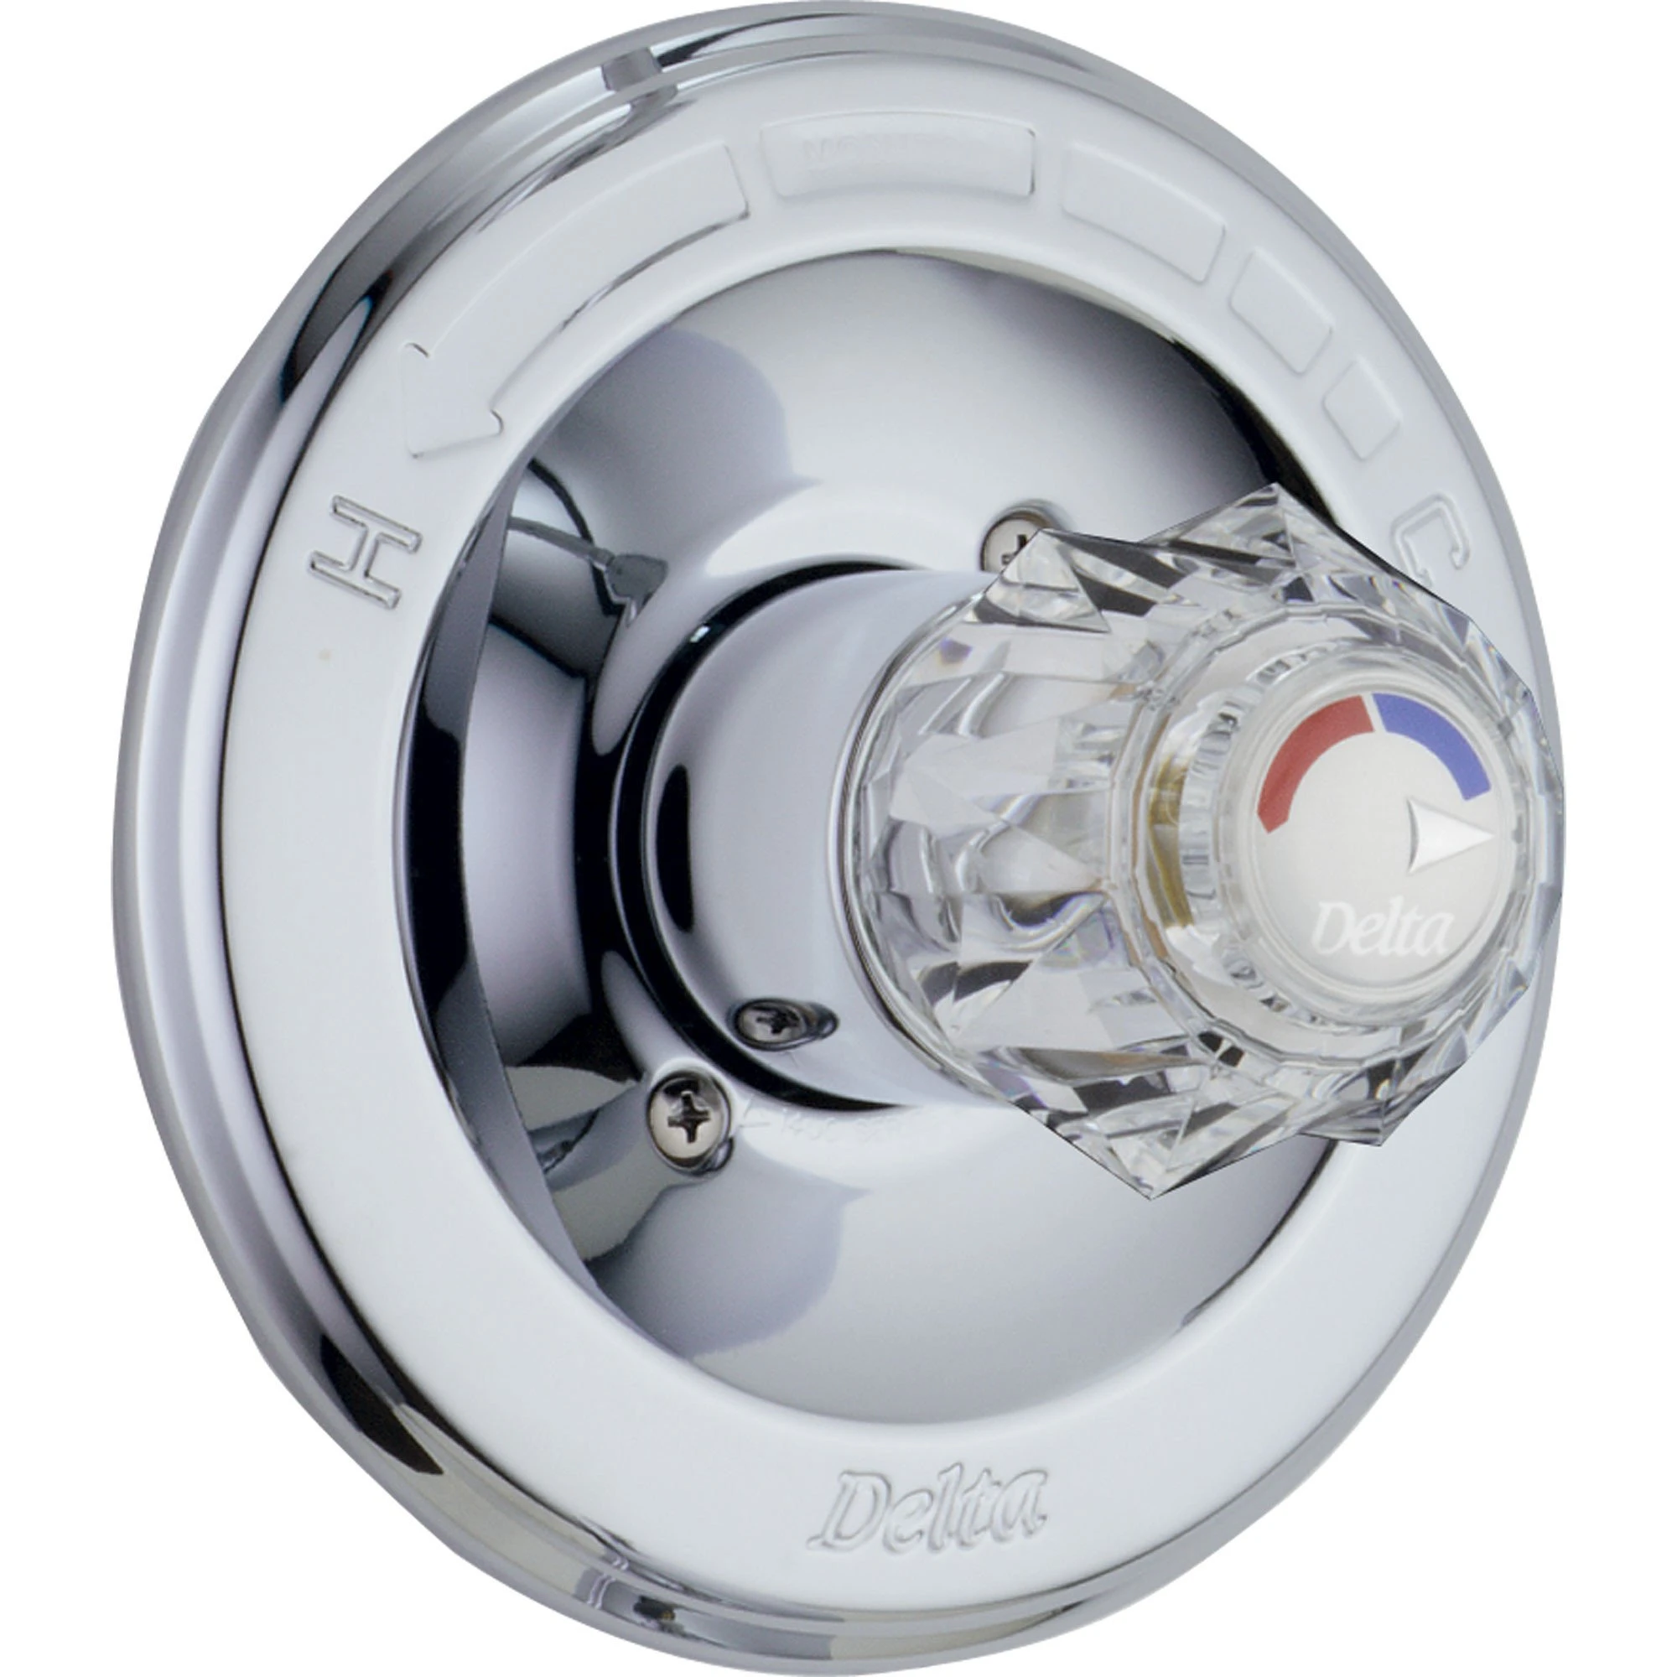
What is Process Automation

Slide 3
Where does it all start…
Product is developed with potential to address a need
Process is designed (Facility, Equipment, and Utilities) to support the manufacturing of the product
Project planning is conducted to establish an overall strategy of how to go from design to validation
Validation Plans (incl. CSV Val Plan)
System Assessments (incl. Risk Assessments, Part 11 Assessments, Vendor Assessments)
System Boundaries

Slide 4
Design, Implement, and Test
User Requirements Specification (URS) Developed
Complex and custom software could see further documents developed such as Functional Requirements Specification (FRS)
Automation Integrator interprets requirements and generates a proposed automation design
Detailed Design Specification (DDS)
Upon client approval of design, integrator develops the software code
Testing is needed to ensure the code meets all design requirements and intended use.
FAT, SAT, Commissioning, Qualification

Slide 5
Project Implementation

Slide 6
Let’s Make Some Ice Cream
Breyer’s Ice Cream is pursuing new type/flavor of ice cream
Breyer’s R&D team develops the new product in the lab environment
They capture their product/process knowledge in a process description which is helpful for A&E firm
Breyer’s does a lot of project planning including developing validation plans, etc.
Facility, Equipment, Utilities designed to meet known process needs for the new ice cream
Establish a need for automation and then compiling associated requirements

Slide 7
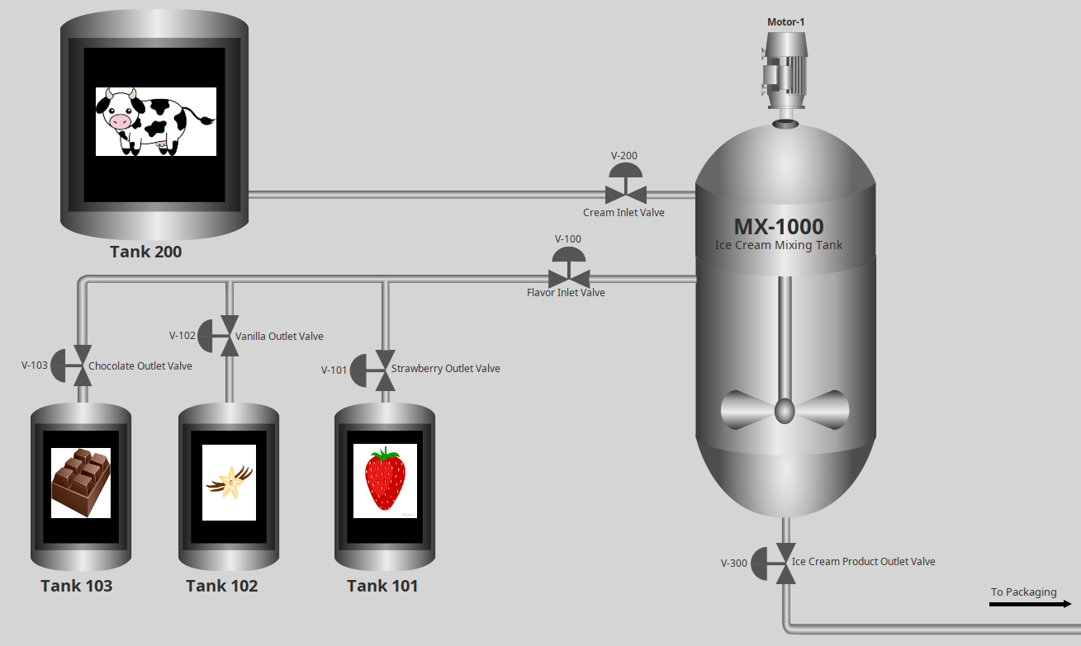
Example Continued
Per facility layout and flow of the process, Breyers has the raw material holding tanks separated a long distance from the ice cream mixing tanks
They decide to implement a DCS to be able to automate the interaction between the two
<CONTINUE WITH DESCRIBING FULL EXAMPLE of how to automate the ice cream making process – Control sequencing>
Add Picture of P&ID

Slide 8
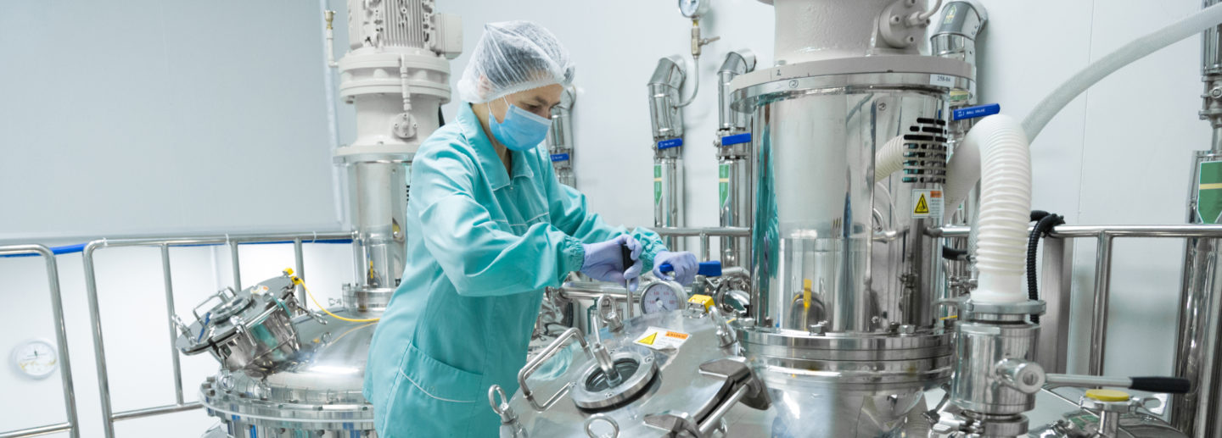
Automation
Continuous
Discrete
Batch

Slide 9
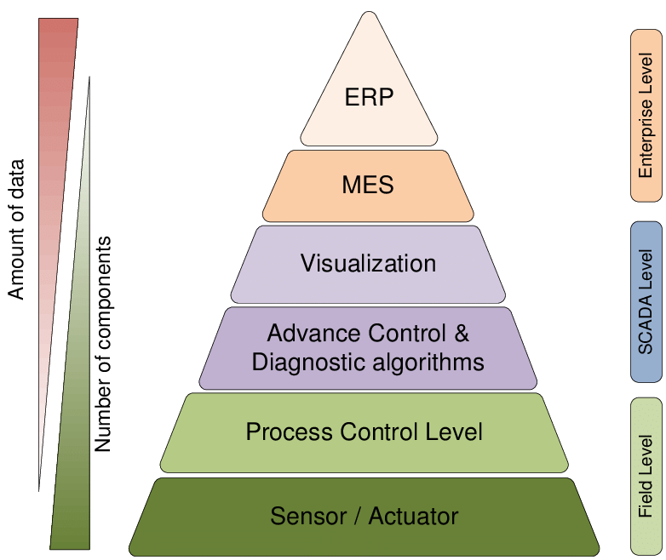
Automation Layers

Slide 10
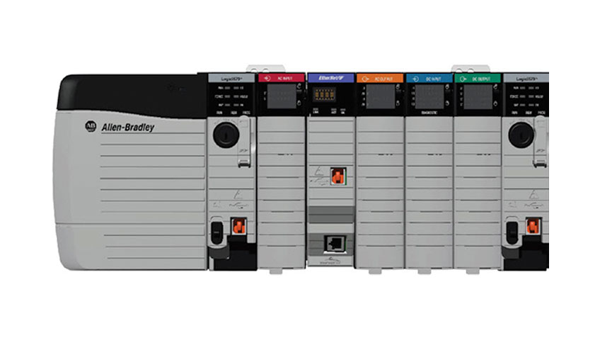
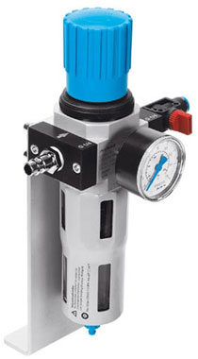
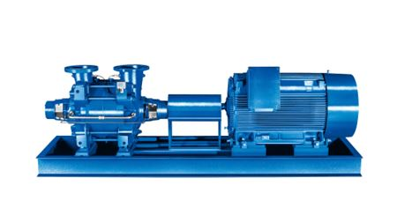
Automation Layers
I/O
PLC’s
Programmable Logic Controller
RTU
Remote Terminal Unit
Valves
Sensors
Pumps

Slide 11
Automation Layers
Monitoring and Supervising
SCADA
Supervisory Control And Data Acquisition
DCS
Distributed Control System
HMI
Human Machine Interface
Historian
Data Collection
Reporting
Notes:
Questions: W

Slide 12
Automation Layers
Enterprise Systems
MES
Manufacturing Execution Systems
Electronic Batch Records (EBR)
Support System Interfacing
Learning Management Systems (LMS)
Equipment Asset Management (EAMS)
Document Management Systems
Laboratory Information Management (LIMS)
Notes:
Software Support Interfacing

Slide 13
Example Continued
Per facility layout and flow of the process, Breyers has the raw material holding tanks separated a long distance from the ice cream mixing tanks
They decide to implement a DCS to be able to automate the interaction between the two
<CONTINUE WITH DESCRIBING FULL EXAMPLE of how to automate the ice cream making process – Control sequencing>
Add Picture of P&ID

Slide 14
Project Testing

Slide 15
Testing Phase
Once the implementation of the automation software is complete – testing ensues
Internal Development Testing (DT)
Software Factory Acceptance Test (SFAT)
Once the automation software is tested and hardware installation is complete on site – testing continues
Site Acceptance Test (SAT)
Commissioning (IOV)
Qualification (IOQ)

Slide 16
Development Testing
Debugging the software
Integrator led effort
Line by Line code review – not as focused on process functionality
Checklist
Offline simulation environment

Slide 17
Software Factory Acceptance Test (SFAT)
Likely 3rd party supported effort (if being leveraged towards qualification)
Predetermined acceptance criteria
Offline simulation environment
Test Cases
Graphics
Sequence of Operations
Alarms
Interlocks

Slide 18
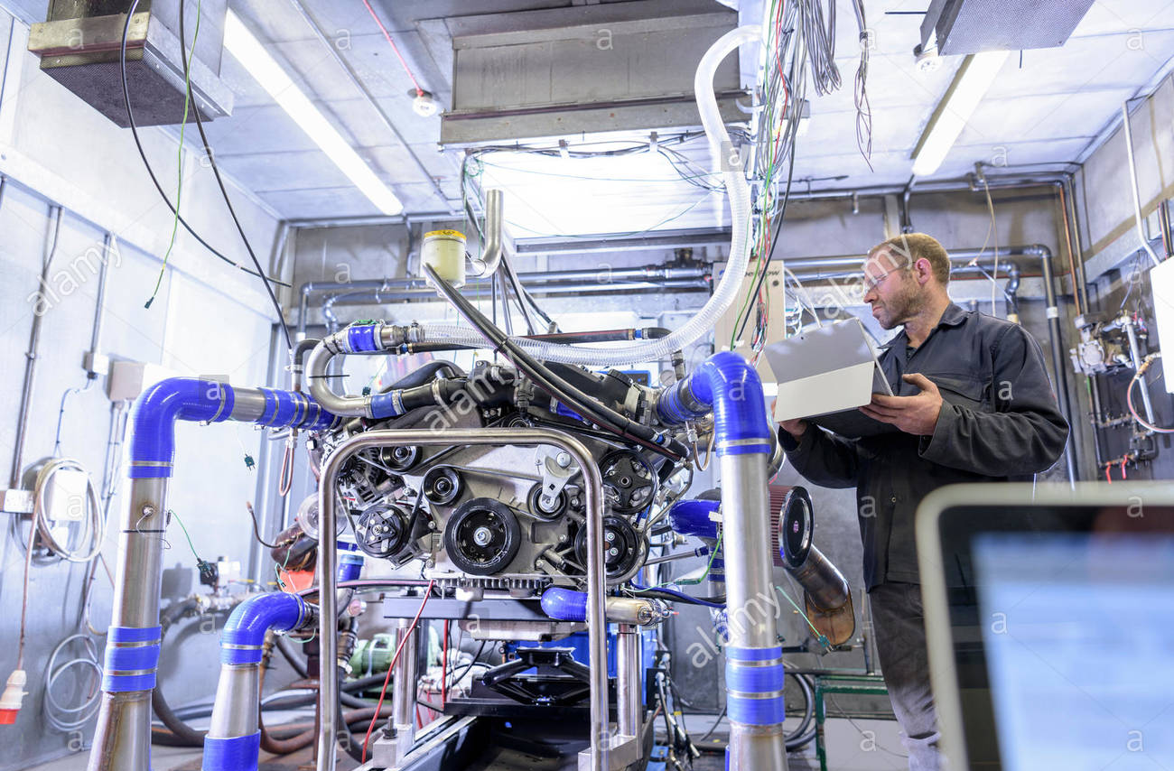
Site Acceptance Testing (SAT)
All necessary hardware and network infrastructure installed on manufacturing site
Startup Activities
Code downloaded on site
Site network communication checks
Loop Checks, Loop Calibrations
Site Acceptance Testing
Vendor Supported
SFAT testing can be leveraged

Slide 19
Commissioning (IOV)
Client Quality Plan
Documents created/executed per client procedures
Involved personnel trained under client’s procedures
Issues handled per client procedures
Can leverage SFAT and SAT testing
Testing to ensure that all design requirements have been met

Slide 20
Qualification (IOQ)
Risk Based approach allows for limited redundancy of testing
Focused primarily on critical aspects
Risk assessments help define these
Can leverage SFAT, SAT, IOV
Testing to ensure intended use is met

Slide 21
Change & Deviation Management
Managing issues throughout the test execution effort(s)
Engineering Change Management
Managing changes/issues outside of test execution
Configuration Management
Managing software changes throughout the implementation
Import/Export procedures, Download procedures, etc.

Slide 22
Trace Matrix and Summary Report
Traceability to ensure all requirements were tested
Trace URS to FRS to DDS to SFAT/SAT/IOV/IOQ
Summarize all acceptance criteria were met
Summarize any critical issues

