Slide 1
Psychological Safety
Sid Jain
Supervisor, Manufacturing Projects
Biogen
ISPE CaSA 2022

Slide 2
I keep complaining about this, but it never gets fixed
My team does more work than the other shift
I can’t tell my manager I have too much work
I don’t feel in control of my workload
My ideas never get implemented
I don’t care about continuous improvement because no one listens to me
Our department is always getting more work piled on us
We can’t figure out why the process keeps failing
My team is resistant to change
My team can’t focus on long-term priorities
My team can’t get along with each other
My team is making more mistakes
My team is afraid of working on critical operations
You tell me one thing, someone else tells me something else
No one ever tells us anything, no communication on important topics
X person’s tone sounds overbearing/patronizing/belittling

Slide 3
The easiest part of solving a problem is the manual work of:
Coding the automation
Installing new equipment
Upgrading business systems
Writing the procedure

Slide 4
The Core of every Complaint
This sounds like…
A lack of…
I keep complaining about this, but it never gets fixed | Control | Mutual Respect
My team does more work than the other shift |  | Mutual Respect
I’ve told X about an issue many times, but nothing changes |  | Mutual Respect
I don’t feel in control of my workload | Control
My ideas never get implemented | Control | Mutual Respect
I don’t care about continuous improvement because no one listens to me |  | Mutual Respect
Our department is always getting more work piled on them | Control
My team never listens to me |  | Mutual Respect
My team is resistant to change | Control
My team can’t focus on long-term priorities | Control
My team can’t seem to get along with each other |  | Mutual Respect
My team is making more mistakes | Control
You tell me one thing, someone else tells me something else | Control | Mutual Respect
No one ever tells us anything, no communication on important topics | Control | Mutual Respect
My team is afraid of working on critical operations | Control
X person’s tone sounds overbearing/patronizing/belittling |  | Mutual Respect

Slide 5
Question
Think of a coworker who you trust to do their job exceptionally well.
What qualities do they have that make you trust their work?

Slide 6
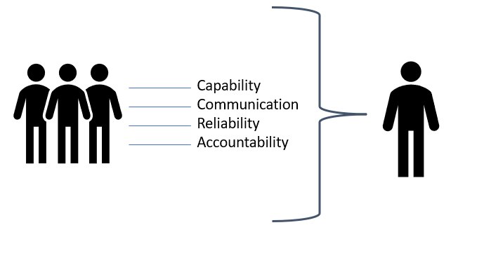
Competence Factors of Trust
Gain Trust (and control) by displaying Competence

Slide 7
Question
Think of a coworker who you trust because they are a good person.
What qualities do they have that make you trust their opinions?

Slide 8
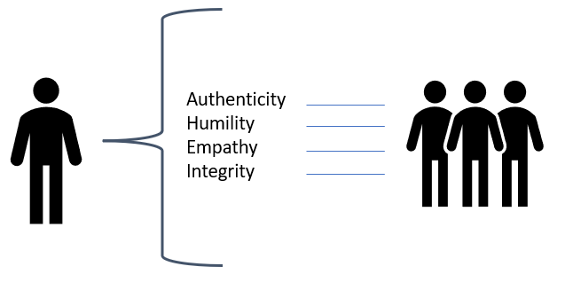
Character factors of trust
Gain Trust (and respect) by displaying Character

Slide 9
Trust is the key to Psychological Safety

Slide 10
Lines of trust build respect and gain control

Slide 11
Implementation of Psychological Safety in Biomanufacturing
Biogen Case Study and common myths

Slide 12
Myth #1
Psychological Safety comes after focusing on more important things like training and GMP.

Slide 13
Situation
In Apr 2019, my shift was reduced to just supervisor and three MAs (other shifts had 8+ MAs, lead, supervisor)
In July 2019, a fourth production bioreactor brought online, increasing run rate by 25%
Over 2019 and 2020 hired 12 new team members and lost 5 experienced MAs to attrition
We needed a new teaming philosophy

Slide 14
Psychological Safety Principles in Action
Build Challenge Stress for the team
Challenge stressors are those that may result in strain, but at the same time, are energizing and provide opportunities for feelings of accomplishment, as well as growth and development (Cavanaugh et al., 2000)
Turn mistakes into Learning into Solutions.
Acknowledge Your Errors. Make It Harder To Mess Up.
Allow team space to share their struggles
Create an environment where people feel safe to share discomfort and dissent.
Acknowledge your fallibility
Be comfortable in owning your own mistakes, publicly, to build trust and making it easier for your team to do the same.

Slide 15
Roadmap to Psychological Safety
Give autonomy
Provide opportunities for planning their own time, workload, and prioritization to build ownership.
Reward excellence
Be generous with praise and build up positive team image with peer groups
Build trust
Trust is the cornerstone quality necessary to thrive in a highly networked and integrated field such as pharma.
Hold team accountable to high performance
Reward displays of vulnerability

Slide 16
Myth #2
Psychological Safety means allowing lower performance and “being nice to the team”

Slide 17
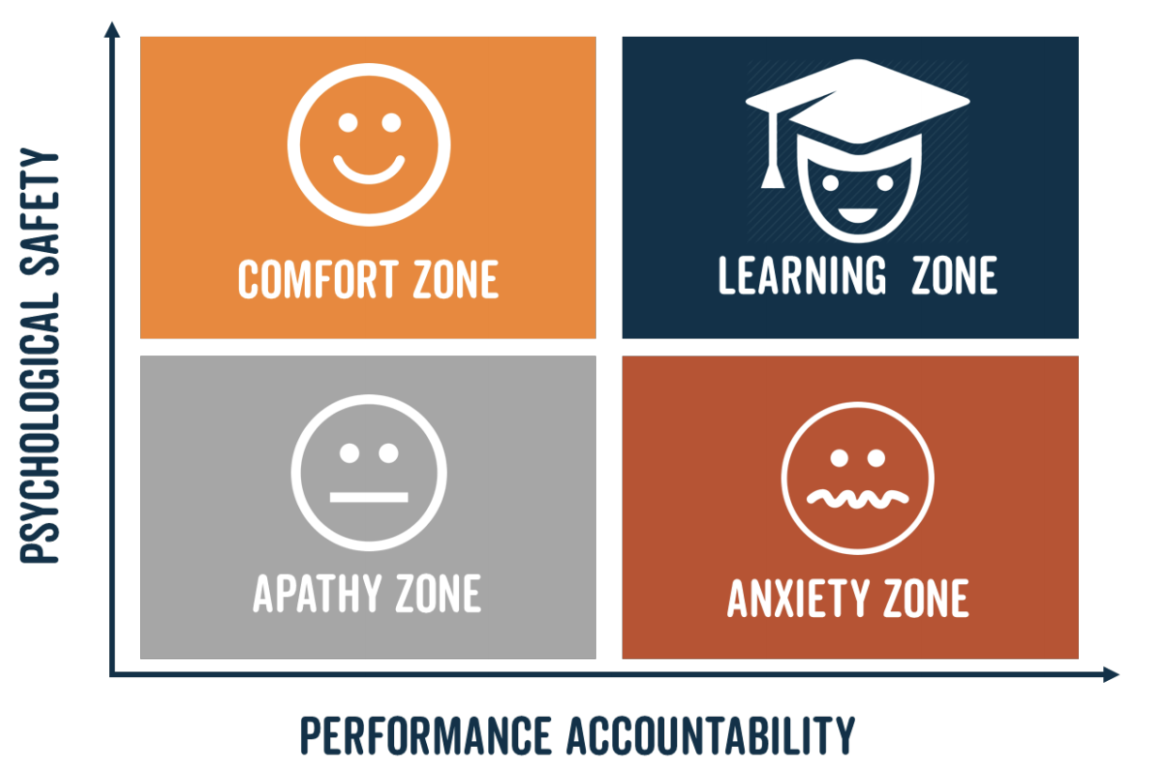
Psychological Safety is not an excuse for lower performance. It unlocks high performance while minimizing anxiety.
Examples:
New operator aseptic training
Continuous Improvement
Source: https://www.jethrojones.com/blog/psychological-safety

Slide 18
Myth #3
Displays of vulnerability make leaders and teams seem weak.

Slide 19
Vulnerability
Vulnerability allows for a better response to difficult tasks
Without the freedom to display vulnerability, people deal with difficult tasks with anxiety alone or do a poor job
Displaying vulnerability allows you to:
Show the honest limits of your skills, which builds trust
Ask for help, which improves the outcome of a difficult task
Examples:
Two operators talking through a problem with vulnerability and grace
Cell Culture Safety Walkthrough

Slide 20
Psychological Safety in Action

Slide 21
Results of Psychological Safety
More employees work effectively at the edge of their learning zone
More employees set ambitious goals and conquer department objectives.
Better systematic gap correction rate
Higher team morale
More engagement as individuals feel empowered to take ownership
Process under control and teams work well together

Slide 22
It’s more than just about making mistakes
It’s about how to communicate one-one-one and as a group to create an atmosphere of innovation and risk-taking

Slide 23
The Five Aspects of Psychological Safety

Slide 24
Elements of Psychological Safety

Slide 25
Need for Psychological Safety
Talent retention and promotion in an increasingly competitive job market: With the onset of the "great resignation" it is more important than ever to be intentional and agile about retaining our top talent in house. Psychological safety helps create a team working environment that executes on exciting and mission-critical challenges while retaining high morale.
Dealing with the complexity of a wicked problems: Today's workplace is dealing with “wicked” problems of increasing complexity that need systems-level thinking to resolve. The challenges we face today are a combination of equipment, software, personnel, business systems, and documentation. Dealing with systems-level wicked problems require robust cross-functional collaboration and trust between departments. Being intentional in our interpersonal connections between colleagues will help solve these complex problems.
Psychological Safety is the most resilient way to increase productivity: Creating a high-performing team that avoids burnout requires investment in trust-building for relationships both vertically and horizontally in the organization. Individuals within a team who trusts each other and teams that trust each other perform at a higher level while making the work seem easier to manage.

Slide 26
A culture of psychological Safety can overcome these problems
I keep complaining about this, but it never gets fixed | Experimental Safety
My team does more work than the other shift | Call it Out Safety
I’ve told X about an issue many times, but nothing changes | Challenger Safety
I don’t feel in control of my workload | Call it Out Safety
My ideas never get implemented | Inclusion Safety
I don’t care about continuous improvement because no one listens to me | Inclusion Safety
Our department is always getting more work piled on them | Support Safety
My team never listens to me | Apathy Zone
My team is resistant to change | Comfort Zone
My team can’t focus on long-term priorities | Comfort Zone
My team can’t seem to get along with each other | Inclusion Safety
My team is making more mistakes | Anxiety Zone
You tell me one thing, someone else tells me something else | Trust Deficit
No one ever tells us anything, no communication on important topics | Inclusion Safety
My team is afraid of working on critical operations | Anxiety Zone
X person’s tone sounds overbearing/patronizing/belittling | Call It Out Safety

Slide 27
2021 Biogen Psychological Safety Training
Creating a Psychological Safety Training Program

Slide 28
Biogen’s Psychological Safety training structure

Slide 29
Workshop Structure
30 min presentation
20 min breakout session introducing a tool from the Biogen Team Effectiveness Toolkit.
15 min review session – managers gave key lessons learned from the session
People Manager Playbook and Team Effectiveness Toolkit provided to managers
6-month follow-up survey

Slide 30
Tools & Resources
Books:
The Culture Code by Daniel Coyle
The Power of Moments by Chip and Daniel Heath
The Fearless Organization by Amy Edmondson
Tools:
Left Hand/ Right Hand Exercise
Diversity Icebreaker
Team Norms
Ladder of Inference
Resolving Conflict with A.G.R.E.E framework

