Slide 1
2016 ISPE-CaSA Technology Conference
Quality Metrics -
ISPE Team Update
31-March 2016, Raleigh Durham
Michael Arnold, R.Ph
Vice Chairman- ISPE
International Board of Directors

Slide 2
Agenda
The Quality Metrics Timeline
ISPE Wave 2 Quality Metrics Pilot Overview
FDA Draft Guidance - ISPE Key Messages
Upcoming Activities

Slide 3
Quality Metrics Core Team
Matthew Pearson, Roche Genentech
Christopher Potter, PhD , ISPE
Paul Rutten, McKinsey
Peggy Speight, BMS
Vanya Telpis, McKinsey
Paul J. Weninger, Perrigo
Carol Winfield, ISPE
Bryan Winship, Mylan
Nuala F. Calnan, PhD, DIT
Laura Cannon, Teva
Michael G. Davidson, Pfizer
Betsy P. Fritschel, J&J
Mairead Goetz, Novartis
Steve Greer, P&G
Diane Hagerty, Roche Genentech
Lorraine E. McClain, Teva

Slide 4
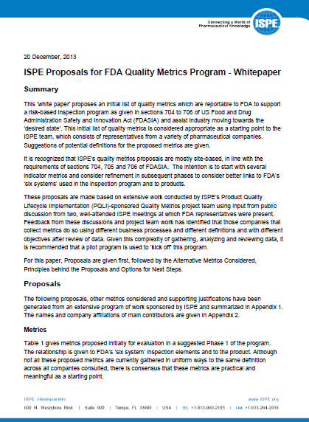
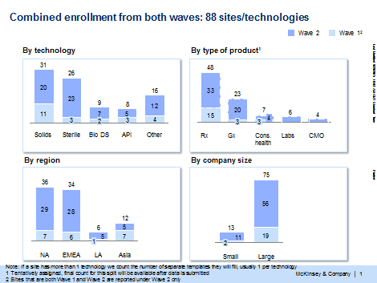
ISPE Quality Metrics Timeline
Wave 1
Report
Wave 2
Launch Quality Metrics Wave 1 Pilot
2012
ISPE Wave 2 Pilot
2013
2014
2015
2016
Beyond!
ISPE Whitepaper
We are here
July 2012
FDASIA signed into law
Brookings Institute
Launch wave 2 Pilot
83 Sites, 28 Companies

Slide 5
ISPE Proposals for FDA Quality Metrics White Paper December 2013
Phased approach recommended
Targeted set of metrics proposed
Site Based reporting
Pilot program

Slide 6
Quality Metrics Industry Pilot
Measuring Quality Performance
Quantitative metrics
Technology Specific metrics
Additional survey-based metrics
Lot acceptance rate
Complaints rate (total and critical)
Confirmed OOS rate
US recall events (total and by class)
Stability Failure rate
Invalidated (unconfirmed) OOS rate
Right first time (Rework / Reprocessing) rate
APQR reviews completed on time
Recurring deviations rate
CAPA effectiveness rate
Media fill (for sterile aseptic sites) failures
Environmental monitoring (for sterile aseptic sites)
Process capability
Quality culture
2 more quantitative metrics calculated from data collected for Wave 1:
Deviations rate
Incoming material OOS
Product- and site-based metric
Consensus Industry Metrics
ISPE Quality Metrics Initiative, 01 June 2015

Slide 7
ISPE Wave 1 Pilot – What Did We Learn ?
Feasible to collect standardized set of metrics
Few companies aggregate metrics across supply chain to be able to report at product, differentiated by site
Level of Burden not to be underestimated
Understanding data context is crucial
Start with a targeted set of “relatively well established” metrics
The Wave 1 Pilot also provided some key insights in relation to the prevailing quality culture within an organization that merit further exploration.
44 Sites, 18 Companies, 14 Metrics
Key benefits reported from Pilot Participants:
Gaining a deeper understanding of the standardized metrics definitions and design
Establishing a centralized submissions process trial
Developing access to a benchmarking report that allowed them to examine progress against peers

Slide 8
ISPE Wave 2 Pilot – Objectives
Evolve data set across segments, geographies and time to further the learnings from Wave 1 and evaluate trending patterns
Test the proposed FDA metrics
help develop robust definitions
understand data collection challenges
Evaluate logistics and effort of gathering data at a product application level
Continue to develop measures, tools and dialogue related to Quality Culture and Process Capability to facilitate ongoing industry self-development and assessment
Enable continued objective and data driven dialogue with FDA and other Health Authorities
Wave 2

Slide 9
ISPE Wave 2 Pilot Metrics
Quantitative metrics
Culture indicators
Survey-based metrics
Total complaints rate ^{1,4}
Critical complaints rate ¹
Recall events
Lot acceptance rate ^{1,4}
Invalidated OOS rate ^{1,4}
Right first time rate
Deviations rate ¹
Recurring deviations rate
CAPAs with preventive actions
Planned maintenance
Employee turnover
Human error deviations
Deviations with no assigned root cause
------
CAPAs requiring retraining⁴
APR approvals⁴
Quality culture survey²
Process capability³
Drug Shortages⁵
In addition to site data collection, participating companies will compile logistics and effort of gathering product data at application level (on 2-5 products) for complaints rates, lot acceptance rate and invalidated OOS
1 To be tested in multiple variants (e.g. lots attempted vs. dispositioned, packs released vs. lots released, lots tested vs. total tests performed)
2 Only for sites which have not participated in wave 1
3 Will include additional questions to the ones tested in wave 1
4 Aligned with the Federal Register Notice guidance. Additionally OOS rate and Lots pending disposition for 30+ days can also be calculated from the data
5 questions to assess how standardized metrics can assist prediction of drug shortages

Slide 10
ISPE Quality Metrics Wave 2 Timeline
Data lock for Wave 2 pilot analyses
Wave 2 pilot Report
Nov 30
Wave 2 Pilot enrollment
Data collection and submission
Industry analysis
Individual reports
We are here
Feb-Mar 2016
Jun 2015
Oct 30
Launch Quality Metrics wave 2 Pilot
Data lock for analyses of selected date for the FRN response
83 Sites, 28 Companies
Enhanced geographic, technology and product type representation

Slide 11
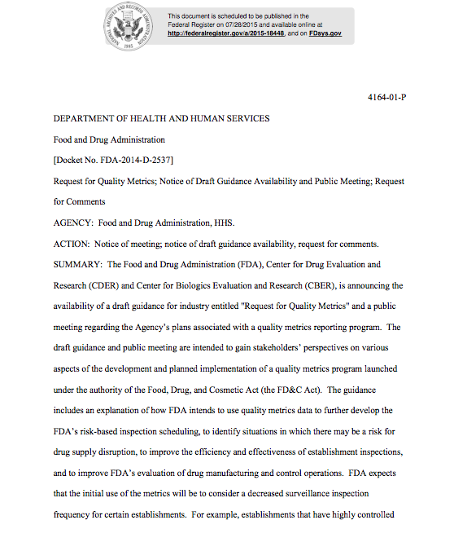
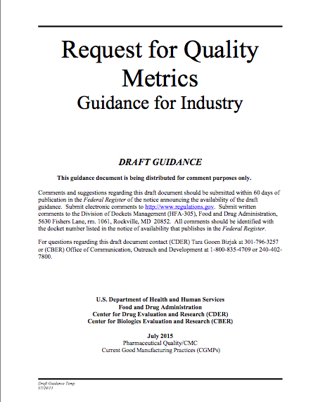
Draft Guidance for Industry Issued -Request for Quality Metrics
ISPE supports the principles of the FDA Quality Metrics program
Risk-based inspection scheduling
Risk-based principles for reduced post-approval change reporting
ISPE appreciates the ongoing dialogue and opportunity for continued collaboration across industry and FDA to further the establishment of a robust quality metrics program

Slide 12
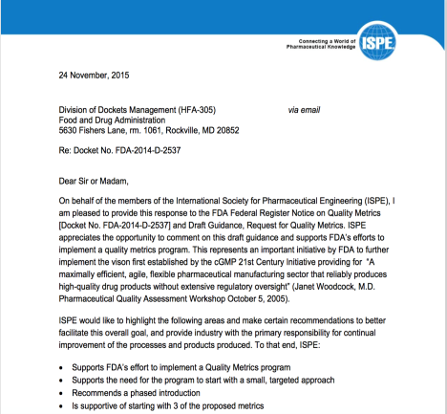
ISPE Key Messages- Start Small, Learn, Evolve
To implement a quality metrics program successfully based on ISPE experiences
ISPE supports the need for the program to start with a small, targeted approach, to enable industry and FDA to learn and evolve the approach over time.
Considerations:
Recommend a phased approach within industry segments
Voluntary reporting for those not participating during the learning period

Slide 13
ISPE Key Messages- Starting Metrics & Reporting Structure
ISPE is supportive of starting with 3 of the proposed metrics
Lot Acceptance Rate (report by site, differentiated by product)
Product Quality Complaints (report by product only)
Invalidated OOS (report by site)
ISPE recommends to defer as potential future metrics or data points
APR on Time Rate and Optional Metrics
“lots pending disposition for over 30 days”
Start with reporting consistent with current industry practice
May reduce burden for start up of program
Terminology Matters

Slide 14
ISPE Key Messages – Reporting Burden & Transparency
Burden appears underestimated in FRN
Preliminary results from ISPE Pilot Wave 2 included in Response to FDA
Anticipated costs for firms
Adjust internal IT systems , Incorporate additional review , Data retention to support verification during inspection
For many firms reporting by product, differentiated by site presents additional complexity and burden
Greater transparency recommended
How will data be used?
Trending? Comments for context? Public disclosure? Deans list?
Clarity on learning period
Communication to firms of impact of reported data

Slide 15
Update from ISPE Quality Culture Team
Acknowledging the key influential role of Quality Culture with respect to the capture and reporting of quality metrics the ISPE Quality Metrics Core Team formed a Quality Culture Sub-Team in July 2014
The Quality Culture sub-team comprises of a cross section of Industry large and mid-sized pharma, incorporating both innovator and generics organisations, key industry suppliers and academia.
The team has met bi-weekly since July 2014 with an initial focus on identifying and sharing the variety of practices currently used.
A repository of approaches, practices and tools were captured for detailed review
No single tool or practice provides a quantitative or qualitative ‘silver bullet’ as a means to establish the current health of the Quality Culture within an organization.
Six “dimensions” teams were formed July 2015, developing a program of tools, training and templates for companies to use to inform their cultural excellence programs. These tools will be published through ISPE during 2016 and 2017

Slide 16
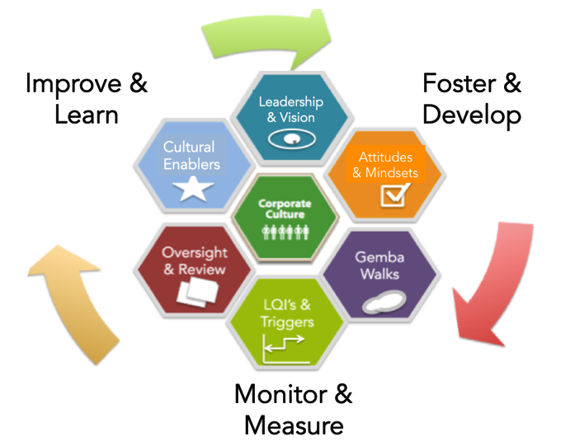
Six Dimensions of Cultural Excellence
The ISPE Quality Culture Sub -Team proposes that the promotion of a ‘relentless restlessness’ towards improvement in Quality Culture necessitates a 360° approach to Cultural Excellence
A holistic Quality Culture Framework has been developed, entitled the Six Dimensions of Cultural Excellence

Slide 17
ISPE Quality Culture Sub-Team Developing Cultural Excellence
Promotion of a healthy Quality Culture is strongly welcomed
Quantitative and Qualitative measures that may be best assessed internally rather than reported externally
Development of Tools, Training and Templates is underway
“ISPE’s Current Position on Quality Culture acknowledges that each organization will have a different context, within which their Quality Culture exists, based on organizational ownership, supply chain configuration, maturity, product mix and regional influences.”
Knowledge of cultural context is crucial
to measurement and assessment

Slide 18
Quality Metrics Vision – A journey
Industry led “work space” to further develop metric program
Additional measures to be discussed
Benchmarking: companies understand their quality performance and maturity compared to peers
Industry Knowledge: In depth statistical analysis, mature process capability, quality culture , targeted research initiatives
Collaboration: sharing best practices, engage with regulators at design stage
Potential Benefit: Achieving transparency of quality performance across industry. Turning quality into a competitive advantage.
Starter Set of Metrics
Potential Benefit: Simplification of regulatory process for sites in good standing
Reported to FDA
Benefit: Risk-based inspection frequency
Notes:
Achieving transparency of quality performance across industry; turning quality into a competitive advantage

Slide 19
ISPE Quality Metrics - upcoming key activities
ISPE Wave 2 Pilot Analytics & Outcomes
Quality Culture Team - advancing the development of Cultural excellence framework
Further Mature Quality Metrics Vision
Continue engagement in cross industry dialogue
Think Big,
Start Small ...
but start!
Quality Metrics Session,
2016 ISPE/FDA/PQRI Quality Manufacturing Conference,
June 6 to 8, Bethesda

Slide 20
Q & A

