Slide 1
iQC Lab of the Future Program
March 2016

Slide 2
What is the Lab of the Future?
The Lab of the Future is a QC multi-year program to:
  Achieve the vision of building a state of the art Quality Control organization
  Increase QC efficiency, reliability, and scalability
  Empower collaboration across various functions within and outside QC
  Enable Biogen’s operations of the future and Next Generation LSM
  http://rtpsnsp01.biogenidec.com/p.jsp?i=207

Slide 3
Where are we today?
Feb 2016
Implementation Vendor Evaluation and Selection
2016-2019
Lab of the Future Implementation
Jan 2016
Vendor RFP’s Submitted
Sep 2015
Funding Approval & Kick-Off Planning Phase
Dec 2015
Critical BPM Milestone
Jul 2015
Final Consultant Recommendations
May 2015
Consulting Assessment Begins

Slide 4
Initial Assessment

Slide 5
We executed a comprehensive functional, technical, and business assessment to uncover key insights that can drive recommendations
Performed research on biopharma best practices
Considered all major sites as well as external labs and other country labs
Conducted 75+ interviews of primary research across multiple functions in QC, QA, TD, IT, Manufacturing, and MS
Engaged with key stakeholders from SCALE, TD LIMS, and NGA
Undertook technology market scan of LIMS and ELN vendors
Reviewed secondary research on financial benchmarks
Utilized consulting resources to structure the analysis and also gather key industry insights
Defined critical QC system interfaces in the enterprise architecture
Collected and analyzed Biogen data on resources, activity, forecasts, financials in order to build the business case

Slide 6
The as-is state consists of standalone systems, significant manual effort and data duplication
Spec & Method Documents
Item Master
OOS/NC Status
TD LIMS
MYCIMS
PDH
ERP (R12)
EAM
(Infor)
LMS
(IsoTrain)
NCs
(TRACKWISE)
Item
Master
Received
Lot
Sample
Lot
Lot
Disposition
Instrument
Status
Training
Certs
Record
OOS/NC
Specifications
Receiving QC
Test Methods
Test Results
New
Lot
Configure Specs
Method Documents
  QC LIMS
  Manufacturing
Test Results
  Sample Plans
  Print Sample Labels
  Test Method Documents
  Paper Test Records
Test Results
  Paper MBR
  Paper BHR
  Paper Test Results
Sample Login
Sample
Login
Discoverant
Smart QC
Instrument Systems
(e.g., Empower)
Process Control Systems
(e.g., Delta V)
Samples
Manual Entry
Sample Labels

Slide 7
Designing the Future

Slide 8
Empowering You
The Limitations
of Today
The Possibilities of Tomorrow
How are specifications populated into LIMS?
Today, all specifications must be manually transcribed into LIMS.
Specifications will automatically be populated into LES from PLM
How do I execute a test method?
At the moment in LIMS a method execution is a paper based exercise with documents stored in MyCIMS.
The Lab of the Future will offer guided electronic execution of standardized test methods
How do I use data from instruments such balances, pH meters, etc ?
Today, data from some commonly used lab instruments cannot be imported into LIMS resulting in lot of manual effort and non-value-added review
With the LES platform you can automatically import specific instrument data and instantaneously pull up the relevant limits.
Where is my Sample?
Currently, LIMS does not feature reporting capabilities around sample Lifecycle. Highly manual process to check where a sample is located?
The Lab of the future will feature dashboard views which will enable you to see your Sample Lifecycle among other capabilities of analytics
These are just a few examples of the power of The lab of the Future

Slide 9



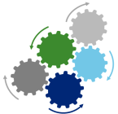


An improved and scalable solution will build key capabilities.
Current State Gaps
Future State Capabilities
Seamless Integration with ERP, PLM, and NGA enabling Next Generation Operations with APC
Currently unable to integrate major processes and systems within the supply chain
NGA
Enable testing at any site through clear sample chain of custody and 100% reliability of sample status and location
Multiple sources of truth for guiding procedures, specifications, etc.
System guided method execution and electronic transfer of data enabling review by exception
Difficult sample tracking, standard tracking, and chain of custody procedures
Key resource integrations (Instruments, Analyst Training, etc.) with systemic enforcement of business processes
Reliance on an abundance of manual processes and data management
Real-time and automated compliance providing streamlined Quality review and rapid release
Overly-customized LIMS prevents the use of key out-of-the box functionality and prevents upgrading to implement new capabilities
Single sources of truth for specifications, methods, and sample plans
Automatic population of analytical data into regulatory submissions and annual product reviews

Slide 10
Lab of the Future Impact
Lab of the Future Capabilities
Laboratory Execution System
Comprehensive Sample Management
Specification Management
Manufacturing Excellence
Resource Management
Test Method Development
Lab Operation Planning
Lab
Analytics
Lab of the Future Benefits
Scalability
  Increase the number of testing with the same amount of resources
Operational Efficiency
  Reduce non-value added work associated with testing, verification and manual operations
Reliability
  Improve data integrity with systems and instrument integration
  Provide a clean and transparent chain of custody

Slide 11
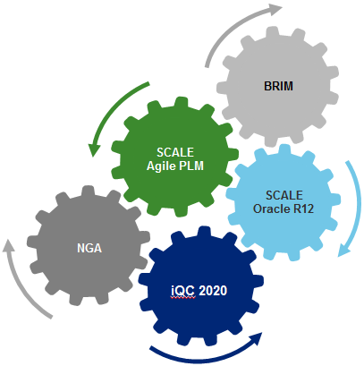
Integration of the iQC program is essential to other programs already in progress
Investing in the iQC 2020 vision is critical:
Decreases Time to Benefit for PO&T Improvement Programs like SCALE, NGA, and BRIM
Integration with some systems is not possible (PLM) while others would require a substantially larger investment
BRIM
BRIM
PLM
SCALE
Agile PLM
Oracle R12
SCALE
Oracle R12
NGA
NGA
Current LIMS

Slide 12
Future State – What does it look like?

Slide 13
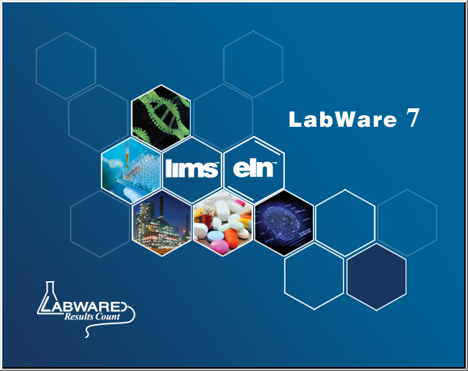
Lab Execution System
The foundation of Biogen’s labs of the future
Implement a new Lab Execution System (LES) and associated key capabilities over the next 4 years
  A new LabWare 7 LIMS + Electronic Lab Notebook (ELN) platform redesigned to enable guided method execution
  Leverage lessons learned from existing implementation, utilize components from the current system, when appropriate, and implement best in class industry practices
  Focus on out-of-box functionality with less customization
  Critical to fulfilling the Solothurn vision (Next Generation Operations)

Slide 14
The to-be state is an iQC platform that provides a Lab Execution System
TD & AT
(Methods)
PDH & PLM
BRIMS
ERP (Oracle R12)
Resource Mgmt.
(EAM, LMS,..)
NCs
(TRACKWISE)
1
2
1
3
4
5
6
9
12
7
8
11
12
2
10
Specifications
  Integration Platform (Enterprise Services Bus)
Methods
1
3
4
7
8
9
11
1
3
4
5
6
7
8
9
11
2
10
2
10
  Lab Execution System
  NGA - Manufacturing Execution System
  QC Sample Management
  Reagent Management
  Test Method Execution
  Material, Drug Substance, Drug Product Testing
  Stability Testing
  Environmental Testing
  Ad-hoc Sample Testing
  Guided, paperless execution of production requests:
    Commercial production
    Clinical production
    Experimental / process validation batches
  Electronic Batch Records
Integrations
Item Master
Market Approvals
Test Request (Sample)
Test Response (Result)
Production Request
Production Response
Resource Master
Resource Status
Material Lot
Lot Status
Non-conformance
NC Status & Disposition
Discoverant
Smart QC
Instrument Systems
(e.g., Empower)
Process Control Systems
(e.g., Delta V)

Slide 15
Identified 8 key initiatives to deliver a series of business benefits and new capabilities to achieve the vision
 | Capability | Description
1 | Lab Execution System | Define test methods / analytical procedures in a structured form that can be interpreted and executed by LabWare Enable ELN to guide Lab Technicians through the test methods and create an electronic test record for results and resources used
2 | QC Comprehensive Sample Management | Provide clear, reliable chain of custody for all samples managed and tested by QC Manage samples from pickup through transfer to lab, aliquot, storage, and shipment to external labs (other plants or CLOs)
3 | Specifications Management | Integrate QC Labs with PLM to take advantage of and use structured specifications to support material testing
4 | Manufacturing Excellence | Integrate with MES for In-process and material testing Defined service model for sample plans Integrate with ERP to supply CofA data for released batches
5 | Resource Management | Manage Reagent and Standards used in QC Lab operations. Subscribe to resource management systems to verify resource qualifications and status prior to use (e.g., EAM, LMS)
6 | Test Method Development | Improve the transfer of scientific methods to operations to support repeatable execution of methods at scale
7 | QC Lab Operations Planning | Efficient demand management for QC services Dynamic scheduling that facilitates adjustments to plan based on priority, resource status, regulatory approvals
8 | QC Lab Analytics | Population of Off-line Data Store (ODS) with Test Execution Records Determine appropriate analytics tool and provide access to ODS Develop pre-defined analytical reports and dashboards Population of regulatory submissions and annual product reviews

Slide 16
The Lab of the Future is a multi-year program to reach the iQC 2020 vision
 | 2015 |  |  | 2016 |  |  |  | 2017 |  |  |  | 2018 |  |  |  | 2019
 | Q2 | Q3 | Q4 | Q1 | Q2 | Q3 | Q4 | Q1 | Q2 | Q3 | Q4 | Q1 | Q2 | Q3 | Q4 | Q1 | Q2 | Q3 | Q4
iQC 2020 Capability Lab Execution System Comprehensive Sample Management Specifications Management Manufacturing Excellence Resource Management Test Method Development QC Lab Operations Planning QC LAB Analytics
iQC Milestones
PLM & EDMS (MyCIMS) Manage Structured Specifications Manage Executable Methods
ESB - Integrations LIMS Model and Adaptors Supply Chain Model and Adaptors
Resource Management Equipment Technicians
NGA* Develop and Implement Pilot Deploy for all products
1
2
3
4
5
Commercial
In-process & Clinical
New Functionality
Maintain Functionality
Integrate Functionality

Slide 17
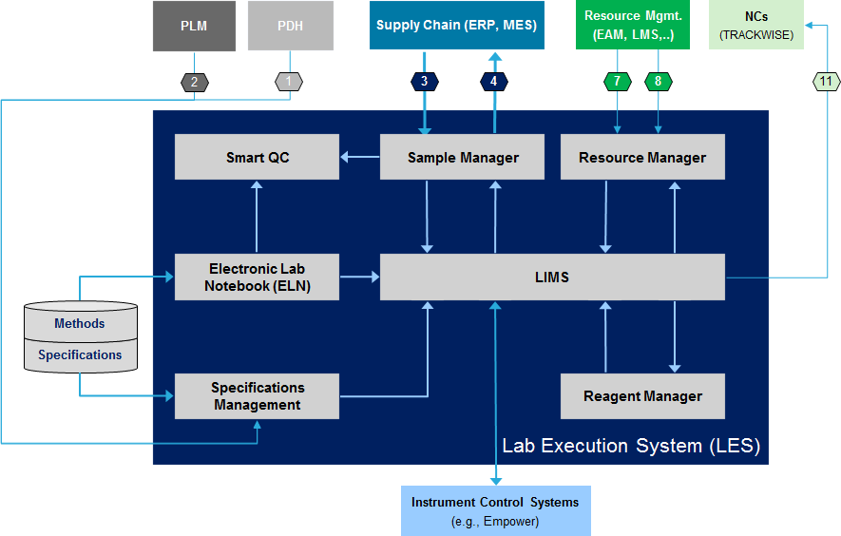
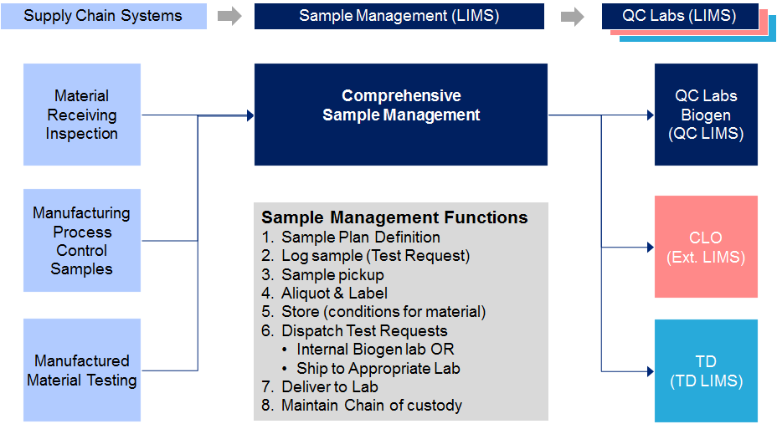
First 2 recommended initiatives will significantly improve the QC capabilities, efficiency and level of service provided
1. Lab Execution System
2. Comprehensive Sample Management
Implement Labware v7 ELN and LIMS for QC Labs capable of:
System guided execution of test methods and review by exception
Automatic verification of resources (Reagents, Equipment, Technicians)
Import structured specifications
Manage reagents (production, expiry, etc.)
Integrate with PLM, TD & Supply Chain
Manage samples taken by supply chain customers from pickup through test results:
Dispatch to appropriate lab for testing
Manage transfer / shipment of samples
Integrate with CLOs for Sample Login
Maintain electronic Chain of Custody records for each sample.

Slide 18
Comprehensive Sample Management
Supply Chain Systems
Sample Management (LIMS)
QC Labs (LIMS)
  Material Receiving Inspection
  QC Labs Biogen
  (QC LIMS)
  Sample Control / Test Request Dispatch
  (QC LIMS)
  Manufacturing Process Control Samples
  CLO
  (Ext. LIMS)
Sample Management Functions
Log sample (Test Request)
Sample pickup
Aliquot & Label
Store (conditions for material)
Dispatch
  Internal Biogen lab OR
  Ship to Appropriate Lab (per Shipment table)
Deliver to Lab
Maintain Chain of custody
  Manufactured Material Testing
  TD
  (TD LIMS)

Slide 19
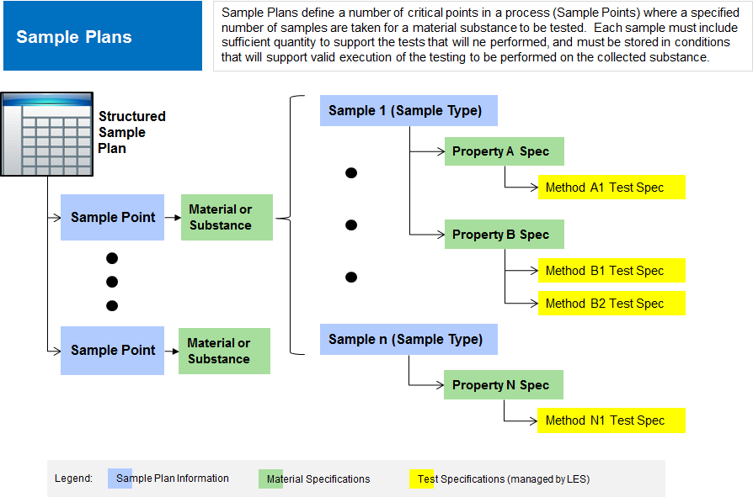
Integration Design Excerpt – Sample Plans

Slide 20
Getting to the Details – How do we get there?

Slide 21
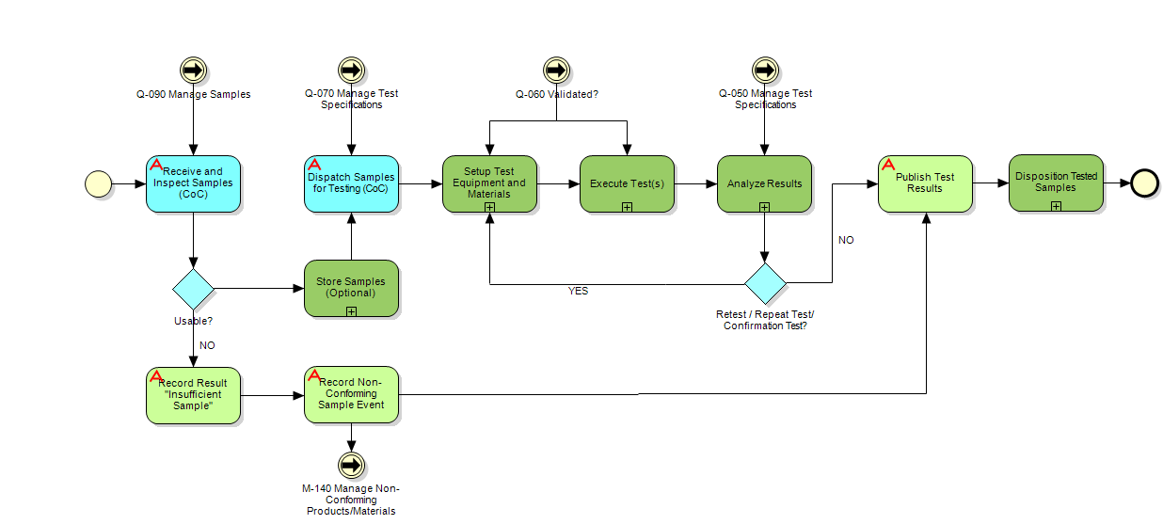
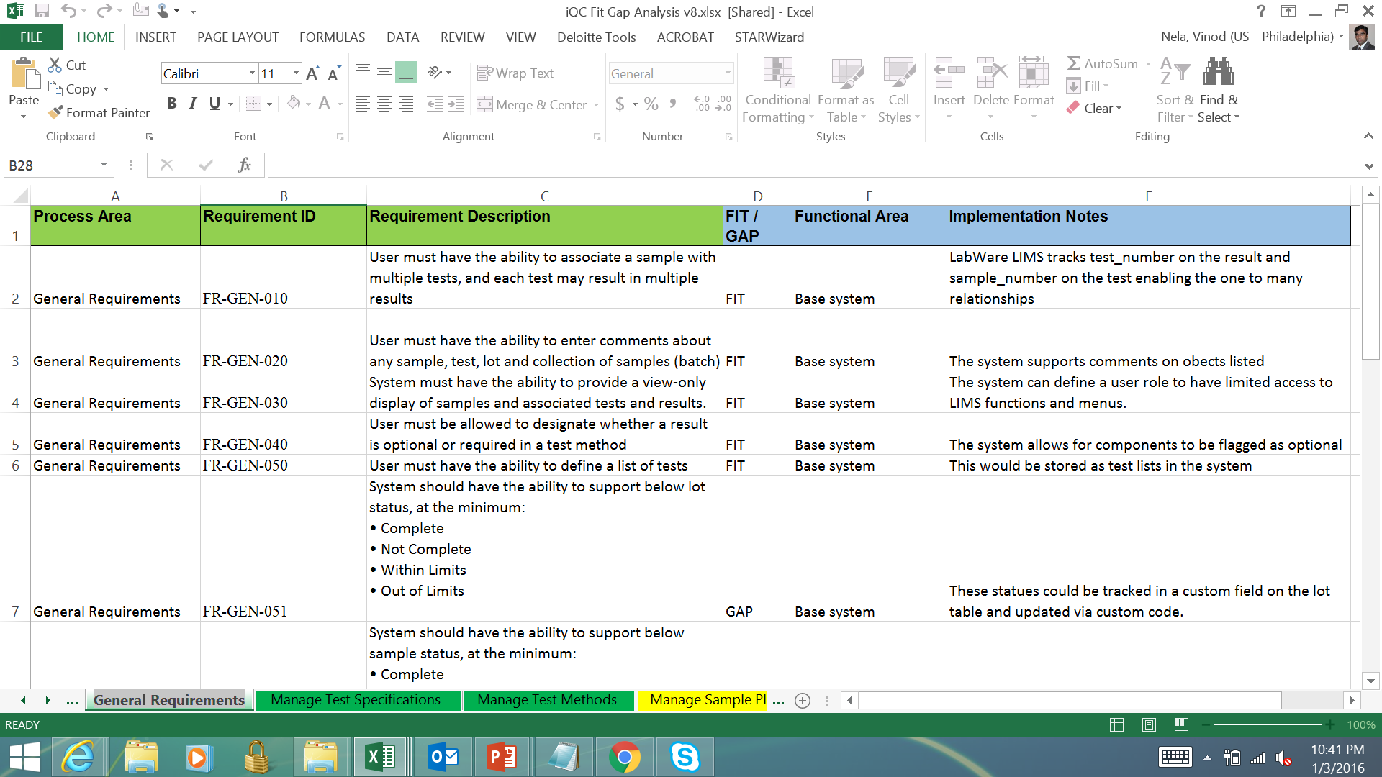
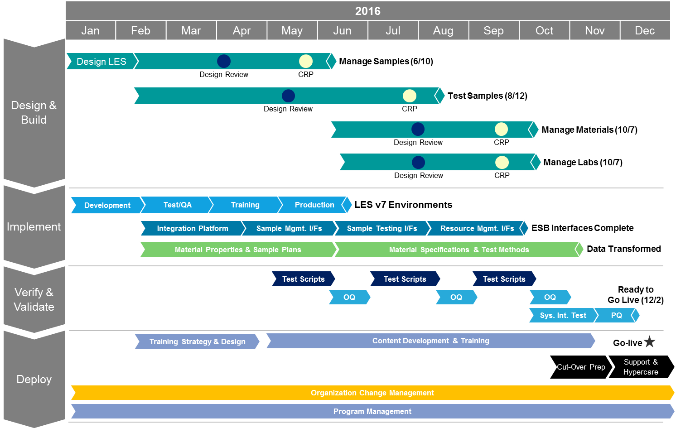
We conducted process requirements gathering and a fit gap analysis to outline a detailed project plan for future design and implementation phase
The Team
61 + extended business groups from RTP, Cambridge and Hillerod
17 + extended core team driving business process alignment and Change Management
8+ core team (Biogen + Deloitte)
12 Future State iQC Business Processes
Workshops and Interviews
50 + business process and functional review workshops and interviews
15 + integration and data model workshops and interviews with NGA, PLM and SCALE teams
260 + Business Requirements and Integration Requirements and associated Fit Gap with Labware V7 and ELN
Feedback Reviews
20 + business process and functional requirements feedback review sessions
180 + feedback review items discussed
Detailed Project Plan for 2016 Design and Implementation
Notes:
BR: I think this should be moved up to the front, as it represents what we did in our last engagement. It’s also the foundation of the next phase.

Slide 22

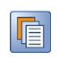



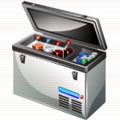

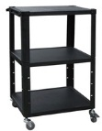
High Level Process Overview - Visual
Take Samples
Manage Samples
Test Samples
Review Test Results
Identify Sampling Need
LAB 1
Pickup Samples
Receive and Inspect Samples
Receive and Review Results
Review
Purpose
Aliquot
Samples
Test Samples
Collect Samples
Take Required Action
Aliquot
Samples
Store
Samples
Review and Approve Results
Stage Samples for Pick Up
LAB 1
Transfer Samples to Labs
Publish Test Results
Sample Chain of Custody
Notes:
Note: Test results to be used to communicate bad samples (insufficient quantity, damaged sample) -

Slide 23
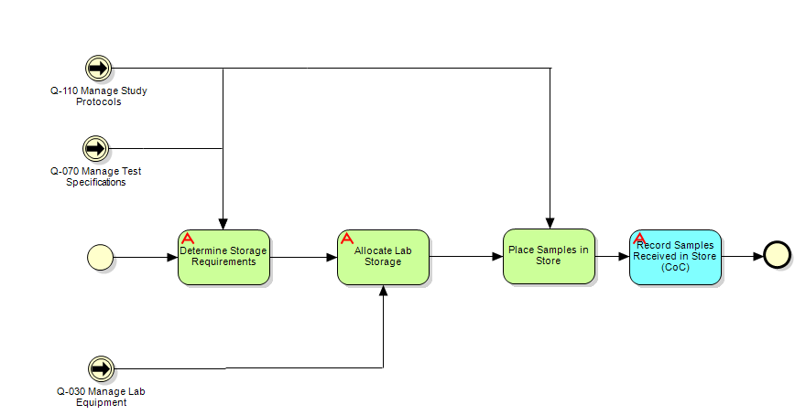
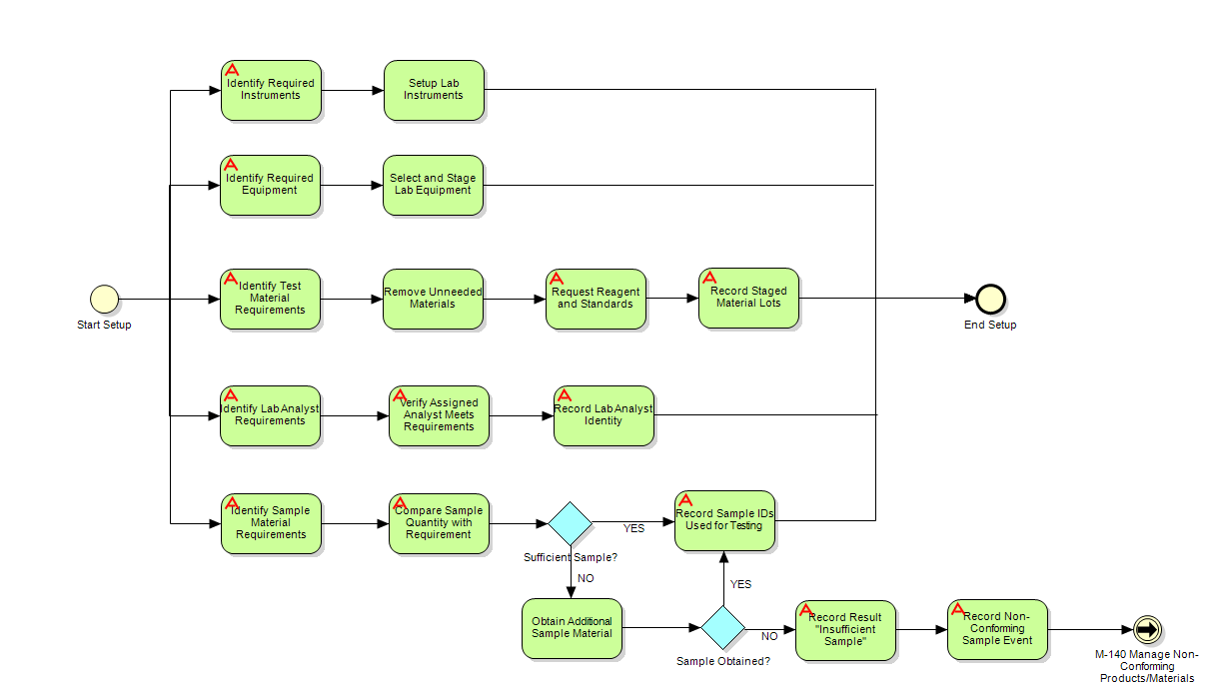
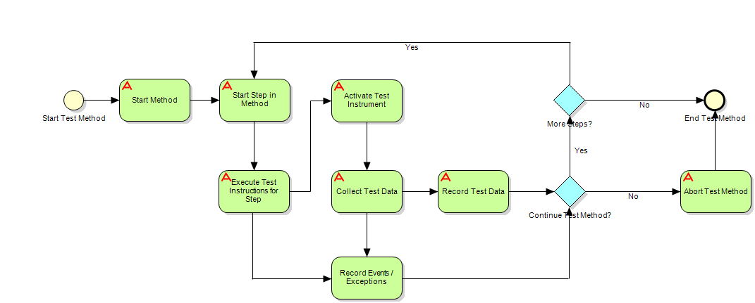
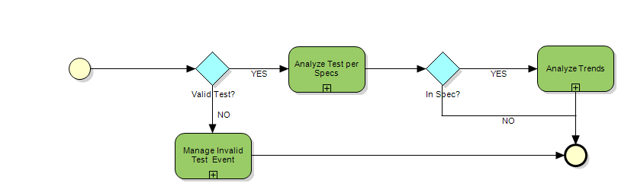
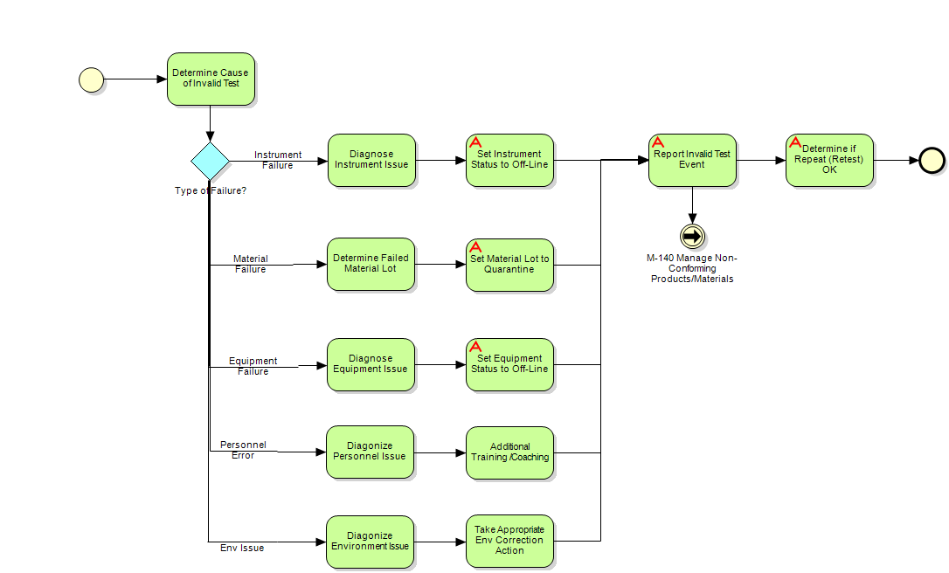
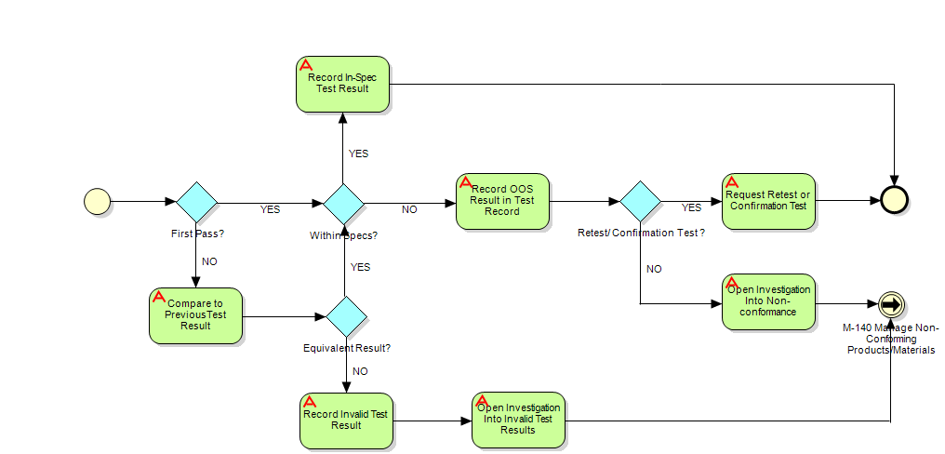
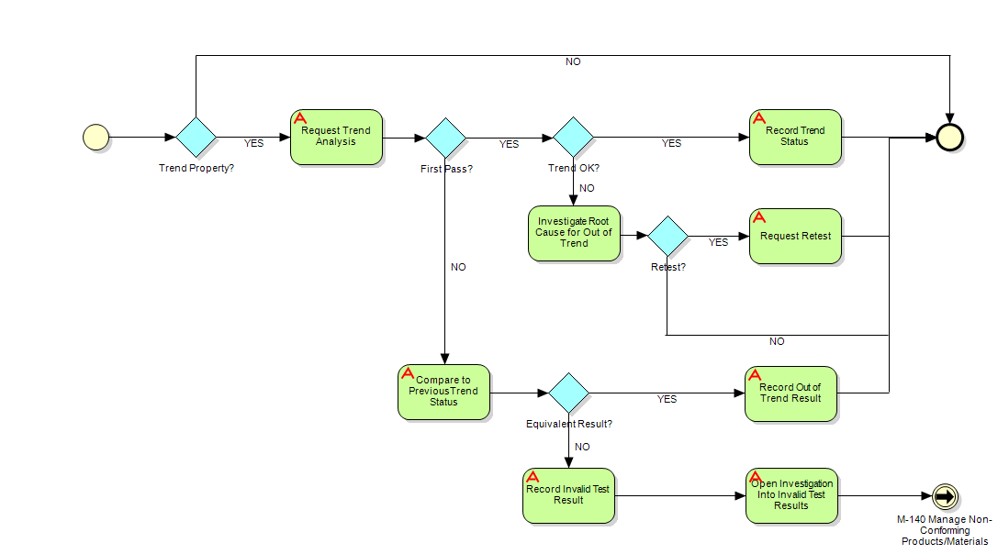
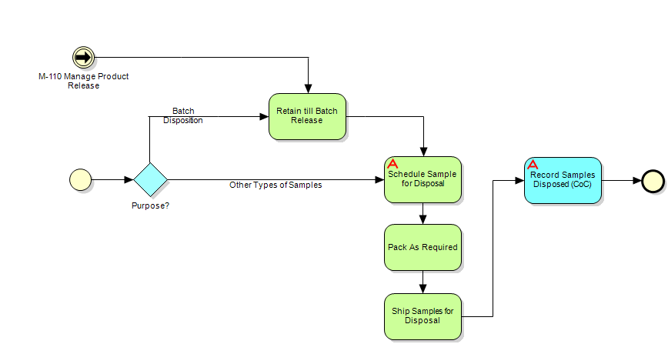
Each process area has a series of sub-process that were mapped out
Store Samples
This section documents the process of storing samples in appropriate storage location and condition and update inventory records
Setup Test Equipment and Materials
This section documents the process of setting up test instruments, requesting standards and reagents, verifying lab technician credentials to execute tests on a given sample
Execute Tests
This section documents the process of executing a structured test method on validated instruments and capturing test data and exceptions
Analyze Results
This section documents the process of analyzing test results and includes analyzing for invalid assays, comparing it with test specifications and analyzing trends
Manage Invalid Test Event
This section documents the process of identifying the cause of invalid test and creating an event to manage the invalid test exception
Analyze Test per Spec
This section documents the process of analyzing the test result against test specification to record if a result is within spec or out of spec and take appropriate action
Analyze Trends
This section documents the process of analyzing the test result against test trends and take appropriate action
Disposition Tested Samples
This section documents the process of disposal of samples

Slide 24
Execute Tests– High Level Process
This is the top level process of Test Samples in Lab Execution Systems
High Level Process

Slide 25
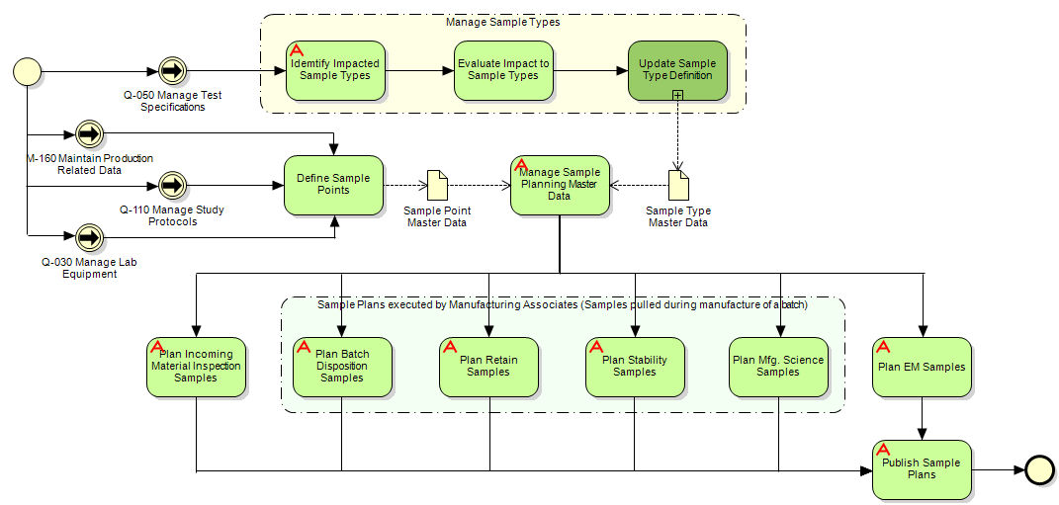
Manage Sample Plans
Manage Sample Plans
Sample plans define the type and number of samples that must be collected for testing at defined points in a process where each sampling point can be defines as a process step, elapsed time, and location.
Definition of sample plans required information from two sets of master data: Sample Point and Sample Type.

Slide 26
Managing Change

Slide 27
Communication Strategy
Recurring meetings to promote team collaboration and inform key leaders on program status and progress
Frequency / Duration | Purpose | Attendees
Executive Sponsor Committee
Monthly (1hr) | Focus: Strategic Agenda: Program-level executive review; status summary, key risks, issues, decisions | Program Lead, IT Lead, IT SteerCo. Member, Executive Sponsor(s)
Weekly (1hr) | Focus: Strategic Agenda: Program status summary, sector or IT-impacting risks, issues, decisions | Program Lead, IT Lead, Sector or IT Leads, Council Members
Daily (30 min) | Focus: Tactical Agenda: Program-level status review, key risks, issues, dependencies and decisions | Core Team and External Partners
Bi-weekly (1hr) | Focus: Tactical Agenda: Status Update, issues and dependencies | Program Lead, Core Team and Extended Core Team Leads
Monthly (1hr) | Focus: Tactical Agenda: Status Update, issues and dependencies | Program Lead, Workstream and Sub-workstream Leads, PMO Lead
Bi-Weekly (1hr) | Focus: Strategic & Tactical Agenda: Cross-program risks, issues, dependencies | Program Leads and Program Core teams
Operating Committee
Core Team
Extended Core Team
Extended Business Team
Integration Team

Slide 28
Our recommendations focus on delivering value in the following benefit areas
Benefit Category
Description
Outsourcing / Capacity
Support resources that manage CLOs and enter data into LIMS.
Efficiency: Cost Avoidance
  Reducing inefficiencies in analyst and reviewer time.
  Improvements in sample management.
  Automation in TD to QC method transfer.
  Reduction in duplicate work of entering sample management data in multiple systems.
Benefits
Efficiency: Cost Savings
  Optimizing equipment and reagent use.
  Visibility and forecasting automation, improving site planner function.
COGS (Direct)
  Reduce time for required inventory due to reduced QC cycle time and improved QC cycle reliability.
Cost of Compliance
  Primary system for Manufacturing Associate will be MES.
  Reduction in incidence of errors leading to rework and deviations.
Total Cost of Ownership
  Reduce necessity for ongoing current system fixes impacting keeping “lights-on” costs.

Slide 29

Summary
iQC
This is a QC-driven project but will provide substantial benefit to Quality, PO&T, and Biogen and enable the full vision of Next Generation LSM and Biogen’s operations of the future
Build and improve key business capabilities including guided method execution and QC comprehensive sample management
Implement a new Lab Execution System (LES) - Labware 7 LIMS + ELN with a focus on out-of-box functionality with less customization
Integration with other program and instruments will be a fundamental component to achieve the future vision of the iQC

Slide 30
Acknowledgements
Jeremy Slessman, Sr. Mgr, QC
Christy Mounts, Director, QC
Bill Rusin, Sr. Mgr, IT
Besufeked Alemayehu, VP, IT

