Slide 1
Reliability in Continuous Manufacturing
Bethany Silva - Life Science Industry Manager, Endress+Hauser
Steve Milford - Product Business Manager - Flow, Endress+Hauser
Adam Hughes - Sales Development Manager - Temperature & Systems, Endress+Hauser
ISPE-CaSA 2022

Slide 2
Continuous manufacturing
The industry trends

Slide 3
Benefits of Continuous Bioprocessing
Why Continuous?
Faster clinical progress
More production uptime
Improved inter-batch consistency
Time to Market
Increase throughput
Smaller Footprint
Product Quality
Less capex costs with smaller scales

Slide 4
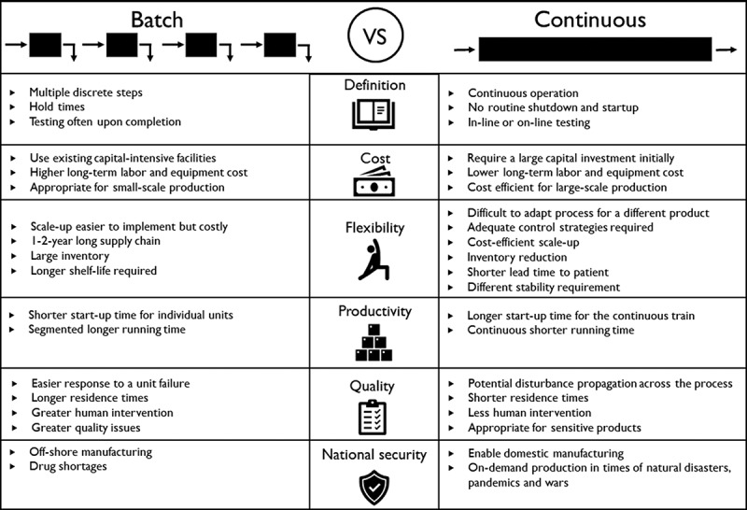
Fed-batch vs Continuous

Slide 5
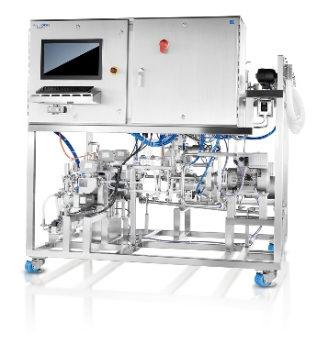
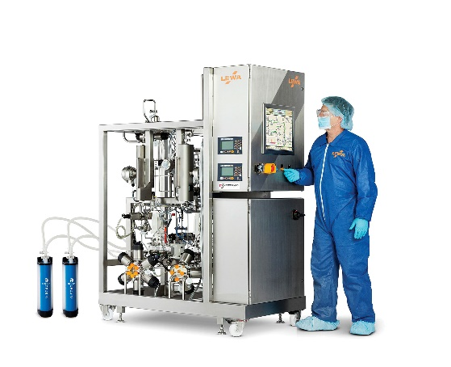
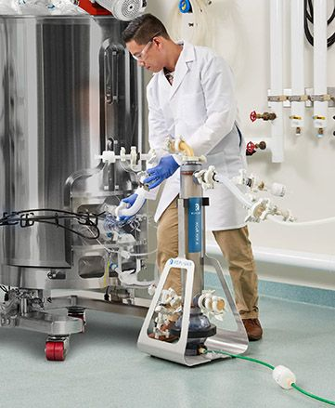
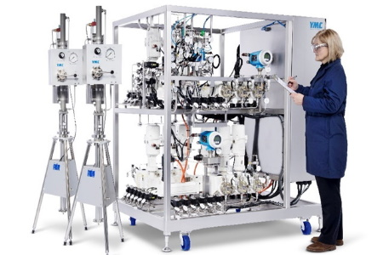
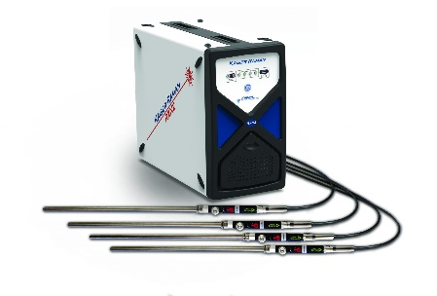
Equipment for Continuous Process
Perfusion Bioreactors w/ ATF systems
Multi-column Chromatography systems
Inline Buffer Dilutions Systems
Inline analytics
Real time release
In-line Buffer Dilution/ Buffer Stock Blending System
Inline Process Analytic Technologies (PAT)

Slide 6
Government Initiatives
May 19, 2020 -- The U.S. Department of Health and Human Services (HHS) announced a new project to promote U.S.-based pharmaceutical manufacturing to secure the supply of essential medicines during crises like the COVID-19 pandemic. The project includes a $354 million contract with Phlow of Richmond, VA.
      Under the new HHS plan, drug ingredients will be manufactured at facilities in the U.S., including a new facility to be built in Virginia. To lower production costs and increase quality, safety, and volume of medicines, the project will use advanced manufacturing processes, including "flow" chemistry and other continuous manufacturing techniques.
Sept. 21, 2020 the U.S. House passed H.R. 4866, the National Centers of Excellence in Continuous Pharmaceutical Manufacturing Act
      H.R. 4866 would amend the 21st Century Cures Act to direct the FDA to designate national centers of excellence (NCEs) that would work with the agency and the biopharma industry to craft a national framework for continuous manufacturing. The bill also calls for support for additional R&D of the technology, workforce development, standardization and collaboration with drug manufacturers to help them adopt continuous manufacturing. The bill authorizes $80 million to be appropriated for the NCEs each year from fiscal 2021 through 2025.
Oct. 19, 2021, the House passed H.R. 4369, National Centers of Excellence in Advanced and Continuous Pharmaceutical Manufacturing Act of 2021
      H.R. 4369 grants FDA the authority to designate National Centers of Excellence based on certain criteria, such as research and developmental capabilities of the institution; “scalable” manufacturing knowledge-sharing networks; demonstrated experience in designing new technologies; and a history of successful knowledge transfer. The new bill builds on existing partnerships between FDA and research institutions, such as Rutgers University’s Center for Structured Organic Particulate Systems (C-SOPS), which has been a player in the advancement and integration of continuous manufacturing technologies into commercial production.

Slide 7
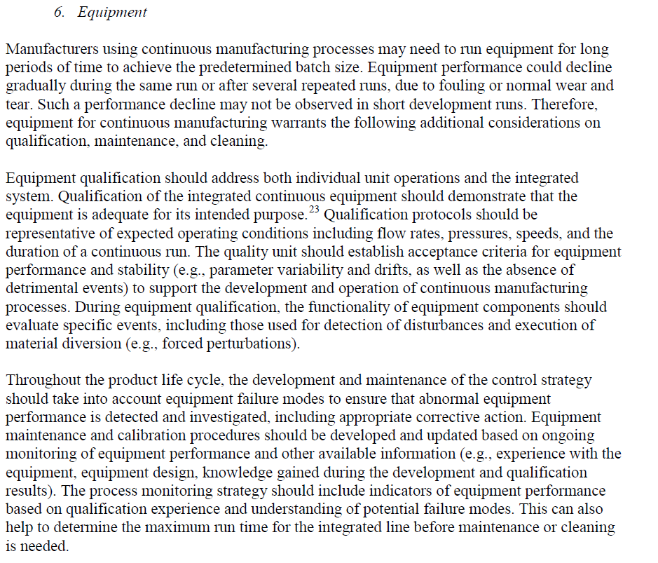
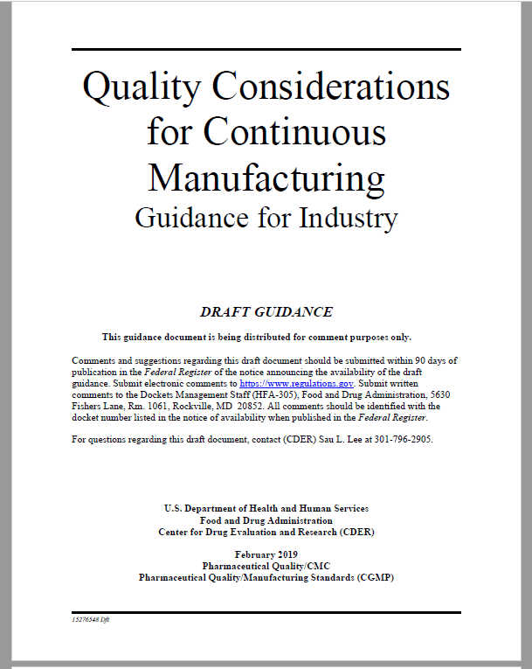
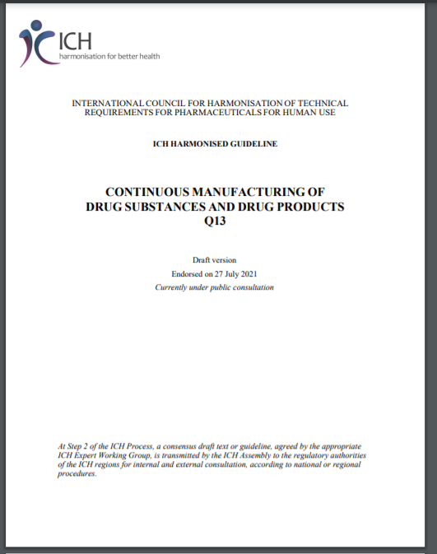
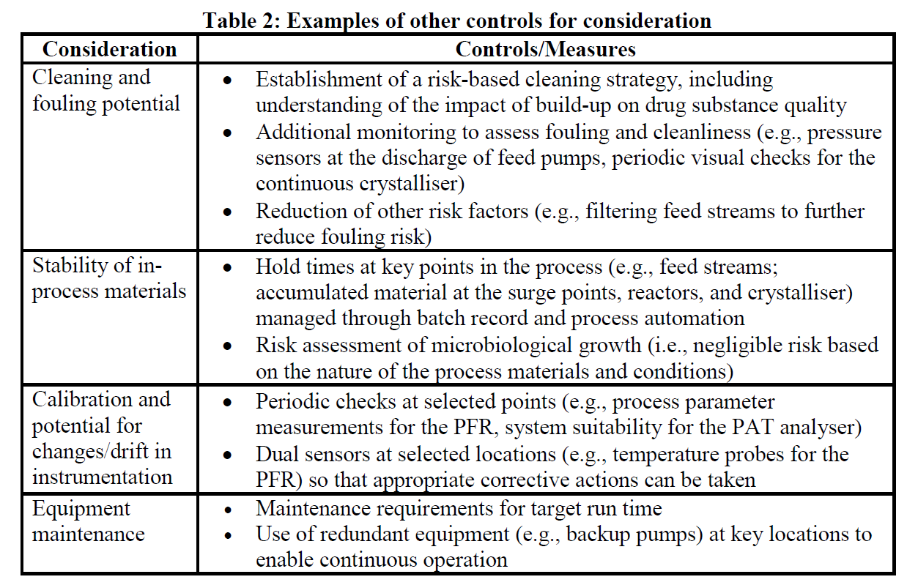
Regulatory Guidance

Slide 8
Measurement and Control of Process and Quality Attributes
You cannot control something that you cannot measure
Typical Measurements:
    Dissolved oxygen
    pH
    Conductivity
    Turbidity
    Ultraviolet (UV) light absorbance
    Flow rate
    Pressure
    Level
    Temperature
Near-infrared (NIR) and Raman Spectroscopy

Slide 9
Moving from Preventative to Predictive Maintenance Strategy
Preventive maintenance (PM) is the regular and routine maintenance of equipment and assets in order to keep them running and prevent any costly unplanned downtime from unexpected equipment failure. A successful maintenance strategy requires planning and scheduling maintenance of equipment before a problem occurs
Predictive maintenance refers to the use of data-driven, proactive maintenance methods that are designed to analyze the condition of equipment and help predict when maintenance should be performed
  Increased Reliability, Productivity & Asset Lifecycle
  Savings of Maintenance & Calibration Costs
  Reduce Risk in-between calibrations
  Flexibility for production schedules and equipment availability
  Optimizing the calibration cycles based on data
  Reducing unnecessary human error risks

Slide 10
Flow
Best practice for regulatory compliance
more cost-effective alignment with ISO 9001 & FDA 21 CFR Part 820.72 requirements

Slide 11
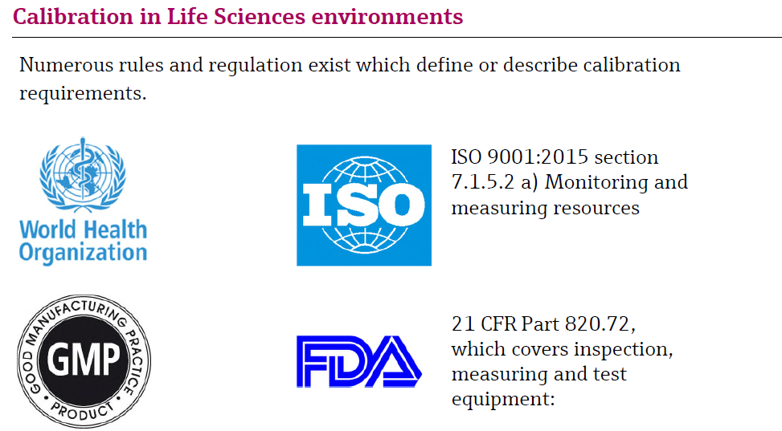
Calibration in Life Science environments

Slide 12
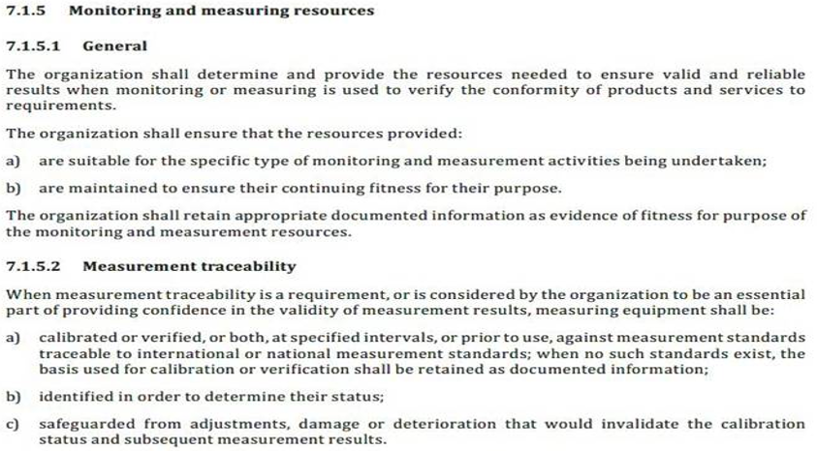

ISO 9001:2015 specifically section 7.1.5.2 a)
Products which already meet the requirements of ISO 9001:2008 section 7.6a) also meet the comparable requirements of revision ISO 9001:2015 section 7.1.5.2 a)

Slide 13
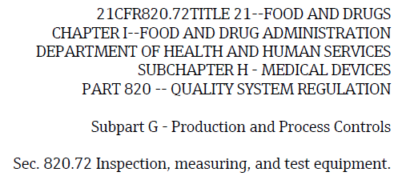

FDA 21 CFR 820.72

Slide 14

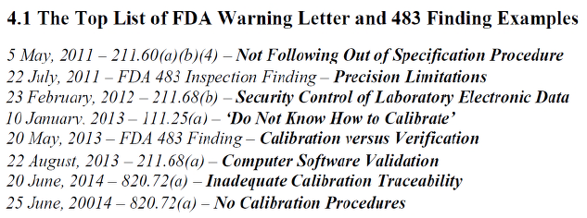
Non-compliance can generate harmful Form FDA 483 Warning Letters
FDA’s Office of Regulatory Affairs (ORA) is the lead office for all field activities, including inspections and enforcement. During an inspection, ORA investigators may observe conditions they deem to be objectionable. These observations, are listed on an FDA Form 483 when, in an investigator’s judgment, the observed conditions or practices indicate that an FDA-regulated product may be in violation of FDA’s requirements.
*
Form FDA483s are public domain & available through the FDA Freedom of Information Act Office. Any Form FDA 483 can be requested by anyone

Slide 15
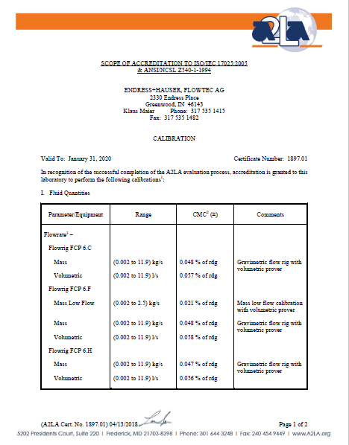
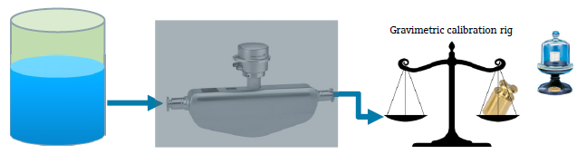
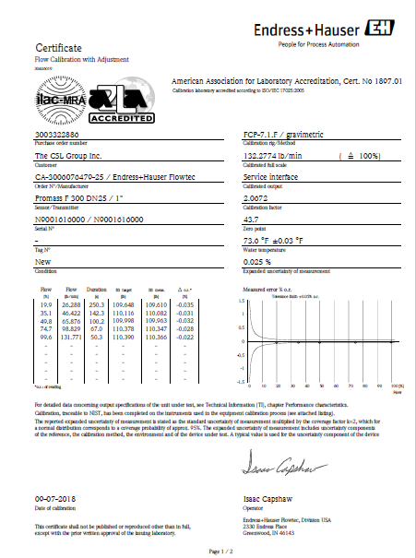
What is Flowmeter Calibration?
Calibration is the determination and documentation of the difference between the Meter value and the Reference value without technical intervention
Traceability is accomplished by a formal comparison to a standard which is directly or indirectly related to national standards
During the calibration, the entire measuring device is seen as a “black box” where only the result of the measurement is considered
Defects to the sensor are only detected if they have a direct impact to the measuring performance
The Meter & the process are open & exposed during Calibration, and production interrupted

Slide 16
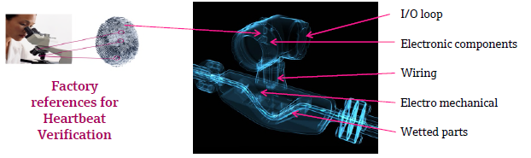
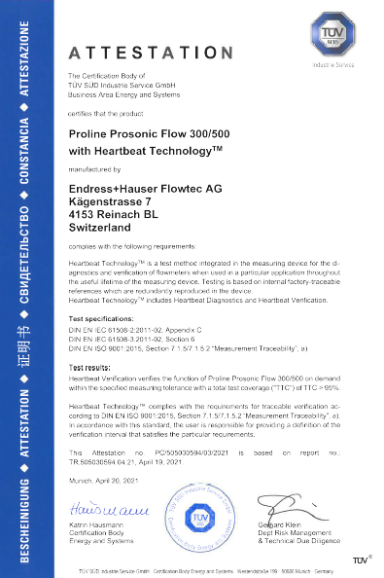
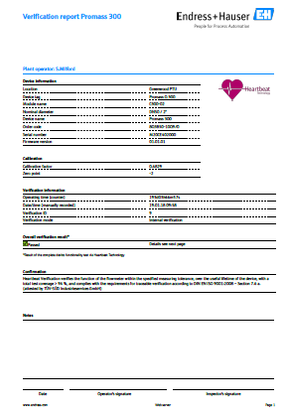
What is Flowmeter Verification?
Verification it is the act of reviewing, inspecting or testing the Meter, to establish and document that the Meter is still within factory tolerances and no relevant parts have been altered, changed or have drifted in any way
During manufacture, internal & redundant factory references are calibrated based on traceable references to establish a factory baseline​ for comparison during the lifetime of the Meter whenever it undergoes Verification
The Meter remains in-situ during Verification, and process uninterrupted

Slide 17
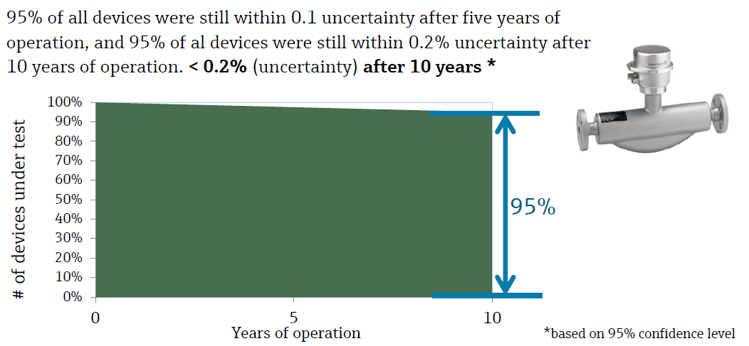
Take a modern Coriolis meter….
is Calibration necessary every 12 months?
Sample size 3,000 meters from global ISO 17025 calibration facilities

Slide 18
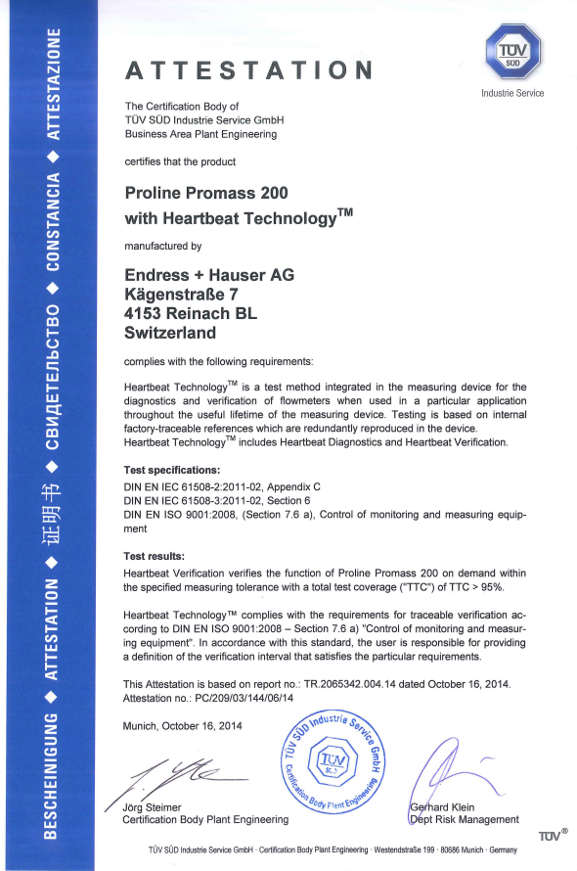
Traceable Verification –
Third Party Attestation states Traceable to ISO 9001
Heartbeat TechnologyTM is a test method integrated in the measuring device for the diagnostics and verification of flowmeters when used in a particular application throughout the useful lifetime of the measuring device. Testing is based on internal factory-traceable references which are redundantly reproduced in the device.
Heartbeat Verification verifies the function on demand within the specified measuring toleration…with a total test coverage…>95%
Heartbeat TechnologyTM complies with the requirements for traceable verification according to DIN EN ISO 9001:2008 – Section 7.6a) “Control of monitoring and measuring equipment”.

Slide 19
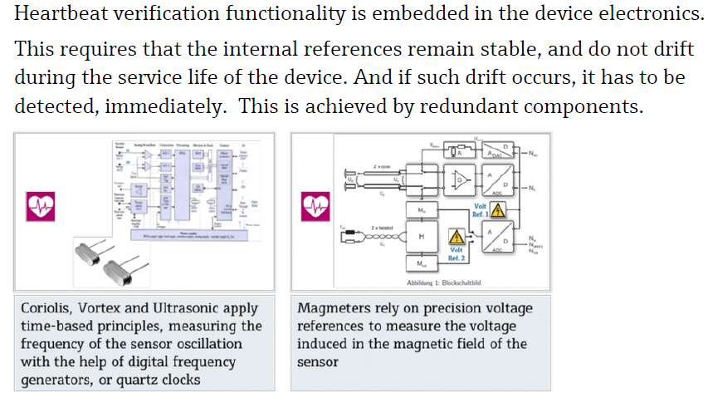
How are embedded verification references traceable for ISO 9001?
Coriolis, vortex & ultrasonic flowmeters are time-based using high-precision clocks & frequency generators.
During final calibration, the clocks are calibrated against traceable standards.
Redundant references mean the chance of an undetected failure or drift lies at 0.000000067 or 1 in 14.925 million.

Slide 20
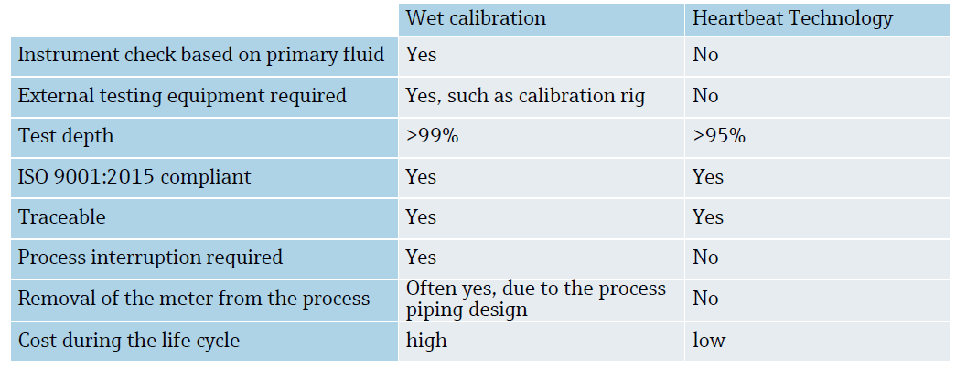
What are the considerations?
“Wet” Calibration
Heartbeat Verification

Slide 21
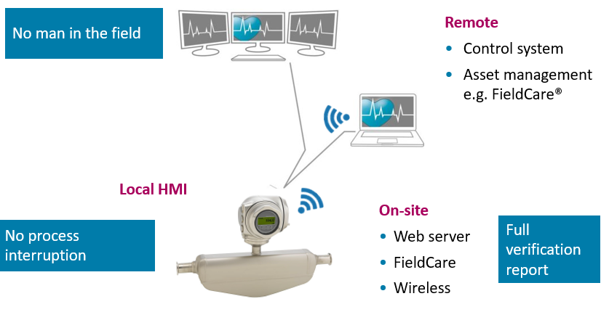
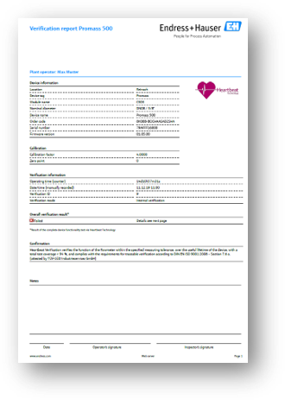
Verification does not necessitate a local connection or on-floor personnel

Slide 22

IEC 61508 Standard, Safety Integrity Level (SIL) & FMEDA data
IEC 61508 sets out the requirements for ensuring that systems are designed, implemented, operated and maintained to provide the required safety integrity level (SIL). Four SILs are defined according to the risks involved in the system application, with SIL4 being used to protect against the highest risks. The standard specifies a process that can be followed by all links in the supply chain so that information about the system can be communicated using common terminology and system parameters.
Devices developed in accordance with IEC 61508 are subjected to FMEDA assessment, and a Functional Safety Report can be generated which prescribes TTC (Total Test Coverage) and considers all theoretical failures:
The most complex Endress+Hauser Coriolis meter has a TTC of >95% based upon IEC 61508 FMEDA, with a λ_{du} of 121 FIT
1 FIT = 1x10⁻⁹ Failures In Time, so λ_{du} 121 FIT is 121 Dangerous Undetected Failures in 1 billion hours or 114,155 years, so average 0.00053 failures per year, or one every 1,887 years, where failure means out of specification, with a Recommended Test Interval = 4 years
(Copy of Functional Safety Data on request. Complete TUV Report via NDA)

Slide 23
Frequency of Verification and Calibration
The frequency of Verification is determined by the criticality of the process and the S.O.P.
Criticality is the combination of the severity of an effect and the probability or expected frequency of occurrence. The objective of a criticality analysis is to quantify the relative importance of each failure effect, so that priorities to reduce the probability or to mitigate the severity can be taken.
Criticality Cr = P * S
where P is probability of occurrence in a year & S is severity of the severest consequence
The Criticality determines allowable Risk Level
The lower the λ_{du} value of a measurement device, the longer that a specific Risk Level can be maintained through continuous Diagnostic Coverage and Verification, before the device must have a full proof-test (“wet” calibration in flow terms)
We can provide guidance on Risk Level and Calibration intervals
Many Life Sciences companies operate a Verification before or after every production batch, because it is so fast, without cost or process interruption, and demanded remotely from outside the cleanroom environment
Regulation Compliance and Documentation requirements are met

Slide 24
Result - Unbroken Chain of Documentation for the Regulatory Inspector
Traceable Sequential Verification Reports
Attestation Cert ISO 9001 Traceability
Factory Calibration Rig Accreditation Certificate
Flowmeter Factory Calibration Certificate

Slide 25
Temperature measurement
In-line calibrations

Slide 26
What is Temperature Calibration?
“The comparison of a measurement value of a device under test with those of a calibration standard of known accuracy”
For RTD’s there are two accepted methods of Calibration
Comparative Calibration – when the RTD in question is tested against a higher quality reference thermometer. The reference thermometer typically exhibits an accuracy 3x to 4x higher than the RTD being tested
Fixed Point Calibration – carried out against the internationally defined (ITS-90) temperatures at which the physical state of substances alter. The most common is the triple point of water, 0.010° C [Ice Bath]
  All reference thermometers used for Comparative Calibrations are calibrated using the fixed-point method
  A fixed point has No Drift! It is a known physical phenomenon
  The triple point of water / ice bath is the only “true” test point per IEC 60751 for an RTD to determine if it qualifies as a Class B, A or AA. All other points are simply verification that the unit is performing within acceptable limits

Slide 27
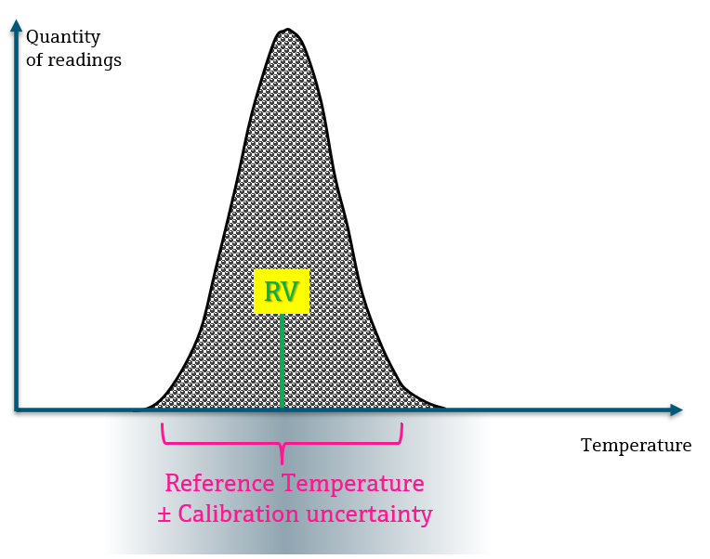
Terminology: Calibration
In a calibration situation, the real or
calibration reference value (RV) of the temperature is provided by fixpoint, a block calibrator or stirred bath
Also a calibration method has an
uncertainty (CU), caused by e.g.
heat transfer errors etc.
This calibration uncertainty has to
be determined accurately
The CU must be documented
on the calibration record

Slide 28
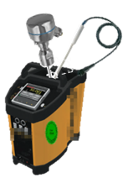
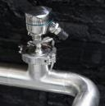
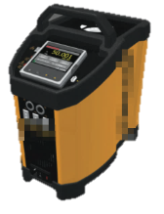
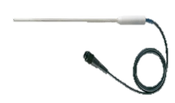
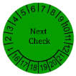


OFFLINE - Calibration
Reference
Calibration
Regularly calibrated by a third party
Regularly Re-Calibration
by trained and skilled staff
remove
check
Dry block calibrator or calibration bath
accuracy
homogeneity repeatability
Reference thermometer
accuracy
every
X month
remounting
Manual
validation
Manual
Docu

Slide 29
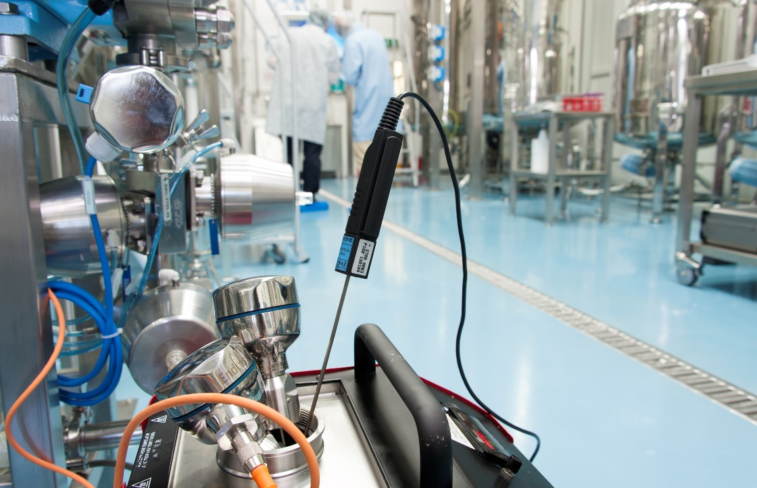
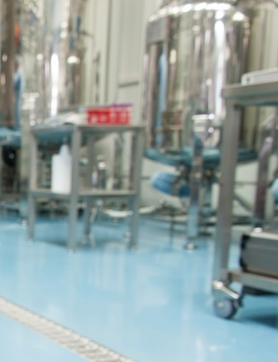
Challenges of a manual on-site calibration
Uncertainty of
  Oil or block calibrator
  Reference thermometer
Different installation conditions
  Ambient temperature
  Immersion length
  Measurement medium

Slide 30
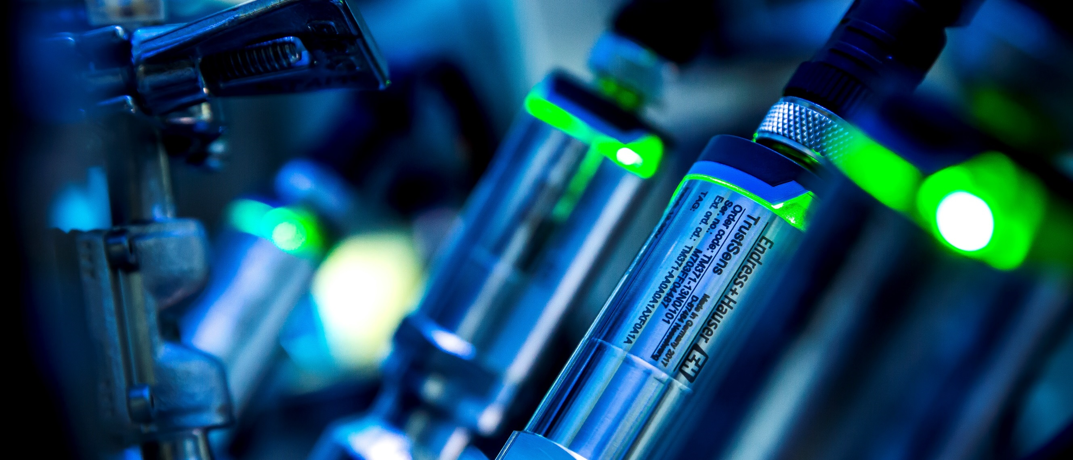
Advantages of a fully automatic inline self-calibration
Controlled environment:
Built-in reference and Pt100
Immersion length not an issue:
Reference and Pt100 sensor always side-by-side
No trained staff required:
Fully automatic inline self-calibration
Only uncertainty: the reference sensor

Slide 31
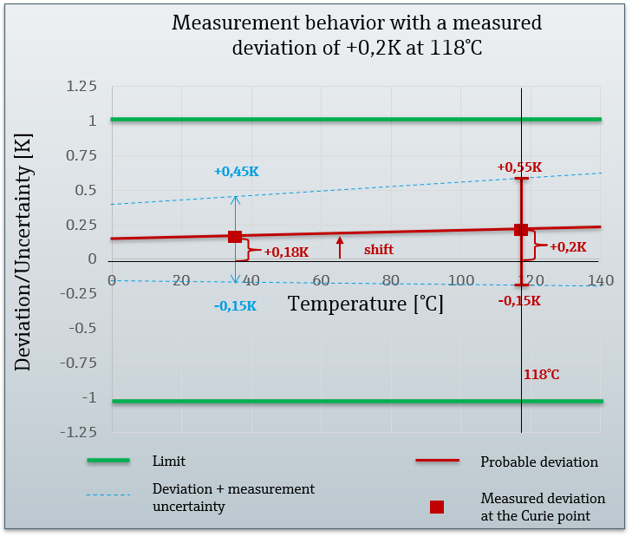
Measurement behavior dependent on a known deviation at the Curie point
An analysis by the university of Ilmenau shows, how a measured deviation at 118°C affects the entire measurement range.
A measured deviation at one point means in most cases an almost parallel shift of the characteristic RTD curve (red curve).
If a deviation of +0.2K has been detected at the Curie point (118 ° C), a probable deviation at the process temperature (37 ... 40 ° C) of less than 0.18 K follows. Even taking into account the measurement uncertainty (e.g. at 37°C this is in an interval of -0.15 K to +0.45 K), it has been proved, that the TrustSens is more accurate than +0.55 K and -0.15 K over the measurement range. An usual limit for the measured deviation at which temperature sensors are removed from the plant is ± 1 K. Due to this fact, any TrustSens sensor with a deviation of less than 0.2 K at the Curie point is in conformity with this requirement.

Slide 32
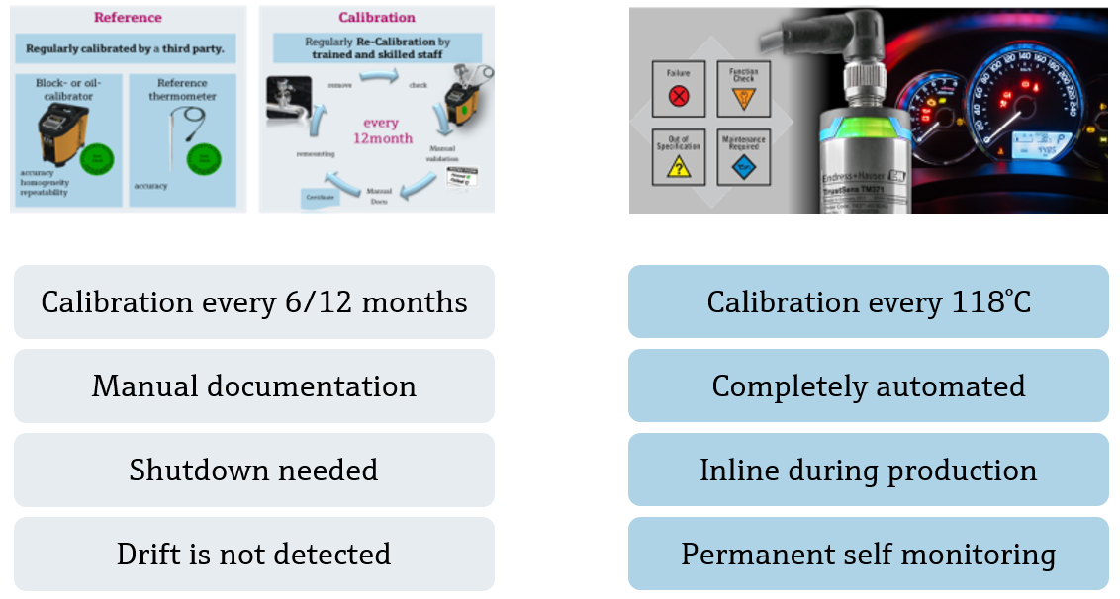
Manual offline calibration vs. inline calibration

Slide 33
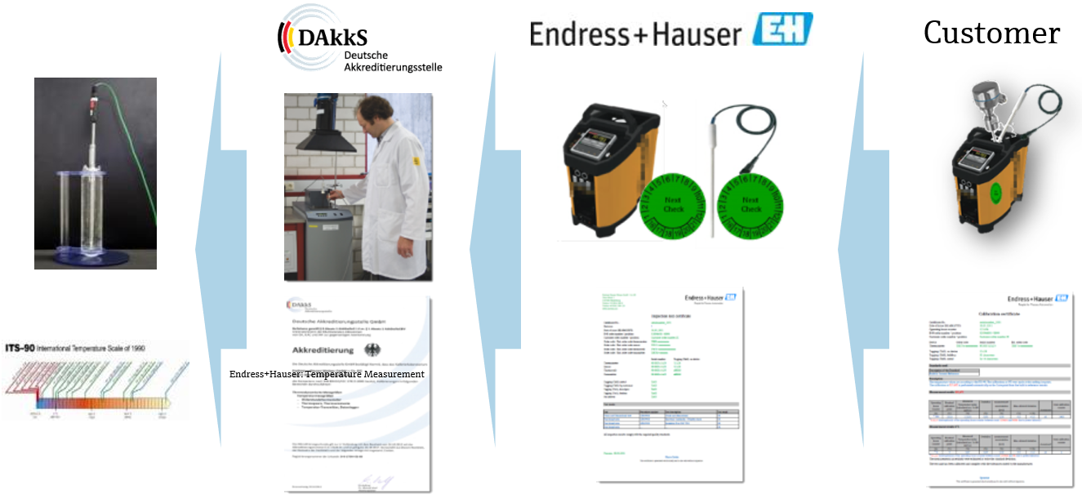
Differentiator between verification and calibration is the traceability chain

Slide 34
Thank you!
Questions?

