Slide 1
Learn your strengths and how to use them
Lindsey Daniel, PE
Process Engineer, CRB
Ashley Harp, PE
Lead Process Engineer, CRB
March 31, 2016

Slide 2
Agenda
Start Time | Stop Time | Activity
2:00 | 2:05 | Introductions/Agenda
2:05 | 2:25 | Icebreaker
2:25 | 2:55 | Presentation on Strengths
2:55 | 3:15 | Breakout session #1
3:15 | 3:30 | Break
3:30 | 3:50 | Breakout session #2
3:50 | 4:00 | Wrap Up & Q&A

Slide 3
ICEBREAKER

Slide 4
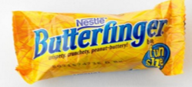
ICEBREAKER
What is one stressful thing about your job that you wish you could improve?
One thing you love about your job?
What is a life goal you are working on?
What is your favorite was to revive yourself during the work day?

Slide 5
The Many Varieties of Strengths
Physical Strengths
Character Strengths
Talent Based Strengths
Notes:
Physical Strengths = Easily quantifiable – How far can you run? How much can you bench? How many squats can you do?
Character & Talent based strengths are both positive psychology based (note Meyers Briggs is personality based – preferences & how you perceive the world around you)
Character Strengths = core positive capacities for thinking, feeling, and behaving that benefit others & oneself
Talent Based Strengths = XXX
Talent based strengths are strongly impacted by your personal motivations
None of the answers are Right or Wrong or Good or Bad

Slide 6
Identifying Strengths
Physical Strengths
Go to the gym or the track
Character Strengths
Via Institute on Character www.viacharacter.org (free)
Talent Based Strengths
Richard Step www.richardstep.com (free)
STRENGTHSFINDER 2.0 www.strengthsfinder.com ($$)

Slide 7
Clifton STRENGTHSFINDeR ASSESSMENT & Strengthsfinder 2.0
Tom Rath and gallup
Notes:
StrengthsFinder 2.0 Book - Tom Rath and gallup
Alternately:
Now, Discover your Strengths – Markus Buckingham & Donald O. Clifton

Slide 8
What is Clifton StrengthsFinder?
Online test - 177 questions, 20 seconds per question - identifies top 5 strengths
Based on over 30 years of research
Data based - more than 100,000 talent-based interviews
Measurement of individual talent - highlights the greatest potential for building personal strengths
Notes:
20 seconds per to identify your most natural responses, which are less likely to change over time – the time limit forces a natural response instead of overthinking the “right” response
Test does not ask about knowledge, degree, skills, resume, etc. It is a true measure of your natural talent. Gallup believes that knowledge and skill, while important, are most helpful when they serve as amplifiers for your natural talent
Talent vs. Strength
Tom Roth says, “What StrengthsFinder actually measures is talent, not strength- the ultimate goal is to build true strength, and talent is just one of the ingredients in the formula.”
“Talent comes naturally, but strengths are earned”
Talents – naturally recurring patterns of thought feeling, or behavior that can be productively applied (Hodges & Clifton, 2004, p 257)

Slide 9
The Path of Most Resistance
As humans, we are programmed to want to be good at everything so we focus on overcoming our weaknesses
77% of parents in the US believe that a child’s lowest grade deserves the most time and attention
Our society promotes the underdogs who overcome their lack of natural talent
Rudy Ruettiger, Notre Dame football player
“You cannot be anything you want to be – but you can be a lot more of who you already are.” – Tom Roth, StrengthsFinder 2.0
Notes:
How many times have you been told “you can be anything you want to be if you just try hard enough”
Most of us know the story of Rudy Ruettiger who scored a touchdown in his final seconds as a Notre Dame Football player. He spent thousands of hours pouring his blood, sweat, & tears into an activity that he generally wasn’t good at.
IMAGINE what he could have accomplished if he put all that effort into something that he was naturally talented in!

Slide 10
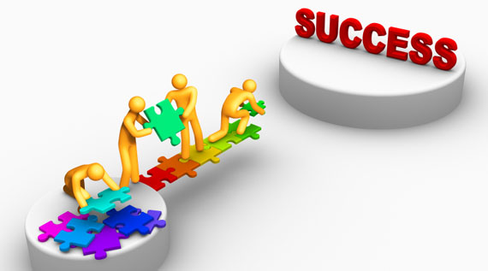
Don’t Ignore Your Weaknesses – Manage Them
You cannot be good at everything - so build a team that is
Be aware of your strengths - focus and develop them to offset your weaknesses
Build systems to minimize your weaknesses - checklists, tools
Manage around weakness - calendars, planners, planned breaks
Notes:
Use other’s strengths to build a high functioning team
This allows the team to be balanced & be the most successful (high performance)
Plan ahead (prepare)
Practice
Focus more on Capitalization (targeting strength) than on Compensation (remediating deficiencies)
Read the Stephen Covey’s account in the excerpt from “The 7 Habits of Highly Effective People” pg 202

Slide 11
A Recipe For Strength
23-year study of 1,000 children in New Zealand revealed that a child’s personality at age 3 was “remarkably similar” to that at age 26
Talent acts as a multiplier when you start with dominant talent and add in skills, knowledge and practice
What Motivates You?
Notes:
There are 3 building blocks to how we perform tasks – talent, skills, & knowledge
You are born with Talent
You can learn Skills
You can gain Knowledge
Strengths NOT weakness are your areas for improvement – where you will learn the most, grow the fastest, and be most resilient
Working on your strengths is much more productive than pouring all your effort into improving your weaknesses
Motivation – know this before you can maximize your strengths
Align yourself with your passions
Be Careful not to over use or borrow too much from your strengths – Read Stephen Covey’s account in the excerpt from “The 7 Habits of Highly Effective People” pg 39
Also known as “Blind Spots”

Slide 12
The Obligatory Statistics
Focusing on Strengths keeps teams engaged
Highly engaged teams =
22% higher profitability
21% higher productivity
65% lower turnover
48% fewer safety incidents
(Gallup data)
Study of 10,000 New Zealand workers
Workers with High Awareness of Strengths – 9.5 times more likely to flourish than workers with Low Awareness
Workers with High Strengths Use – 18 times more likely to flourish than workers with Low Use
(Hone et al., 2015)
Notes:
More engaged teams function more successfully…using your strengths allows you to be more engaged in your team.
People working outside their strength zone are 6 times less likely to be engaged at work. (StrengthsFinder 2.0 pg 12)
Highly engaged teams have 22% higher profitability, 21% higher productivity, 65% lower turnover, and 48% fewer safety incidents. – Gallup data
With all this data – why aren’t we living life using our strengths?
Most people don’t know what their strengths are or how to describe them
Most people don’t know the strengths of those around them

Slide 13
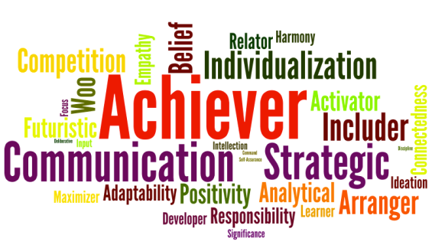
34 Strengths
Notes:
See Theme Description sheet

Slide 14
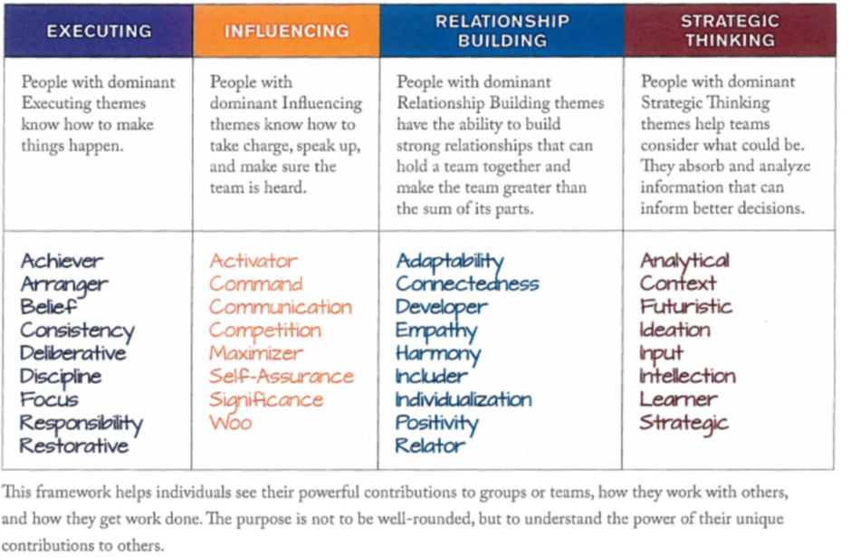
Strengths Domains
(“Strengths Based Leadership”, Tom Roth)

Slide 15
Breakout session #1
Notes:
Handout:
What Top Themes do we share?
What Top Themes are unique?
What Drives/Motivates you?
How do you communicate?
What Top Themes could cause conflict within the team?
How can we work to overcome those possible conflicts & obstacles?
How do you celebrate?
Baased on the hypothetical challenge, assign team members to roles within the team.

Slide 16
Re-group and presentations
Notes:
What roles did you choose?
Why?

Slide 17
15 minute break

Slide 18
Breakout session #2
Notes:
Team Challange

Slide 19
Wrap-up and questions

