Slide 1
Supply Chain, Design, and Safety Implications of Emerging SU TECHNOLOGIES
ISPE-CaSA Life Sciences & Technology Conference
March 10th, 2020 Durham , NC

Slide 2

Granulomatosis with polyangiitis
Granulomatosis w/polyangiitis is rare disorder that causes
  inflammation of blood vessels in nose, sinuses, throat, lungs &
  kidneys
  Formerly called Wegener’s granulomatosis, condition is 1 of a
  group of blood vessel disorders called vasculitis.
  Slows blood flow to some of your organs & affected tissues can
  develop areas of inflammation called granulomas, which can affect
  how these organs work
  Early diagnosis & treatment of granulomatosis w/polyangiitis might
  lead to full recovery w/out treatment, but the condition can be fatal

Slide 3
Signs & Symptoms of Granulomatosis w/Polyangiitis Might
Include:
Joint pain
Fatigue
Shortness of breath or wheezing
Weight loss
Coughing, sometimes
w/bloody phlegm
Numbness in limbs, fingers or
toes
Blood in your urine
Ear inflammation & hearing
problems
Skin sores, bruising or rashes
Eye redness, burning or pain, &
vision problems
Pus-like drainage w/crusts from
your nose, stuffiness, sinus
infections, & nosebleeds

Slide 4
Cont…
Commonly misdiagnosed – i.e., rheumatoid arthritis
For some, disease only affects the lung; for others, the
disease only affects the kidneys
Bottom line - without treatment, kidney or lung failure
can occur
Cause of Granulomatosis w/polyangiitis is unknown
    Not contagious
    Not hereditary
    Most often affects people between 40 – 65 years old
  Treatment is a combination of steroids &
  anti-chemotherapeutics

Slide 5


Patients are everywhere…

Slide 6
Single use (SU) Process design
Marisol Hydock
Msat - Process specialist, viral vector manufacturing
Bluebird bio, inc.

Slide 7
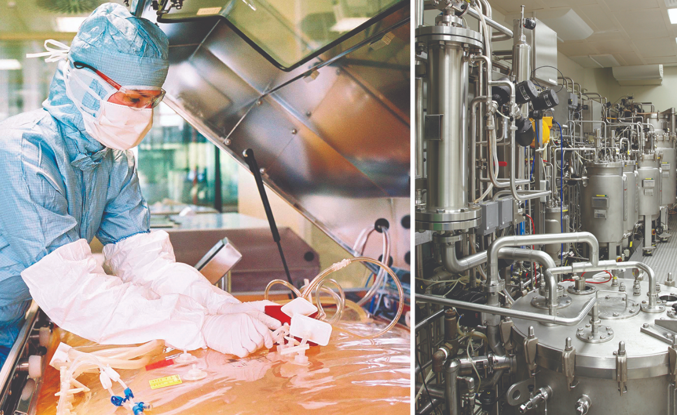
Agenda
Single Use Technology vs. Multi-use Stainless Steel
Definitions
SUT Consumable Types
Why use Single Use (SU) Technology?
Tools and Methods for Process Design
Process Constraints
Material Qualification
Conclusion

Slide 8
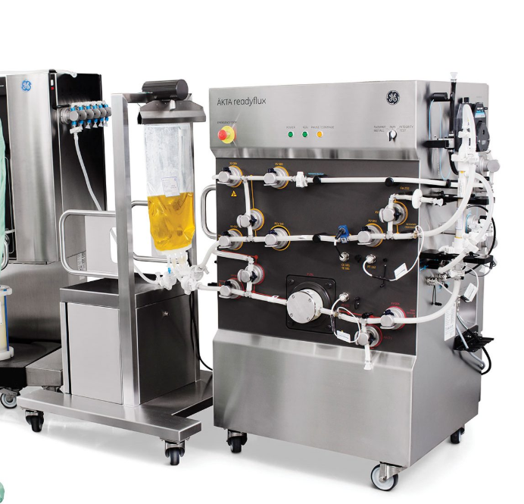
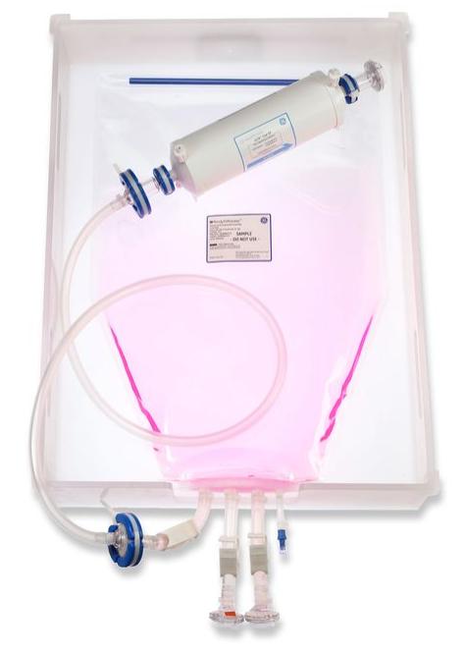
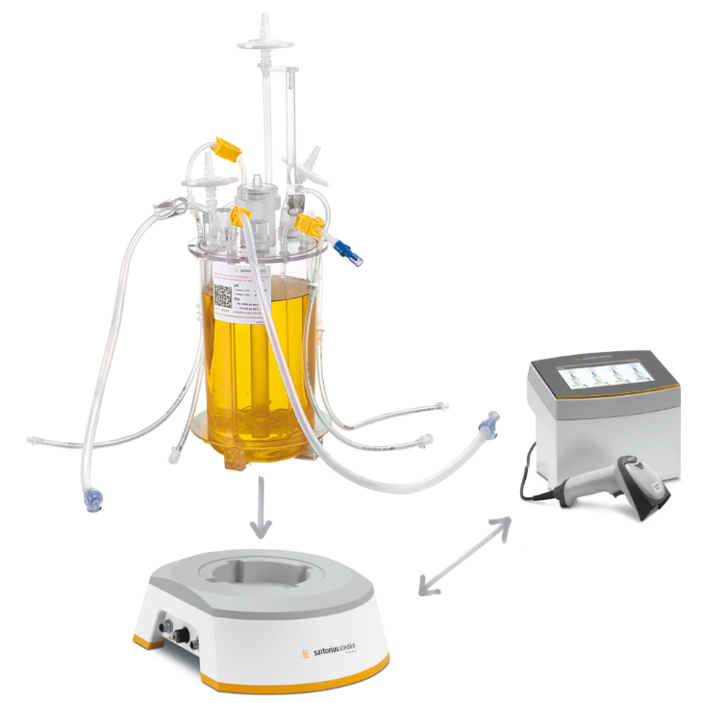
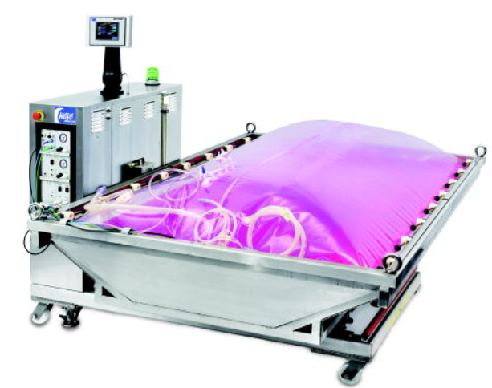
Definitions
SU Disposables / Consumables
general term for bags, tubing, assemblies, filters, or any other process components that come in contact with the product stream and discarded after one use

Slide 9
Why Single Use Technology (SUT)?
Reduce cross-contamination risk
  materials arrive with a sterility certificate, via autoclaving or gamma irradiation
Flexible manufacturing; decrease downtime
  efficient line changeover; no QC release testing needed
  enable multi-product manufacturing
Eliminate need for autoclaving, clean-in-place (CIP), and steam-in-place (SIP)
  reduces utilities consumption – water, energy
Eliminate need for cleaning validation (CV)
Easy disposal
  typically incinerated as medical waste
  plastic can instead be recycled into pallets or building materials

Slide 10
Process Constraints
High temperature
tubing and bags must be temperature resistant
Autoclaving exposes cable ties to heat, which can lead to leaks
High pressure / flow rates
braided silicone - robust tubing to withstand peristaltic pumping
Oetiker clamps instead of zip-ties
Filter integrity testing (FIT) can generate 40-70psi of pressure
Harsh solvents
film must be chemically compatible
Sterility requirements
certificate should list sterilization method and whether it is qualified for custom parts
Lead times
off the shelf / standard vs. custom / made to order
Consumables storage
Warehouse space needed to store several runs worth of bags and assemblies
Small volume cell and gene therapy (CGT) manufacturing
Often working with lab scale volumes but equipment needs to be GMP-ready
Small volume mixing (< 50L)and GMP data trending software often present a challenge

Slide 11
Conclusion
SUT can significantly reduce speed to market, reduce cross-contamination, and reduce equipment downtime - particularly for facilities working in the clinical space or doing multi-product manufacturing.
Efficient and effective SUT process design requires the use of design tools, clear cross-functional communication, and a platform approach.
Understanding process capabilities and applying a risk-based approach to material selection will improve process performance and product safety.

Slide 12
Supply Chain Implications of Single Use Consumables
Andrew Passarotti
Associate Manager, Supply Chain
bluebird bio Viral Vector Manufacturing

Slide 13
Agenda
Determining which Proficiencies to Build
Establishing Vendor Partnerships
Completing the Supply Chains

Slide 14


Proficiencies of a Manufacturing Site
Gauge Site Capabilities
Factors to Consider:
  Personnel Constraints
  Facility Constraints
  Site Project Plan

Slide 15

Proficiencies of a Manufacturing Site
Gauge Site Capabilities
To outsource or insource?
Formulate and Filter?
Insource, Build, and Autoclave?
Outsource and Stock?
Outsource and Irradiate?
Process Solutions
SU Assemblies

Slide 16
Establish Vendor Partnerships
Measure Material Criticality
Factors to Consider:
  Sole vs Single vs Multiple Source
  Is material tied to the specific make/model of equipment?
Procurement Freedom
Market Availability

Slide 17
Complete the Supply Chain!
As with Patient Demand… Supply is Global!
  Vendor Selection can impact ability to meet patient demand.
    International vs. Domestic vs. Local
    Vendor Audits
    Complexity of components
  Key opportunity: Be the voice of our industry, and shape vendor capabilities.
Procurement Freedom
Market Availability

Slide 18
Supply Chain as a Balancing Act…
Convenience of customization vs. lead times
Leveraging spend with one vendor vs. reducing risk by diversifying spend
  Maintain vendor attention while reducing risk
Ensuring supply vs. minimizing waste
  Major pain point of starting up storage facilities

Slide 19
Extractables & Leachables
Wendy Haines, PhD, DABT, ASQ CQA
Associate Director of Technical & Scientific Services, PharmEng Technology

Slide 20
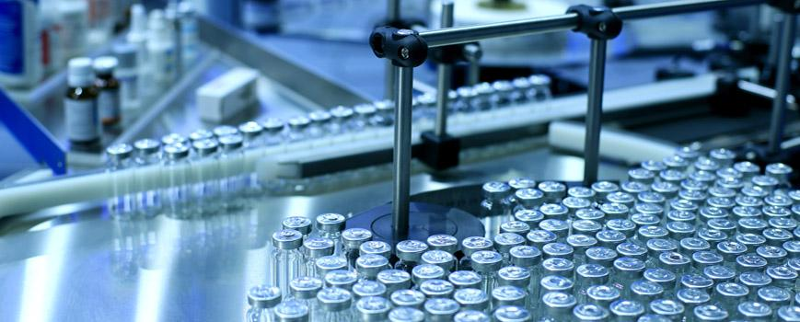
Agenda
Definitions
Where do Extractables & Leachables(E&L) come from?
Why conduct E&L studies?
E&L Studies
Conclusion

Slide 21
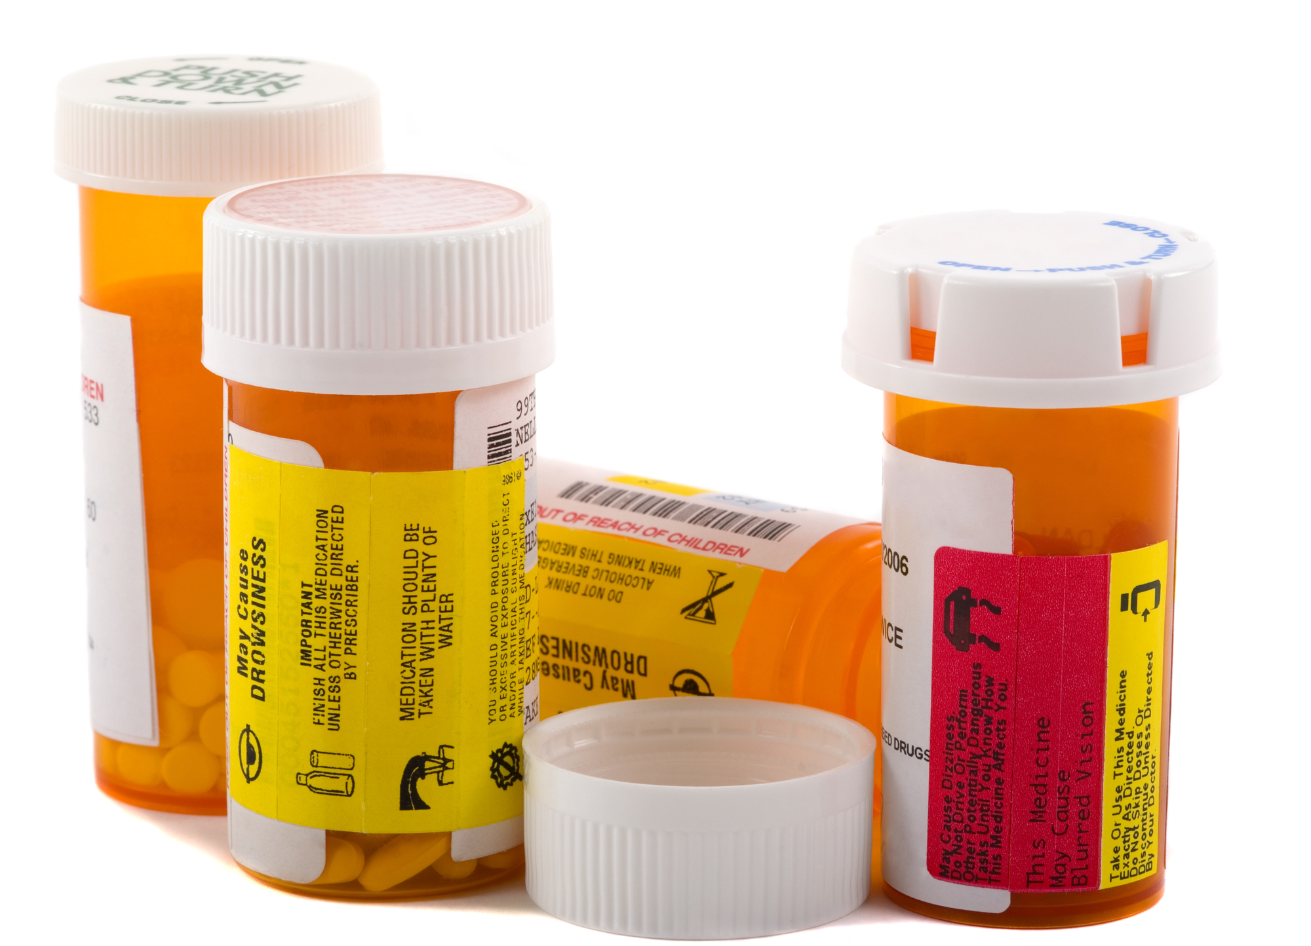
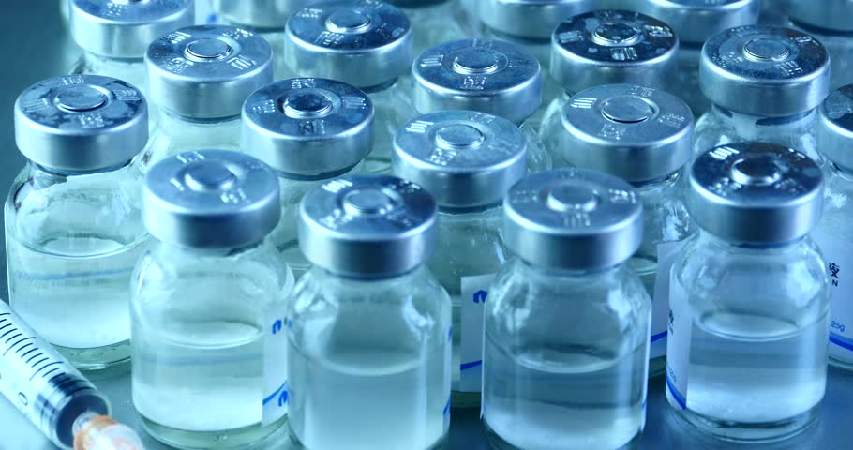
What are extractables (E)?
Species that can be released from the surface of
components used in manufacturing and storage of drug
products under laboratory conditions (accelerated temps).

Slide 22
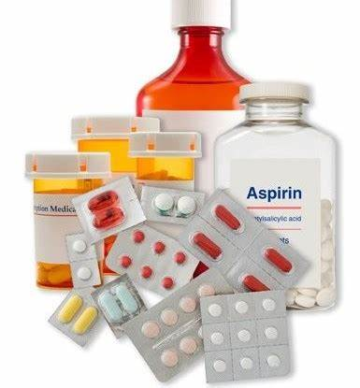
What are leachables (L)?
Species that can be released from the surface of
components used in manufacturing and storage of drug
products under normal conditions.

Slide 23
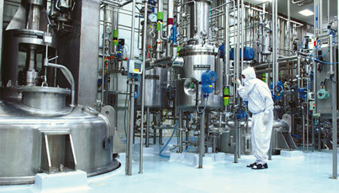
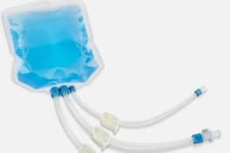
Where do E&L come from?
Manufacturing process
    Single-use bags
    Filters
    Tubing
    Gaskets, connectors & O-rings
    Valves & springs

Slide 24
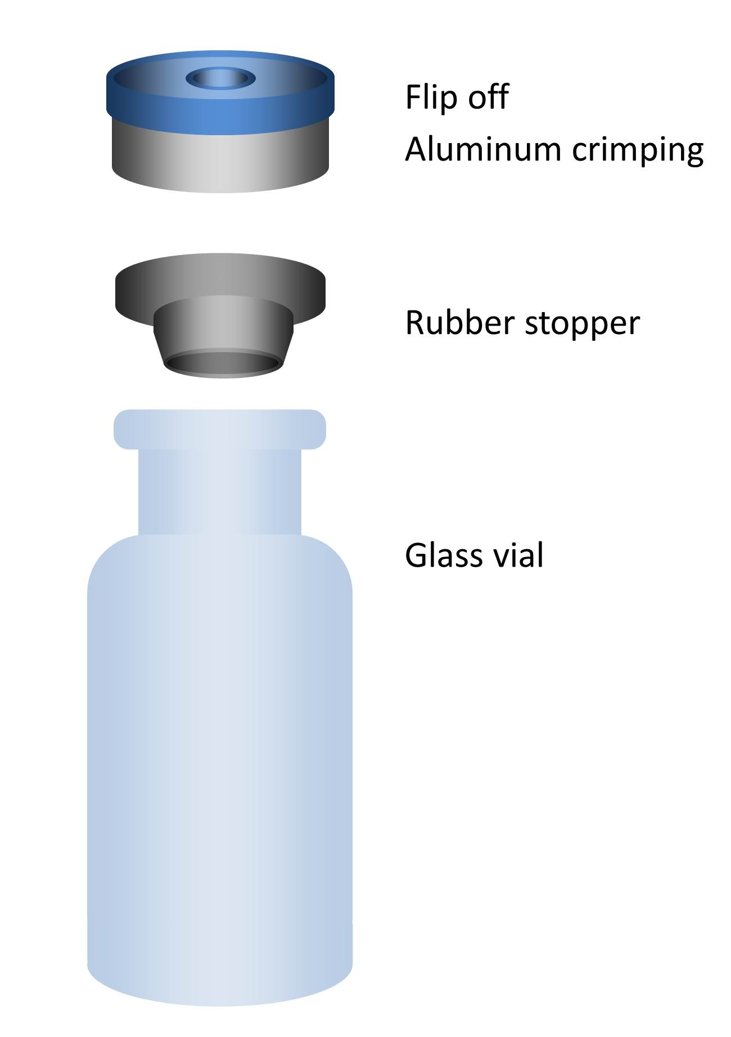
Where do E&L come from (cont.)?
Container closure system (CCS)
    Containers: vials, bottles, ampules
    Closures: caps, stoppers
    Liners, overseal, administration port
    Overwraps, administration accessories,
    container labels

Slide 25
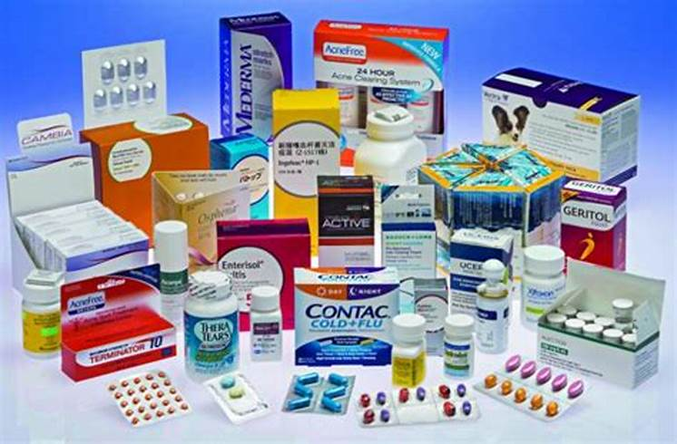
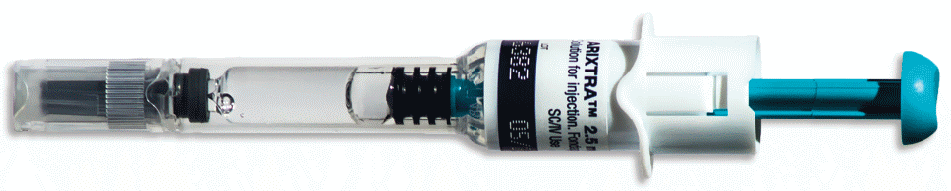
Where do E&L come from (cont.)?
Packaging
    Primary packaging – external components
    Secondary & tertiary packaging
    Labels & adhesives
    Inks & coloring
Drug delivery devices
    Single-use systems – syringes, IV
    bags

Slide 26
Why must E&L studies be conducted?
Finished Drug Product: Containers & Closures
Drug product containers & closures shall not be reactive,
additive, or absorptive as to alter the safety, strength, quality
or purity of the drug beyond the official or established
requirements. 21CFR 211.94
Laboratory controls shall include the establishment of
scientifically sound and appropriate specifications,
standards, sampling plans, and test procedures designed
to assure that components, drug product containers,
closures, in-process materials, labeling, and drug products
conform to appropriate standards of identity, strength,
quality, and purity. 21CFR 211.160

Slide 27
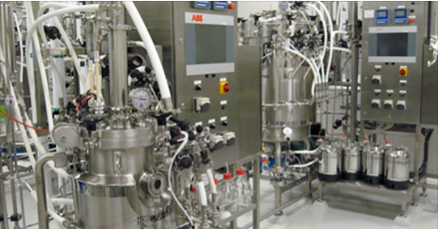
Why must E&L studies be conducted (cont.)?
Biologics: Equipment, Containers & Closures
All surfaces that come in contact with products shall be
clean and free of surface solids, leachable contaminants,
and other materials that will hasten the deterioration of
the product… 21CFR600.11 (b)(h)

Slide 28
E&L Studies

Slide 29
Safety Concern Threshold (SCT)
SCT is dose (µg/day) below which an individual
leachable would not elicit effects, carcinogenic or
otherwise, which could constitute a safety concern
(Ball et al., 2007)
SCT is impacted by:
    Route of administration
    Degree of product-packaging contact
Product Quality Research Institute (PQRI) recommends
high risk SCT set at 0.15 µg/day, low risk SCT at 1.5 µg/day
Matrix (by FDA) used to assign risk from leachable species
to pharmaceutical product

Slide 30
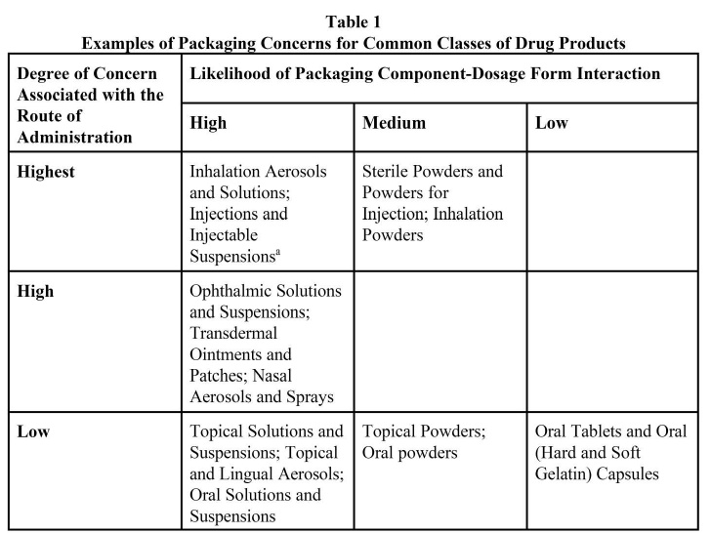
FDA,1999

Slide 31
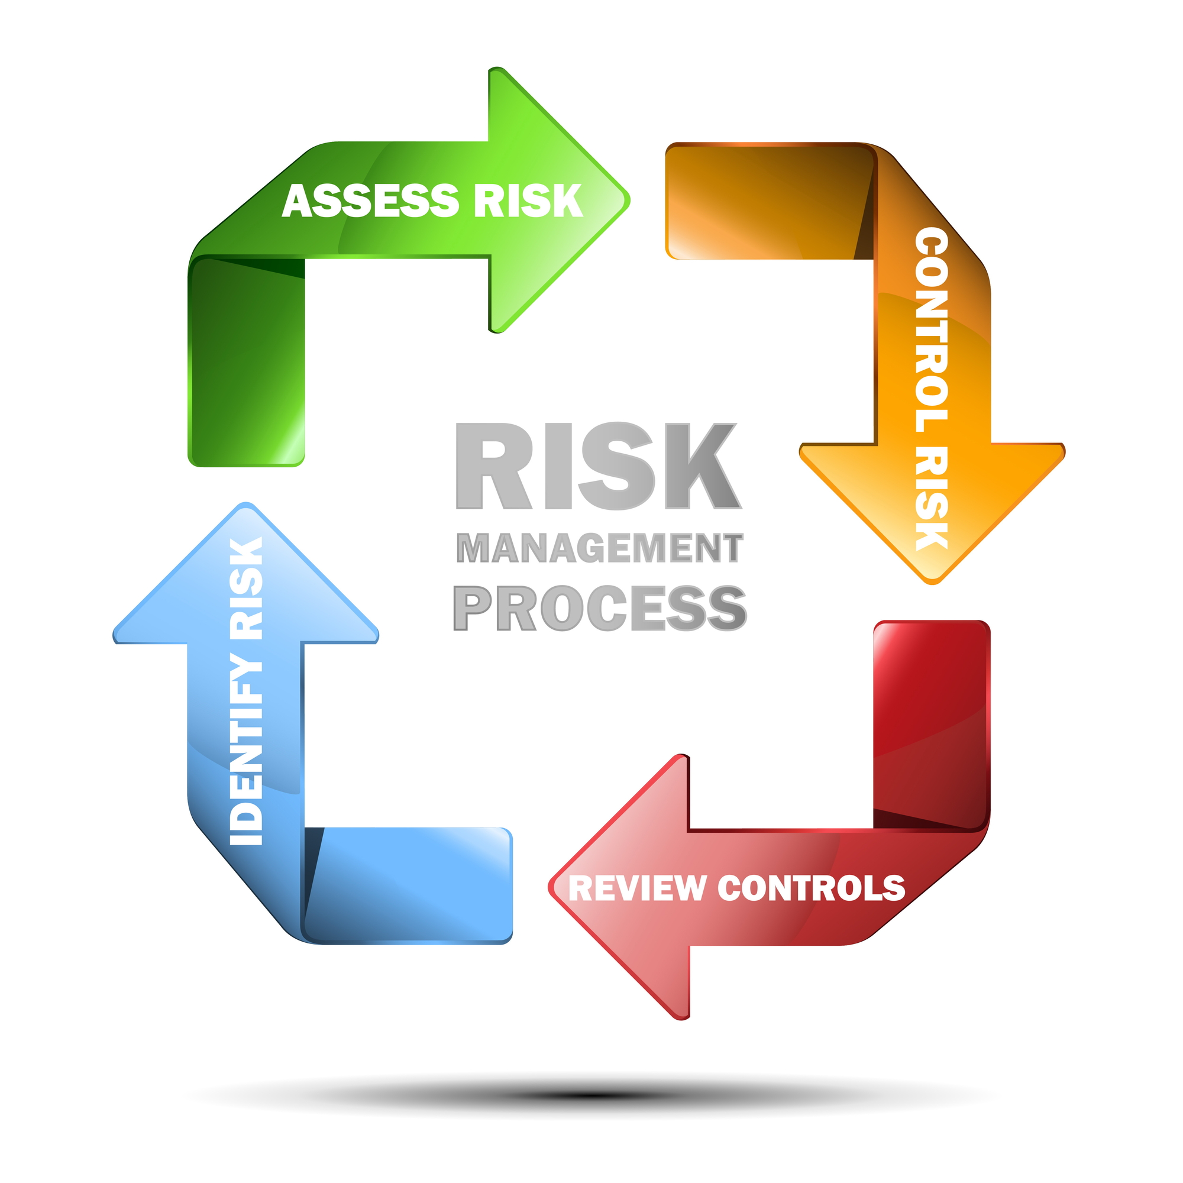
Risk Assessment
When assessing risk, think about the following:
    Dose
    Duration
    Route of Administration
    Patient Population
    Other Unique Product Attributes

Slide 32
Manufacturing & Packaging Assessment
Understand E&L for individual component & potential to
migrate
Connect chemistry of drug quality & performance/function
of component
Assess safety & compatibility of components & systems
Understand impact of manufacturing, storage & shipping
of drug
Correlate clinical use and patient safety

Slide 33
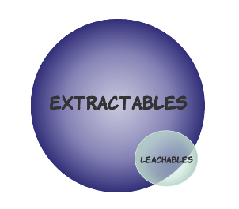
E&L Studies
Extractables study identifies species from manufacturing
& packaging systems that could migrate into product
under normal conditions
Once baseline is established from E studies, then L are a
series of tests conducted at predetermined time-points on
product for duration of shelf-life
Shared information between suppliers, manufacturers &
agency

Slide 34
Extractables Study
Key Points:
    Number of components & material types tested
    Solvents to perform extraction
Extraction should be performed in a range of solvating
power to ensure both organic and inorganic extractable
species
If product is a liquid, chose solvents best mimicking
product to provide worst-case extractable profile
Typically 2-3 solvents are chosen
    Water
    Organic solvent

Slide 35
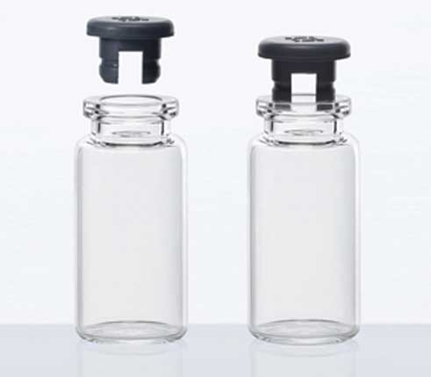
Extractables Study (cont.)
Material Type:
    Plastics & rubbers should be tested by all solvents
    Metal springs – if treated with organic solvents, yield inorganic
    impurities
A number of extraction methods, employing multiple
analytical techniques
Determine analytical evaluation threshold (AET) from SCT
Detailed analytical report, toxicological assessment of
extractables to identify target leachables

Slide 36
Leachable Study
Time-points are predefined & can run simultaneously with
stability
Samples are screened for leachables, including those
identified in extractable study & any new species, those
that exceed the SCT are identified & assessed for toxicity
Critical components are control & leachable samples

Slide 37
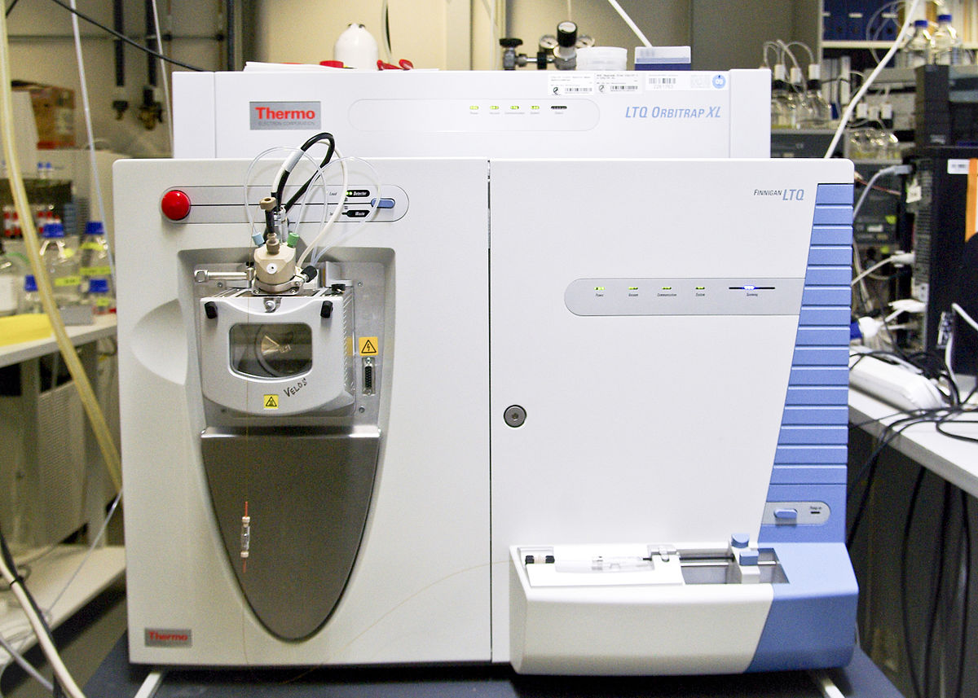
Analyzing E&L Samples
E&L can be divided into 3 categories:
    Non-volatile
    Volatile & semi-volatile
    Inorganic/elemental
Analysis of samples
    LC-MS – non-volatile
    GC-MS – volatile & semi-volatile
    ICP-MS – inorganic/elemental

Slide 38
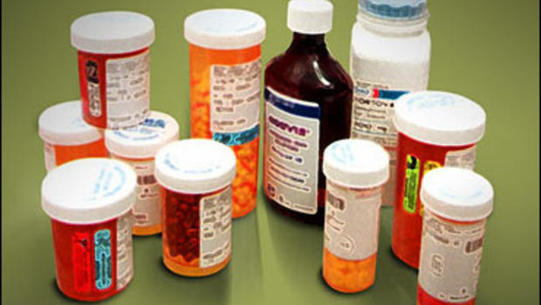
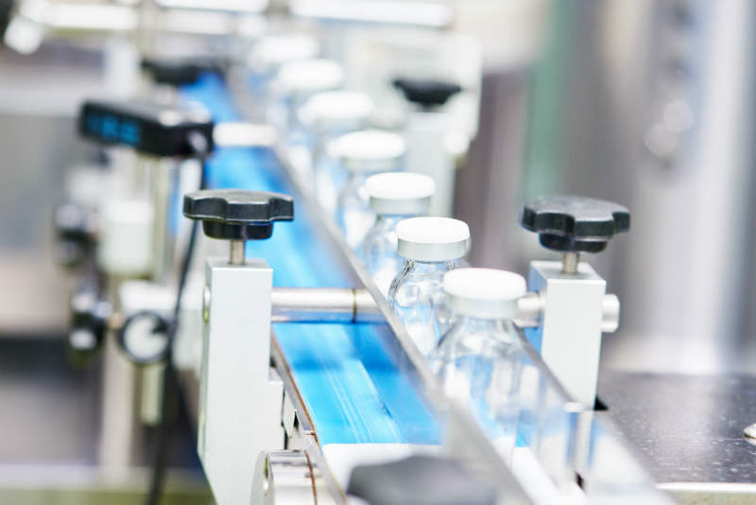
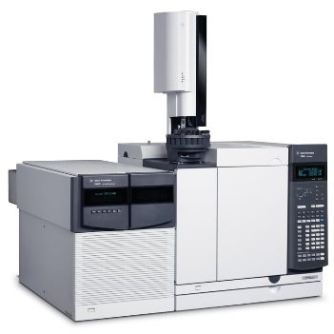
Conclusion
E&L are complex studies & require thorough planning &
variety of analytical methods
E&L studies are required to ensure patient safety & drug
efficacy
Cooperation/communication between suppliers,
manufacturers & agency is critical

Slide 40
